Slide 1

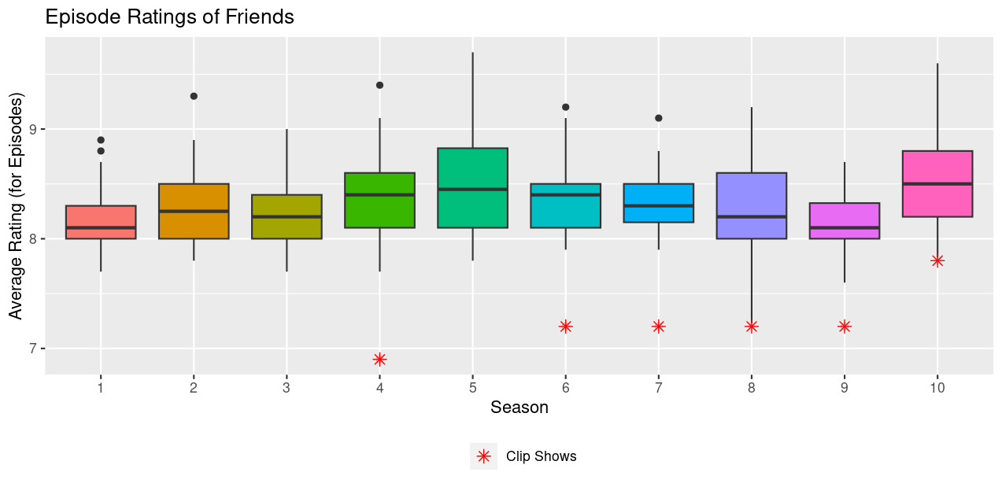
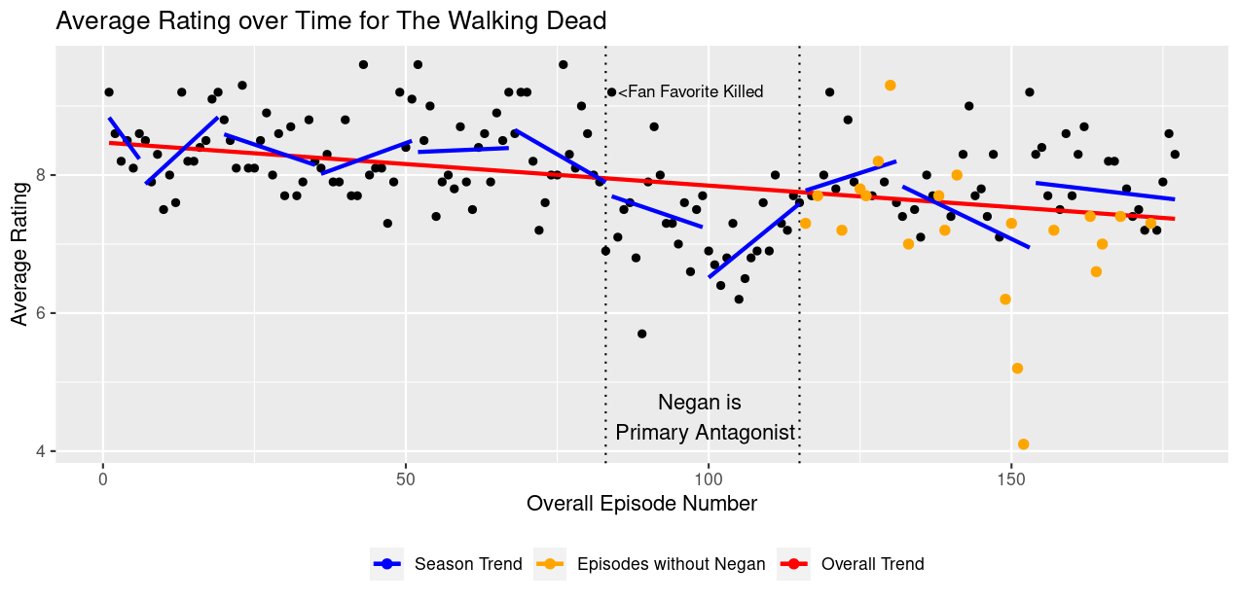




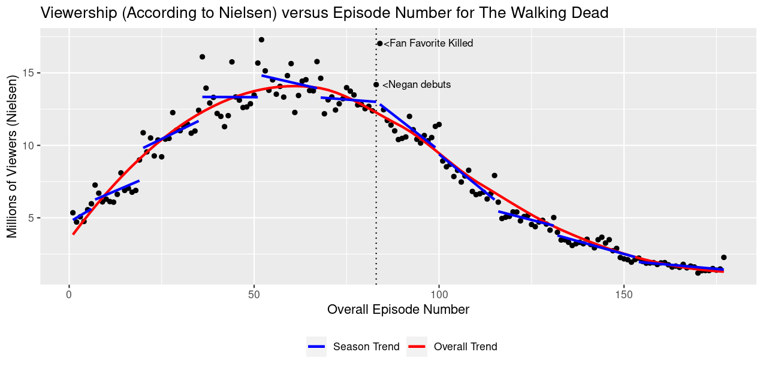
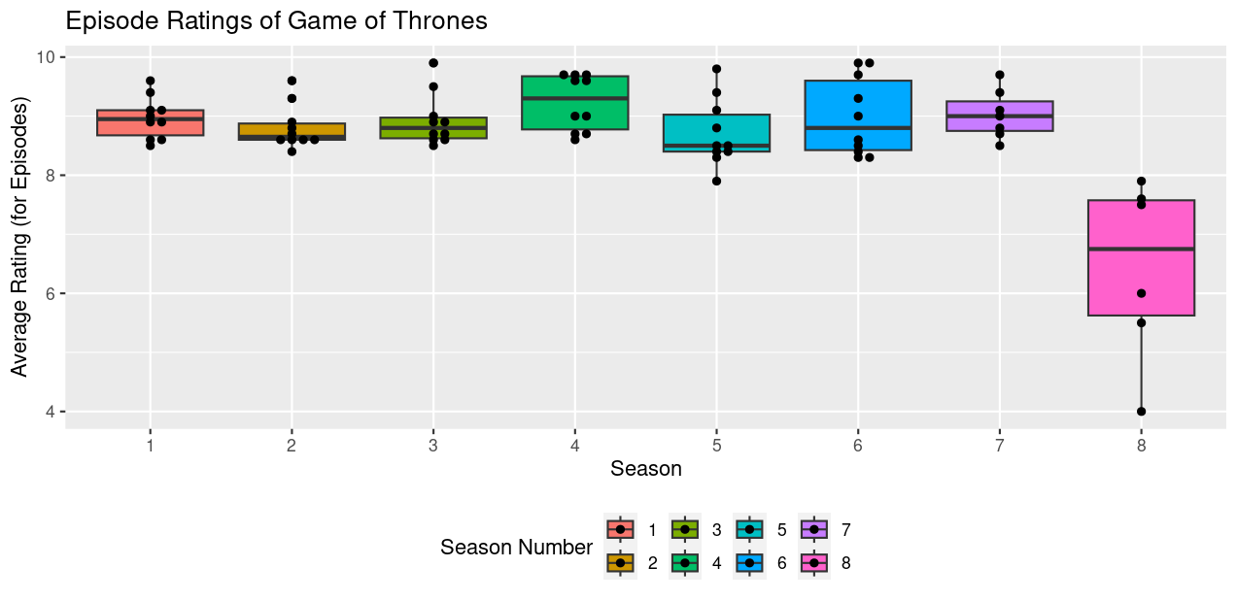
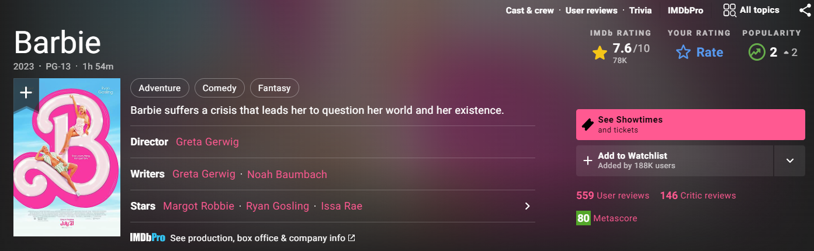
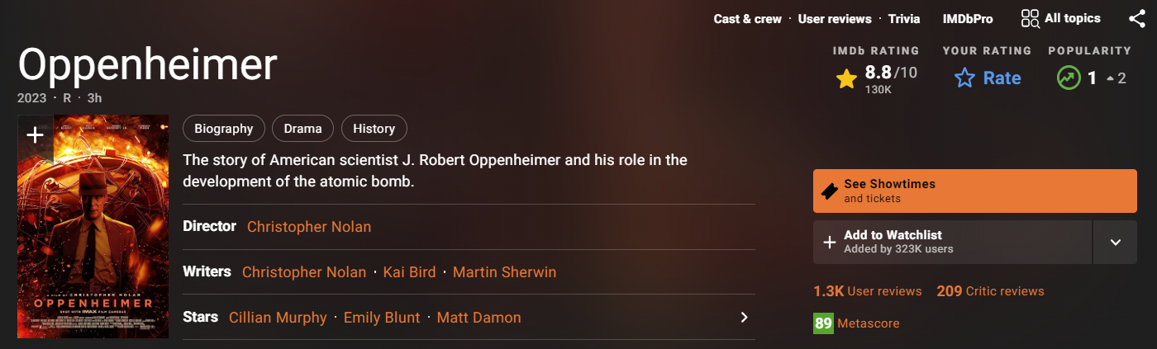
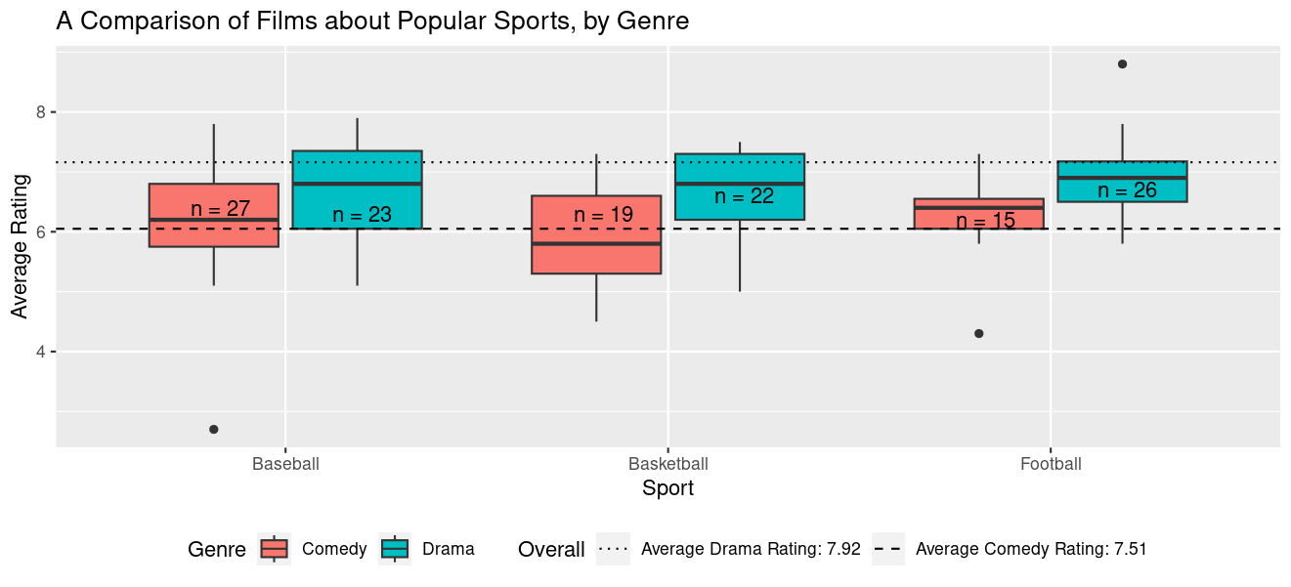
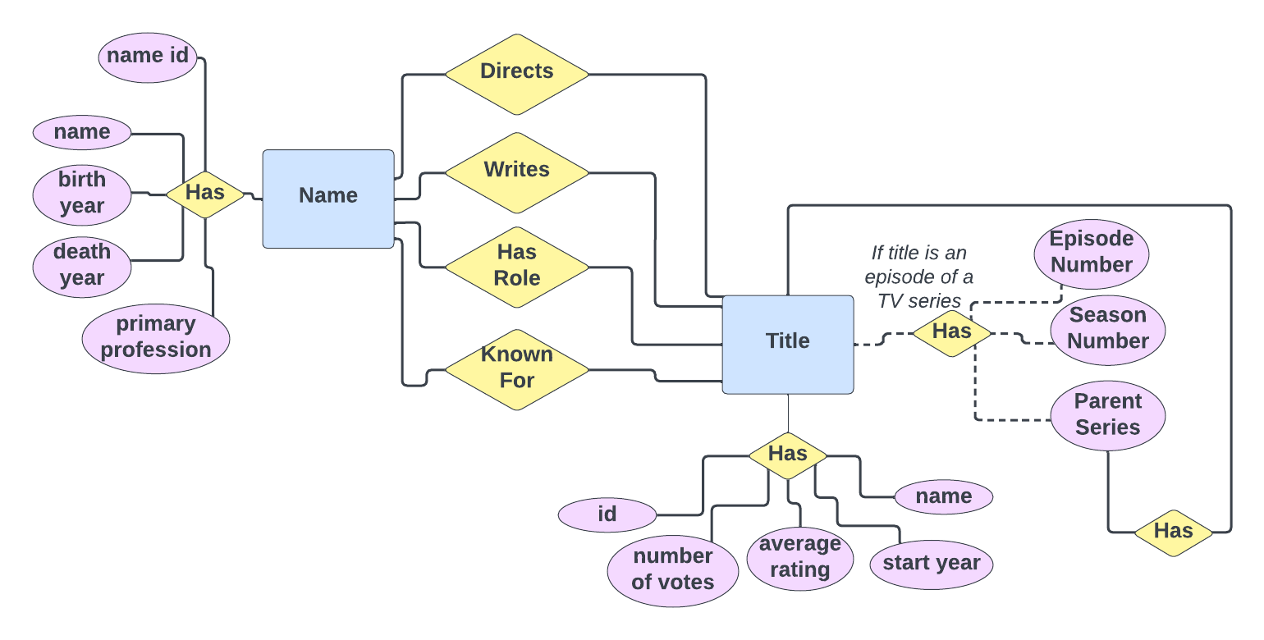
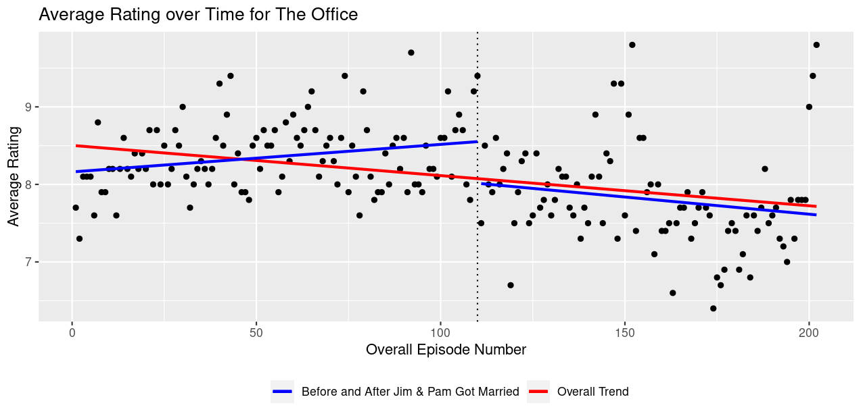
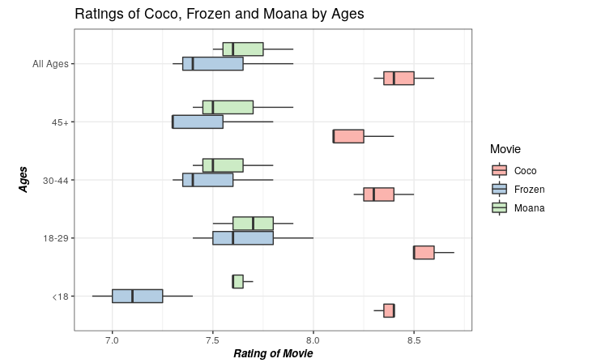

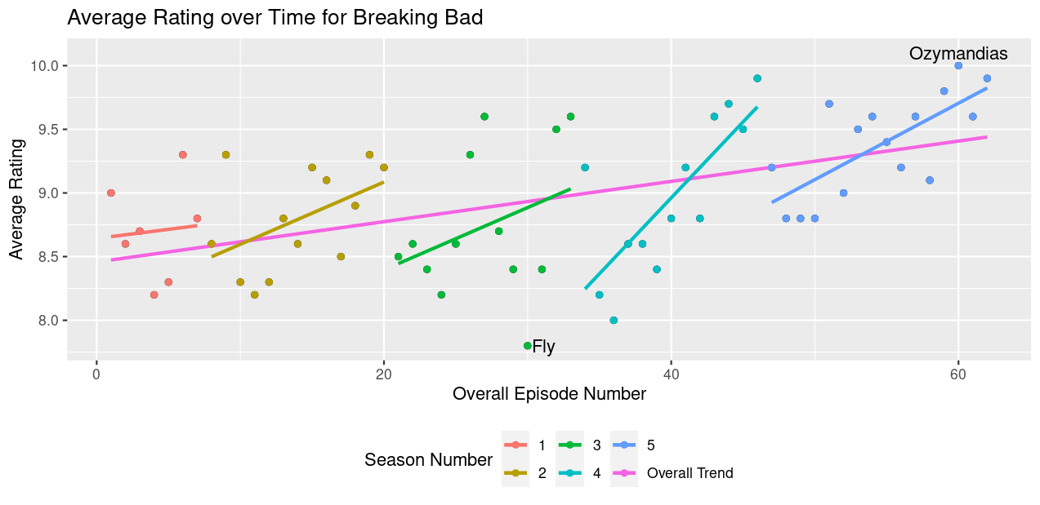
Bringing IMDb to the Classroom (Spoiler Alert!)
Jessica L. Chapman and Ivan P. Ramler St. Lawrence University
Motivation
GAISE recommends using real data with a context and purpose
This is especially effective when students understand the context
Students come from a variety of subject matter backgrounds, but something nearly all students have in common is binge watching behavior
“Community [i]s my favorite show and I watched it about 7 times.”
“At the end of the day, when I am not busy with all of my other responsibilities, I find myself spending a good amount of time binge watching the show [The Office].”
“I chose this show [Game of Thrones] because it is probably my favorite TV show; I even liked it so much the first time I watched it all again!”
“I ha[ve] watched this show [That 70s Show] 10 times.”
Sample Student Discoveries
More Examples of Using IMDb Data with Webscraping or Additional Data Sources
Friends: The One(s) with the Clip Shows
The Walking Dead: Fans didn’t like Negan, or did they?
Clip shows are episodes that consist mainly of scenes from previously aired episodes of the show
Friends made six clip shows
Many students notice that the Friends clip shows are among the lowest rated episodes (low outliers are clip shows)
Ratings for Seasons 7 and 8 (Negan and Saviors as primary antagonists) were lower than other seasons
After Negan is captured, the lowest rated episodes tend to be those without him
Figure 2: Episode Ratings by Season for Friends
Figure 6: Episode Ratings over time, with season and overall trends, for The Walking Dead
Game of Thrones: Fans were very unhappy with the final season
Season 7 Premiere (a fan favorite was killed) had second highest viewership, and was followed by a major drop in viewers
Season 7 Premiere had the highest number of “votes” on IMDb (42,498) and was one of the highest rated episodes
What is IMDb?
IMDb is an online internet database of information related to movies and TV series
Users can search for titles and/or actors
Registered IMDb users can rate titles on a scale of 1 – 10
Students have remarked upon the consistency of the first three seasons
Many also point out that the first five seasons were based upon the existing books written by George R.R. Martin
Figure 7: Viewership (Nielsen) over time, with season and overall trends, for The Walking Dead
Figure 3: Episode Ratings by Season for Game of Thrones
A Comparison of Sports Films (since 1980), by Genre
Accessing the IMDb Data
Over 6GB of data are available for download in the form of several compressed tsv files
You (or your advanced students) will need to join the relevant files and filter data according to desired criteria
We use a Shiny app to allow our introductory statistics students access to ratings data for episodes of popular TV series made since 1980
https://stlawu.shinyapps.io/imdb_tv/
Students have strong feelings about the final season of Game of Thrones
“The final season of Game of Thrones has become one of the most famous final-season flops of television history and is largely seen by fans of the show as a complete betrayal by the writers, David Benioff and D.B. Weiss.”
Dramas tend to be rated more highly than comedies
Sports comedies are on par with overall comedies, while sports dramas tend to have lower ratings than dramas overall
IMDb and Wikipedia have differing lists of sports films
The Office: Jim and Pam’s marriage ruined The Office
Students point out that ratings peaked in Seasons 3 and 4 (Episodes 41 – 79)
They notice that, despite the overall downward trend for ratings of The Office, fans loved the series finale (has the largest residual)
Figure 9: Average ratings for Baseball, Basketball, and Football movies, by genre (comedy vs drama)
Disclaimer
IMDb occasionally changes the information available on its website which could change the types of analyses students can do
Figure 1: Relationships between (select) information available about common IMDb entities (Titles and Actors/Actresses)
IMDb has previously published ratings by age group and by gender, and data science students have scraped that data for past projects
This data science student scraped data to compare ratings, by age group, for three popular Disney movies
Figure 4: Episode Ratings over time, with pre/post wedding and overall trends, for The Office
Breaking Bad: One of the best TV series of all time?
What Can Students Learn from IMDb Data?
All Students
Data Storytelling
Outliers and strange patterns are interesting and should be explored
Ask and refine research questions
Data quality
Students have pointed out that Ozymandias is considered one of the all-time best episodes of a TV series
Others noted that Fly, the lowest rated episode of the series, was a “bottle episode” (shot in one place) because of budgetary constraints
Advanced Students
Data wrangling
Webscraping
Advanced data visualizations
Working with large datasets
Working with databases
Figure 9: Ratings, by age group, for Frozen, Coco, and Moana
Sources
https://www.imdb.com/
https://developer.imdb.com/non-commercial-datasets/
https://en.wikipedia.org/wiki/List_of_The_Walking_Dead_episodes
https://en.wikipedia.org/wiki/List_of_American_football_films
https://en.wikipedia.org/wiki/List_of_baseball_films
https://en.wikipedia.org/wiki/List_of_basketball_films
Our Assignments
We have used IMDb data in our introductory statistics and data science courses
Actual assignments have varied over time; past assignments can be found on our GitHub: https://github.com/iramler/jsm2023_imdb
Acknowledgements
This project is funded, in part, by the NSF awards #1919554 and #2142705. Any opinions, findings, and conclusions/recommendations expressed in this material are those of the author(s) and do not necessarily reflect the views of the NSF.
Figure 5: Episode Ratings over time, with season and overall trends, for Breaking Bad

