Slide 1
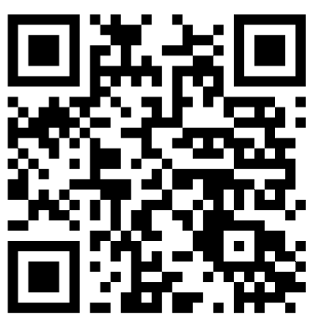
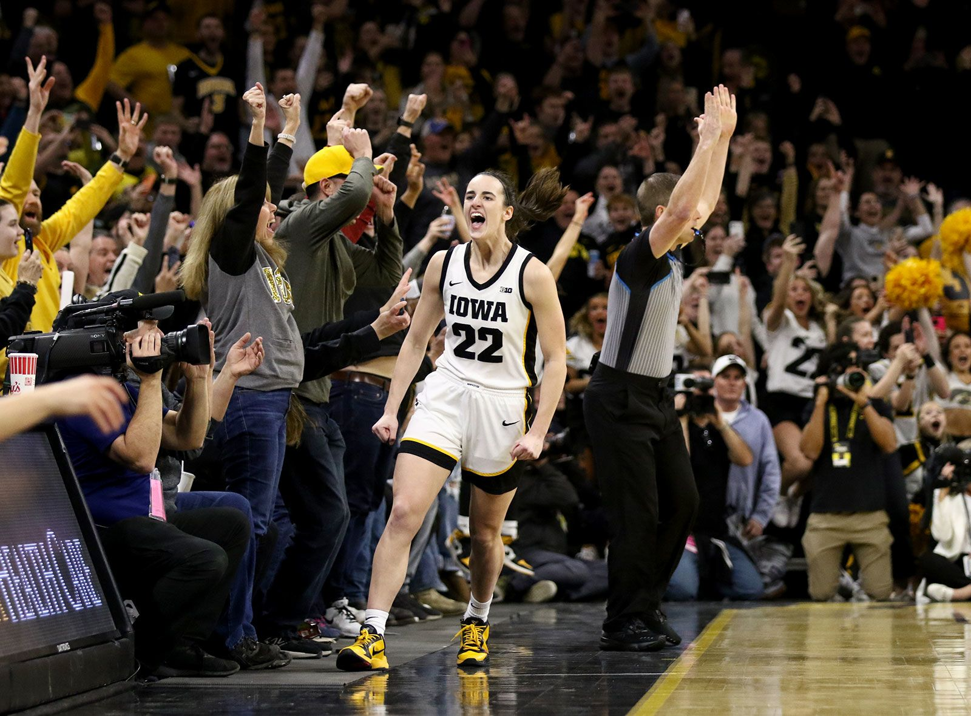
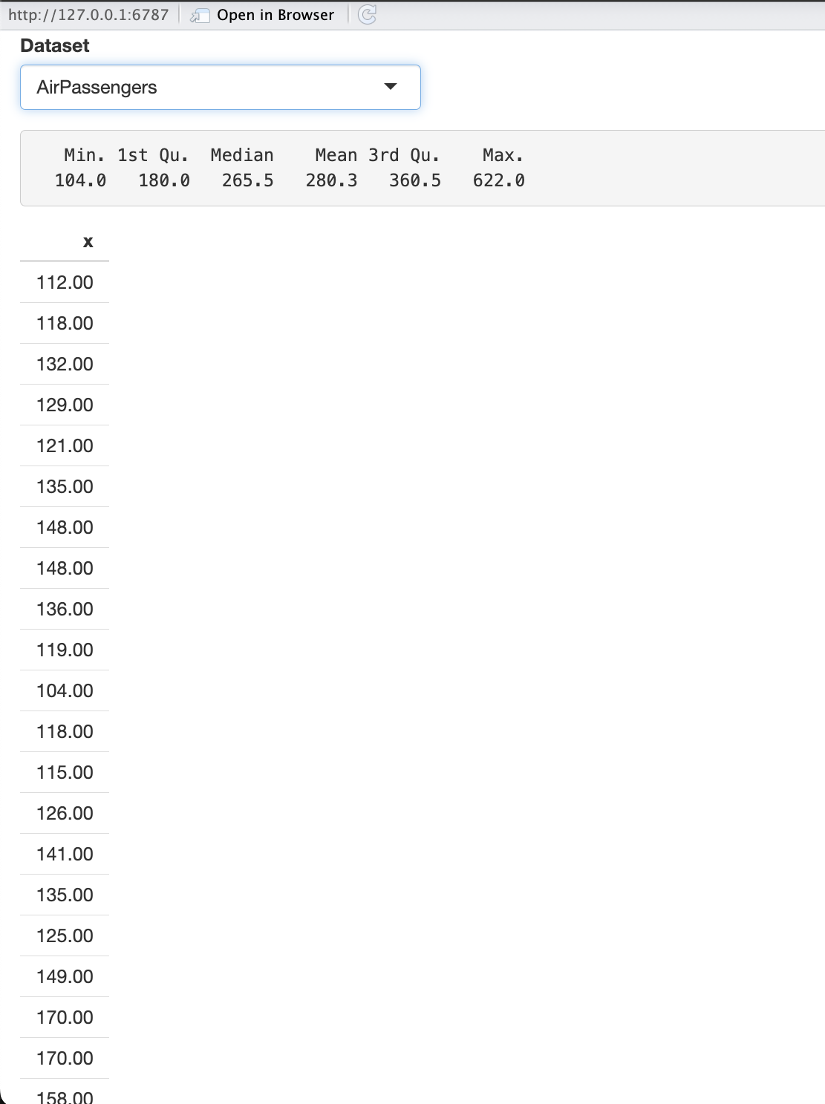
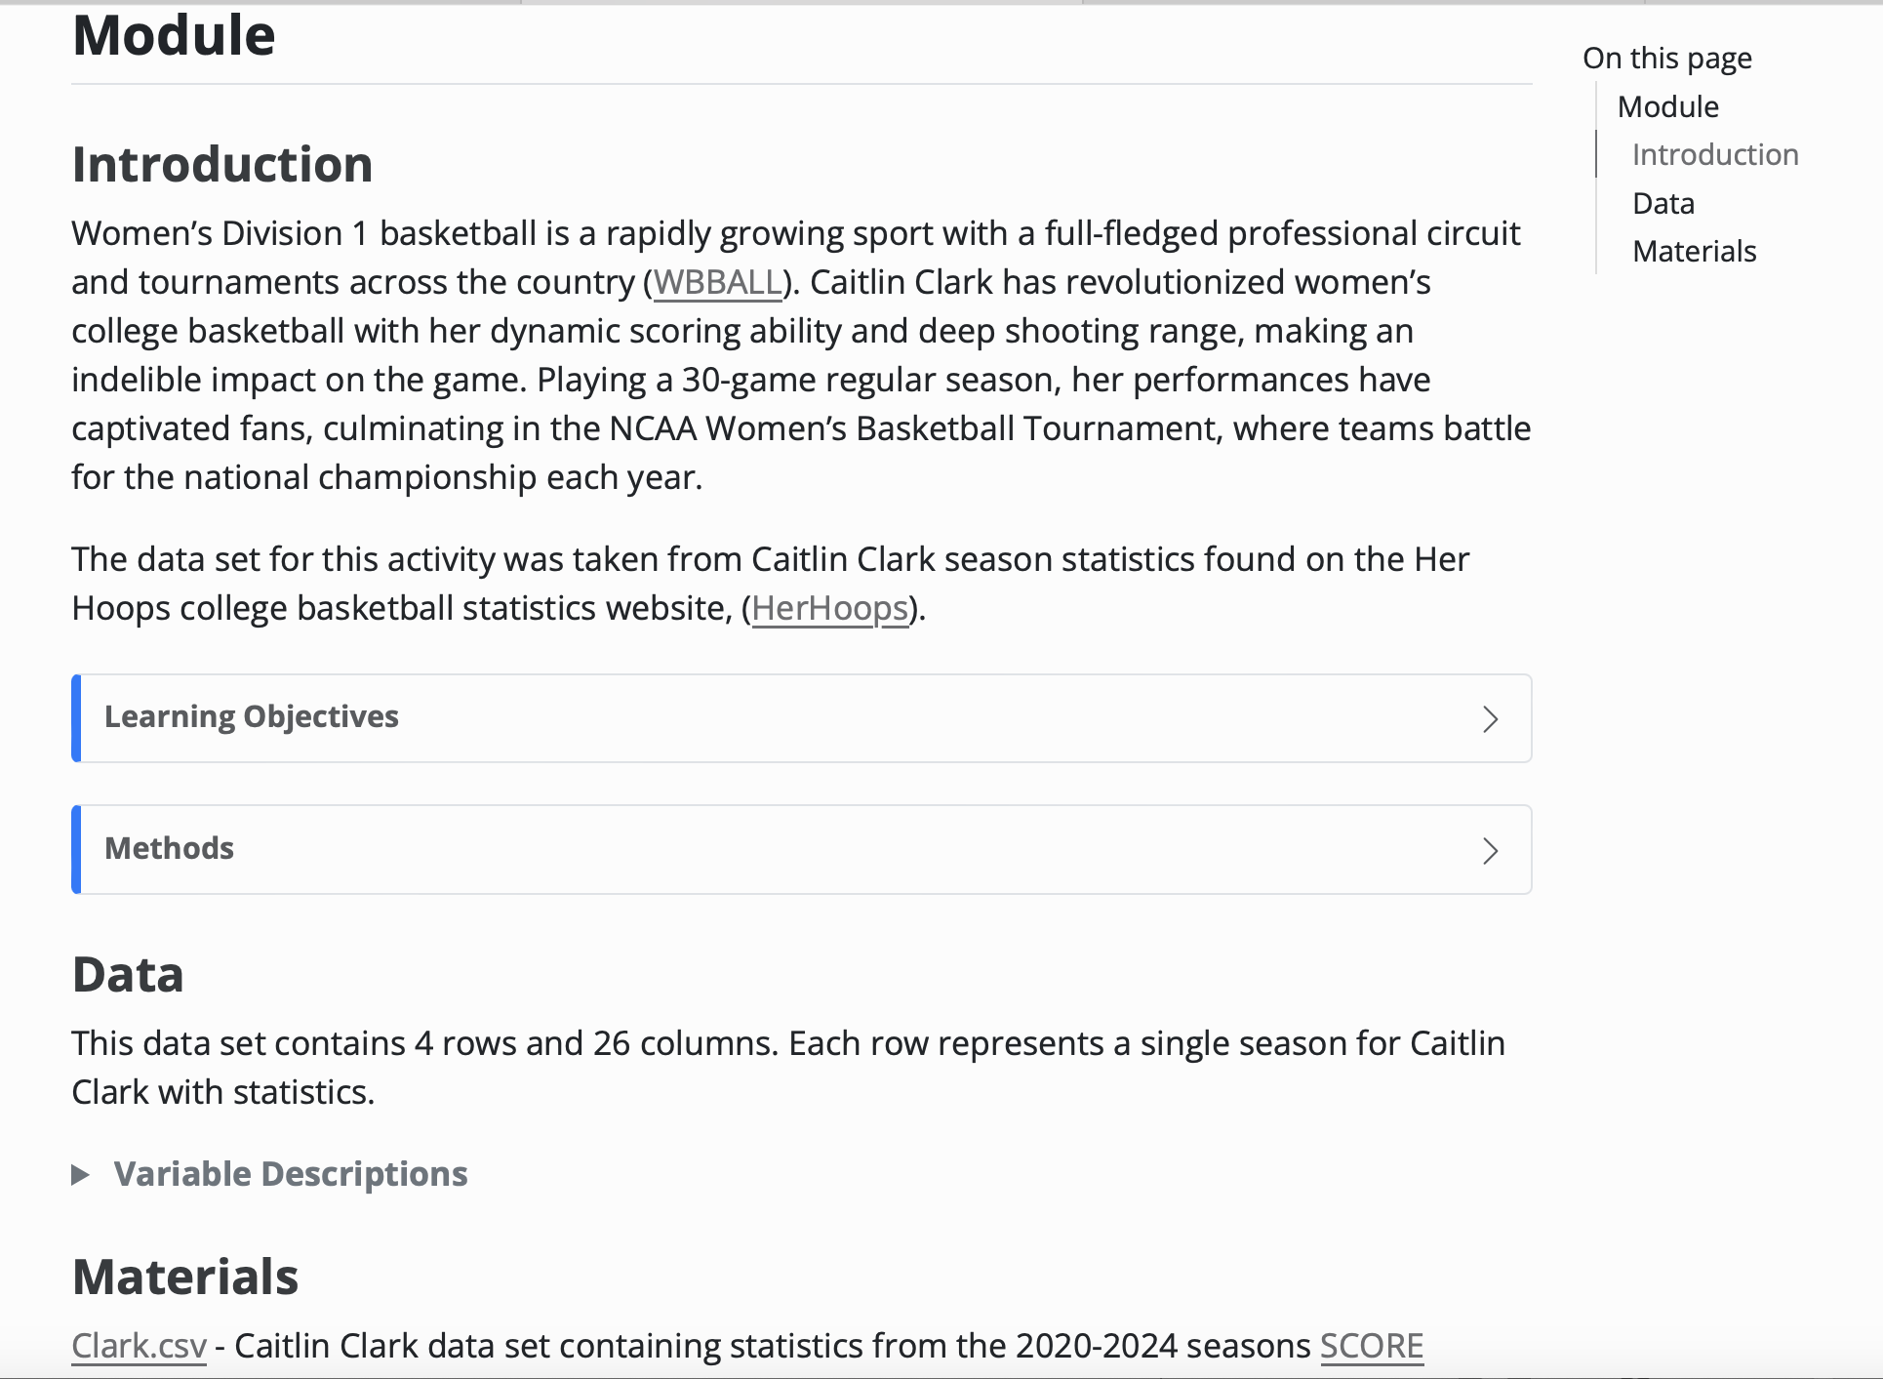
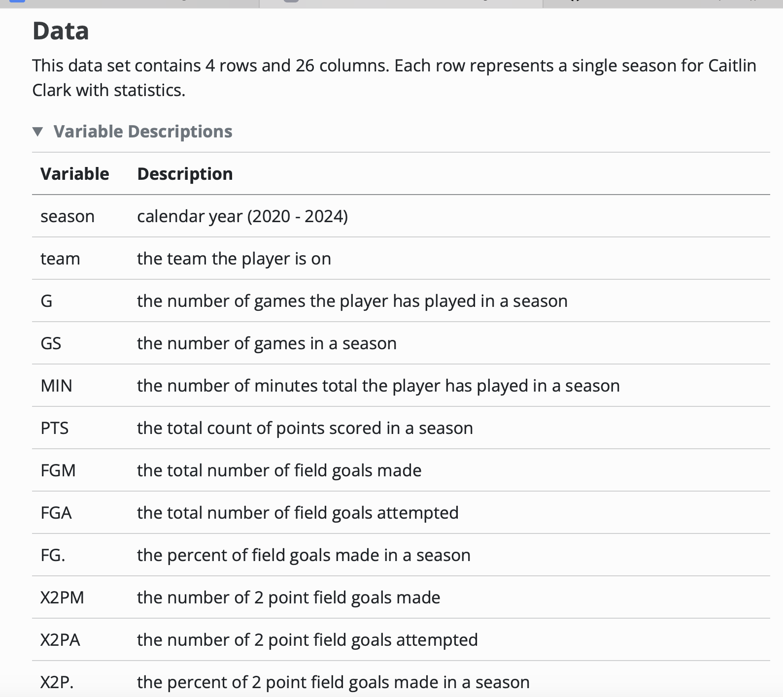
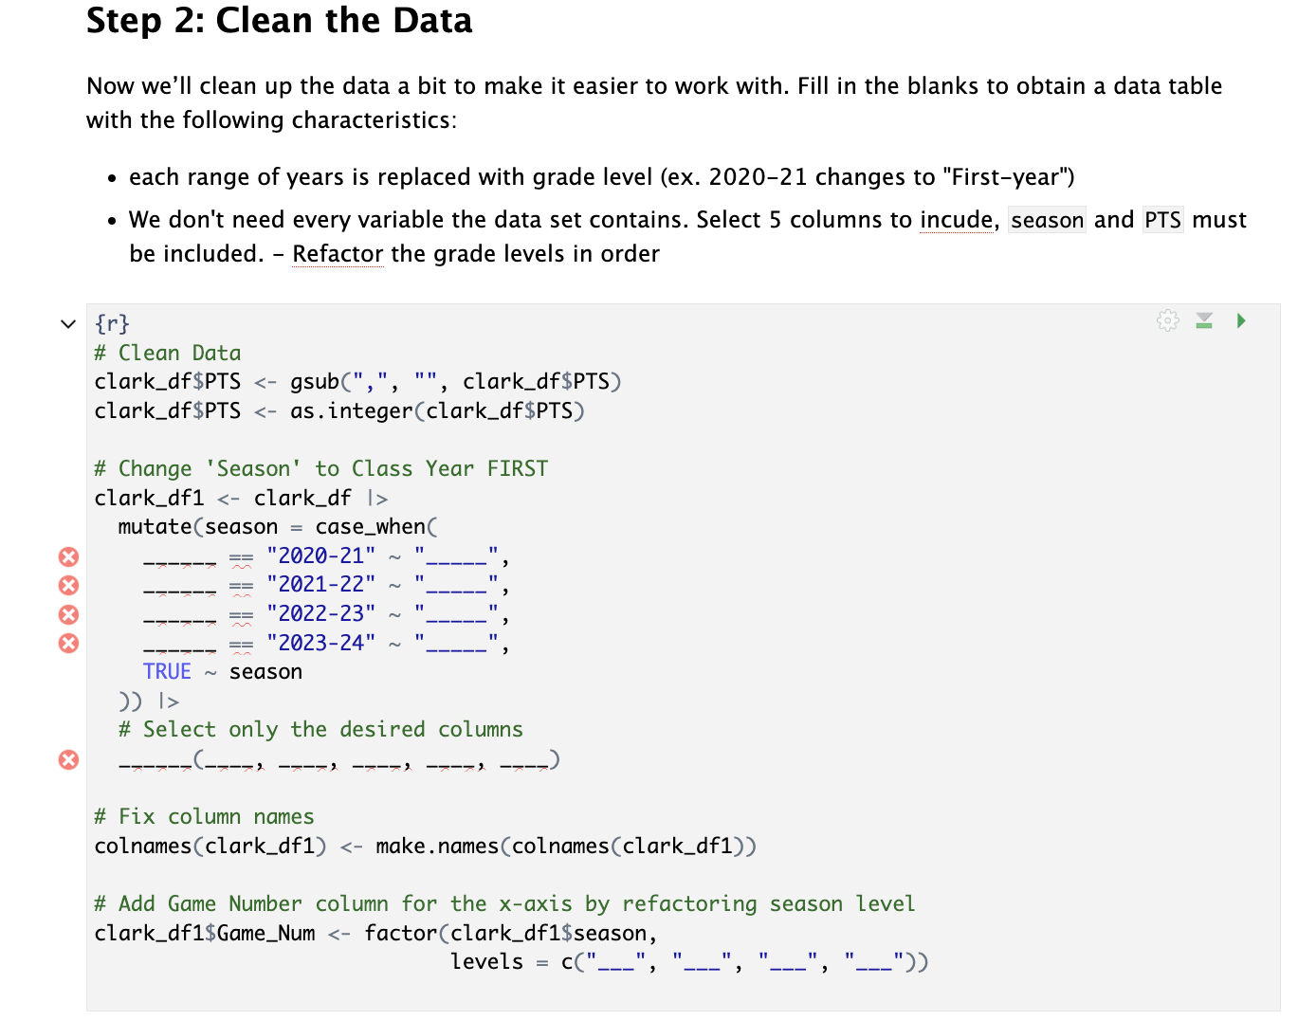
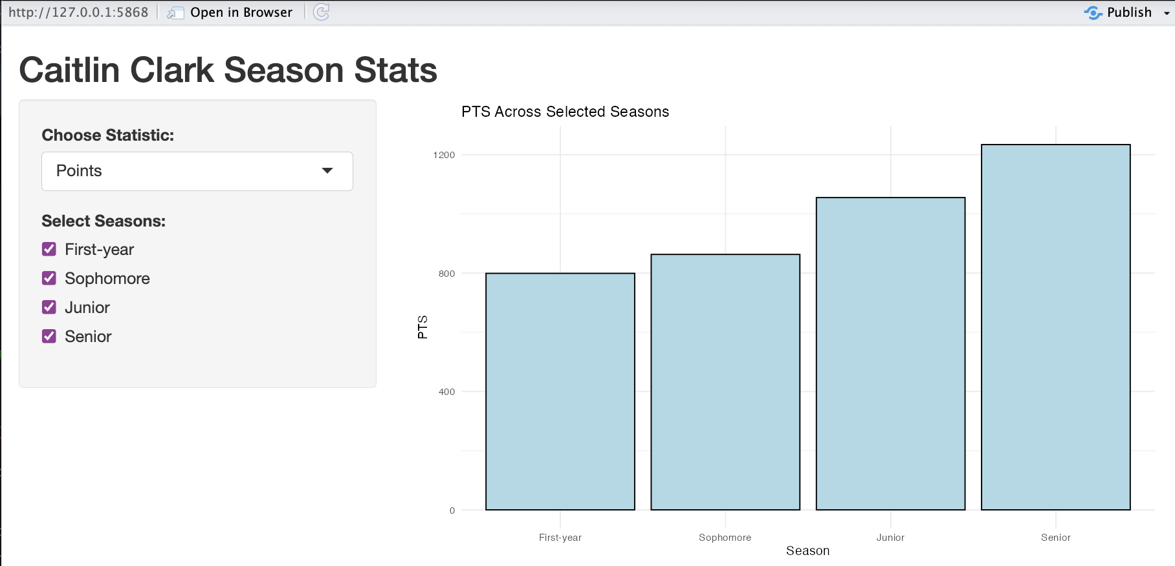
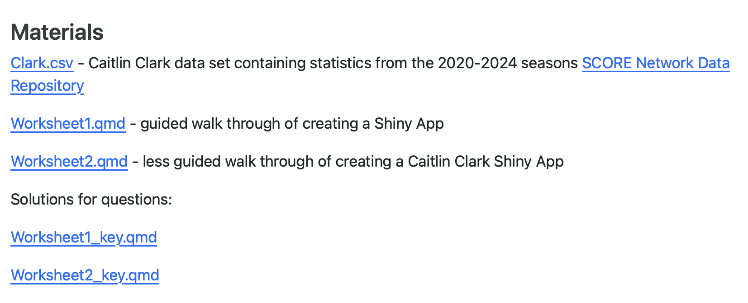
SCORE Network: Building a Shiny App
Abigail Sikora ’25 (Statistics)
Advisor: Professor Ivan Ramler
What is SCORE?
NCAA Women’s Basketball
Worksheet 1
Funded by the National Science Foundation
Acquires, cleans, manipulates, and documents sports data to create educational resources for data science and statistics
Student will follow along and run a simple Shiny app to see how UI and server work
Steps:
Add a dropdown and outputs to display dataset
Build the app piece by piece and describe how it responds
What is a Module?
1. Introduction
Summary of the sport and concepts that will be in handout
Provides learning objectives and methods
https://media.cnn.com/api/v1/images/stellar/prod/240215172544-01b-caitlin-clark-celebrates-record-021524.jpg?c=original
Who is Caitlin Clark?
Standout college basketball player for Iowa
Known for elite scoring, deep threes, and playmaking
NCAA’s all-time leading scorer
Inspired a new generation with her style and competitiveness
Worksheet 2
This is the first SCORE Module that walks students through how to make a Shiny App
2. Data
Summary of dataset, with variable descriptions
Supplies data file and source, (herhoops.com )
3. Materials
The module contains class handouts and worksheet keys
What will be learned
The student will understand the structure and components of a Shiny App
They will create an interactive visualization with dynamic outputs on their own by integrating R packages and following the steps of the worksheet
They will interpret outputs from the Shiny App and report what they find
Worksheet 1 should be completed before doing worksheet 2
Load and clean Caitlin Clark’s game stats for use in a Shiny app
Build a UI with dropdowns and checkboxes to select stats and seasons
Write server code to generate a bar plot based on user selections
4. Conclusion
Summarize the takeaways and learning objectives from the sports application handouts

