Slide 1

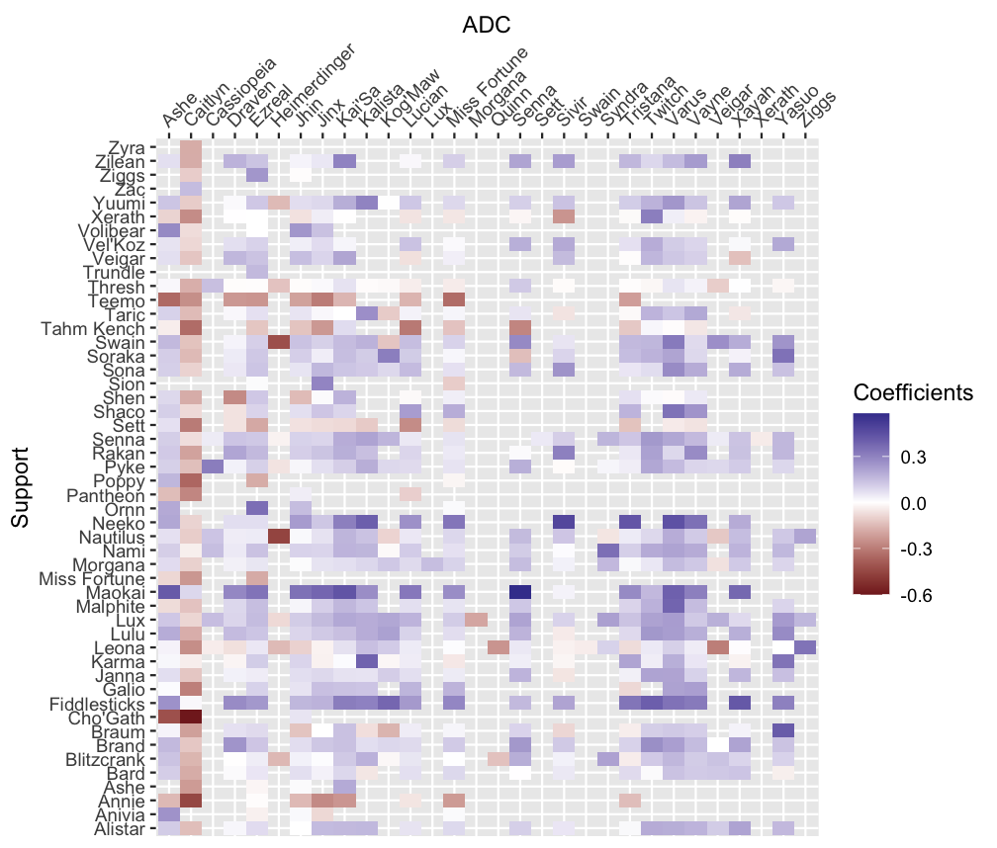
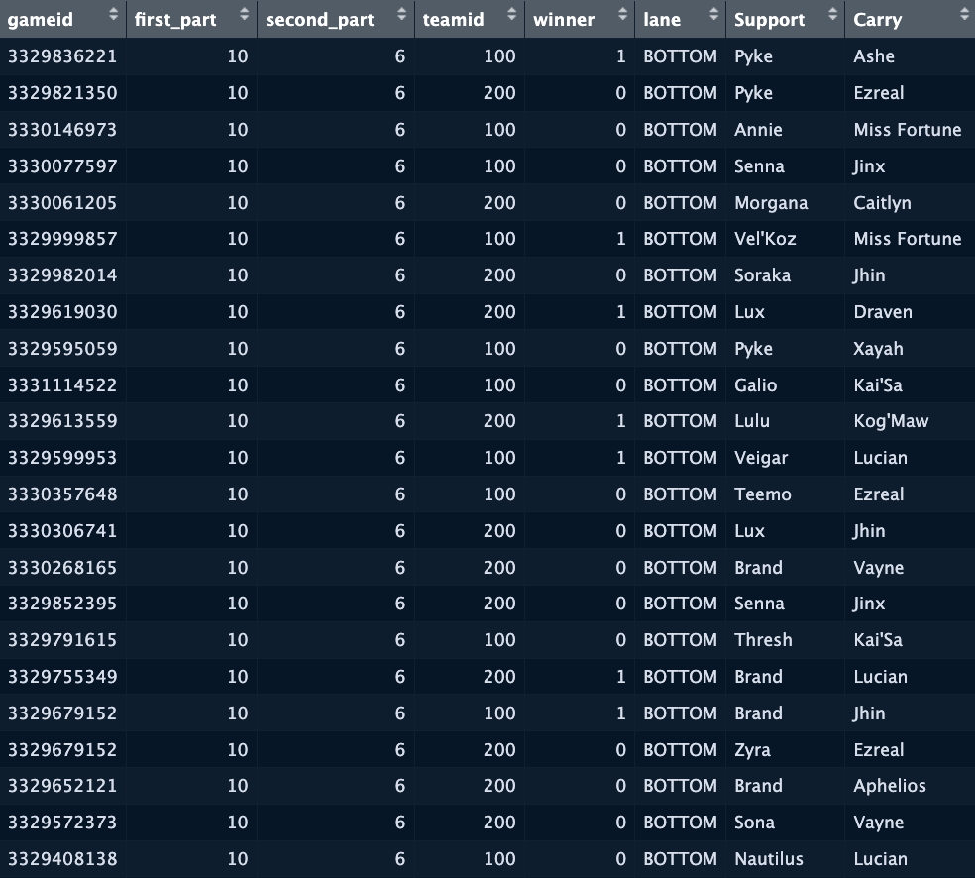
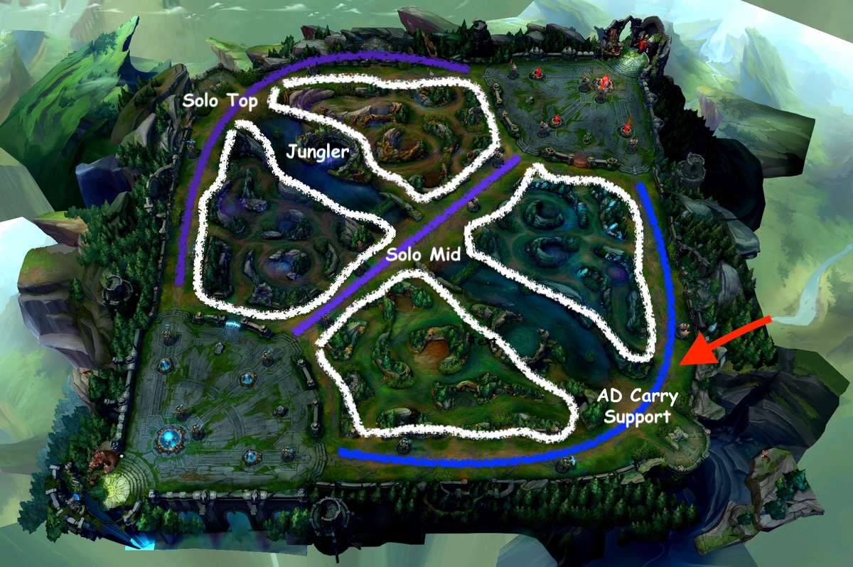
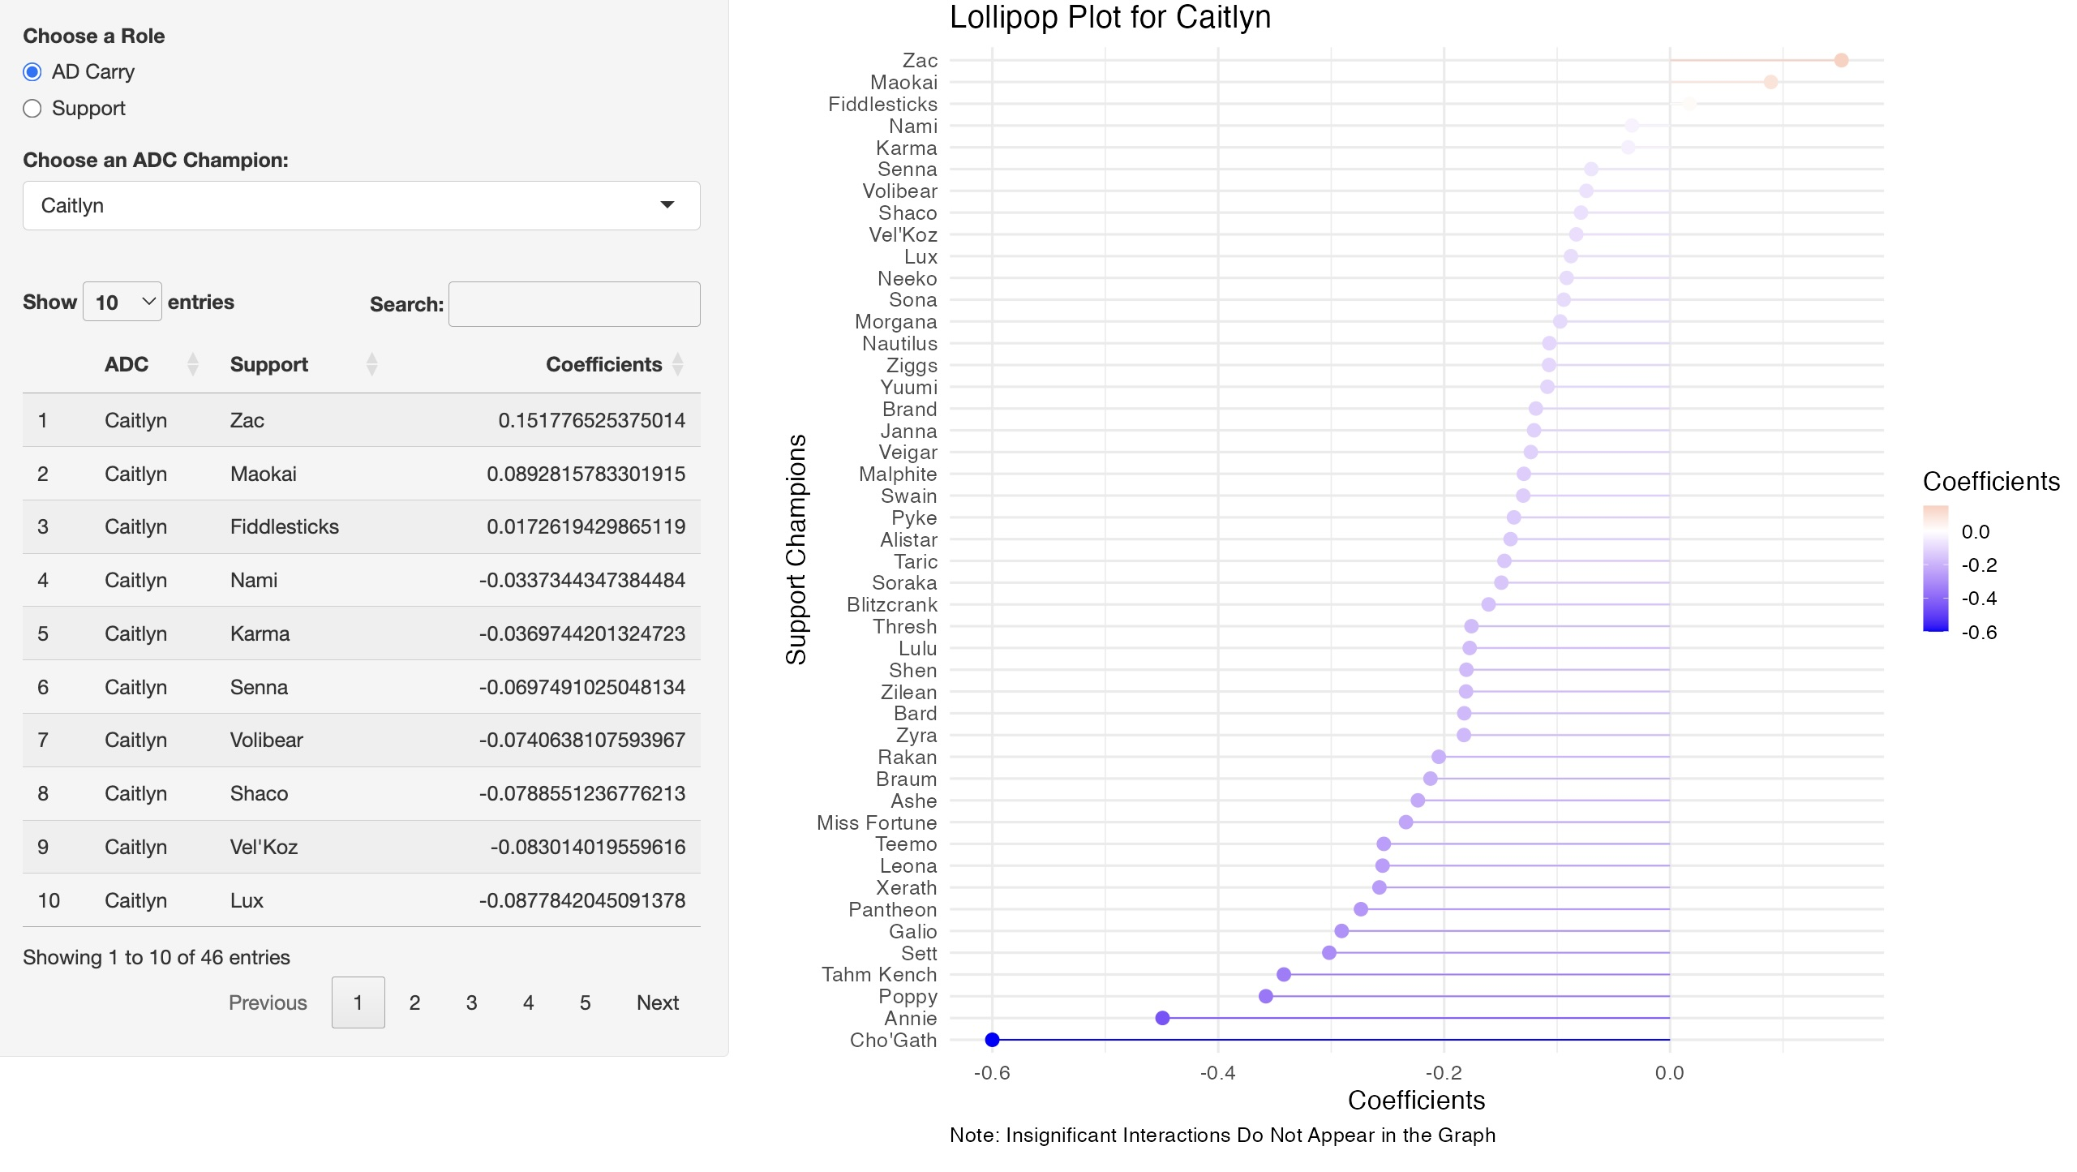
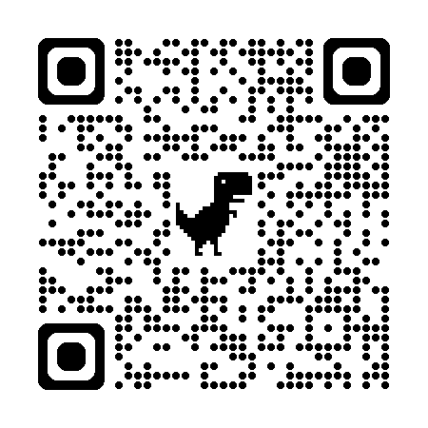
Quantifying the Meta: Analyzing Synergy in Esports with Advanced Statistics
George Charalambous
Advisors: Dr. Ivan Ramler Department: MCSSS (Data Science)
1. Introduction
League of Legends is one of the most popular multiplayer online battle arena (MOBA) games. Developed by Riot Games and released in 2009, it has consistently attracted hundreds of millions of players annually. A typical match features two teams of five players, each selecting unique champions with distinct abilities to compete on the Summoner’s Rift map. The objective is strategically progressing through the map, defeating opponents, and ultimately destroying the enemy Nexus.
2. Research Goal
The bottom lane is the only area in League of Legends where two champions consistently operate together—specifically, the AD Carry and the Support. Therefore, the primary objective of this project is to investigate and quantify these synergistic interactions between AD Carry and Support champion pairings.
3. Data Collection
4. Data Processing
Merged and cleaned two large datasets containing match-level and detailed in-game statistics in R and RStudio.
Identified patch 10.6 as the most data-rich and isolated bottom lane interactions, filtered for valid ADC-Support pairings and removed rare combinations (fewer than 10 occurrences) to ensure statistical reliability.
Same process was repeated for patch 10.7, resulting in a combined dataset
5. Model Application
The glmFSA() function from the rFSA R package was used to fit a logistic regression model with interaction effects between ADC and Support champions, using winner as the binary outcome variable.
Both Carry and Support were set as fixed variables, ensuring they were included in all models.
Number of random starts was set to 10 to increase the likelihood of finding a globally optimal subset of variables.
Model selection was guided by the Akaike Information Criterion (AIC), to minimize it.
6. Output Visualization
7. Results Interpretation
8. Web Application
Notes:
Text-size:
The Main Title should be at least 100 points (4 cm high)
Subheadings should around 50 points (Between 1.5 - 2 cm high)
Body text is most easily read when it is 25 points (Between 0.5 - 1 cm high). The absolute minimum for text is 18 points.
The title of your poster should appear at the top in large letters.
People will not read a lot of text, and certainly won't read standard journal-sized text.
Printed text should be very brief, or most people will walk away.
Studies show that text written in all capital letters is hard to follow; it is better to use bold print than all caps.
Bullets may be helpful in summarizing information.
Divide the contents of your poster into appropriate sections.
Titles to highlight different sports being represented
Bullet points for the SCORE and data repository sections
This project funded by NSF grant

