Slide 1
Poster Design
Fall 2023
PQRC

Slide 2
Outline
Planning
Layout
Color
Text & Font
Visuals
Number
Familiarity vs. Surprise
Resources

Slide 3
Planning
Components of any poster:
Title, Author(s)
Introduction
Methods/Approach
Conclusion

Slide 4
Planning
Components of a Science Poster:
Title, Author(s)
Introduction
Problem Statement
Methods
Results
Conclusions

Slide 5
Goals
Convey the following:
What you did
Why you did it
How you did it
Why it is important

Slide 6
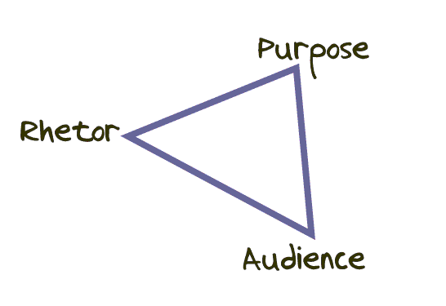
Planning
Key Questions
What do I want to convey?
Who is my target audience?
Rhetorical triangle

Slide 7
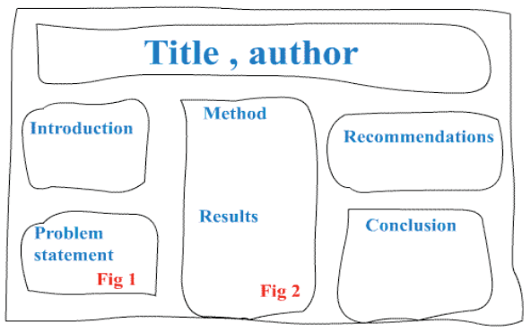
Planning
Create a rough sketch

Slide 8
Audience
Know your Audience
General audience (Mom, Grandpa)?
Assume little specific knowledge
Give sufficient background
Discipline specific audience?
What can you assume they know?
Less background necessary (don’t bore)

Slide 9
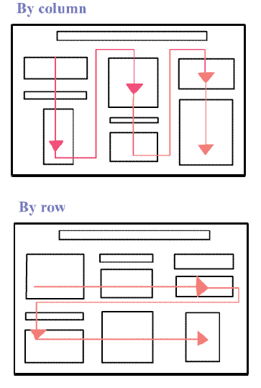
Layout
Information should be ordered by column (preferred) or by row
Use a numbering system (and other visual clues) to help the audience follow the flow of information

Slide 10
Color
Choose color scheme for the entire poster
Use dark font for light backgrounds,
Use light font on dark backgrounds
Highlight with contrasting colors
Avoid using too much color
Avoid intensely bright colors

Slide 11
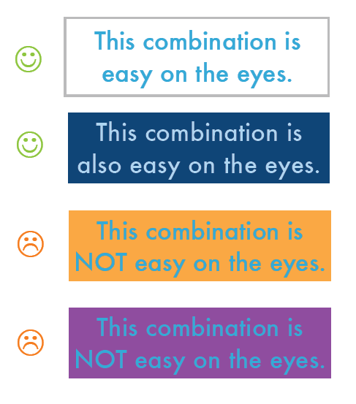
Color

Slide 12
Text & Fonts
Choose interesting font that’s easy to read
Choose appropriate size for different types of information
Do not use black background (too much ink on the paper)
Avoid using all CAPS and Italics

Slide 13
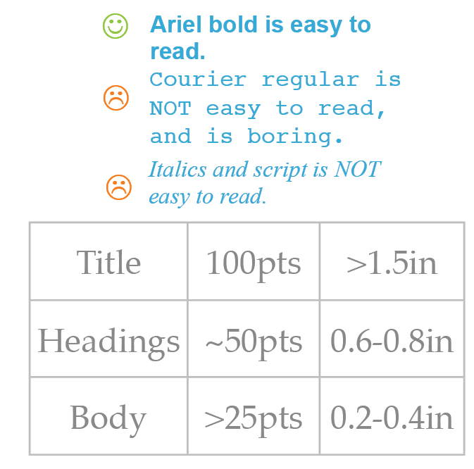
Text & Fonts

Slide 14
Text & Fonts
Use phrases, not sentences
Use bullets
Succinct but informative

Slide 15
Visuals
Graphics, diagrams, and photos
Communicate message and add interest
Avoid clutter
Label appropriately
Cite your source
Avoid scanned photos and hand-drawn graphics whenever possible

Slide 16
Familiarity vs. Surprise
Following conventions (general)
familiarity
ease of interpretation
Breaking conventions (emphasis)
surprise
Curiosity
Example: Water cycle might use circular layout of the cycle for the poster

Slide 17


How to Make a Quality Poster
M. Schuckers, T. Morse, M. Joseph
Peterson Quantitative Resource Center, St. Lawrence University
1. Planning
Components of Any Poster:
Title, Author(s)
Introduction
Methods/Approach
Conclusions
Science Posters:
Title, Author(s)
Introduction
Problem Statement
Methods
Results
Conclusions
Key Questions:
What to convey?
What you did
Why you did it
How you did it
Why it is important
Who is my target audience?
General, little prior knowledge
Specific, less background needed
2. Layout
Create a Rough sketch:
3. Text, Font, & Colors
Text
Phrases not sentences
Use Bullets and/or numbering
Succinct but informative
4. Visuals
Use graphics, diagrams, and photos
Communicate message and add interest
Label appropriately and avoid clutter
Avoid scanned photos and hand-drawn graphics
Familiarity vs. Surprise
Following convention:
Familiarity
Ease of interpretation
Breaking conventions:
Surprise raises curiosity
Emphasizes important information
Font
Interesting but easy to read font
Appropriate sizes (See Figure )
Avoid CAPS and Italics
Ordering:
Organize poster by column (preferred) or by row
Use numbering system or visual cues to depict flow of information
Colors
Scheme for entire poster
Highlight with contrasting color
Avoid too much color
Avoid intensely bright colors
See Figure XX
5. Poster Resources
PQRC (Drop-in or T:\qrc\Poster Workshop)
WORD Studio
TECDesk
SLU Logos (T:\qrc\drop\Logos2017\Logos)
Printers in ODY, NCAT, GIS Lab
Helpful Links:
http://www.lib.uct.ac.za/infolit/poster.htm
http://www.amstat.org/meetings/jsm/2008/pdfs/ImprovingStatisticalPosters.pdf
http://www.wpi.edu/Academics/ATC/Media/poster-tips.pdf
http://web.grinnell.edu/individuals/kuipers/stat2labs/write%20paper.html

Slide 18


Slide 19
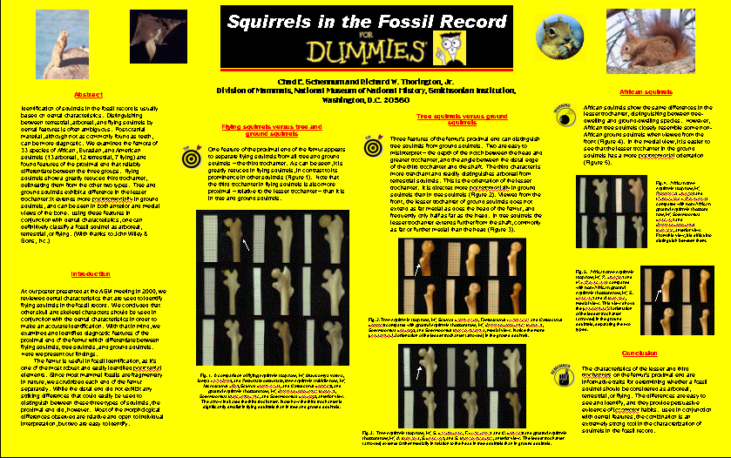

Slide 20
Comment
If you use Powerpoint, convert to PDF before printing.
Official SLU logos can be found on Canvas

Slide 21

Resources
http://www.lib.uct.ac.za/infolit/poster.htm
http://www.amstat.org/meetings/jsm/2008/pdfs/ImprovingStatisticalPosters.pdf
http://www.wpi.edu/Academics/ATC/Media/poster-tips.pdf
http://web.grinnell.edu/individuals/kuipers/stat2labs/write%20paper.html

