Slide 1

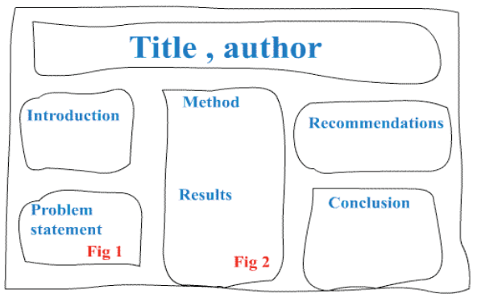

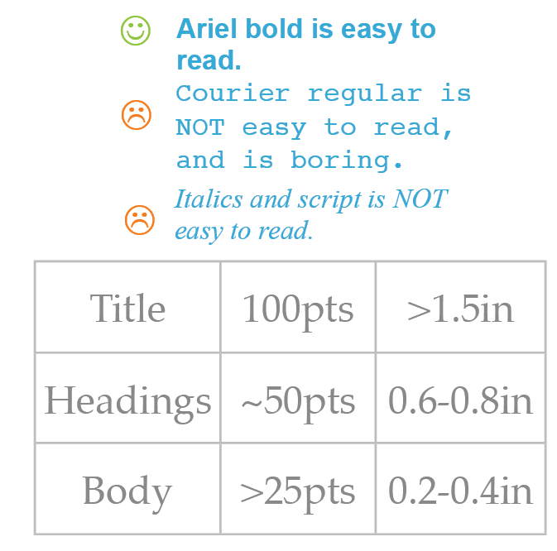
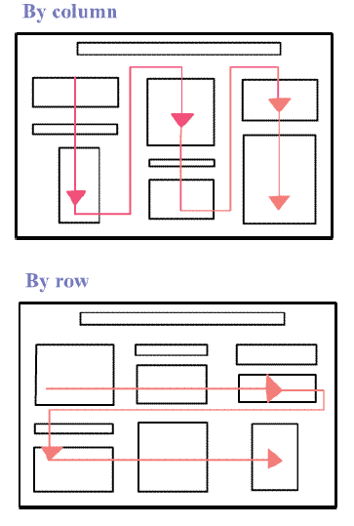
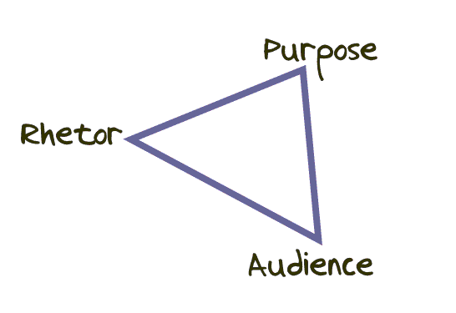
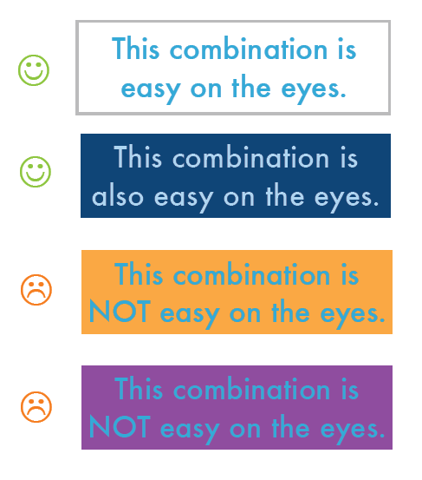
How to Make a Quality Poster
M. Schuckers, T. Morse, M. Joseph
Peterson Quantitative Resource Center, St. Lawrence University
1. Planning
Components of Any Poster:
Title, Author(s)
Introduction
Methods/Approach
Conclusions
Science Posters:
Title, Author(s)
Introduction
Problem Statement
Methods
Results
Conclusions
Key Questions:
What to convey?
What you did
Why you did it
How you did it
Why it is important
Who is my target audience?
General, little prior knowledge
Specific, less background needed
2. Layout
Create a Rough sketch:
3. Text, Font, & Colors
Text
Phrases not sentences
Use Bullets and/or numbering
Succinct but informative
4. Visuals
Use graphics, diagrams, and photos
Communicate message and add interest
Label appropriately and avoid clutter
Avoid scanned photos and hand-drawn graphics
Familiarity vs. Surprise
Following convention:
Familiarity
Ease of interpretation
Breaking conventions:
Surprise raises curiosity
Emphasizes important information
Font
Interesting but easy to read font
Appropriate sizes (See Figure )
Avoid CAPS and Italics
Ordering:
Organize poster by column (preferred) or by row
Use numbering system or visual cues to depict flow of information
Colors
Scheme for entire poster
Highlight with contrasting color
Avoid too much color
Avoid intensely bright colors
See Figure XX
5. Poster Resources
PQRC (Drop-in or T:\qrc\Poster Workshop)
WORD Studio
TECDesk
SLU Logos (T:\qrc\drop\Logos2017\Logos)
Printers in ODY, NCAT, GIS Lab
Helpful Links:
http://www.lib.uct.ac.za/infolit/poster.htm
http://www.amstat.org/meetings/jsm/2008/pdfs/ImprovingStatisticalPosters.pdf
http://www.wpi.edu/Academics/ATC/Media/poster-tips.pdf
http://web.grinnell.edu/individuals/kuipers/stat2labs/write%20paper.html

Slide 2
How to Make a Conference Poster using PowerPoint
I. Starting Out
Have an Idea of what text and images you want to put on the board, as well as what they
layout of the board is going to be
b. Start with a Blank Document
c. Change the page size from 8.5” x 11”
i. Design > Page Setup: 48” x 36”
ii. Zooming by using the control on the bottom right corner of the window or by scrolling while
holding down the Ctrl key will be useful for layouts this large
d. You can lay out up to 10 gridlines in each direction to align text and images more accurately
i. View > Gridlines
e. To prevent printing problems, leave at least a ½” margin on all sides
II. Text
a. Headings
i. Insert > Text Box
ii. Effects: Format > etc… Change line color, fill, size, and font; create reflections, shadows,
rotated text…
iii. Right-Click > Format Shape to change text box margins
b. Body Text
i. Smaller Headings; theme colors
ii. Body Text below Heading can be in the same or separate Text Boxes
iii. Text can be typed in or copied in from other programs, such as MS Word
iv. Formatting may not stay the same
v. Use “Paste Special” ( keep source formatting) for copying and pasting equations
III. Figures and Graphs
a. PowerPoint can display almost all types of media (pictures, sound, video, etc)
b. Pictures: Insert > Picture (preserves quality) OR Copy & Paste (easier, but lower quality)
c. Tables: Insert an Excel Spreadsheet, or create a Table on the PowerPoint page
d. Graphs: Input the data and create a graph via Excel, or Copy & Paste an existing graph
e. Note: If any media is inserted using copy & paste, make sure it is of very high quality, as
sizing the image to fit a 48” x 36” board may not work well
f. Verify Image Quality by looking at the poster via sizing 100% (using View Ribbon or Sizing in
bottom right)
IV. Dressing it up!
a. St. Lawrence University logos can be found at T:\qrc\drop\Logos2017\Logos
b. Background: Design or Design > Background Styles
c. Graph Styles: Select series of graph, Format > Shape Fill
d. Tip: Add subtle Text Effects to the sections you want to draw attention to, i.e., an abstract or
important graph/chart
e. Home > Arrange to change locations of items
V. Finishing up
a. Save your presentation as a .ppt (PowerPoint file)
b. Save As > Adobe PDF
i. Saving as a PDF prevents you from making accidental changes later in time

