Slide 1


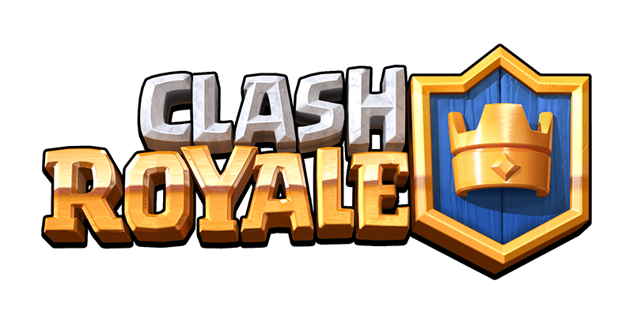

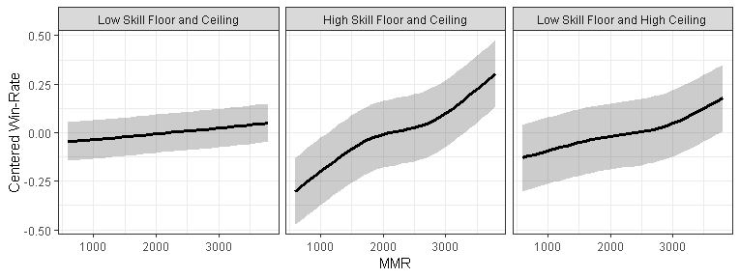
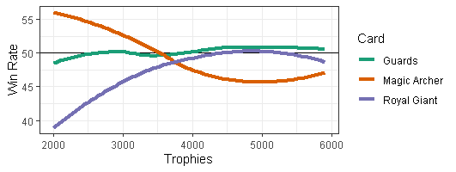
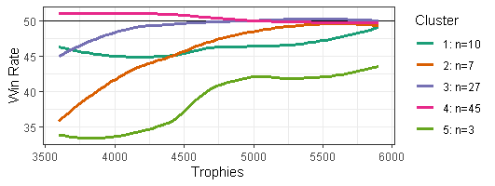
Profiling Character Viability Across
Player Skill Levels in Esports Games
Ivan Ramler & Choong-Soo Lee: St. Lawrence University
2019 Rocky Mountain Symposium on Analytics in Sports
Research Goals
Investigate win rate profiles across skill levels for heroes in Heroes of the Storm and cards in Clash Royale
Use cluster analysis to identify heroes/cards with similar performance rates across skill levels
Develop webapps to allow players to investigate characters of interest
Background
Electronic sport: An esport is a competition with a set of rules for determining the winner, requiring physical prowess and skill to move the virtual competitor and/or a virtual object as required by the rules.
Real Time Strategy (RTS): A genre of video games in which the game does not progress incrementally in turns. Notable games include Starcraft, Warcraft, and Clash Royale.
Multiplayer Online Battle Arena (MOBA): A popular esports genres both casually and professionally. Notable games include League of Legends, DOTA2, Heroes of the Storm, and Smite.
Skill Level Score: Internal Elo based metric used to match similarly skills players with each other. e.g., Heroes of the Storm uses “Matchmaking Rating (MMR)” and Clash Royale uses “Trophies”.
Skill Floor: a way of describing how difficult it is to begin the process of mastering a character
Skill Ceiling: the level of play that’s possible with training and mastery
Heroes of the Storm
MOBA game released by Blizzard Entertainment in 2015
Similar games include League of Legends and DOTA2
Data on over 1,000,000 matches collected from HOTS Logs API (a popular fansite)
Investigate win-rates across Matchmaking Rating (MMR) for each of the 84 available heroes.
Figure 1 shows an example of Maiev, a hero with a high skill floor and high skill ceiling
Profiles for all 84 heroes available at https://bit.ly/2XPhAN8
QR Code in top left corner
Figure 2 displays the three clusters identified using k-means
Low Skill Floor/Ceiling (left most) show little change in win rates across MMR (“easy to learn heroes”)
High Skill Floor/Ceiling (center) have poor win rates early and high rates for skilled players (“difficult to master heroes”)
Figure 1: Scatterplot of Win rate vs. MMR for Maiev.
Figure 2: Three shapes identified by the k-means clustering algorithm.
Clash Royale
Released by SuperCell in 2016 – RTS that combines elements from collectible card games, tower defense, and MOBAs
Players build decks of 8 cards
Winner of the 2016 Google Play “Best Game Award”
Data on over 30 million matches collected from Clash Royale API
Investigate win-rates across Trophies for each of the available cards (excluding those released after June 30)
Figure 3 shows an example of three cards with varying profiles
Profiles for all cards (released prior to June 30, 2019) available at https://bit.ly/2FTA9Wk (QR Code in top right)
Figure 4 displays the three clusters identified using k-means
Webapp (powered by Shiny and Plotly) allows user to change number of clusters (for a given range of trophies) and see list of cards within each cluster
Figure 3: Winrates across trophies for Guards, Magic Archer, and Royal Giant
Figure 4: Three shapes identified by the k-means clustering algorithm.

