Slide 1
Day 4
Read: Chapter 2 of Legler and Roback
(https://bookdown.org/roback/bookdown-bysh/)
Practice:
Conceptual Exercises: 1, 2
Guided Exercises: 2, 3
Goals for today:
Understand likelihood functions
Derive a likelihood function using intuitive approach from class
Identify 3 ways to find MLEs
Use methods from class to find MLEs for intuitive likelihood functions
Use likelihood functions to compare models
Announcements
Mini-Project 1 is due Friday, September 8
No quiz on Monday (but there will be a prep task)

Slide 2
Comp. | # Families | Contribution to Likelihood for One Family (Data Point)
B | 930
G | 951
BB | 582
BG | 666
GB | 666
GG | 530
BBB | 186
BBG | 177
BGG | 173
BGB | 148
GBB | 151
GGB | 125
GBG | 182
GGG | 159
Total
from National Longitudinal Survey of Youth

Slide 3

Likelihood Function for Model 2
$L\left(p_{B|N}, p_{B|BBias}, p_{B|GBias}\right)=p_{B|N}^{930} ∗{\left(1−p_{B|N}\right)}^{951} ∗p_{B|N}^{582} ∗p_{B|BBias}^{582} ∗ p_{B|N}^{666} ∗{\left(1−p_{B|BBias}\right)}^{666} ∗{\left(1−p_{B|N}\right)}^{666} ∗p_{B|GBias}^{666} ∗ {\left(1−p_{B|N}\right)}^{530} ∗{\left(1 −p_{B|GBias}\right)}^{530}∗p_{B|N}^{186}∗p_{B|BBias}^{186}∗p_{B|BBias}^{186}∗p_{B|N}^{177} ∗p_{B|BBias}^{177} ∗{\left(1−p_{B|BBias}\right)}^{177} ∗p_{B|N}^{173} ∗{\left(1−p_{B|BBias}\right)}^{173}∗{\left(1−p_{B|N}\right)}^{173}∗p_{B|N}^{148}∗{\left(1−p_{B|BBias}\right)}^{148}∗p_{B|N}^{148}∗{\left(1−p_{B|N}\right)}^{151} ∗p_{B|GBias}^{151} ∗p_{B|N}^{151} ∗{\left(1−p_{B|N}\right)}^{125} ∗{\left(1 −p_{B|GBias}\right)}^{125} ∗p_{B|GBias}^{125} ∗{\left(1−p_{B|N}\right)}^{182} ∗p_{B|GBias}^{182} ∗{\left(1−p_{B|N}\right)}^{182}$ * ${\left(1−p_{B|N}\right)}^{159} ∗ {\left(1 −p_{B|GBias}\right)}^{159} ∗{\left(1 −p_{B|GBias}\right)}^{159}$

Slide 4
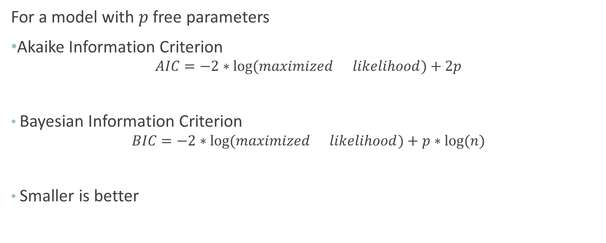
Information Criteria
For a model with $p$ free parameters
Akaike Information Criterion
$$AIC=−2∗log⁡(maximized{likelihood)+2p}$$
Bayesian Information Criterion
$$BIC=−2∗log⁡(maximized{likelihood)+p∗log⁡(n)}$$
Smaller is better

Slide 5
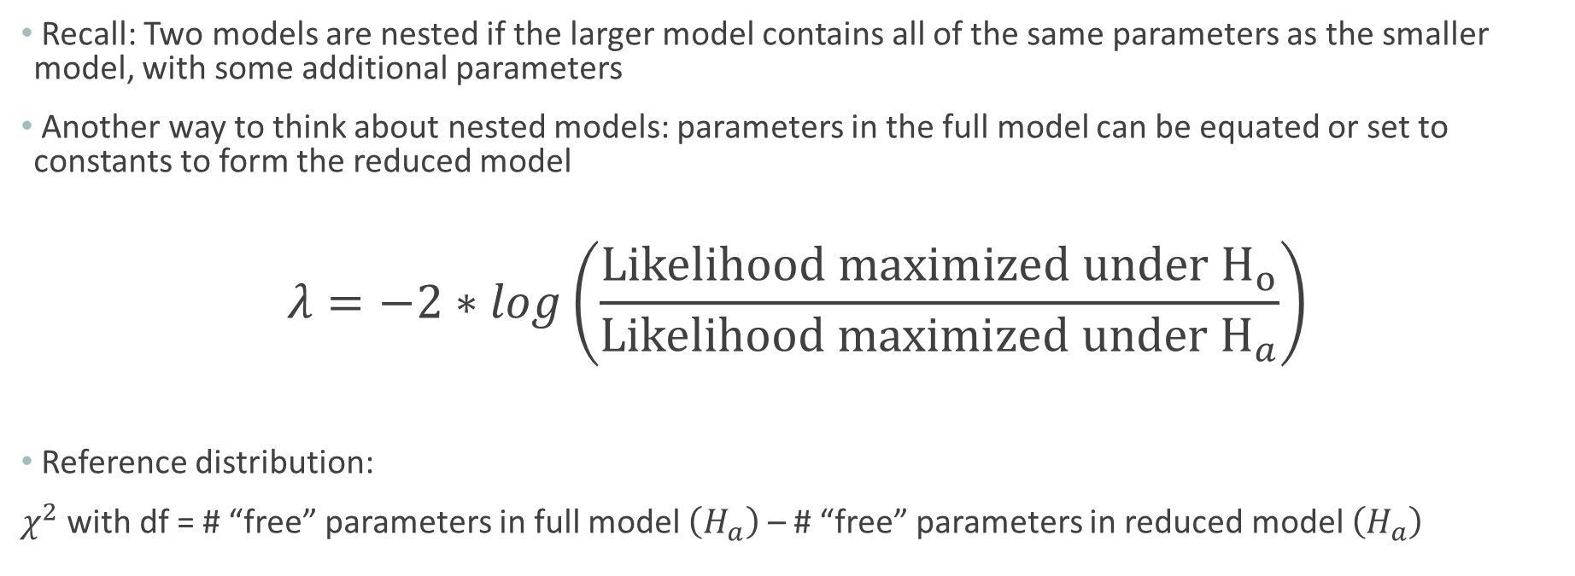
(Asymptotic) Likelihood Ratio Test (Nested Models)
Recall: Two models are nested if the larger model contains all of the same parameters as the smaller model, with some additional parameters
Another way to think about nested models: parameters in the full model can be equated or set to constants to form the reduced model
$$λ=−2∗log\left(\frac{Likelihood maximized under H_{o}}{Likelihood maximized under H_{a}}\right)$$
Reference distribution:
$χ^{2}$ with df = # “free” parameters in full model $\left(H_{a}\right)$ – # “free” parameters in reduced model $\left(H_{a}\right)$

Slide 6
Comp. | # Families | Contribution to Likelihood for One Family (Data Point)
B | 930
G | 951
BB | 582
BG | 666
GB | 666
GG | 530
BBB | 186
BBG | 177
BGG | 173
BGB | 148
GBB | 151
GGB | 125
GBG | 182
GGG | 159
Total
from National Longitudinal Survey of Youth

Slide 7

Likelihood Function for Model 3
$L\left(p_{b}, p_{S|B1}, p_{s|NB1}\right)=p_{b}^{5416} ∗{\left(1−p_{b}\right)}^{5256}∗p_{s|B1}^{1721} ∗{\left(1−p_{s|B1}\right)}^{2265}∗p_{s|NB1}^{3905}∗{\left(1−p_{s|NB1}\right)}^{2781}$

Slide 8
Before Next Time:
Watch short video introducing three non-normal probability distributions. Link will be in Panopto tab (will email when I post it)
Complete Canvas quiz before class starts

