Slide 1
Day 9
Read: Sections 4.1 – 4.6​
(https://bookdown.org/roback/bookdown-BeyondMLR/) ​
Practice:​
Conceptual Exercises: 14, 15​
Guided Exercises: 3, 5
Goals for today:
Multiple Comparisons in glms
Offset
Overdispersion
Test for Goodness of Fit
Announcements
Mini-project 2 due Friday, September 29 (by 4pm)
Extra credit tonight! (See day 8 slides for details)
Quiz on Monday (Poisson regression)

Slide 2
Recall: Multiple Comparisons
Issue: As more pairs are compared (i.e., more hypotheses are tested), it becomes increasingly likely that the groups will appear to differ for at least one pair due to random sampling instead of an actual difference.
i.e., Chance of making at least one Type 1 Error increases. Type1 Error is where we reject a null hypothesis even though it is actually true. (e.g., claim that a pair for groups have different means, but really, we just had a strange random sample and there is no true difference).
Solution: Adjust p-values (and/or confidence levels) such that the chance of making at least one Type 1 Error is set to our specified significance level (e.g., 5%)
Common procedures include Tukey’s Honest Significant Difference (HSD) and the Bonferroni Correction.

Slide 3
Model Goodness of Fit
If our model is the “true” model for the observed data
$$Residual Deviance \sim χ^{2} with df=Residual df$$
Compute probability of observing a deviance at least this large, if model is true
Compare to $χ^{2}$ with $df=Residual df$
Small “p-value” means there is significant evidence of “lack-of-fit”
Reasons for “lack-of-fit”
Missing covariates
Not enough data
Unusual observations
More (or less) variation than expected

Slide 4
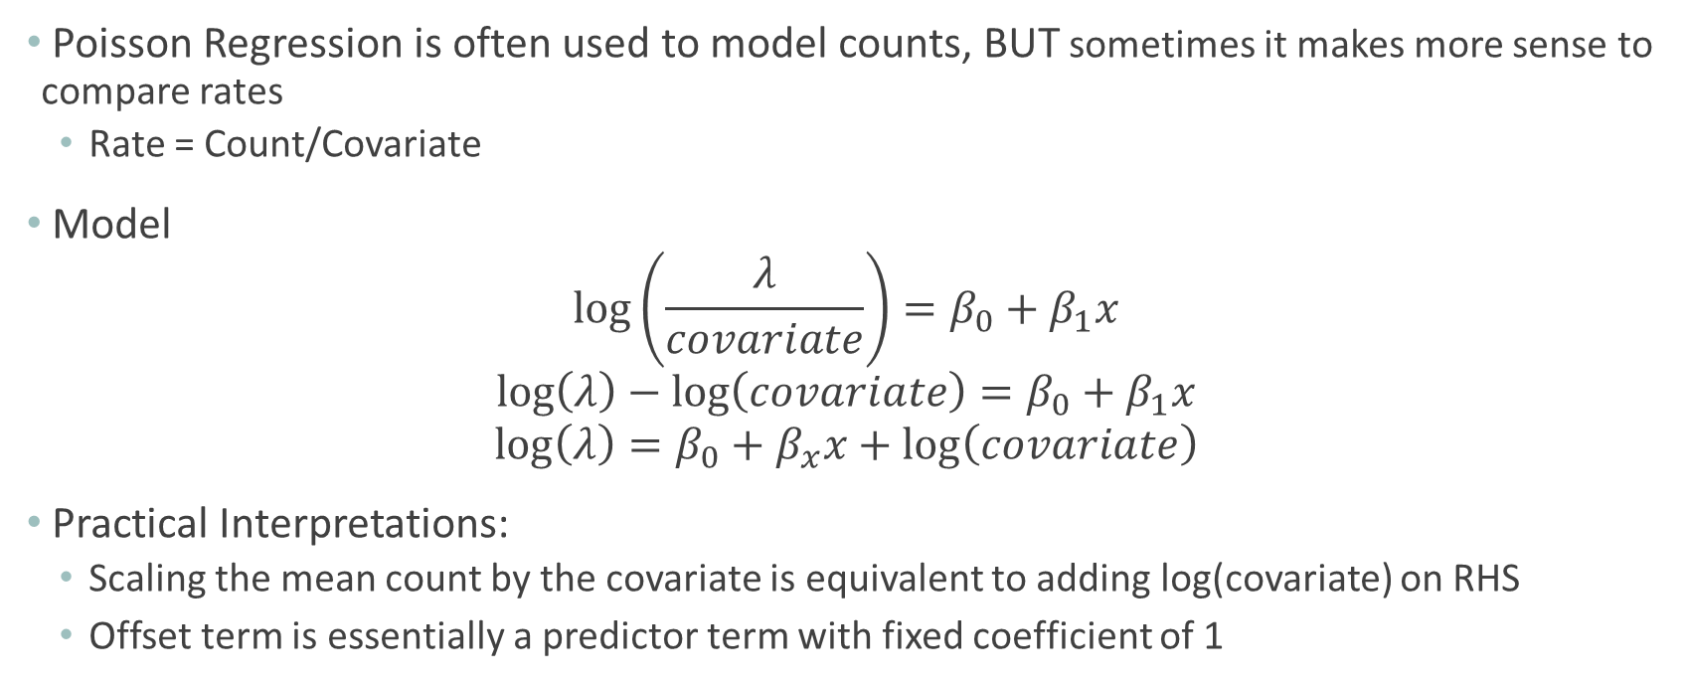
Offset in Poisson Regression
Poisson Regression is often used to model counts, BUT sometimes it makes more sense to compare rates
Rate = Count/Covariate
Model
$$\log\left(\frac{λ}{covariate}\right)=β_{0}+β_{1}x$$
$$\log\left(λ\right)−\log\left(covariate\right)=β_{0}+β_{1}x$$
$$\log\left(λ\right)=β_{0}+β_{x}x+\log\left(covariate\right)$$
Practical Interpretations:
Scaling the mean count by the covariate is equivalent to adding log(covariate) on RHS
Offset term is essentially a predictor term with fixed coefficient of 1

Slide 5
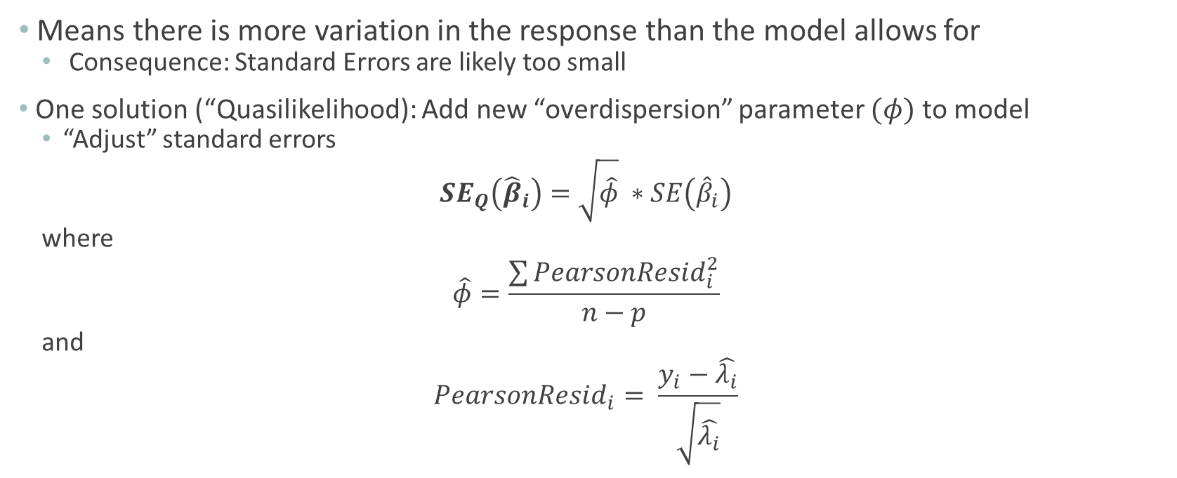
Overdispersion
Means there is more variation in the response than the model allows for
Consequence: Standard Errors are likely too small
One solution (“Quasilikelihood): Add new “overdispersion” parameter $(φ)$ to model
“Adjust” standard errors
$$SE_{Q}\left({\hat{β}}_{i}\right)=\sqrt{\hat{φ}} ∗SE\left({\hat{β}}_{i}\right)$$
where
$$\hat{φ}=\frac{\sum{PearsonResid_{i}^{2}}}{n−p}$$
and
$$PearsonResid_{i}= \frac{y_{i}−\hat{λ_{i}}}{\sqrt{\hat{λ_{i}}}}$$

Slide 6
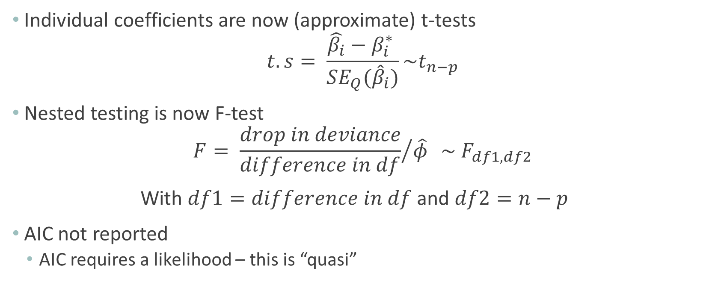
Quasipoisson: Changes
Individual coefficients are now (approximate) t-tests
$$t.s= \frac{\hat{β_{i}}−β_{i}^{∗} }{SE_{Q}({\hat{β}}_{i})}\sim t_{n−p}$$
Nested testing is now F-test
$$F= {\frac{drop in deviance}{difference in df}}/{\hat{φ} } \sim F_{df1,df2}$$
With $df1=difference in df$ and $df2=n−p$
AIC not reported
AIC requires a likelihood – this is “quasi”

Slide 7
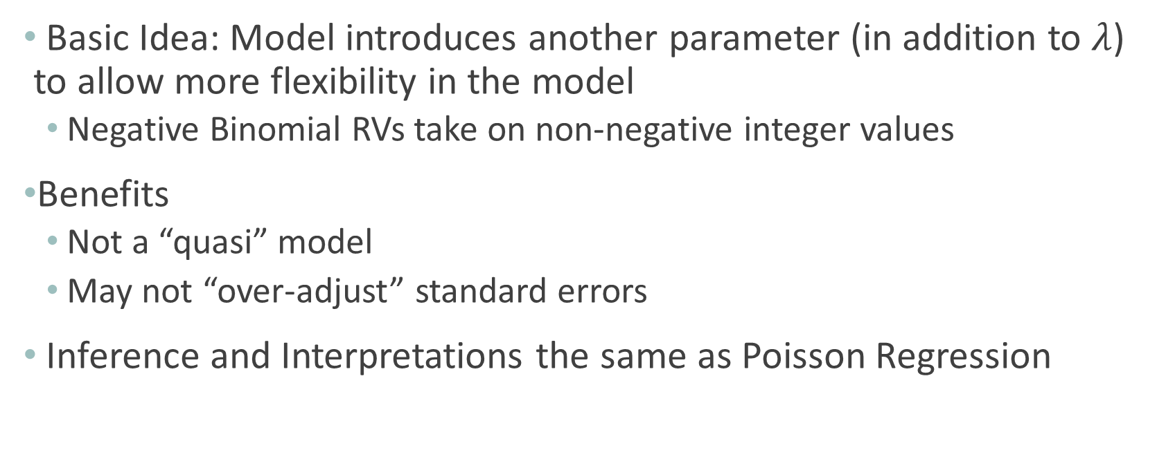
Adjusting for Overdispersion: Negative Binomial Model
Basic Idea: Model introduces another parameter (in addition to $λ$) to allow more flexibility in the model
Negative Binomial RVs take on non-negative integer values
Benefits
Not a “quasi” model
May not “over-adjust” standard errors
Inference and Interpretations the same as Poisson Regression

Slide 8
