Slide 1
Day 14 – Correlated Data
Read: Sections 7.1 – 7.9
(https://bookdown.org/roback/bookdown-bysh/)
Practice:
Conceptual Exercises: 1
Goals for today:
Overdispersion in GLMs
For a given data structure, recognize the potential for correlation
Identify observational units at varying levels
Identify fixed versus random effects
Understand possible problems caused by correlated data
Announcements
Mini-project 3 due today
Solutions to Textbook Exercises posted on Canvas

Slide 2
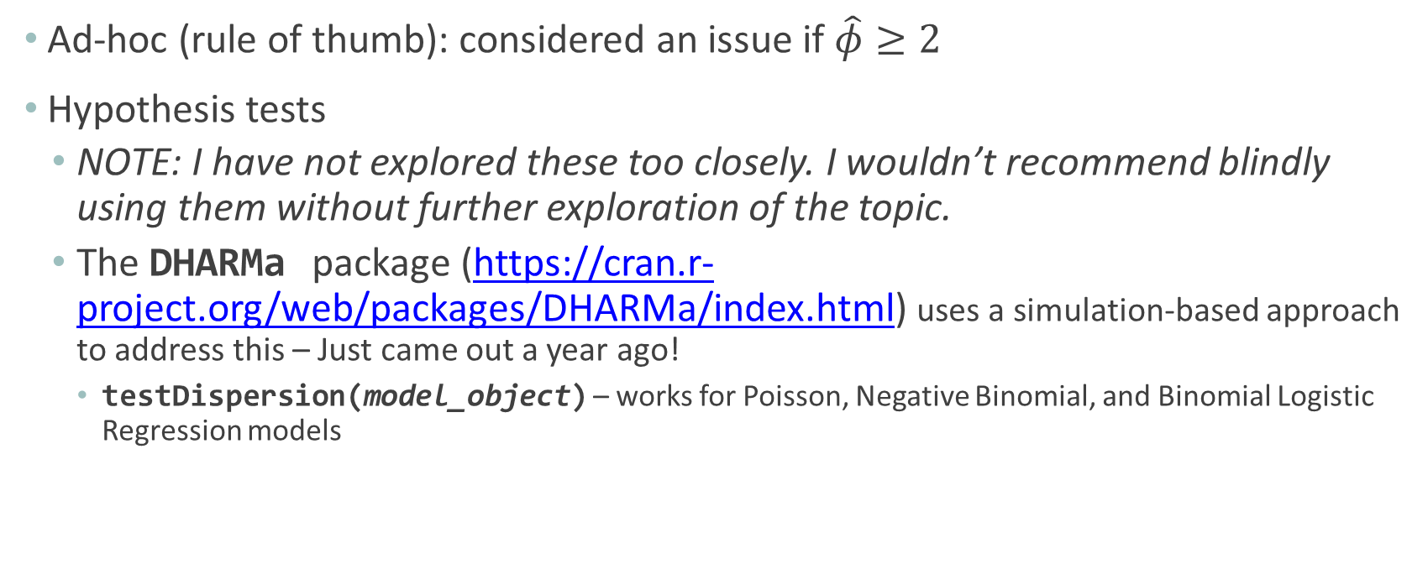
Overdispersion in General Linear Models (GLMs)
Ad-hoc (rule of thumb): considered an issue if $\hat{φ}≥2$
Hypothesis tests
NOTE: I have not explored these too closely. I wouldn’t recommend blindly using them without further exploration of the topic.
The DHARMa package (https://cran.r-project.org/web/packages/DHARMa/index.html) uses a simulation-based approach to address this – Just came out a year ago!
testDispersion(model_object) – works for Poisson, Negative Binomial, and Binomial Logistic Regression models

Slide 3
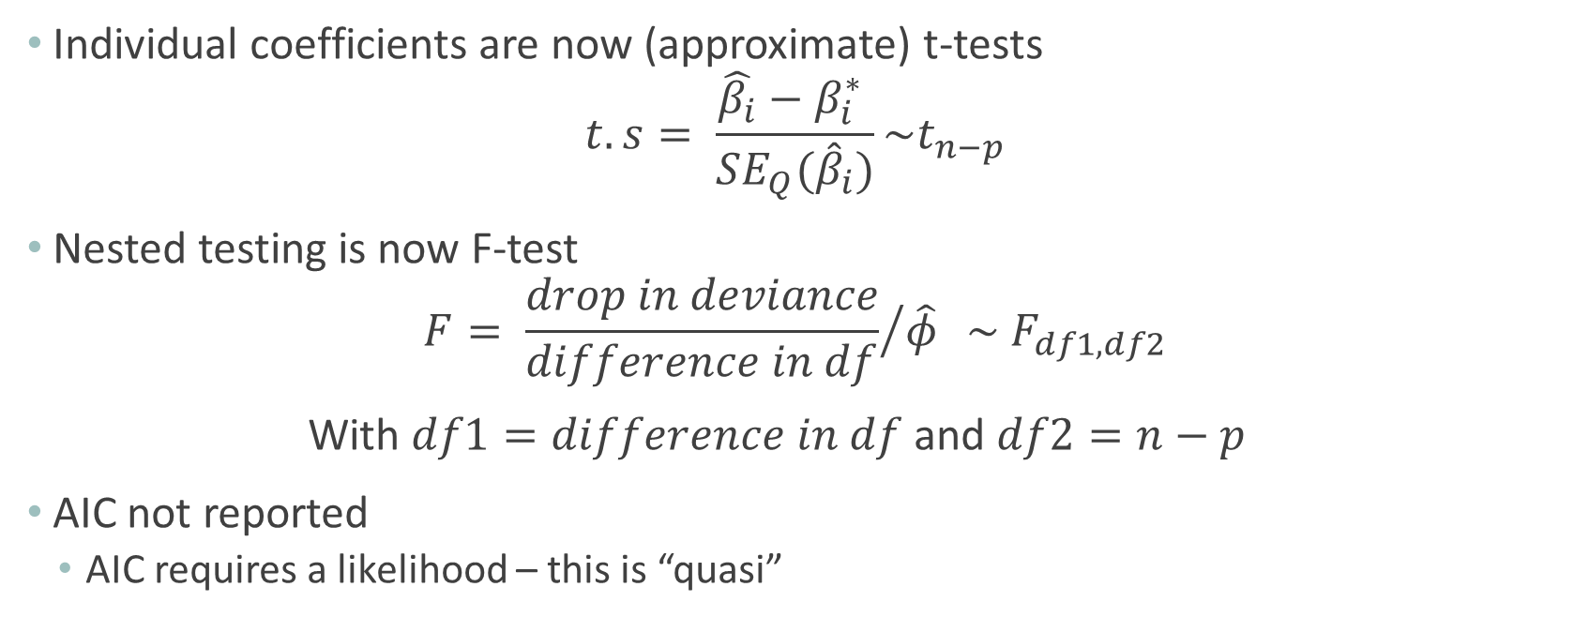
Quasibinomial: Changes
Individual coefficients are now (approximate) t-tests
$$t.s= \frac{\hat{β_{i}}−β_{i}^{∗} }{SE_{Q}({\hat{β}}_{i})}\sim t_{n−p}$$
Nested testing is now F-test
$$F= {\frac{drop in deviance}{difference in df}}/{\hat{φ} } \sim F_{df1,df2}$$
With $df1=difference in df$ and $df2=n−p$
AIC not reported
AIC requires a likelihood – this is “quasi”

Slide 4
Recognizing Correlated Data

Slide 5
Goals for this session
For a given data structure, recognize the potential for correlation
Identify observational units at varying levels
Identify fixed versus random effects

Slide 6













Modeling Achievement in Mathematics
Level Two Observational Units
…
Level One Observational Units

Slide 7
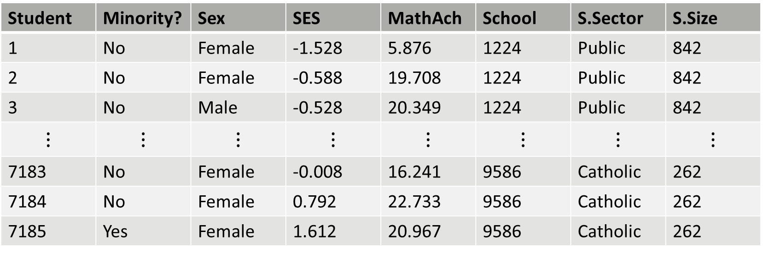
Modeling Achievement in Mathematics
Student | Minority? | Sex | SES | MathAch | School | S.Sector | S.Size
1 | No | Female | -1.528 | 5.876 | 1224 | Public | 842
2 | No | Female | -0.588 | 19.708 | 1224 | Public | 842
3 | No | Male | -0.528 | 20.349 | 1224 | Public | 842
$$⋮$$ | $$⋮$$ | $$⋮$$ | $$⋮$$ | $$⋮$$ | $$⋮$$ | $$⋮$$ | $$⋮$$
7183 | No | Female | -0.008 | 16.241 | 9586 | Catholic | 262
7184 | No | Female | 0.792 | 22.733 | 9586 | Catholic | 262
7185 | Yes | Female | 1.612 | 20.967 | 9586 | Catholic | 262
We would expect students at the same school to have similar Achievement scores
Intraclass Correlation

Slide 8
Terminology
Fixed Effects
Typically, fixed effects describe levels of a factor that we are specifically interested in drawing inferences about, and which would not change in replications of the study.
Minority?, Sex, SES, S.Sector, S.Size
Random Effects
Typically, random effects describe levels of a factor which can be thought of as a sample from a larger population of factor levels
We are not typically interested in drawing conclusions about specific levels of a random effect, although we are interested in accounting for the influence of the random effect in our model.
School
Notes:
Fixed versus Random Effects
Would a significant effect be interesting/meaningful to write about in a paper/journal
Significant differences in math achievement for different socioeconomic backgrounds – Yes! = Fixed Effect
Scores for School Y are significantly lower than for School Z – No! = Random Effect

Slide 9
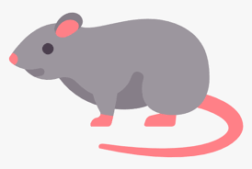

Studying Effects of Teratogens in Rats
…

Slide 10
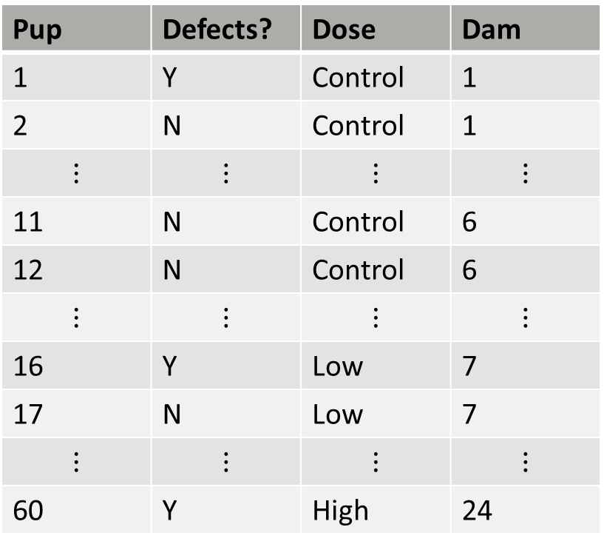
Studying Effects of Teratogens in Rats
Pup | Defects? | Dose | Dam
1 | Y | Control | 1
2 | N | Control | 1
$$⋮$$ | $$⋮$$ | $$⋮$$ | $$⋮$$
11 | N | Control | 6
12 | N | Control | 6
$$⋮$$ | $$⋮$$ | $$⋮$$ | $$⋮$$
16 | Y | Low | 7
17 | N | Low | 7
$$⋮$$ | $$⋮$$ | $$⋮$$ | $$⋮$$
60 | Y | High | 24
Response Variable
Defects?
Fixed Effects
Dose
Random Effects
Dam

Slide 11
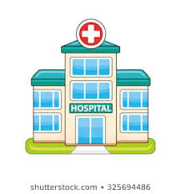
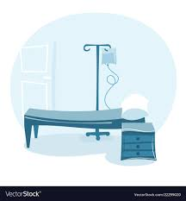
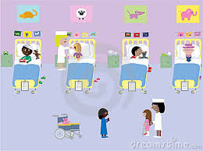
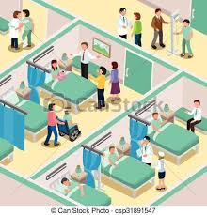

A cluster randomised trial of cloth masks compared with medical masks in healthcare workers

Slide 12
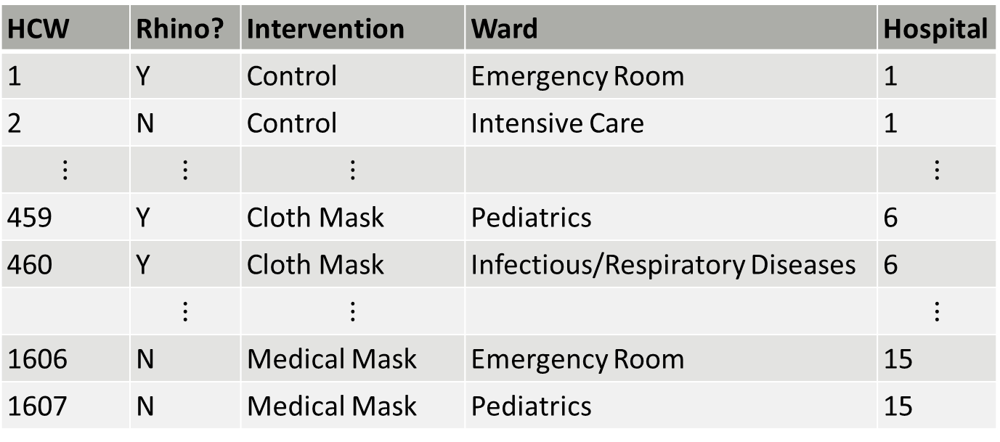
A cluster randomised trial of cloth masks compared with medical masks in healthcare workers
HCW | Rhino? | Intervention | Ward | Hospital
1 | Y | Control | Emergency Room | 1
2 | N | Control | Intensive Care | 1
$$⋮$$ | $$⋮$$ | $$⋮$$ |  | $$⋮$$
459 | Y | Cloth Mask | Pediatrics | 6
460 | Y | Cloth Mask | Infectious/Respiratory Diseases | 6
 | $$⋮$$ | $$⋮$$ |  | $$⋮$$
1606 | N | Medical Mask | Emergency Room | 15
1607 | N | Medical Mask | Pediatrics | 15
Response Variable
Rhinovirus?
Fixed Effects
Intervention, Ward
Random Effects
Hospital

Slide 13
End of “Video”

