Slide 1
Day 6
Read: Sections 3.3.1, 3.3.2, 3.3.6
https://bookdown.org/roback/bookdown-BeyondMLR/
Practice:
Conceptual Exercises: 2, 5, 6, 7
Goals for today:
For Bernoulli, Binomial, and Poisson, and random variables
Recognize when each is the appropriate model for a scenario
Define RVs in context of an application
Identify possible values
Recognize form of pdf
Identify mean and std. dev. (for most)
Match the response variable for a study to one of these RVs (and rule out others)
Announcements
Quiz 2 is Monday, September 18

Slide 2
Scenario
Roll a single six-sided die one time and observe if a six is rolled

Slide 3
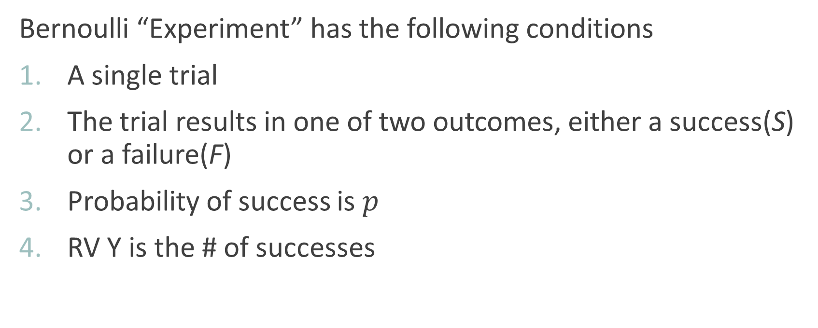
Bernoulli Random Variable
Bernoulli “Experiment” has the following conditions
A single trial
The trial results in one of two outcomes, either a success(S) or a failure(F)
Probability of success is $p$
RV Y is the # of successes

Slide 4
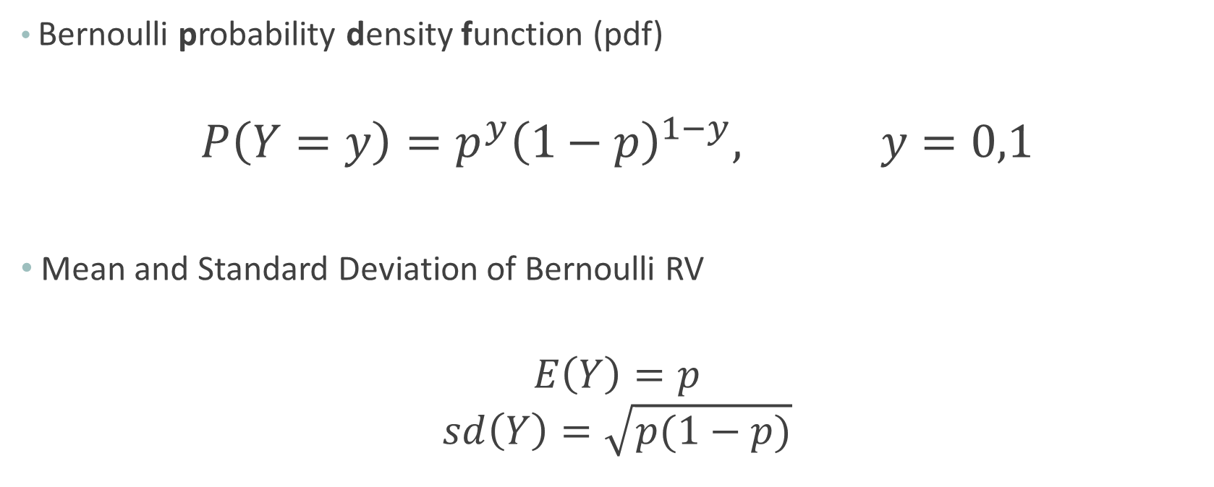
Bernoulli RV
Bernoulli probability density function (pdf)
$$P\left(Y=y\right)=p^{y}{\left(1−p\right)}^{1−y}, y=0,1$$
Mean and Standard Deviation of Bernoulli RV
$$E\left(Y\right)=p$$
$$sd\left(Y\right)=\sqrt{p(1−p)}$$

Slide 5

Example: Bernoulli RV
“Experiment”: Roll a single six-sided die one time and observe if a six is rolled
Define RV
What is $p$?
What is the probability that a six is not rolled?

Slide 6
Scenario
Roll five six-sided dice and observe the number of sixes rolled

Slide 7
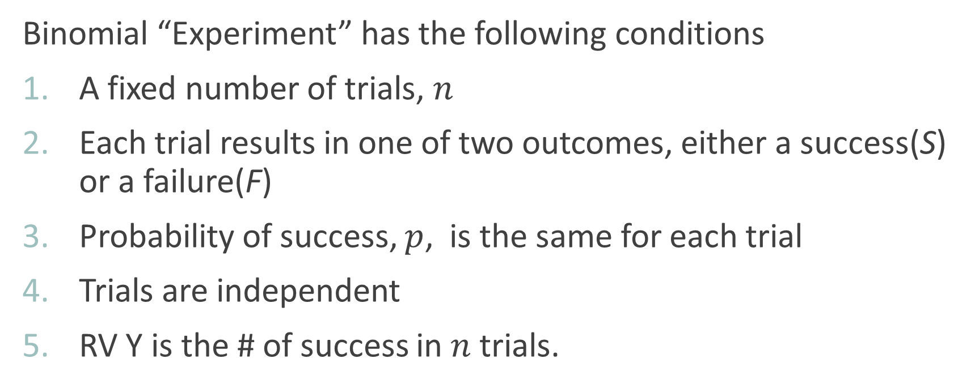
Binomial Random Variable
Binomial “Experiment” has the following conditions
A fixed number of trials, $n$
Each trial results in one of two outcomes, either a success(S) or a failure(F)
Probability of success, $p$, is the same for each trial
Trials are independent
RV Y is the # of success in $n$ trials.

Slide 8
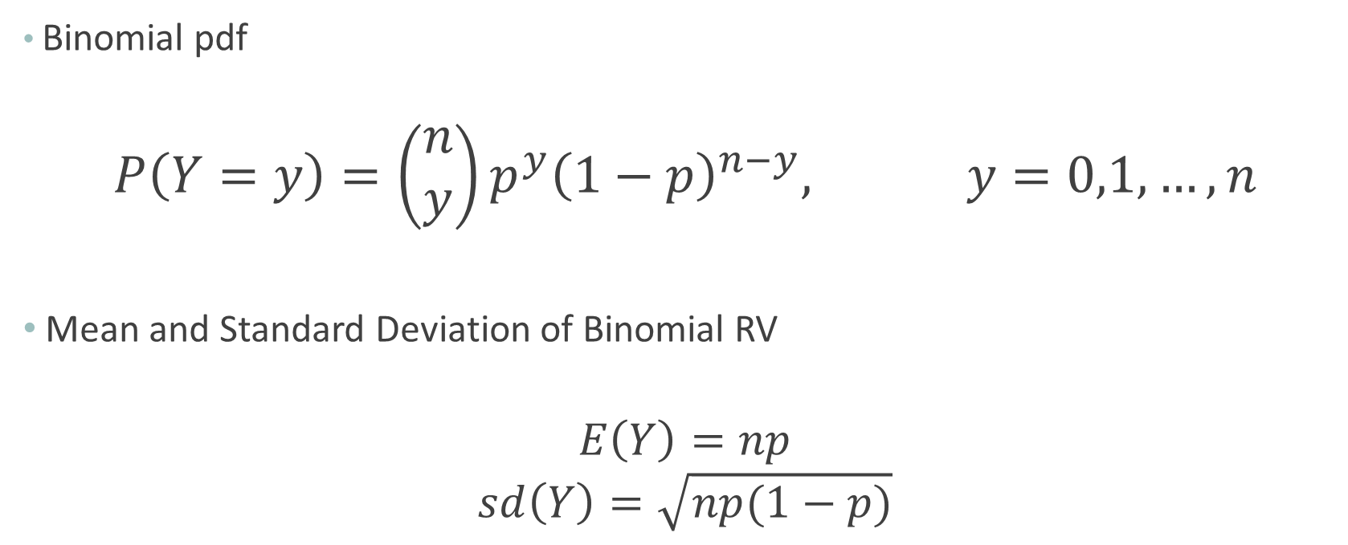
Binomial RV
Binomial pdf
$$P\left(Y=y\right)={\left(\begin{matrix}n \\ y\end{matrix}\right)p}^{y}{\left(1−p\right)}^{n−y}, y=0,1,…,n$$
Mean and Standard Deviation of Binomial RV
$$E\left(Y\right)=np$$
$$sd\left(Y\right)=\sqrt{np(1−p)}$$

Slide 9
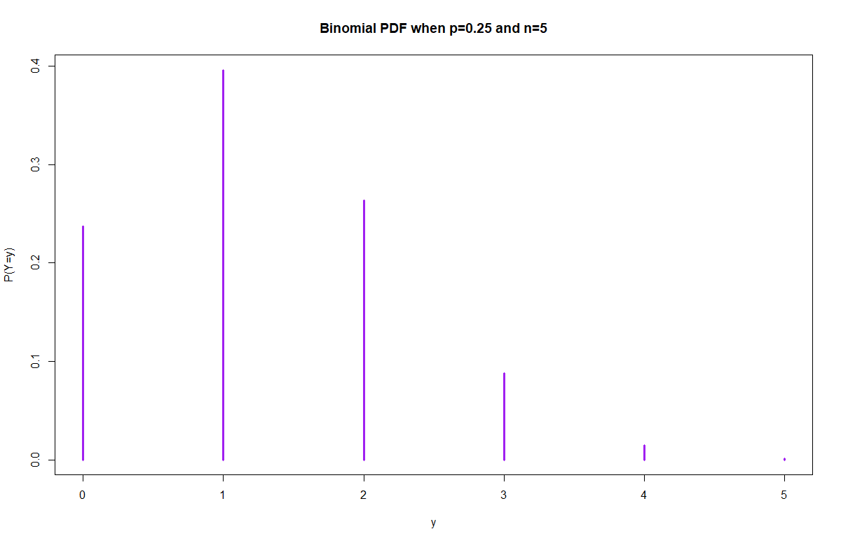
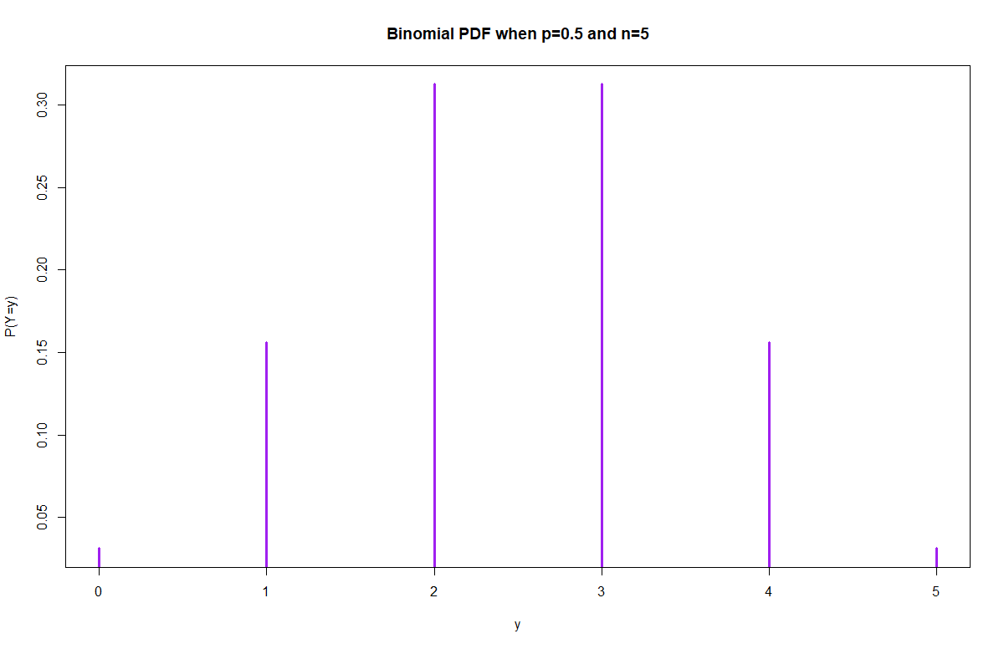
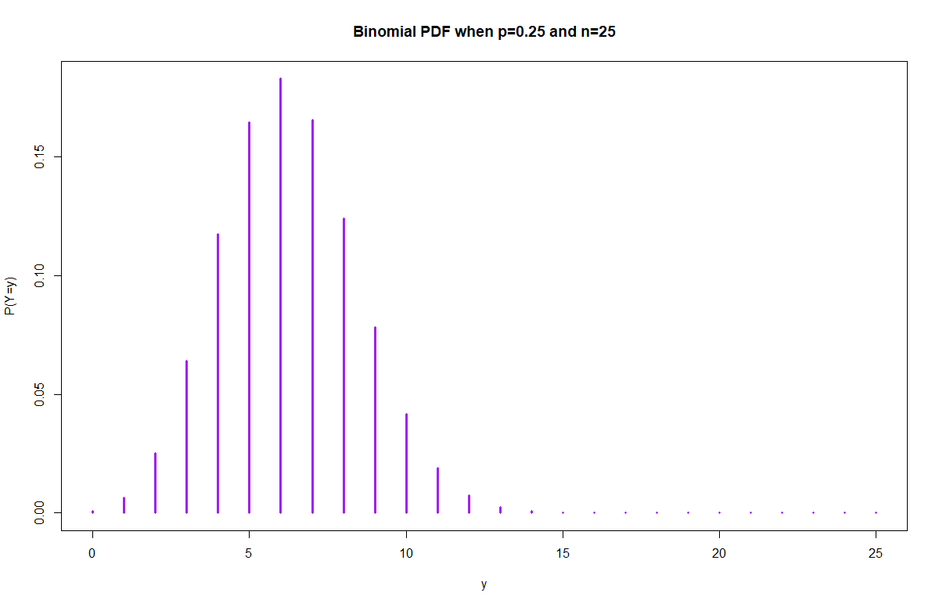
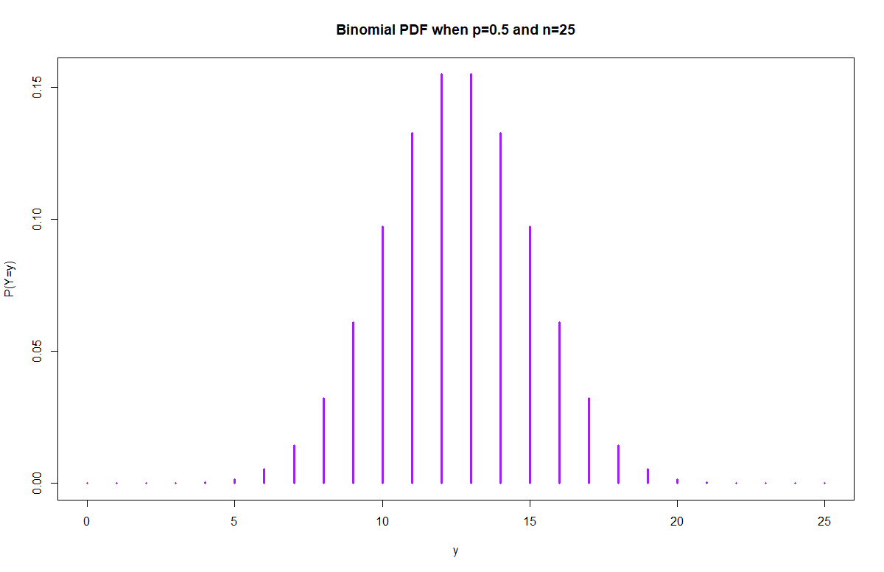

Slide 10
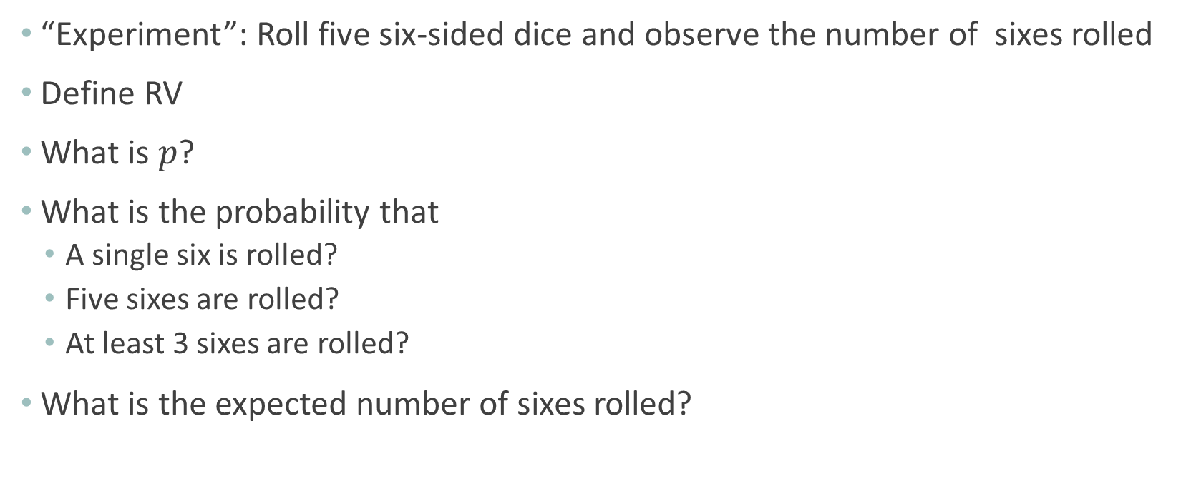
Example: Binomial RV
“Experiment”: Roll five six-sided dice and observe the number of sixes rolled
Define RV
What is $p$?
What is the probability that
A single six is rolled?
Five sixes are rolled?
At least 3 sixes are rolled?
What is the expected number of sixes rolled?

Slide 11
Scenario
Count the number of typographical errers on the next slide

Slide 12
Poisson RV
Conditions for a Poisson experiment are the following:
Events must occur independently
Must be fixed space (time interval, area, volume, etc.)
Y = number of events in that fixed space
Y = # of auto accidents in 1 week
Y = # of customers entering a checkout line in 10 minutes
Y = # of “naked eye” stars in a telescope field
Y = # of goals scored in a soccer game
Notes:
What is the expected number of customers to arrive in an hour?
What is the probability that 8 customers arrive in a given hour?
What is the probability that more than 4 customers arrive in a given hour?

Slide 13

Poisson RV
Poisson pdf
$$P\left(Y=y\right)=\frac{e^{−λ}λ^{y}}{y!}, y=0,1,2,.., ∞$$
Mean and Standard Deviation of Poisson RV
$$E\left(Y\right)=λ$$
$$sd\left(Y\right)=\sqrt{λ}$$

Slide 14
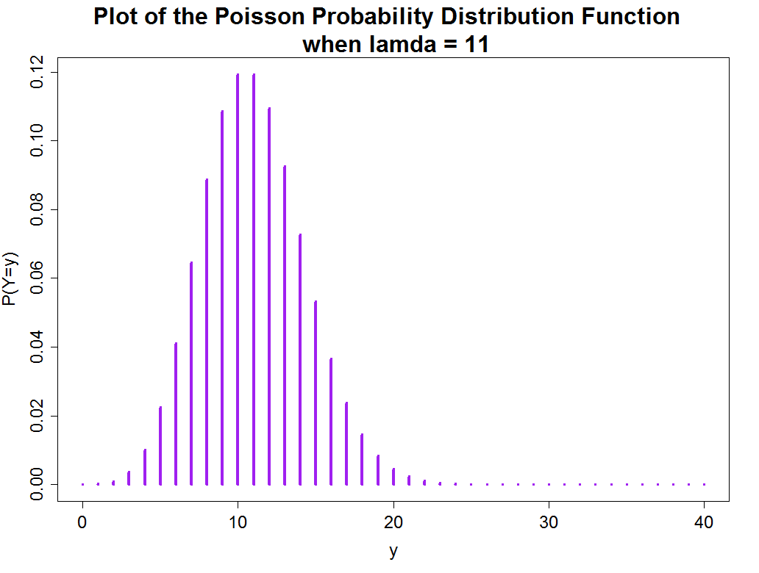
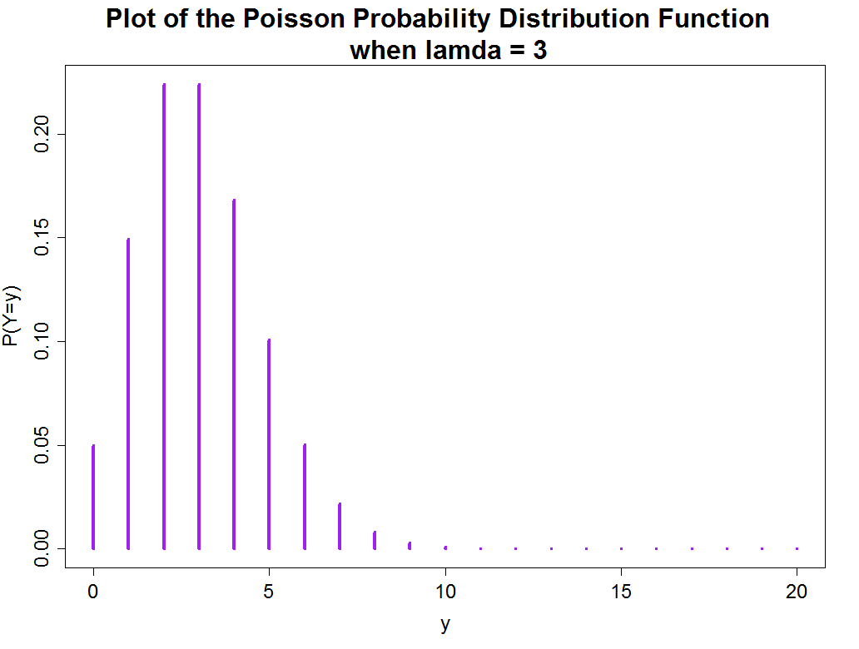
Plots of the Poisson Probability Distribution Function with λ = 11 and λ = 3

Slide 15
Example: Poisson RV
Suppose that the number of typographical errers on a single slide of our notes has a Poisson distribution with λ=0.25.
Define RV
What is the probability there is
Exactly one error on the next slide?
At least one error on the next slide?

Slide 16
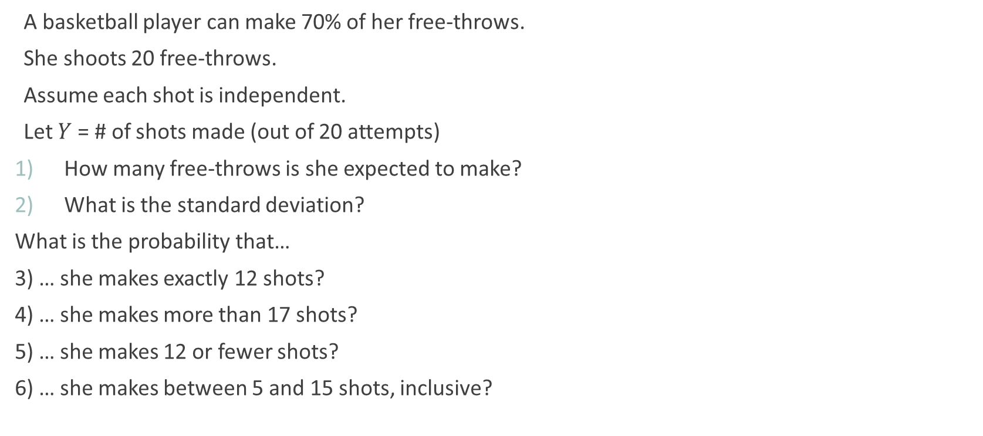
Example: Free Throws
A basketball player can make 70% of her free-throws.
She shoots 20 free-throws.
Assume each shot is independent.
Let $Y$ = # of shots made (out of 20 attempts)
How many free-throws is she expected to make?
What is the standard deviation?
What is the probability that…
3) … she makes exactly 12 shots?
4) … she makes more than 17 shots?
5) … she makes 12 or fewer shots?
6) … she makes between 5 and 15 shots, inclusive?

Slide 17
Example: Customer Service
Assume customers arrive at a travel agency at an average rate of 6 per hour.
Let Y = number of customers that arrive in an hour
How many customers should the staff expect to arrive (in an hour)?
What is the standard deviation?
What is the probability that (in a given hour)
- no one arrives?
- fewer than 4 customers arrive?
- at least 7 customers arrive?

