Slide 1
Day 5
Read: Chapter 2 of Legler and Roback
(https://bookdown.org/roback/bookdown-bysh/)
Practice:
Conceptual Exercises: 1, 2
Guided Exercises: 2, 3
Goals for today:
Use likelihood functions to compare models
Hot Hand Application
Announcements
Quiz 2 is next Monday

Slide 2
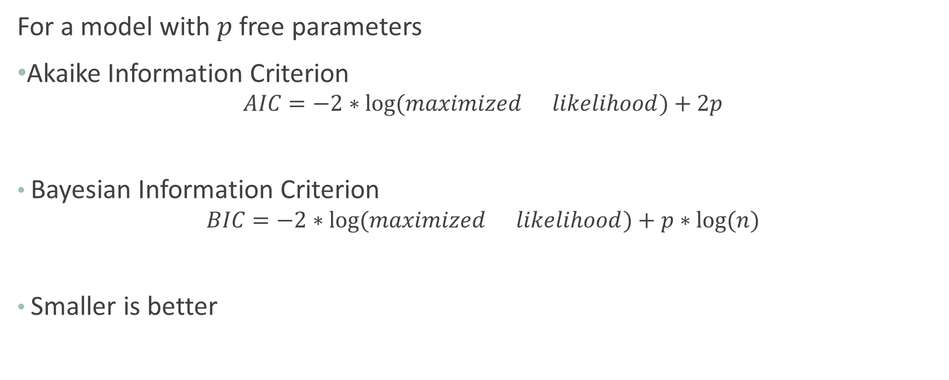
Information Criteria
For a model with $p$ free parameters
Akaike Information Criterion
$$AIC=−2∗log⁡(maximized{likelihood)+2p}$$
Bayesian Information Criterion
$$BIC=−2∗log⁡(maximized{likelihood)+p∗log⁡(n)}$$
Smaller is better

Slide 3
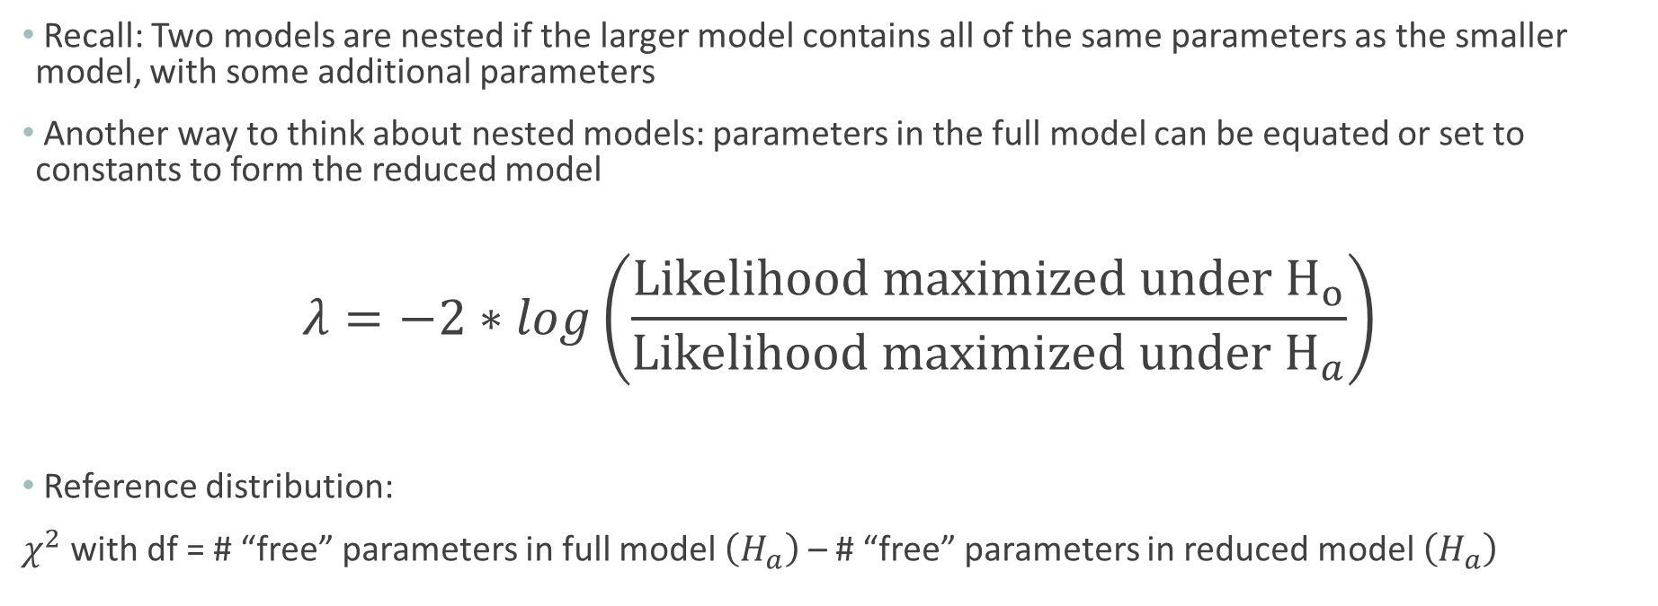
(Asymptotic) Likelihood Ratio Test (Nested Models)
Recall: Two models are nested if the larger model contains all of the same parameters as the smaller model, with some additional parameters
Another way to think about nested models: parameters in the full model can be equated or set to constants to form the reduced model
$$λ=−2∗log\left(\frac{Likelihood maximized under H_{o}}{Likelihood maximized under H_{a}}\right)$$
Reference distribution:
$χ^{2}$ with df = # “free” parameters in full model $\left(H_{a}\right)$ – # “free” parameters in reduced model $\left(H_{a}\right)$

Slide 4
Comp. | # Families | Contribution to Likelihood for One Family (Data Point)
B | 930
G | 951
BB | 582
BG | 666
GB | 666
GG | 530
BBB | 186
BBG | 177
BGG | 173
BGB | 148
GBB | 151
GGB | 125
GBG | 182
GGG | 159
Total
from National Longitudinal Survey of Youth

Slide 5

Likelihood Function for Model 3
$L\left(p_{b}, p_{S|B1}, p_{s|NB1}\right)=p_{b}^{5416} ∗{\left(1−p_{b}\right)}^{5256}∗p_{s|B1}^{1721} ∗{\left(1−p_{s|B1}\right)}^{2265}∗p_{s|NB1}^{3905}∗{\left(1−p_{s|NB1}\right)}^{2781}$

Slide 6
Before Next Time:
Watch short video introducing three non-normal probability distributions (on Panopto)
Complete Canvas quiz before class starts

