Slide 1
Day 18 – Multilevel Models
Read: Sections 8.1 – 8.5
(https://bookdown.org/roback/bookdown-bysh/)
Practice:
Conceptual Exercises: 1, 7
Goals for today:
Write out a multilevel statistical model, including assumptions about variance components
Interpret model parameters (fixed effects and variance components)
Announcements
Quiz Monday (correlated data and basic structures of multilevel models)

Slide 2




Music Data: Data Structure
Level Two Observational Units:
Musicians
Level Two Covariates:
Age, Gender, Experience,
NEM, PEM, Absorption
Response is Negative Affect
Level One Observational Units:
Diaries (performances)
Level One Covariates:
Memory?, Audience, Performance Type

Slide 3
Multilevel Modeling: Basic Idea
There is some overall/underlying relationship between negative affect and number of previous performances
Each individual differs from the “overall” by their own random amount

Slide 4
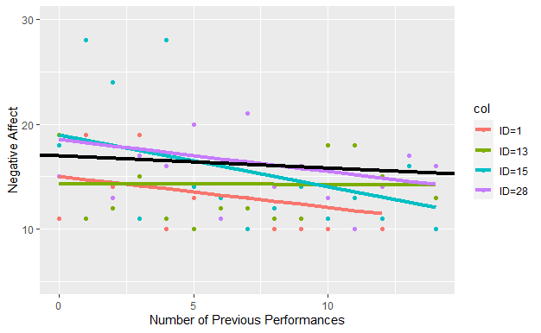
Model Visualization
What looks more different: slopes for individuals or intercepts for individuals?

Slide 5
Model Visualization

Slide 6
Neighborhood Work time
Look through pages 1-3 of the new handout (Multilevel Models, Part 2)
On page 2, why does each pair of plots look different (e.g., plot with x = PEM from top row and plot with x = PEM from bottom row)?
Do you conclusions about each predictor differ when looking at top versus bottom row plots? If so, how?
Which numerical predictor looks most useful (most related to NA)?
On page 3, why does each pair of plots look different (e.g., plot with x = gender from top row and plot with x = gender from bottom row)?
Do you conclusions about each predictor differ when looking at top versus bottom row plots? If so, how?
Using whichever level two numerical predictor you prefer, write out the multilevel model that uses the predictor to explain why musicians have different intercepts (just intercepts, not slopes).

Slide 7
Significance of Predictors in Multilevel Models
R does not provide p-values for any of the individual coefficient tests with multilevel models, because the exact distribution of the test statistic is unknown
Rule of thumb: predictor would be considered “significant” if the test statistic is larger than 2

Slide 8
Improving Interpretations: Centering Numerical Covariates

Slide 9
REML vs ML
REML (Restricted Maximum Likelihood) gives “better estimates” but likelihood values are only comparable between models with the same covariance structure
Can’t really compare models with different fixed effects
REML is a good choice when you have an intended model form
ML (Maximum Likelihood) can give biased estimated for variance components, but uses real likelihoods
AIC/BIC can be used whether or not models are nested
Both dependent on likelihoods, so must use REML=F in lmer
ML is a good choice when you need to compare models

Slide 10
Model Comparisons
For nested models, use a likelihood ratio test to see if the addition of the extra predictors significantly improves the model
AIC/BIC can be used whether or not models are nested
Both dependent on likelihoods, so must use Maximum Likelihood (i.e. use REML = FALSE in your lmer)

