Slide 1
Day 15 – Correlated Data
Read: Sections 7.1 – 7.9
(https://bookdown.org/roback/bookdown-bysh/)
Practice:
Conceptual Exercises: 1
Goals for today:
For a given data structure, recognize the potential for correlation
Identify observational units at varying levels
Identify fixed versus random effects
Understand possible problems caused by correlated data
Announcements
No class on Wednesday, Oct 18 (I’ll be in by 8:50 am for additional office hours)
Exam 1 is Thursday, Oct 19 from 7 – 9pm in Bewkes 107

Slide 2
Review: Correlated Data?
Researchers conducted a randomized controlled study where patients were randomly assigned to either an anti-epileptic drug or a placebo. For each patient, the number of seizures at baseline was measured over a 2 week period. For four consecutive visits the number of seizures were determined over the past 2 week period. Patient age and gender along with visit number were recorded.
Identify the most basic observational units (level one)
Identify the grouping units (there could be multiple levels of grouping)
State the response(s) measured and variable type (Normal, binary, Poisson)
Write a sentence describing within-group correlation (what might be related and why?)
Identify fixed and random effects

Slide 3
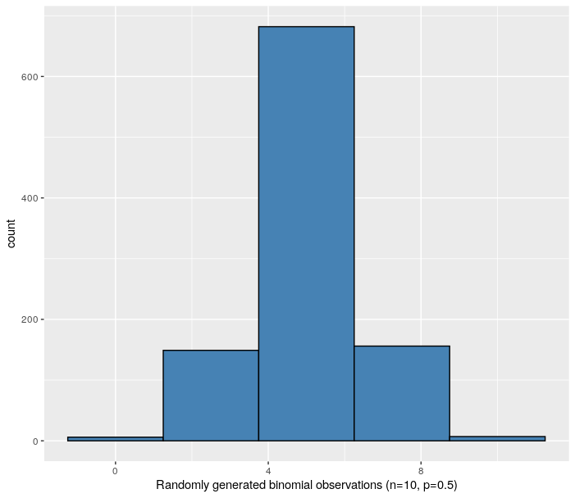

Slide 4
Case Study: Music Performance Anxiety
A 2010 study examined emotional state of musicians before performances and investigated factors that might impact emotional state
Design:
37 undergraduates from a competitive undergrad music program
Subjects completed diaries prior to performances over course of an academic year
Included a Positive Affect Negative Affect Schedule (PANAS) before each performance
Most subjects completed 12 – 15 diaries

Slide 5
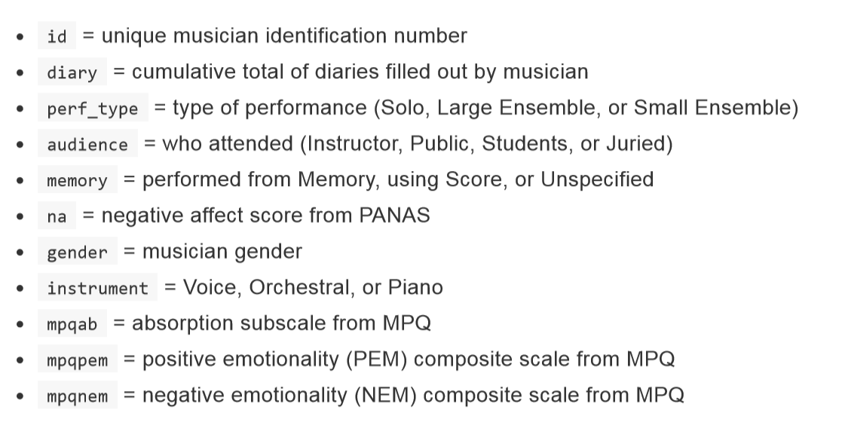
Music Data: Key Variables

Slide 6
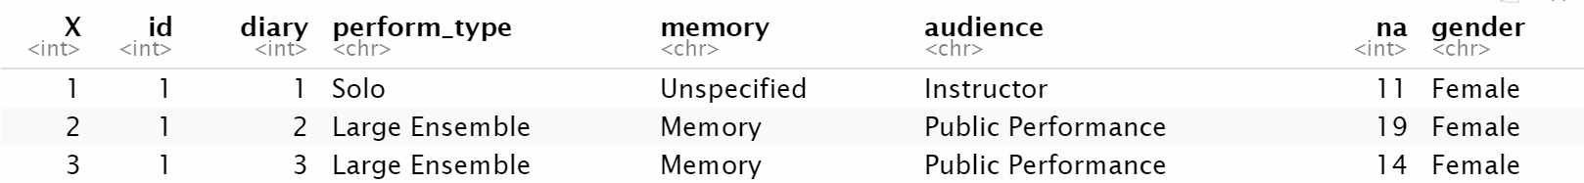
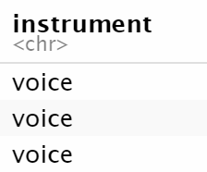
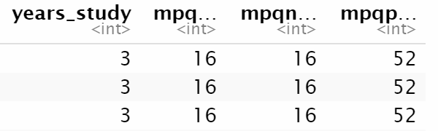
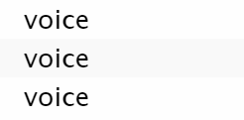
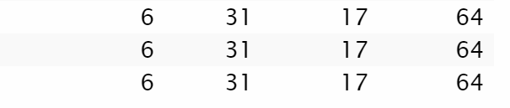
In your neighborhoods
Task:
Identify response variable
Identify Level One observational units
Identify Level Two observational units
Identify Level One covariates
Identify Level Two covariates

Slide 7
Multilevel Modeling: Basic Idea
There is some overall/underlying relationship between negative affect and number of previous performances
Each individual differs from the “overall” by their own random amount

