Slide 1
Stat 313: Advanced Statistical Models
Ivan Ramler
Bewkes 124
iramler@stlawu.edu

Slide 2
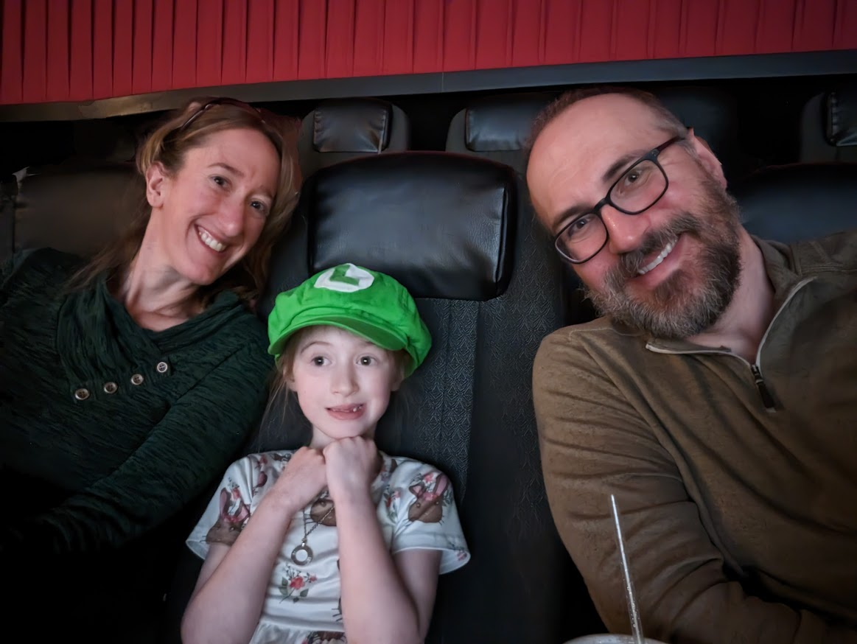
¼ sheets
Name
Year
Major and Minor
Stat 213 (with whom, if not me)?
Have you had any calculus?
Have you taken Probability (Stat 325)?
Tell me an accomplishment from the past year that you are proud of

Slide 3
Day 1
Read: Chapter 1 of Legler and Roback (Skip 1.6.5)
https://bookdown.org/roback/bookdown-BeyondMLR/)
Practice:
Conceptual Exercises: 2
Guided Exercises: 1
ggplot review/primers:
https://myslu.stlawu.edu/~iramler/stat234/coursenotes/data-visualization-with-the-grammar-of-graphics-ggplots2.html
Goals for today:
Setting up laptops
Review Exploratory Data Analysis
Review MLR
Assumptions
Identifying appropriate model forms
Residual Analysis
Inference
Interpretations
Recognize situations where MLR is not appropriate

Slide 4
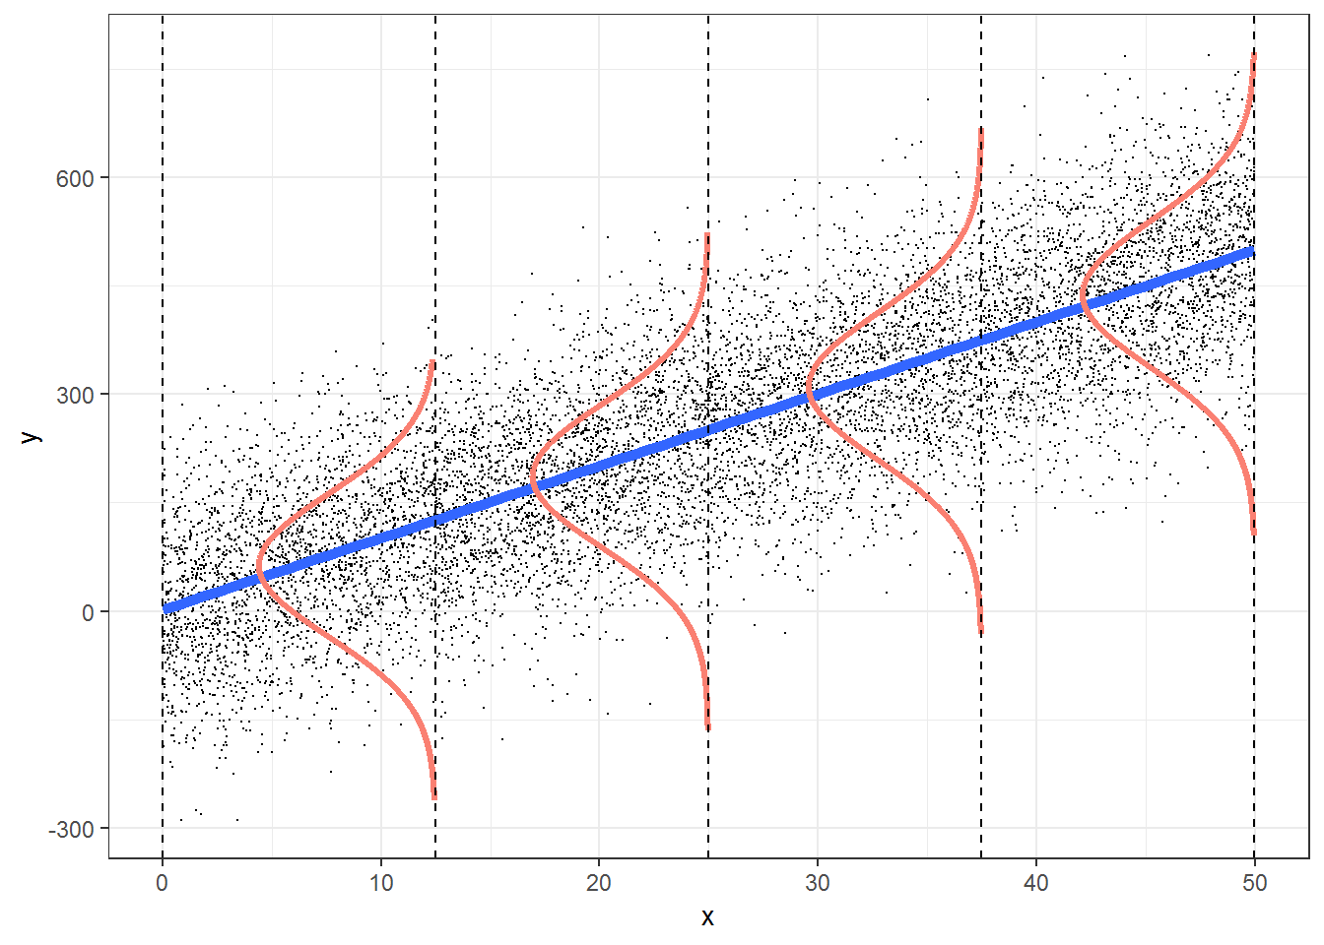
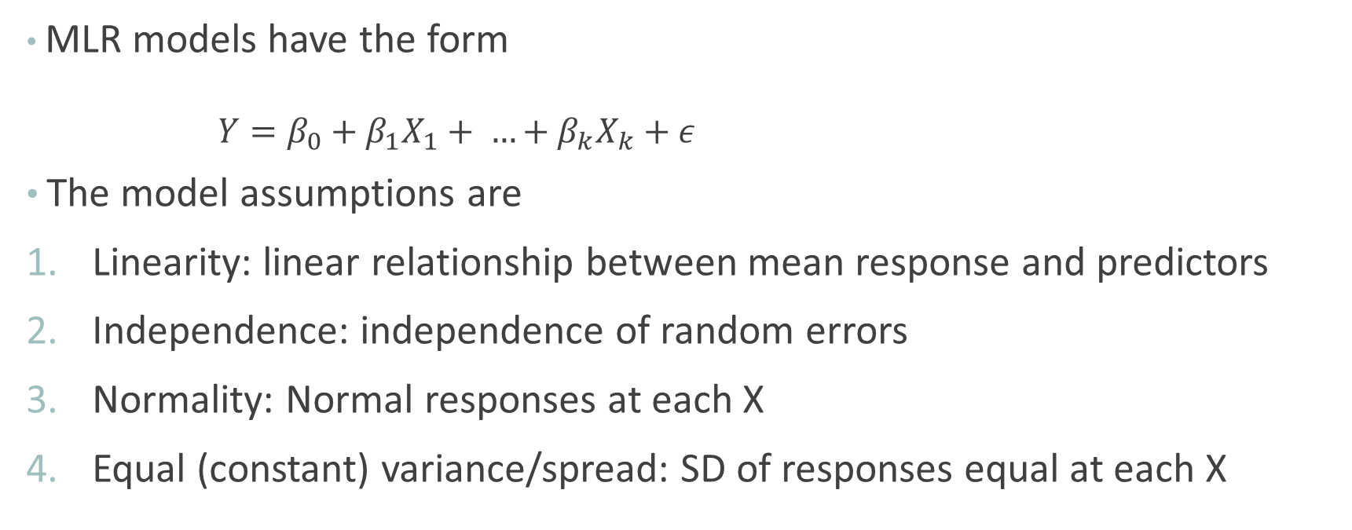
MLR Form and Model Assumptions
MLR models have the form
$$Y=β_{0}+β_{1}X_{1}+ …+β_{k}X_{k}+ε$$
The model assumptions are
Linearity: linear relationship between mean response and predictors
Independence: independence of random errors
Normality: Normal responses at each X
Equal (constant) variance/spread: SD of responses equal at each X

Slide 5

















Examples of Violations that Can’t be Fixed with Transformations
Non-Normal Data
Number of goals scored per game for a hockey (soccer) team
Did a child experience a respiratory disease (pneumonia or bronchitis) in their first year of life?
Correlated (non-independent) Data
Modeling math scores of elementary schools students, with data collected from multiple schools (and other predictors include gender and socioeconomic status)
…

Slide 6
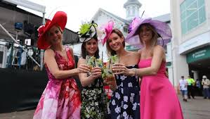
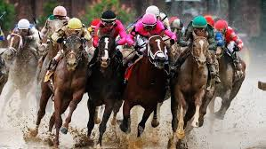
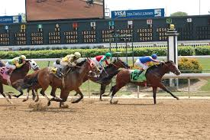
The Kentucky derby
One race in the “Triple Crown”
Louisville, KY
First weekend in May (usually)
Our interest: speed of winner

Slide 7
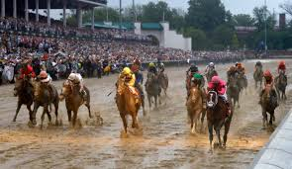
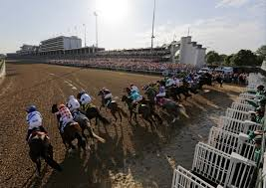
Derby Data: The Variables
Winning speed (feet per second)
Year race was run (1896 – 2017)
Condition of track: “fast,” “good” (good or dusty), “slow” (slow, heavy, muddy, or sloppy)
Number of starters

