Slide 1
Day 2
Read: Chapter 1 of Legler and Roback (Skip 1.6.5)
https://bookdown.org/roback/bookdown-BeyondMLR/)
Practice:
Conceptual Exercises: 2
Guided Exercises: 1
Goals for today:
Continue MLR Review
Assumptions
Identifying appropriate model forms
Residual Analysis
Inference
Interpretations
Announcements
Mini-Project 1 is due by 4pm on Friday, September 8
First In-Class Quiz will be Monday, Sept 4.

Slide 2
Before Next Time:
View Likelihood video (<15 minutes) found in Canvas Prep Task Video modules
Complete Canvas quiz before class starts on Wednesday

Slide 3
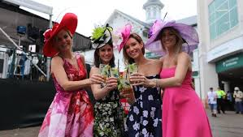
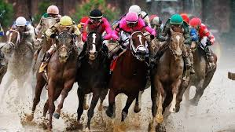
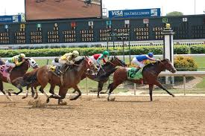
The Kentucky derby
One race in the “Triple Crown”
Louisville, KY
First weekend in May (usually)
Our interest: speed of winner

Slide 4
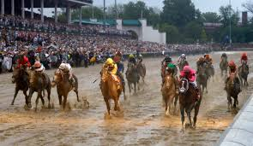
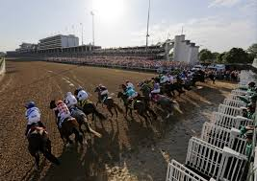
Derby Data: The Variables
Winning speed (feet per second)
Year race was run (1896 – 2017)
Condition of track: “fast,” “good” (good or dusty), “slow” (slow, heavy, muddy, or sloppy)
Number of starters

