Slide 1
Day 10
Read: Sections 4.1 – 4.10
(https://bookdown.org/roback/bookdown-BeyondMLR/)
Practice:
Conceptual Exercises: 11, 12, 13
Guided Exercises: 3, 5
Goals for today:
Adjust model for possible overdispersion (two methods)
Recognize when a Poisson response is possibly zero-inflated
Identify possible reasons for a zero-inflated Poisson
Fit and interpret a zero-inflated Poisson reg. model
Announcements
In-class Quiz 3 on Monday
Mini-project 2 due Friday by 4pm

Slide 2
Overdispersion
Means there is more variation in the response than the model allows for
Consequence: Standard Errors are likely too small
One solution (“Quasilikelihood): Add new “overdispersion” parameter $(φ)$ to model
“Adjust” standard errors
$$SE_{Q}\left({\hat{β}}_{i}\right)=\sqrt{\hat{φ}} ∗SE\left({\hat{β}}_{i}\right)$$

Slide 3
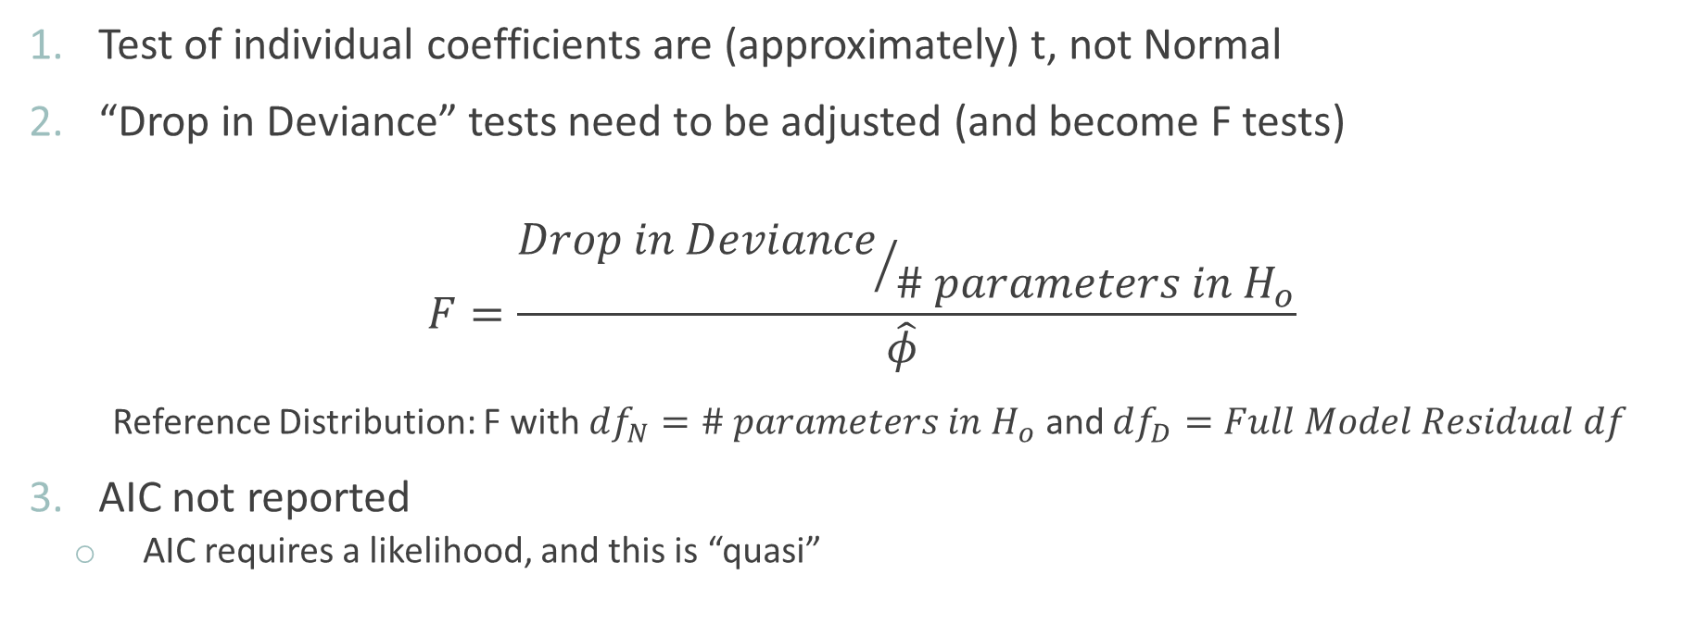
Implications of Using Quasilikelihood Approach
Test of individual coefficients are (approximately) t, not Normal
“Drop in Deviance” tests need to be adjusted (and become F tests)
$$F=\frac{{Drop in Deviance}/{\# parameters in H_{o}}}{\hat{φ} }$$
Reference Distribution: F with $df_{N}=\# parameters in H_{o}$ and $df_{D}=Full Model Residual df$
AIC not reported
AIC requires a likelihood, and this is “quasi”

Slide 4
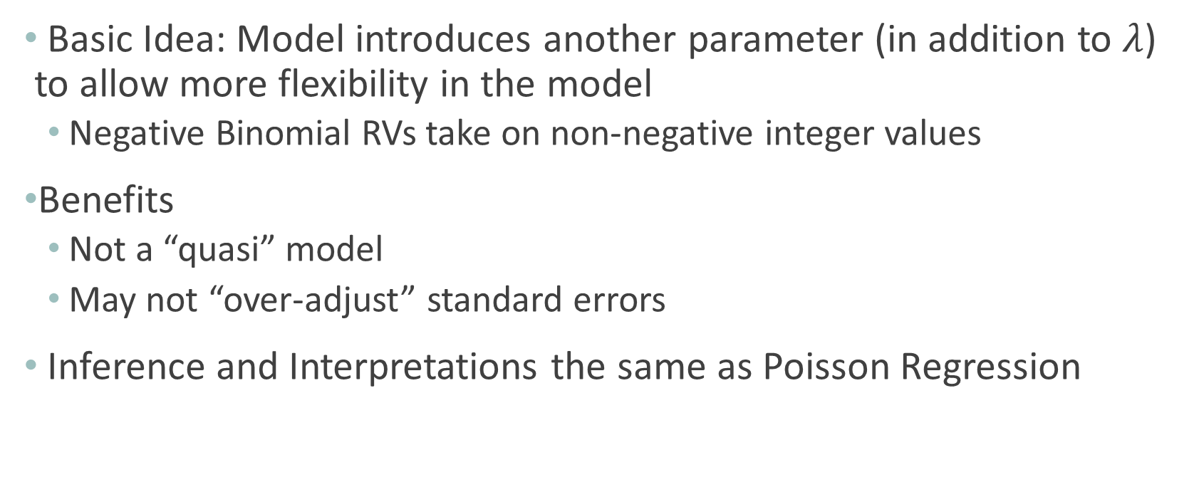
Adjusting for Overdispersion: Negative Binomial Model
Basic Idea: Model introduces another parameter (in addition to $λ$) to allow more flexibility in the model
Negative Binomial RVs take on non-negative integer values
Benefits
Not a “quasi” model
May not “over-adjust” standard errors
Inference and Interpretations the same as Poisson Regression

Slide 5
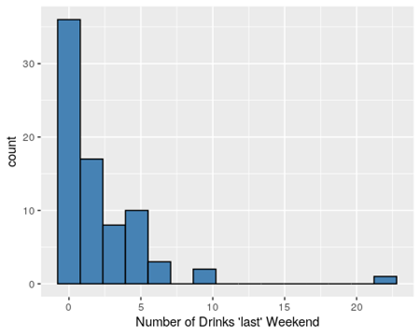
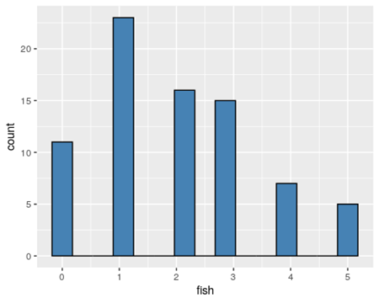
Zero-Inflated Poisson
ZIP = More observed “0” values than should occur in a true Poisson distribution
Creates overdispersion

Slide 6
ZIP Model (“Latent Variable Model”)
ZIP models takes into account that non-drinkers (0s) are of two types:
People who drink, but just happened to have 0 drinks “last weekend”
“Valid” counts for our Poisson model
Non-drinkers (will never drink) – “True Zeros”

Slide 7

ZIP Models
ZIP models have two parts
Models count data (# of drinks) using available predictors
Estimates proportion of 0s reported by non-drinkers (potentially based on predictors of not drinking)
Using Logistic Regression
$$α$$

Slide 8
Vuong Test
Can’t use a drop-in-deviance test to compare regular Poisson and ZIP models
Not nested models
Vuong test can be used to compare non-nested models

