Slide 1
Day 11 – ZIP and Logistic Regression
Read: Sections 6.1 – 6.4
(https://bookdown.org/roback/bookdown-bysh/)
Practice:
Conceptual Exercises: 1
Guided Exercises: 2, 3
Goals for today:
Finish ZIP Models
Identify when logistic regression is appropriate
Know model form
Exploratory data analysis for logistic regression
Fit logistic regression models
Announcements
Quiz 3 is today
Exam 1 is Wednesday, October 11

Slide 2
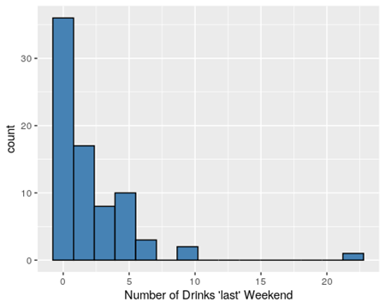
ZIP Models
ZIP models have two parts
Models count data (# of drinks) using available predictors
Estimates proportion of 0s reported by non-drinkers (potentially based on predictors of not drinking)
Using Logistic Regression
$$α$$

Slide 3
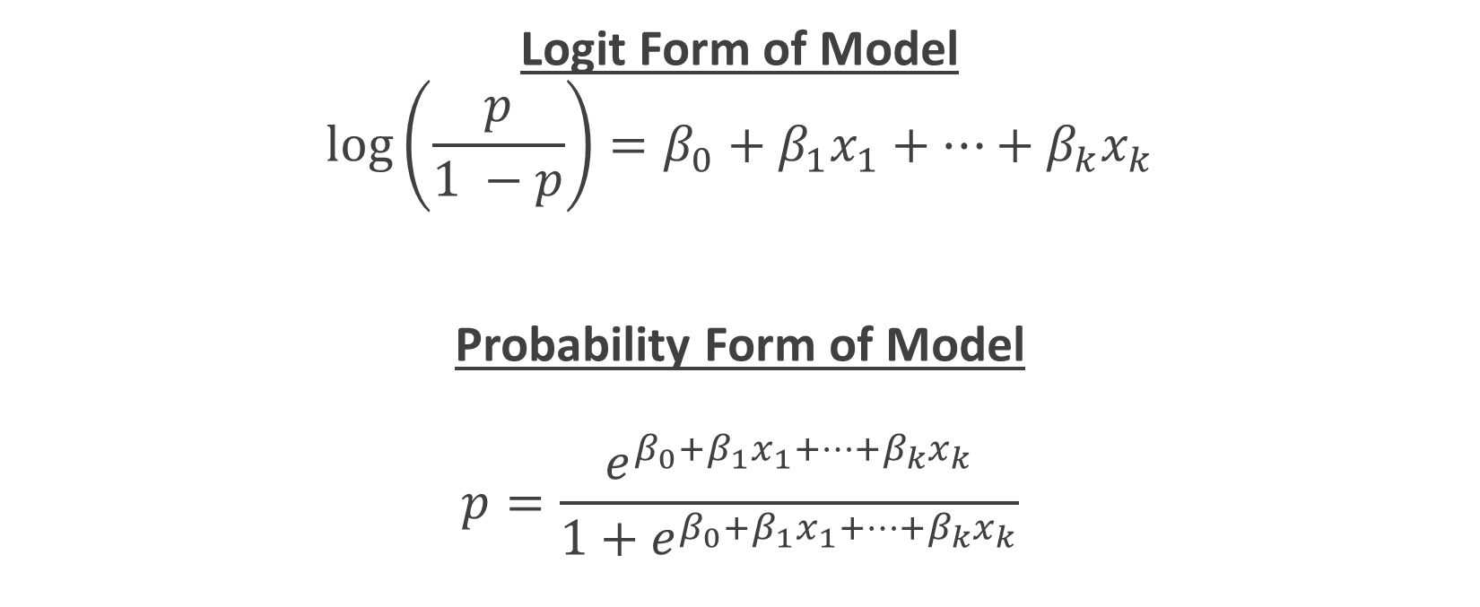
Logistic Regression: A GLM
Logit Form of Model
$$\log\left(\frac{p}{1 −p}\right)=β_{0}+β_{1}x_{1}+…+β_{k}x_{k}$$
Probability Form of Model
$$p=\frac{e^{β_{0}+β_{1}x_{1}+…+β_{k}x_{k}}}{1+e^{β_{0}+β_{1}x_{1}+…+β_{k}x_{k}}}$$

Slide 4

Logistic Regression Model Assumptions
Binary Response
Response is dichotomous (two possible responses)
Independence of Responses
Variance Structure
Variance of a Binomial RV is $np(1−p)$
Linearity
Log odds are linearly related to predictors

Slide 5
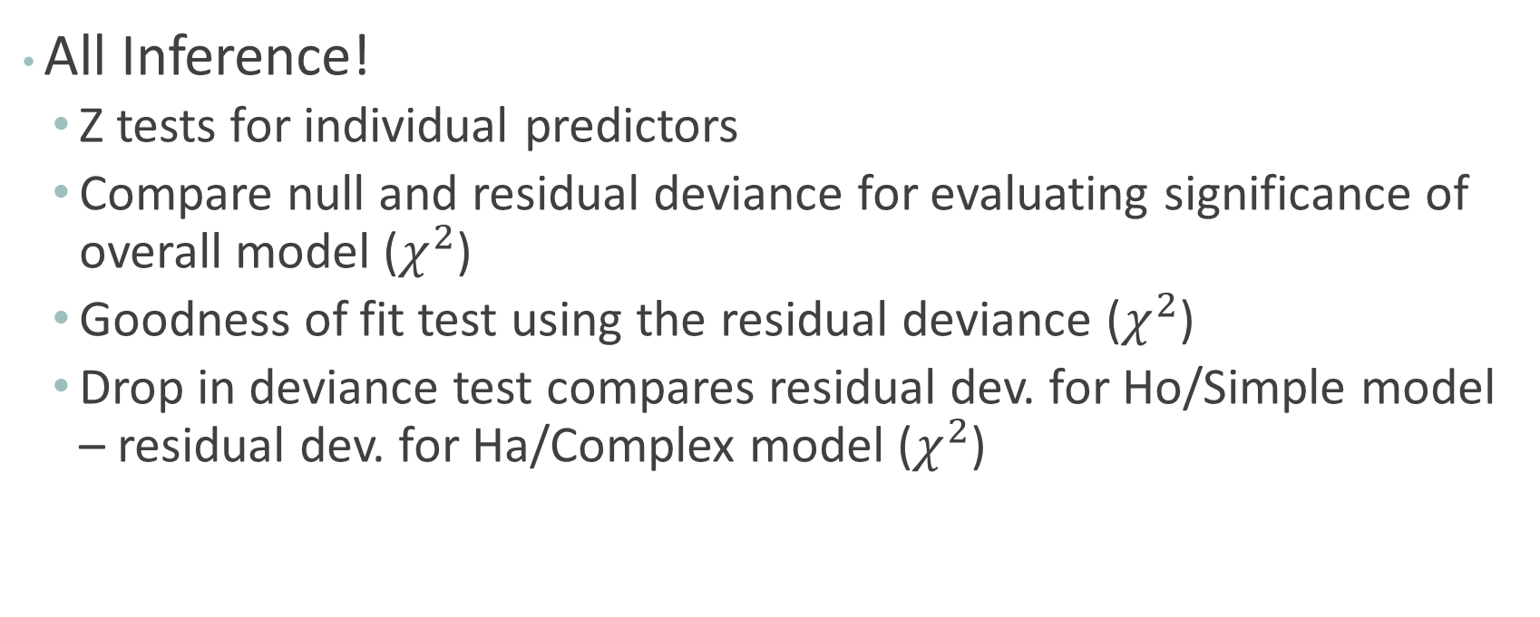
Logistic and Poisson: What’s the same?
All Inference!
Z tests for individual predictors
Compare null and residual deviance for evaluating significance of overall model ($χ^{2}$)
Goodness of fit test using the residual deviance ($χ^{2}$)
Drop in deviance test compares residual dev. for Ho/Simple model – residual dev. for Ha/Complex model ($χ^{2}$)

Slide 6
Testing Individual Coefficients
Is an individual predictor useful in the current model?
Test Statistic
p-value
In the R output
P-value = 2P( Z > |t.s.| )

Slide 7
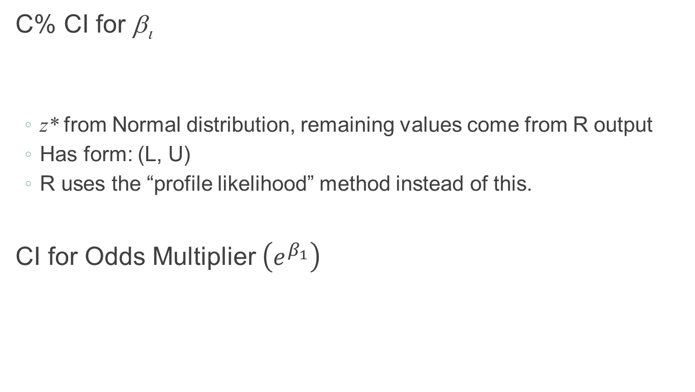
Confidence Interval for Coefficients
C% CI for β_{ι}
z* from Normal distribution, remaining values come from R output
Has form: (L, U)
R uses the “profile likelihood” method instead of this.
CI for Odds Multiplier $\left(e^{β_{1}}\right)$

Slide 8
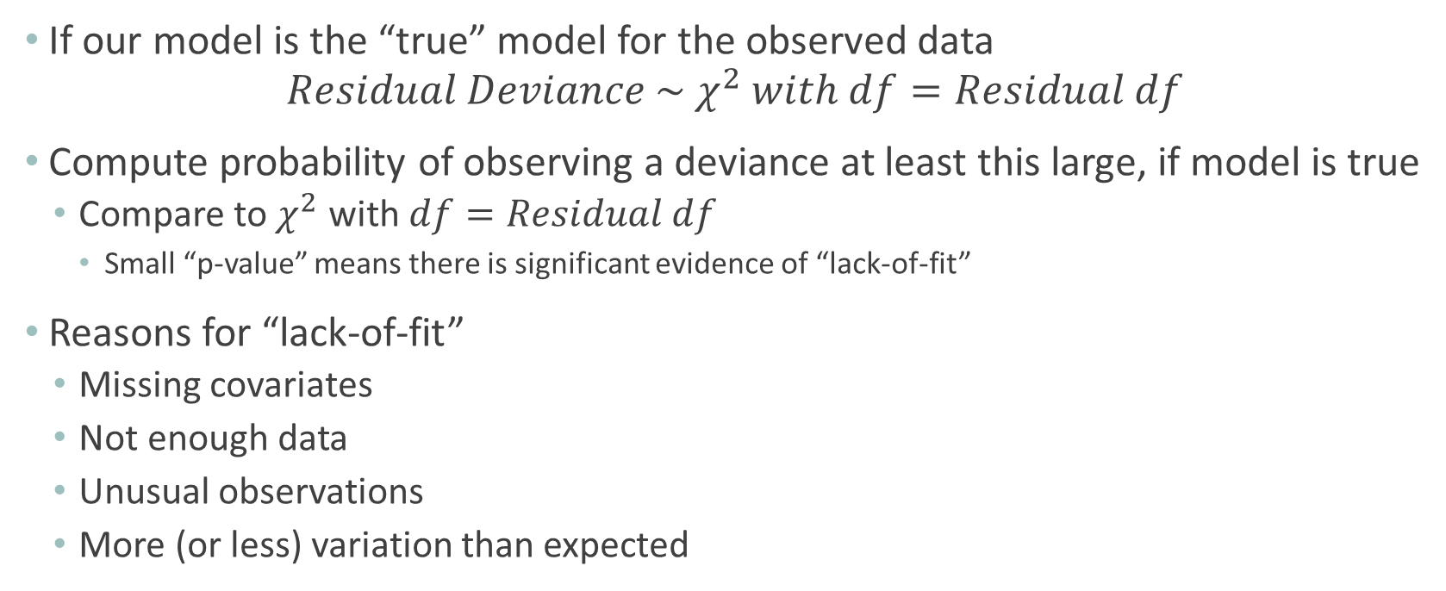
Model Goodness of Fit
If our model is the “true” model for the observed data
$$Residual Deviance \sim χ^{2} with df=Residual df$$
Compute probability of observing a deviance at least this large, if model is true
Compare to $χ^{2}$ with $df=Residual df$
Small “p-value” means there is significant evidence of “lack-of-fit”
Reasons for “lack-of-fit”
Missing covariates
Not enough data
Unusual observations
More (or less) variation than expected

Slide 9
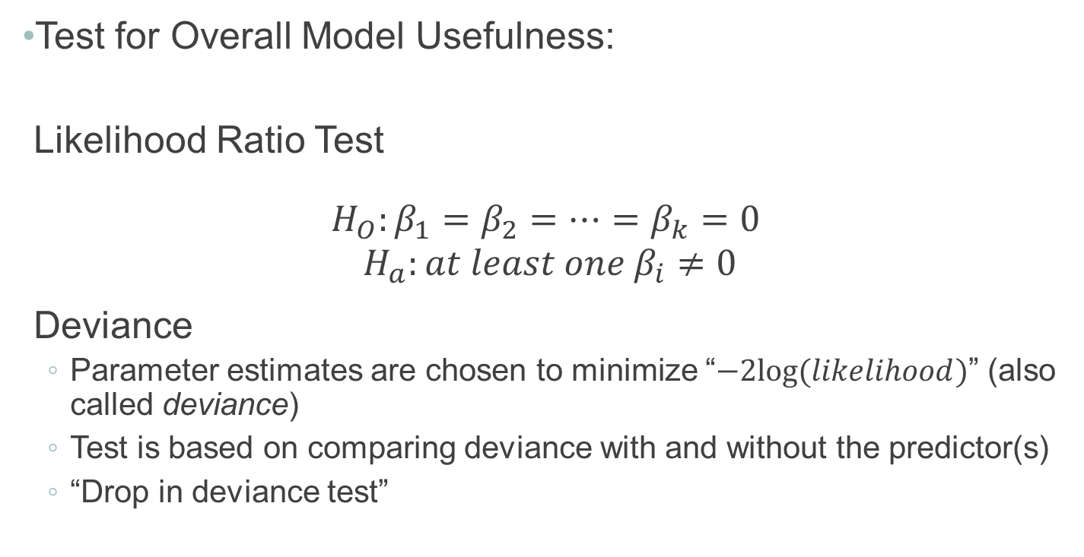
Evaluating Overall Model Utility
Test for Overall Model Usefulness:
Likelihood Ratio Test
$$H_{O}:β_{1}=β_{2}=…=β_{k}=0$$
$$H_{a}:at least one{ β}_{i}≠0$$
Deviance
Parameter estimates are chosen to minimize “$−2log⁡(likelihood)$” (also called deviance)
Test is based on comparing deviance with and without the predictor(s)
“Drop in deviance test”

Slide 10
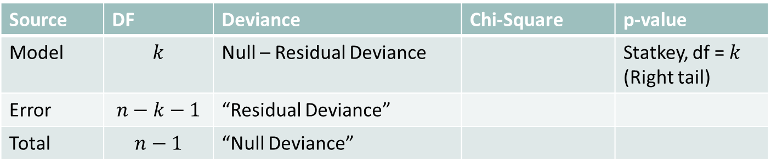
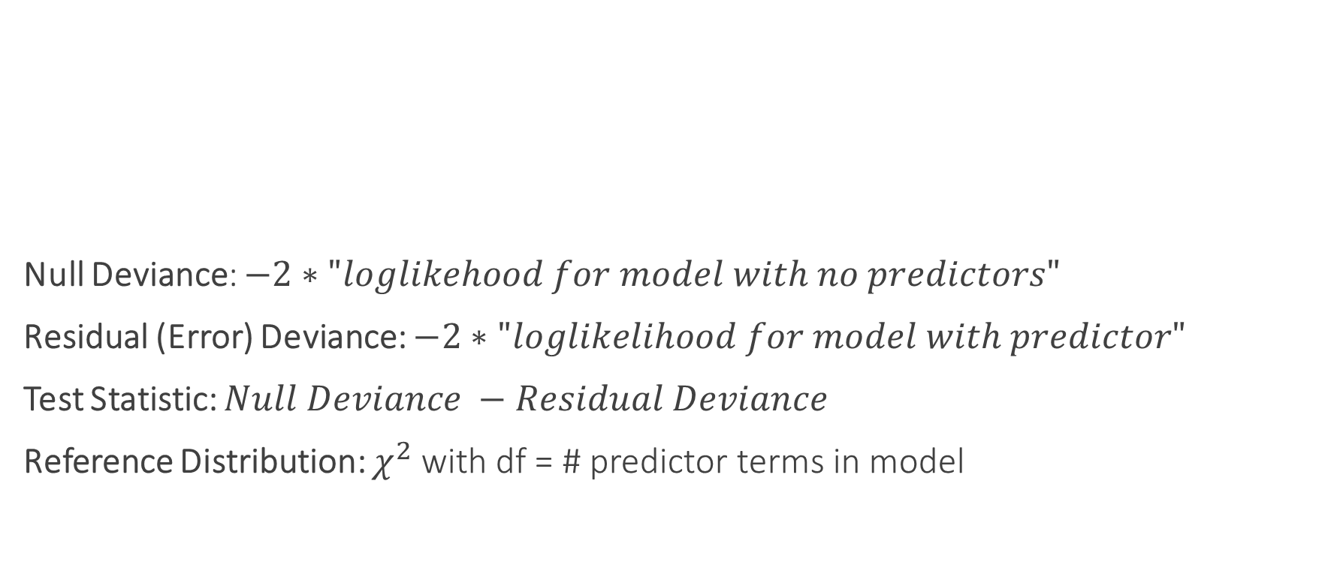
Evaluating Overall Model Utility
Null Deviance: $−2∗"loglikehood for model with no predictors"$
Residual (Error) Deviance: $−2∗"loglikelihood for model with predictor"$
Test Statistic: $Null Deviance −Residual Deviance$
Reference Distribution: $χ^{2}$ with df = # predictor terms in model
Source | DF | Deviance | Chi-Square | p-value
Model | $$k$$ | Null – Residual Deviance |  | Statkey, df = $k$ (Right tail)
Error | $$n−k−1$$ | “Residual Deviance”
Total | $$n−1$$ | “Null Deviance”

Slide 11
Evaluating Subsets of Predictors
Recall: Two models are nested if one model contains all the terms of the second model and at least one additional term

Slide 12
Nested Likelihood Ratio Test (LRT)
$$Test Stat= \\ Residual Deviance for Simple Model \left(H_{o}\right)−Residual Deviance for Complex Model (H_{a})$$
P-value: Compare test statistic to $χ_{df}^{2}$ (right tail)
Also called the “drop-in-deviance” test (dropping to the reduced model)

