Slide 1
Day 17 – Multilevel Models
Read: Sections 8.1 – 8.5
(https://bookdown.org/roback/bookdown-bysh/)
Practice:
Conceptual Exercises: 1, 7
Goals for today:
Recognize when response variables and covariates have been collected at multiple levels
Write out a multilevel statistical model, including assumptions about variance components
Interpret model parameters (fixed effects and variance components)
Announcements
Be prepared for a Quiz on Monday

Slide 2
Case Study: Music Performance Anxiety
A 2010 study examined emotional state of musicians before performances and investigated factors that might impact emotional state
Design:
37 undergraduates from a competitive undergrad music program
Subjects completed diaries prior to performances over course of an academic year
Included a Positive Affect Negative Affect Schedule (PANAS) before each performance
Most subjects completed 12 – 15 diaries

Slide 3
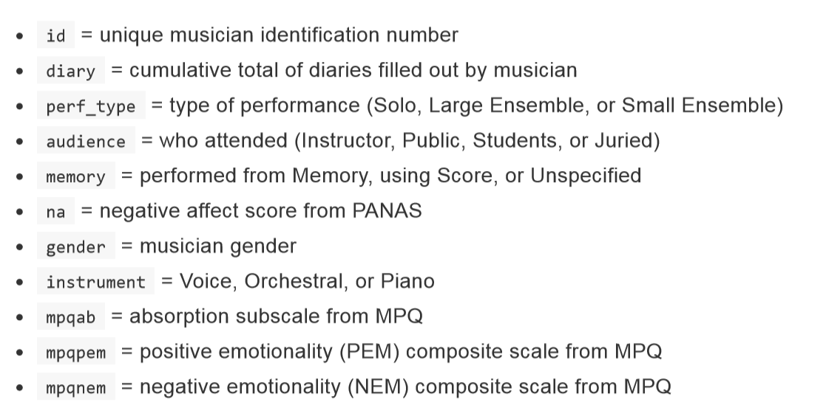
Music Data: Key Variables

Slide 4
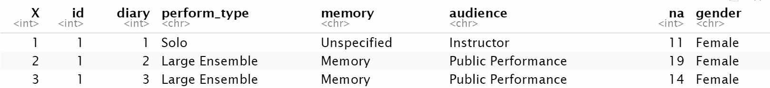
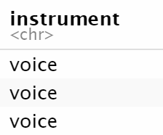
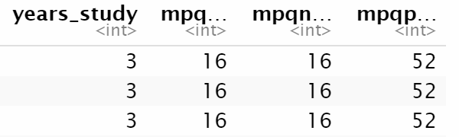
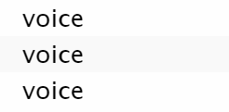
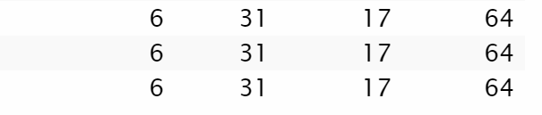
In your neighborhoods
Task:
Identify response variable
Identify Level One observational units
Identify Level Two observational units
Identify Level One covariates
Identify Level Two covariates

Slide 5
Multilevel Modeling: Basic Idea
There is some overall/underlying relationship between negative affect and number of previous performances
Each individual differs from the “overall” by their own random amount

Slide 6
Multilevel Modeling: Basic Idea
There is some overall/underlying relationship between negative affect and number of previous performances
Each individual differs from the “overall” by their own random amount

Slide 7
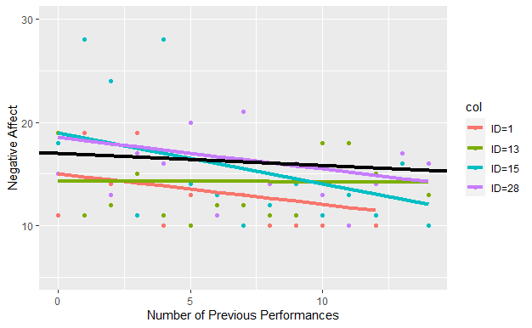
Model Visualization
What looks more different: slopes for individuals or intercepts for individuals?

Slide 8
Model Visualization

Slide 9




Music Data: Data Structure
Level Two Observational Units:
Musicians
Level Two Covariates:
Age, Gender, Experience,
NEM, PEM, Absorption
Response is Negative Affect
Level One Observational Units:
Diaries (performances)
Level One Covariates:
Memory?, Audience, Performance Type

