Slide 1
Day 7
Read: Sections 4.1 – 4.5
(https://bookdown.org/roback/bookdown-BeyondMLR/)
Practice:
Conceptual Exercises: 1-5, 8, 9
Guided Exercises: 2a-g
Goals for today:
Recognize when to use Poisson regression
Write out a Poisson regression model
Fit a Poisson regression model
Interpret output from a Poisson regression model
Conduct basic inference for a Poisson regression model
Announcements
Mini-project 2 assigned soon (FYI, still working on grading MP1)

Slide 2
Poisson Regression

Slide 3
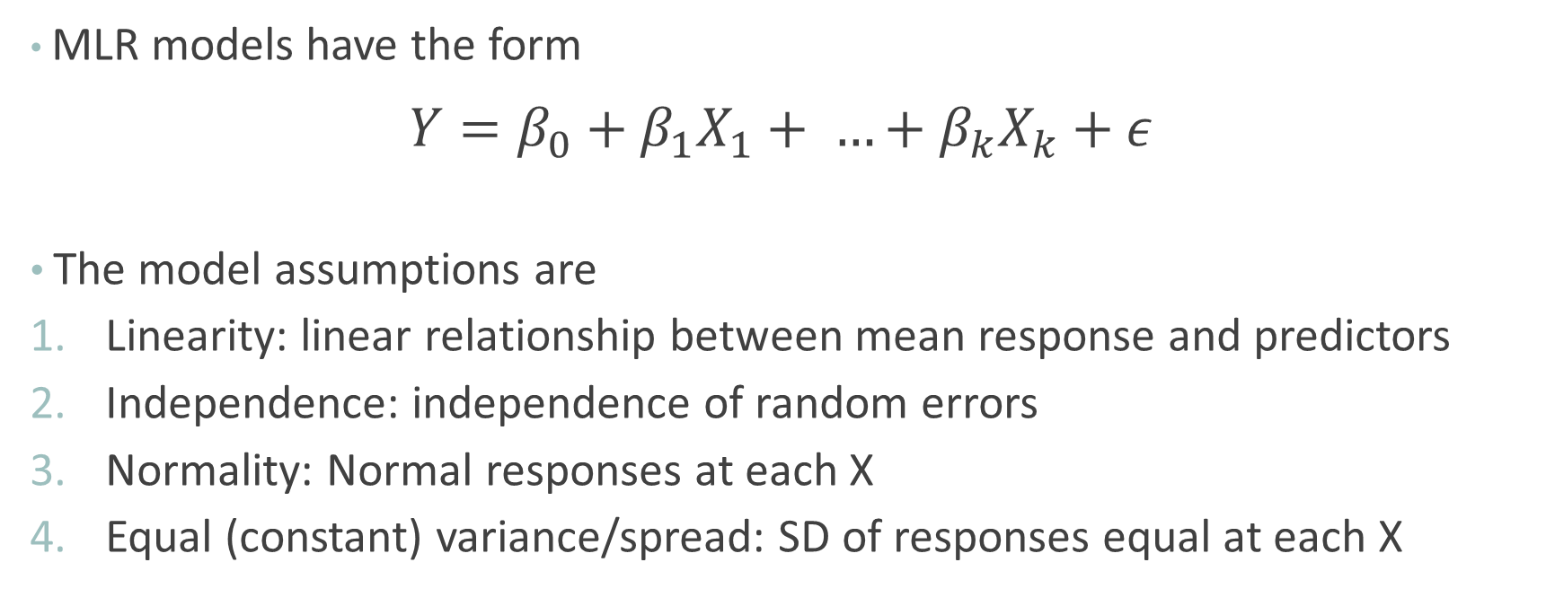
Recall: Multiple Linear Regression
MLR models have the form $Y=β_{0}+β_{1}X_{1}+ …+β_{k}X_{k}+ε$
The model assumptions are
Linearity: linear relationship between mean response and predictors
Independence: independence of random errors
Normality: Normal responses at each X
Equal (constant) variance/spread: SD of responses equal at each X

Slide 4
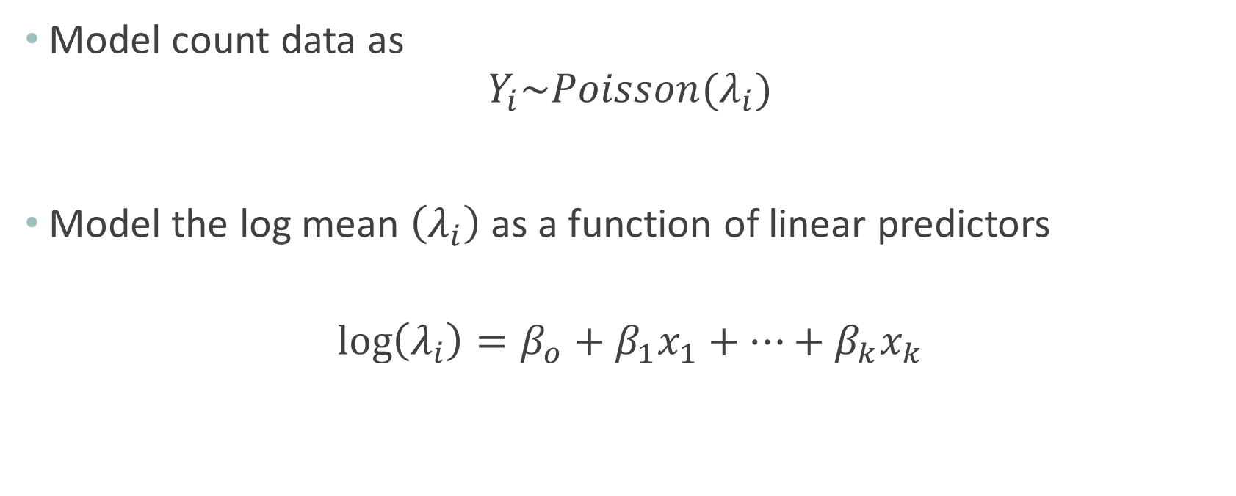
Poisson Regression Model
Model count data as
$$Y_{i}\sim Poisson(λ_{i})$$
Model the log mean $\left(λ_{i}\right)$ as a function of linear predictors
$$\log\left(λ_{i}\right)=β_{o}+β_{1}x_{1}+…+β_{k}x_{k}$$
What do we know about the mean of a Poisson?
Why can’t we use a line to model the mean response?

Slide 5
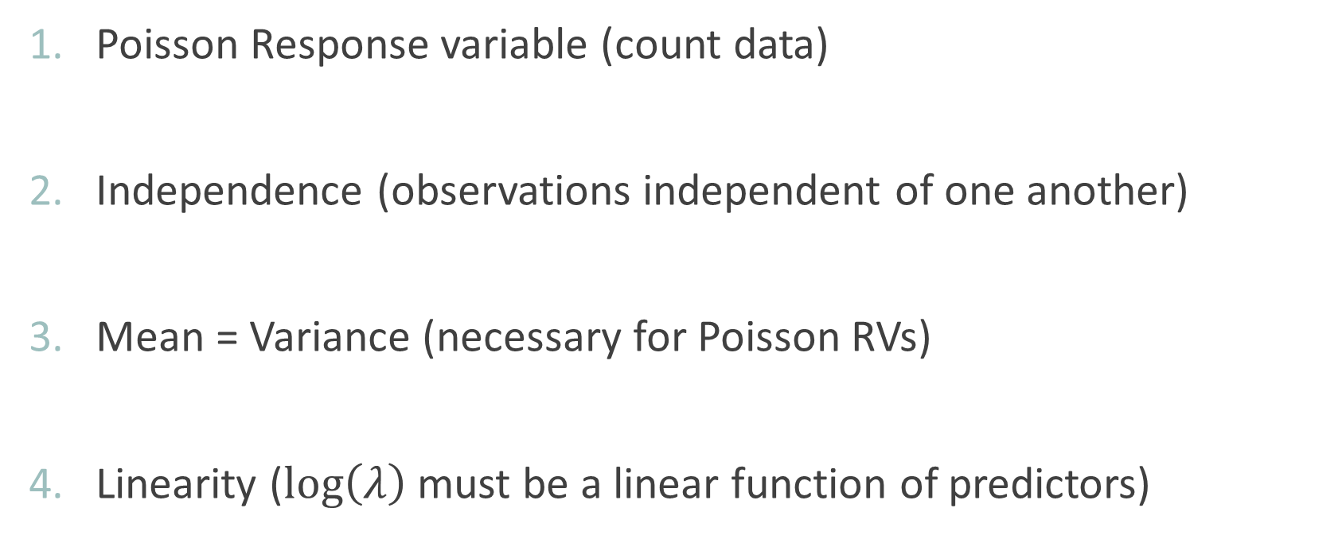
Poisson Regression Model Assumptions
Poisson Response variable (count data)
Independence (observations independent of one another)
Mean = Variance (necessary for Poisson RVs)
Linearity ($\log\left(λ\right)$ must be a linear function of predictors)

Slide 6
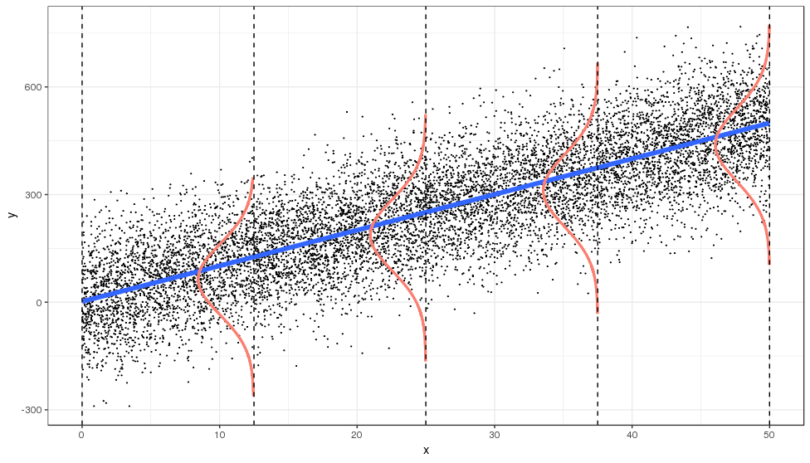
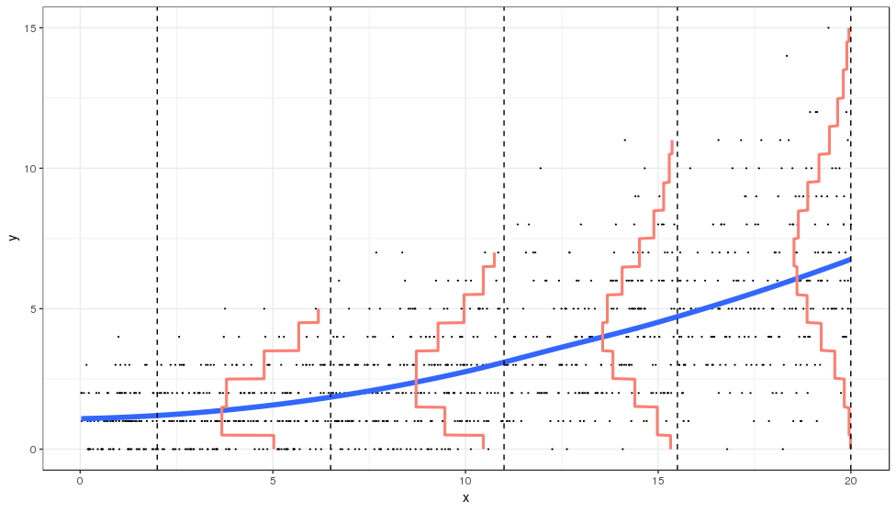
Least Squares vs Poisson Regression

Slide 7

Case Study 1: Philippines Household Data
Research Goal: Model number of people per house in Philippines

Slide 8
Testing Individual Coefficients
Is an individual predictor useful in the current model?
Test Statistic
p-value
In the R output
P-value = 2P( Z > |t.s.| )

Slide 9

Interpreting Coefficients
One unit change in x-variable changes the (predicted) log-mean response by the slope.
CI for Relative Risk $\left(e^{β_{1}}\right)$

Slide 10
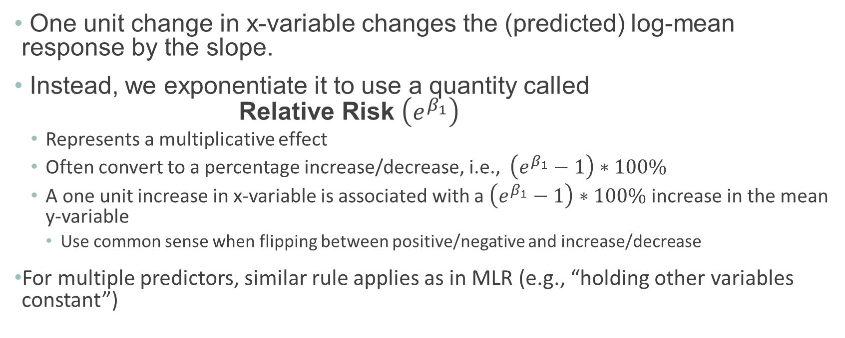
Interpreting Coefficients
One unit change in x-variable changes the (predicted) log-mean response by the slope.
Instead, we exponentiate it to use a quantity called Relative Risk $\left(e^{β_{1}}\right)$
Represents a multiplicative effect
Often convert to a percentage increase/decrease, i.e., $\left(e^{β_{1}}−1\right)∗100\%$
A one unit increase in x-variable is associated with a $\left(e^{β_{1}}−1\right)∗100\%$ increase in the mean y-variable
Use common sense when flipping between positive/negative and increase/decrease
For multiple predictors, similar rule applies as in MLR (e.g., “holding other variables constant”)

Slide 11
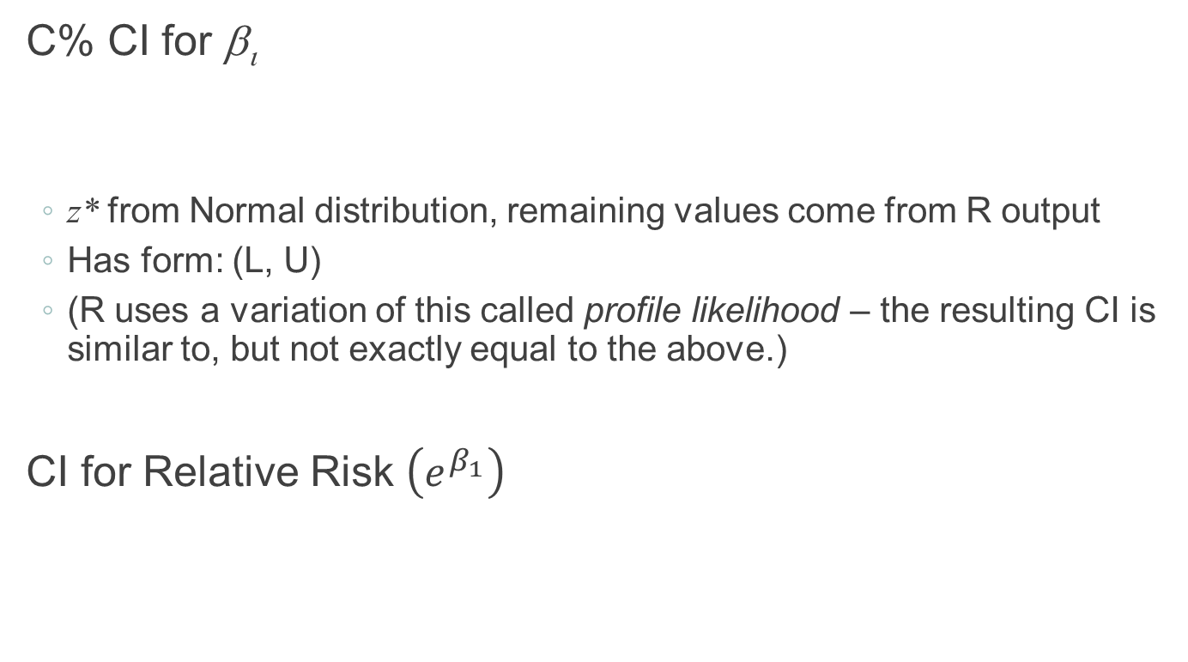
Confidence Interval for Coefficients
C% CI for β_{ι}
z* from Normal distribution, remaining values come from R output
Has form: (L, U)
(R uses a variation of this called profile likelihood – the resulting CI is similar to, but not exactly equal to the above.)
CI for Relative Risk $\left(e^{β_{1}}\right)$

Slide 12
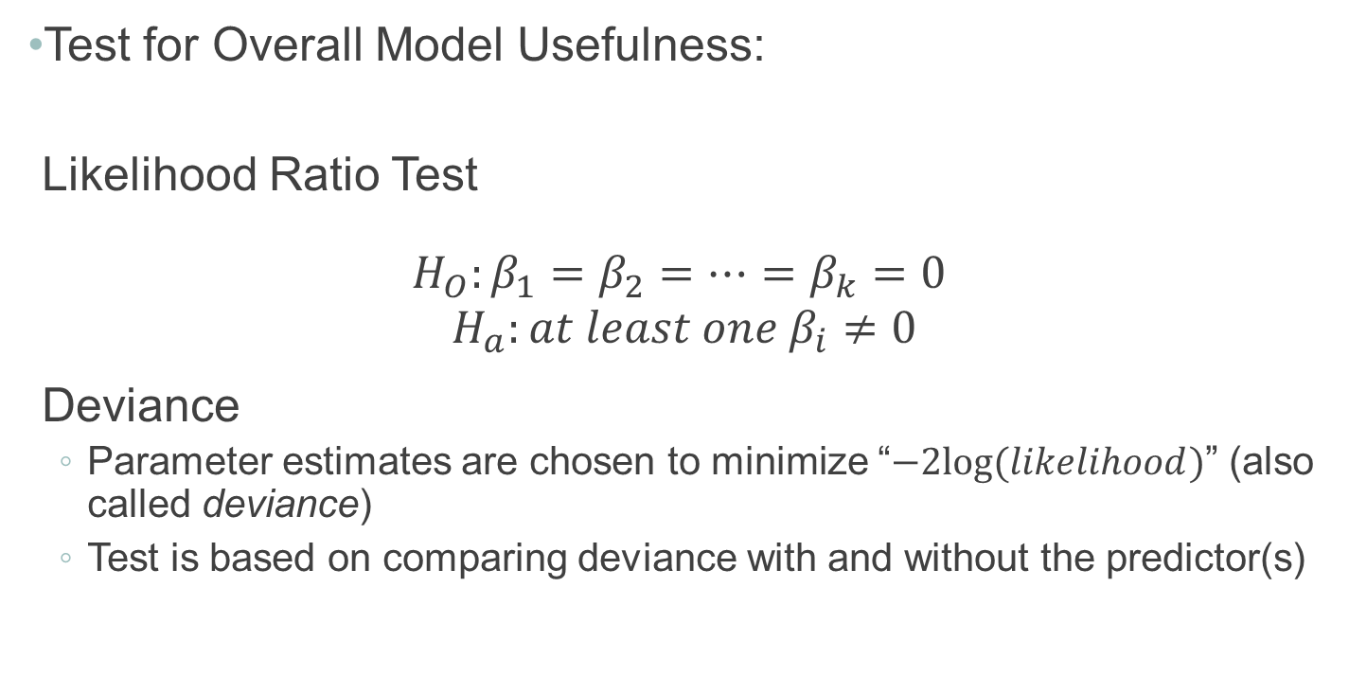
Evaluating Overall Model Utility
Test for Overall Model Usefulness:
Likelihood Ratio Test
$$H_{O}:β_{1}=β_{2}=…=β_{k}=0$$
$$H_{a}:at least one{ β}_{i}≠0$$
Deviance
Parameter estimates are chosen to minimize “$−2log⁡(likelihood)$” (also called deviance)
Test is based on comparing deviance with and without the predictor(s)

Slide 13
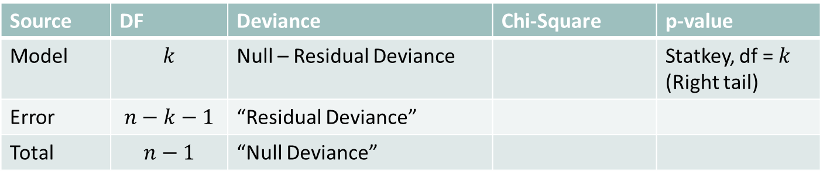
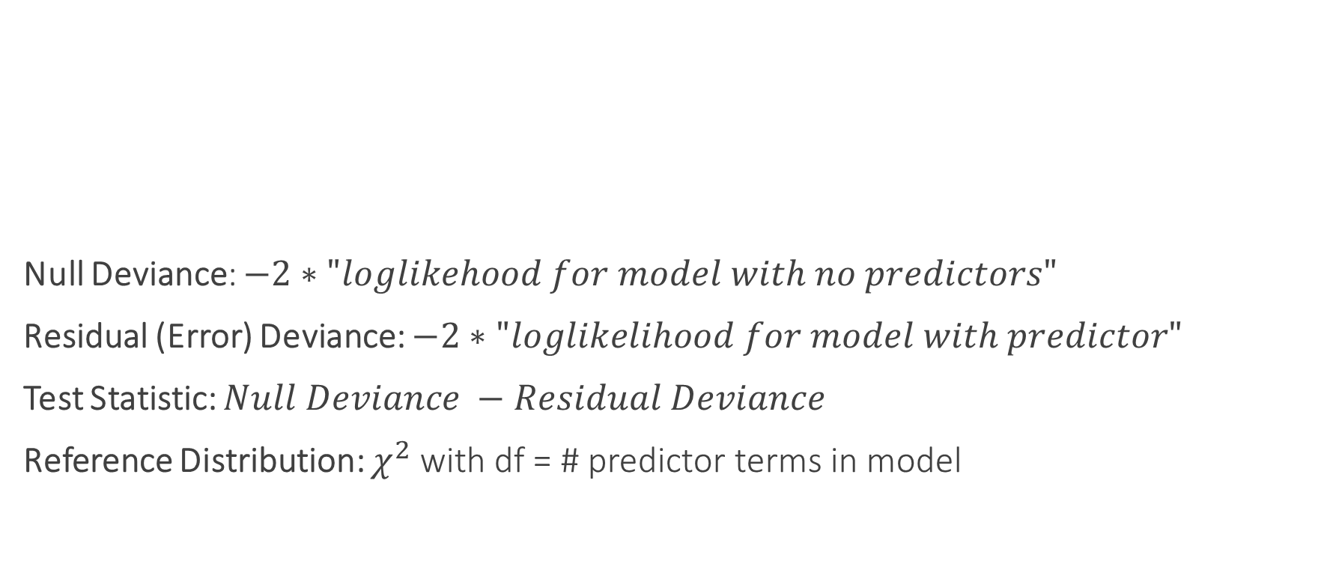
Evaluating Overall Model Utility
Null Deviance: $−2∗"loglikehood for model with no predictors"$
Residual (Error) Deviance: $−2∗"loglikelihood for model with predictor"$
Test Statistic: $Null Deviance −Residual Deviance$
Reference Distribution: $χ^{2}$ with df = # predictor terms in model
Source | DF | Deviance | Chi-Square | p-value
Model | $$k$$ | Null – Residual Deviance |  | Statkey, df = $k$ (Right tail)
Error | $$n−k−1$$ | “Residual Deviance”
Total | $$n−1$$ | “Null Deviance”

Slide 14
Evaluating Subsets of Predictors
Recall: Two models are nested if one model contains all the terms of the second model and at least one additional term

Slide 15
Nested Likelihood Ratio Test (LRT)
P-value: Compare test statistic to $χ_{df}^{2}$ (right tail)
Also called the “drop-in-deviance” test (dropping to the reduced model)

