Slide 1
Day 21 – More Multilevel Models
Read: Sections 8.1 – 8.5
(https://bookdown.org/roback/bookdown-bysh/)
Practice:
Expect weekly “prep tasks”
Late policy?
Goals for today:
Write out a multilevel statistical model (using predictors at both levels), including assumptions about variance components
Interpret model parameters (fixed effects and variance components)
Use AIC, BIC, and Likelihood Ratio Tests to compare models
Announcements
Quiz next week
Exam 2 will be Thursday evening after Thanksgiving break (Nov 30)
Currently planning to have class on Wed Nov 29 (but not on Dec 6)

Slide 2
REML vs ML
REML (Restricted Maximum Likelihood) gives “better estimates” but likelihood values are only comparable between models with the same covariance structure
Can’t really compare models with different fixed effects
REML is a good choice when you have an intended model form
ML (Maximum Likelihood) can give biased estimated for variance components, but uses real likelihoods
AIC/BIC can be used whether or not models are nested
Both dependent on likelihoods, so must use REML=F in lmer
ML is a good choice when you need to compare models

Slide 3
Model Comparisons
For nested models, use a likelihood ratio test to see if the addition of the extra predictors significantly improves the model
AIC/BIC can be used whether or not models are nested
Both dependent on likelihoods, so must use Maximum Likelihood (i.e. use REML = FALSE in your lmer)

Slide 4
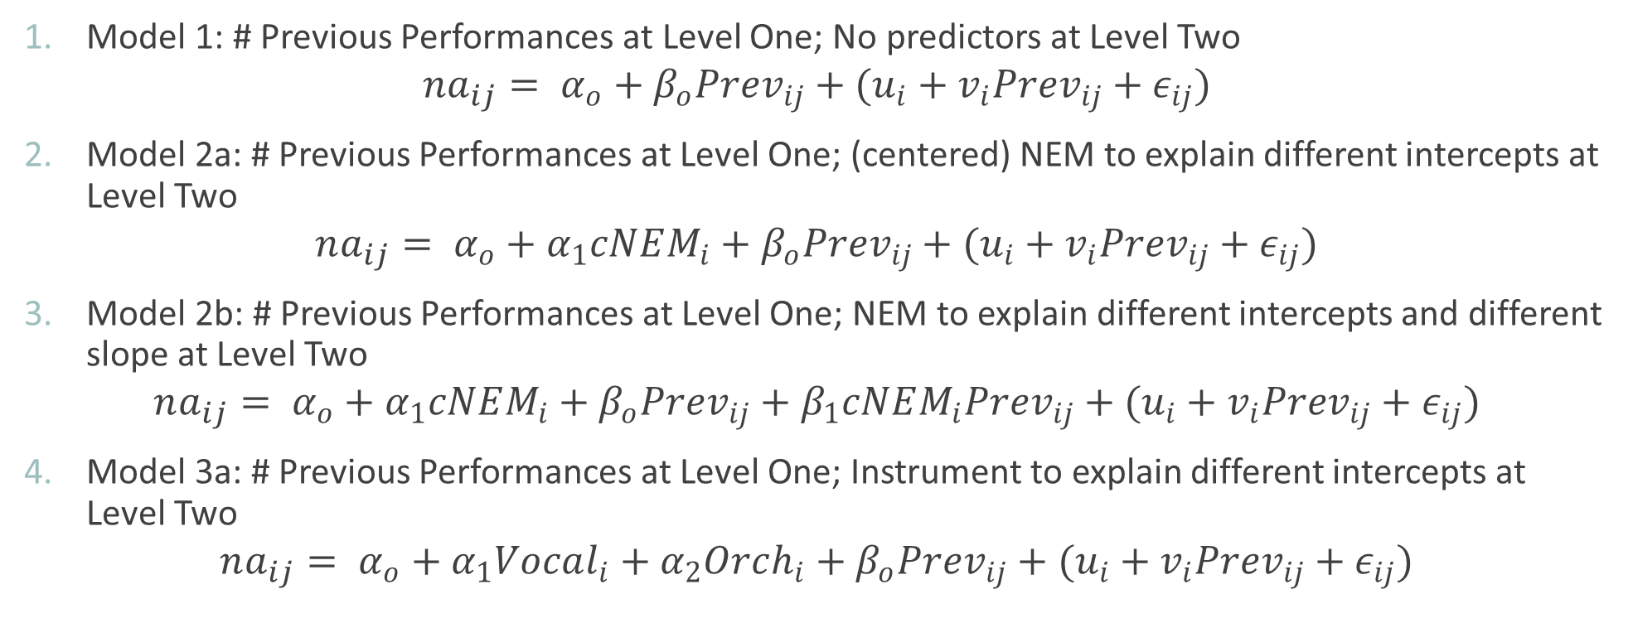
Negative Affect Models So Far (All have same variance components!)
Model 1: # Previous Performances at Level One; No predictors at Level Two
$$na_{ij}= α_{o}+β_{o}Prev_{ij}+(u_{i}+v_{i}Prev_{ij}+ε_{ij})$$
Model 2a: # Previous Performances at Level One; (centered) NEM to explain different intercepts at Level Two
$$na_{ij}= α_{o}+α_{1}cNEM_{i}+β_{o}Prev_{ij}+(u_{i}+v_{i}Prev_{ij}+ε_{ij})$$
Model 2b: # Previous Performances at Level One; NEM to explain different intercepts and different slope at Level Two
$$na_{ij}= α_{o}+α_{1}cNEM_{i}+β_{o}Prev_{ij}+β_{1}cNEM_{i}Prev_{ij}+(u_{i}+v_{i}Prev_{ij}+ε_{ij})$$
Model 3a: # Previous Performances at Level One; Instrument to explain different intercepts at Level Two
$$na_{ij}= α_{o}+α_{1}Vocal_{i}+α_{2}Orch_{i}+β_{o}Prev_{ij}+(u_{i}+v_{i}Prev_{ij}+ε_{ij})$$

Slide 5
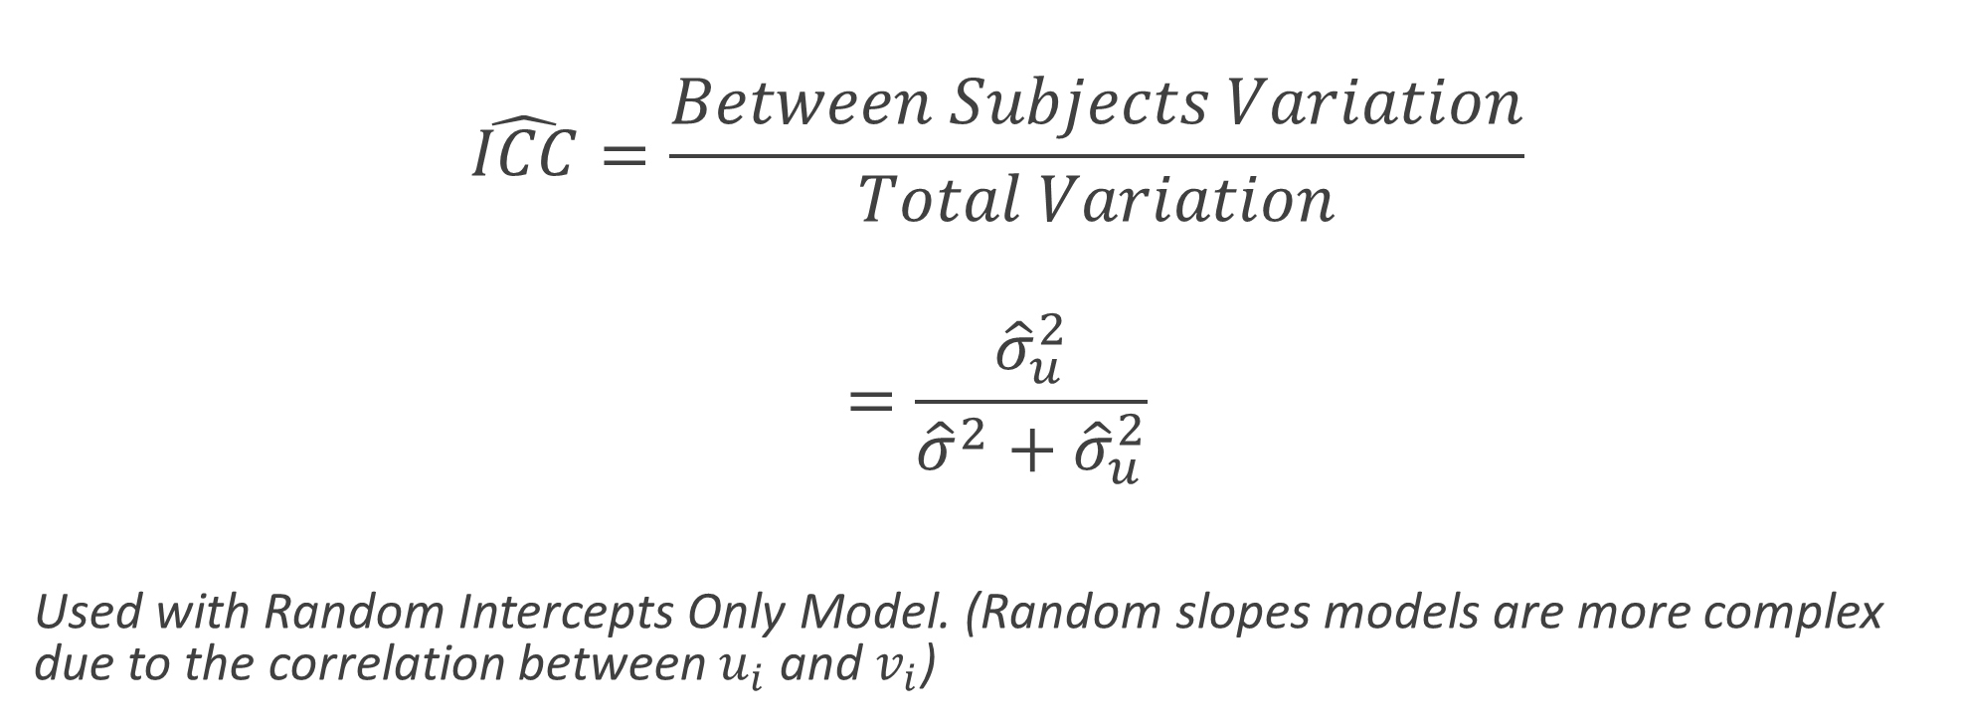
Intraclass Correlation (Comparing Sources of Variation)
$$\hat{ICC}=\frac{Between Subjects Variation}{Total Variation}$$
$$=\frac{{\hat{σ}}_{u}^{2}}{{\hat{σ}}^{2}+{\hat{σ}}_{u}^{2}}$$
Used with Random Intercepts Only Model. (Random slopes models are more complex due to the correlation between $u_{i}$ and $v_{i}$)

Slide 6
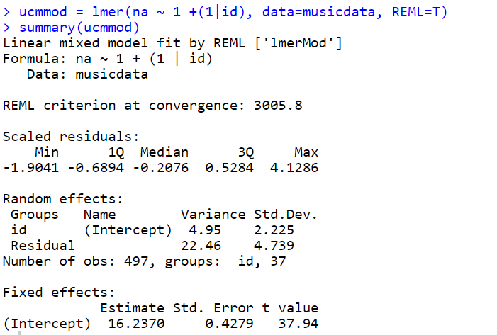

Slide 7
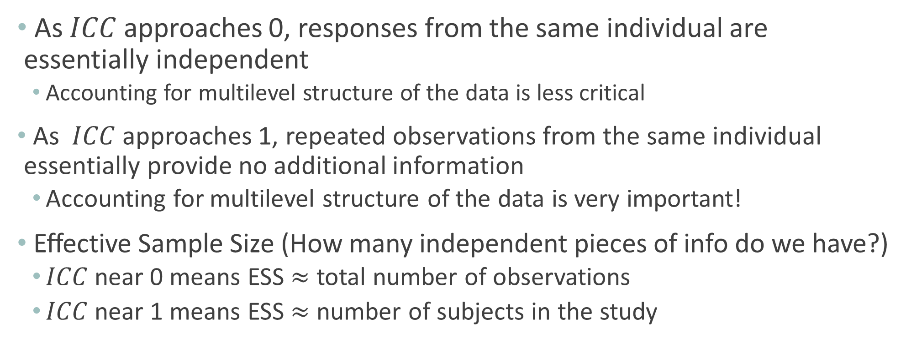
Intraclass Correlation and Effective Sample Size
As $ICC$ approaches 0, responses from the same individual are essentially independent
Accounting for multilevel structure of the data is less critical
As $ICC$ approaches 1, repeated observations from the same individual essentially provide no additional information
Accounting for multilevel structure of the data is very important!
Effective Sample Size (How many independent pieces of info do we have?)
$ICC$ near 0 means ESS $≈$ total number of observations
$ICC$ near 1 means ESS $≈$ number of subjects in the study

Slide 8
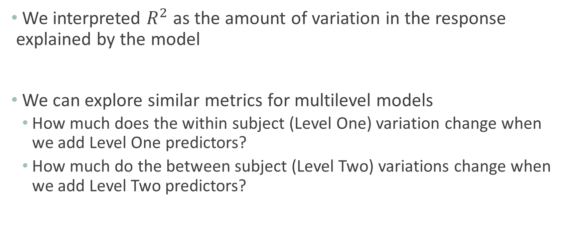
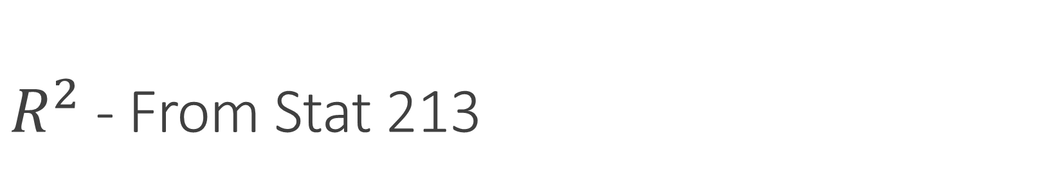
$R^{2}$ - From Stat 213
We interpreted $R^{2}$ as the amount of variation in the response explained by the model
We can explore similar metrics for multilevel models
How much does the within subject (Level One) variation change when we add Level One predictors?
How much do the between subject (Level Two) variations change when we add Level Two predictors?

Slide 9
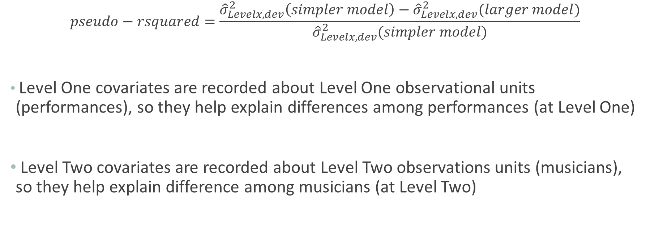
Pseudo-rsquared
$$pseudo−rsquared=\frac{{\hat{σ}}_{Levelx, dev}^{2}\left(simpler model\right)−{\hat{σ}}_{Levelx, dev}^{2}(larger model)}{{\hat{σ}}_{Levelx, dev}^{2}(simpler model)}$$
Level One covariates are recorded about Level One observational units (performances), so they help explain differences among performances (at Level One)
Level Two covariates are recorded about Level Two observations units (musicians), so they help explain difference among musicians (at Level Two)
Caution: Pseudo-$R^{2}$ values are not universally reliable as measures of model performance

Slide 10
Choosing a Final Model
Typical features of a "final multilevel model" include:
- fixed effects allow one to address primary research questions
- fixed effects control for important covariates at all levels
- potential interactions have been investigated
- variables are centered where interpretations can be enhanced
- important variance components have been included
- unnecessary terms have been removed
- the model tells a "persuasive story parsimoniously"

