Slide 1
Day 3
Read: Chapter 2 of Legler and Roback
(https://bookdown.org/roback/bookdown-bysh/)
Practice:
Conceptual Exercises: 1, 2
Guided Exercises: 2, 3
Goals for today:
Understand likelihood functions
Derive a likelihood function using intuitive approach from class
Identify 3 ways to find MLEs
Use methods from class to find MLEs for intuitive likelihood functions
Use likelihood functions to compare models
Announcements
Mini-Project 1 is due Friday, September 8
Quiz 1 is Monday, September 4 (on Stat 213 review)

Slide 2
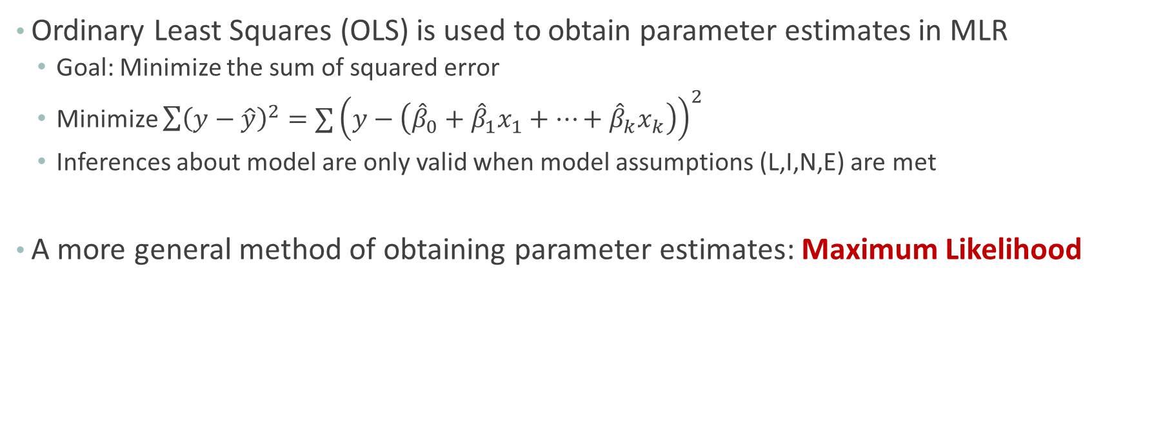
Motivation
Ordinary Least Squares (OLS) is used to obtain parameter estimates in MLR
Goal: Minimize the sum of squared error
Minimize $\sum{{\left(y−\hat{y}\right)}^{2}}=∑{\left(y−\left({\hat{β}}_{0}+{\hat{β}}_{1}x_{1}+…+{\hat{β}}_{k}x_{k}\right)\right)}^{2}$
Inferences about model are only valid when model assumptions (L,I,N,E) are met
A more general method of obtaining parameter estimates: Maximum Likelihood

Slide 3
Definition
Likelihood Function
For a given model form and set of observed data, tells us how “likely” different parameter values are
In contrast:
With a probability function, the probability is known and is used to determine the chance of an outcome (data are not observed)

Slide 4
Questions about Family Composition
Is it really the case that each child a couple produces is equally likely to be a boy or girl?
Or does sex “run in families”?
Do couple “wait” for a boy?

Slide 5
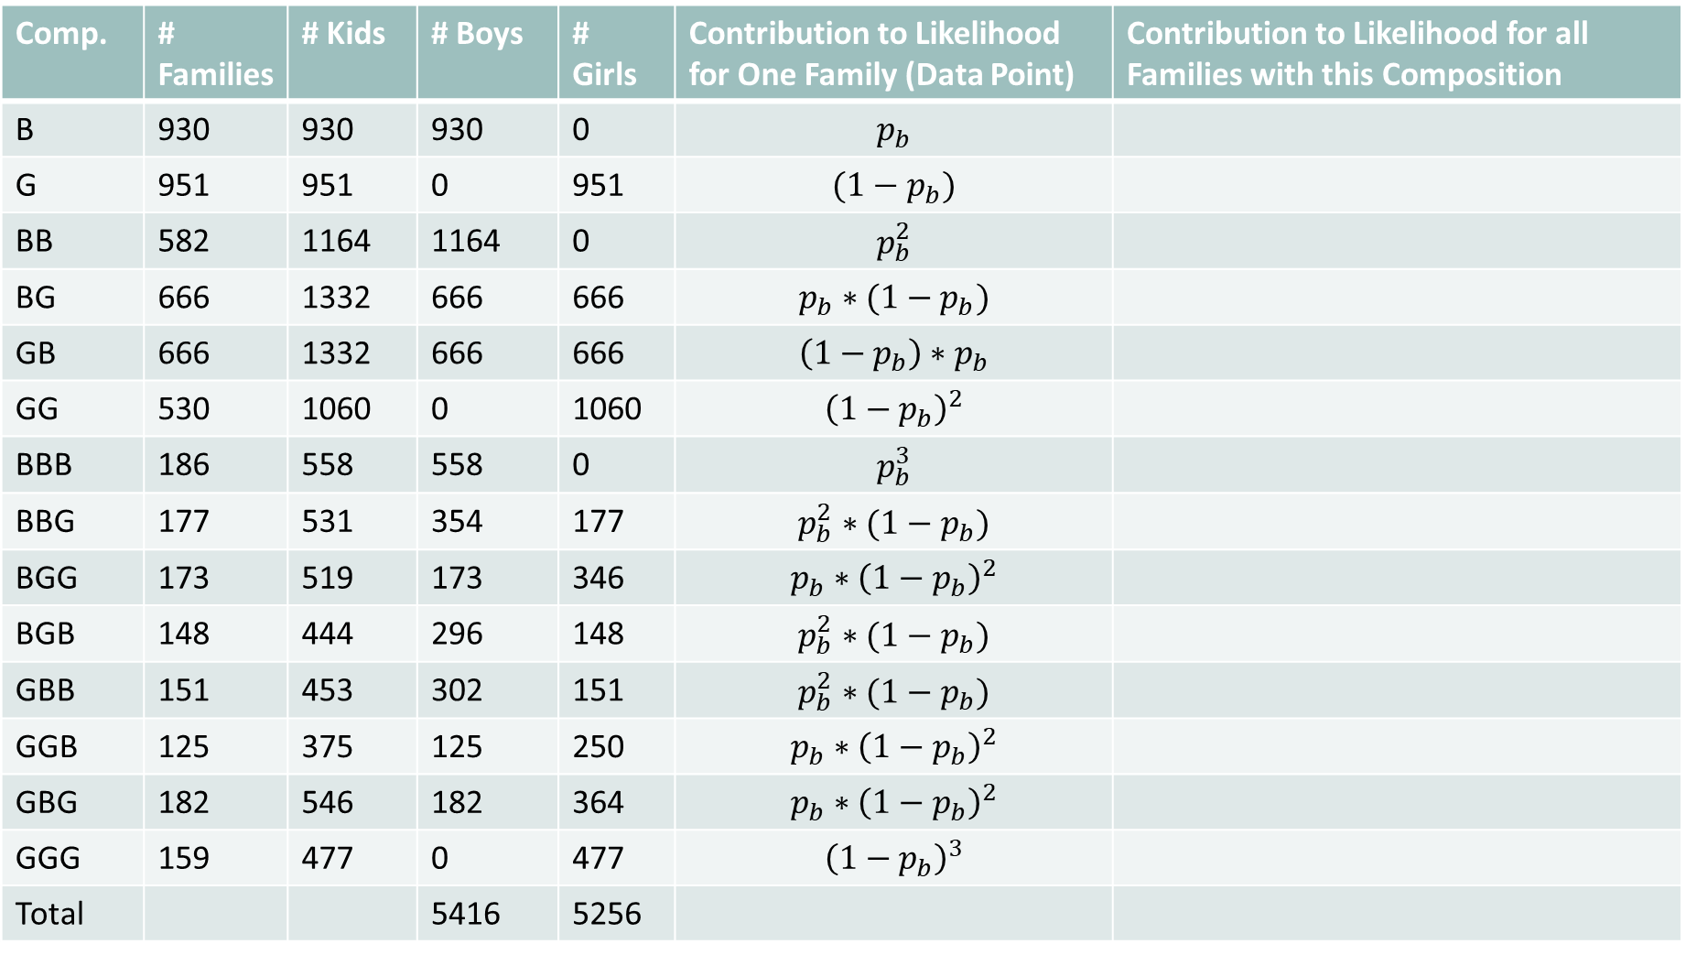
Comp. | # Families | # Kids | # Boys | # Girls | Contribution to Likelihood for One Family (Data Point) | Contribution to Likelihood for all Families with this Composition
B | 930 | 930 | 930 | 0 | $$p_{b}$$
G | 951 | 951 | 0 | 951 | $$(1−p_{b})$$
BB | 582 | 1164 | 1164 | 0 | $$p_{b}^{2}$$
BG | 666 | 1332 | 666 | 666 | $$p_{b}∗(1−p_{b})$$
GB | 666 | 1332 | 666 | 666 | $$\left(1−p_{b}\right)∗p_{b}$$
GG | 530 | 1060 | 0 | 1060 | $${\left(1−p_{b}\right)}^{2}$$
BBB | 186 | 558 | 558 | 0 | $$p_{b}^{3}$$
BBG | 177 | 531 | 354 | 177 | $$p_{b}^{2}∗(1−p_{b})$$
BGG | 173 | 519 | 173 | 346 | $$p_{b}∗{\left(1−p_{b}\right)}^{2}$$
BGB | 148 | 444 | 296 | 148 | $$p_{b}^{2}∗(1−p_{b})$$
GBB | 151 | 453 | 302 | 151 | $$p_{b}^{2}∗(1−p_{b})$$
GGB | 125 | 375 | 125 | 250 | $$p_{b}∗{\left(1−p_{b}\right)}^{2}$$
GBG | 182 | 546 | 182 | 364 | $$p_{b}∗{\left(1−p_{b}\right)}^{2}$$
GGG | 159 | 477 | 0 | 477 | $${\left(1−p_{b}\right)}^{3}$$
Total |  |  | 5416 | 5256
Comp. | # Families | # Kids | # Boys | # Girls | Contribution to Likelihood for One Family (Data Point) | Contribution to Likelihood for all Families with this Composition
B | 930 | 930 | 930 | 0
G | 951 | 951 | 0 | 951
BB | 582 | 1164 | 1164 | 0
BG | 666 | 1332 | 666 | 666
GB | 666 | 1332 | 666 | 666
GG | 530 | 1060 | 0 | 1060
BBB | 186 | 558 | 558 | 0
BBG | 177 | 531 | 354 | 177
BGG | 173 | 519 | 173 | 346
BGB | 148 | 444 | 296 | 148
GBB | 151 | 453 | 302 | 151
GGB | 125 | 375 | 125 | 250
GBG | 182 | 546 | 182 | 364
GGG | 159 | 477 | 0 | 477
Total |  |  | 5416 | 5256
from National Longitudinal Survey of Youth

Slide 6

Likelihood Function for Model 1
$L\left(p_{b}\right)=p_{b}^{930} ∗{\left(1−p_{b}\right)}^{951}∗p_{b}^{1164}∗p_{b}^{666}∗{\left(1−p_{b}\right)}^{666}∗{\left(1−p_{b}\right)}^{666}∗p_{b}^{666}∗{\left(1−p_{b}\right)}^{1060}∗p_{b}^{558}∗p_{b}^{354}∗{\left(1−p_{b}\right)}^{177}∗p_{b}^{173}∗{\left(1−p_{b}\right)}^{346}∗p_{b}^{296}∗{\left(1−p_{b}\right)}^{148}∗p_{b}^{302}∗{\left(1−p_{b}\right)}^{151}∗p_{b}^{125}∗{\left(1−p_{b}\right)}^{250}∗p_{b}^{182}∗{\left(1−p_{b}\right)}^{364}∗{\left(1−p_{b}\right)}^{477}$

Slide 7
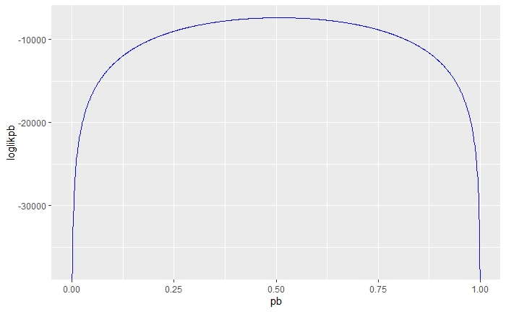

Slide 8
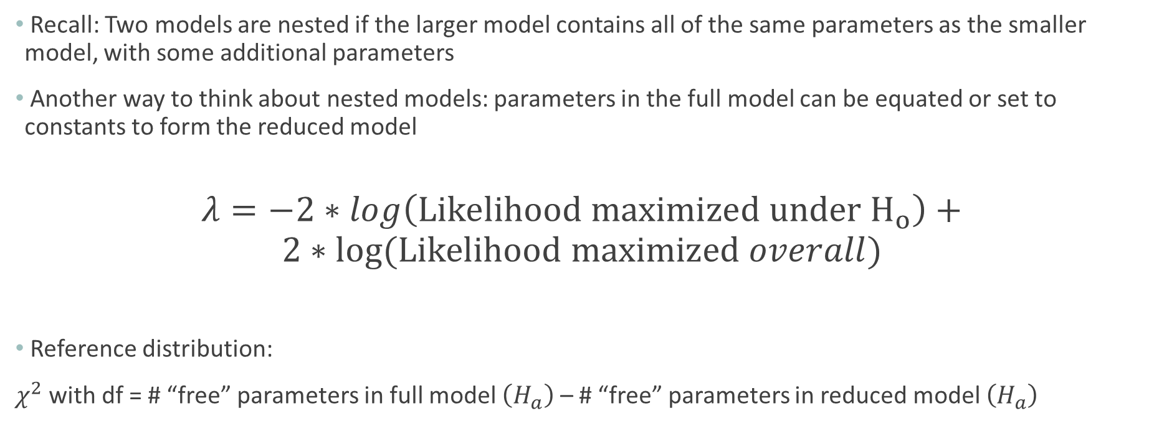
(Asymptotic) Likelihood Ratio Test (Nested Models)
Recall: Two models are nested if the larger model contains all of the same parameters as the smaller model, with some additional parameters
Another way to think about nested models: parameters in the full model can be equated or set to constants to form the reduced model
$$λ=−2∗log\left(Likelihood maximized under H_{o}\right)+$$
$$2∗log⁡(Likelihood maximized overall)$$
Reference distribution:
$χ^{2}$ with df = # “free” parameters in full model $\left(H_{a}\right)$ – # “free” parameters in reduced model $\left(H_{a}\right)$

Slide 9
Comp. | # Families | Contribution to Likelihood for One Family (Data Point)
B | 930
G | 951
BB | 582
BG | 666
GB | 666
GG | 530
BBB | 186
BBG | 177
BGG | 173
BGB | 148
GBB | 151
GGB | 125
GBG | 182
GGG | 159
Total
from National Longitudinal Survey of Youth

Slide 10

Likelihood Function for Model 2
$L\left(p_{B|N}, p_{B|BBias}, p_{B|GBias}\right)=p_{B|N}^{930} ∗{\left(1−p_{B|N}\right)}^{951} ∗p_{B|N}^{582} ∗p_{B|BBias}^{582} ∗ p_{B|N}^{666} ∗{\left(1−p_{B|BBias}\right)}^{666} ∗{\left(1−p_{B|N}\right)}^{666} ∗p_{B|GBias}^{666} ∗ {\left(1−p_{B|N}\right)}^{530} ∗{\left(1 −p_{B|GBias}\right)}^{530}∗p_{B|N}^{186}∗p_{B|BBias}^{186}∗p_{B|BBias}^{186}∗p_{B|N}^{177} ∗p_{B|BBias}^{177} ∗{\left(1−p_{B|BBias}\right)}^{177} ∗p_{B|N}^{173} ∗{\left(1−p_{B|BBias}\right)}^{173}∗{\left(1−p_{B|N}\right)}^{173}∗p_{B|N}^{148}∗{\left(1−p_{B|BBias}\right)}^{148}∗p_{B|N}^{148}∗{\left(1−p_{B|N}\right)}^{151} ∗p_{B|GBias}^{151} ∗p_{B|N}^{151} ∗{\left(1−p_{B|N}\right)}^{125} ∗{\left(1 −p_{B|GBias}\right)}^{125} ∗p_{B|GBias}^{125} ∗{\left(1−p_{B|N}\right)}^{182} ∗p_{B|GBias}^{182} ∗{\left(1−p_{B|N}\right)}^{182}$ * ${\left(1−p_{B|N}\right)}^{159} ∗ {\left(1 −p_{B|GBias}\right)}^{159} ∗{\left(1 −p_{B|GBias}\right)}^{159}$

Slide 11
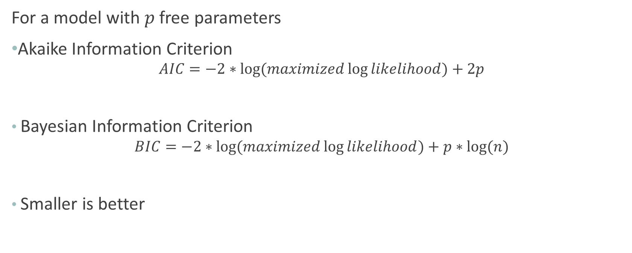
Information Criteria
For a model with $p$ free parameters
Akaike Information Criterion
$$AIC=−2∗log⁡(maximized\log{likelihood)+2p}$$
Bayesian Information Criterion
$$BIC=−2∗log⁡(maximized\log{likelihood)+p∗log⁡(n)}$$
Smaller is better

Slide 12
(Asymptotic) Likelihood Ratio Test (Nested Models)
Recall: Two models are nested if the larger model contains all of the same parameters as the smaller model, with some additional parameters
Another way to think about nested models: parameters in the full model can be equated or set to constants to form the reduced model
$$λ=−2∗log\left(Likelihood maximized under H_{o}\right)+$$
$$2∗log⁡(Likelihood maximized overall)$$
Reference distribution:
$χ^{2}$ with df = # “free” parameters in full model $\left(H_{a}\right)$ – # “free” parameters in reduced model $\left(H_{a}\right)$

Slide 13
Comp. | # Families | Contribution to Likelihood for One Family (Data Point)
B | 930
G | 951
BB | 582
BG | 666
GB | 666
GG | 530
BBB | 186
BBG | 177
BGG | 173
BGB | 148
GBB | 151
GGB | 125
GBG | 182
GGG | 159
Total
from National Longitudinal Survey of Youth

Slide 14

Likelihood Function for Model 3
$L\left(p_{b}, p_{S|B1}, p_{s|NB1}\right)=p_{b}^{5416} ∗{\left(1−p_{b}\right)}^{5256}∗p_{s|B1}^{1721} ∗{\left(1−p_{s|B1}\right)}^{2265}∗p_{s|NB1}^{3905}∗{\left(1−p_{s|NB1}\right)}^{2781}$

