Slide 1
Day 8
Read: Sections 4.1 – 4.6
(https://bookdown.org/roback/bookdown-BeyondMLR/)
Practice:
Conceptual Exercises: 1-5, 8, 9
Guided Exercises: 2a-g
Goals for today:
Continue with Poisson Regression
Model Assessment
Inference
Model Comparisons
Overdispersion in Poisson Regression
Offsets in Poisson Regression
Announcements
Mini-project 2 due Friday, September 29 (by 4pm)
Quiz 3 on WEDNESDAY (Topic: basic probability and basic Poisson regression)
Rare extra credit opportunity!

Slide 2

Extra Credit Opportunity
To earn your extra credit
Attend this talk
Take a selfie while you are there (not while she is speaking)
Upload to Canvas (I’ll create an assignment in Canvas)
Must upload by noon on Sept. 26
Worth 10% on your 2nd lowest quiz

Slide 3
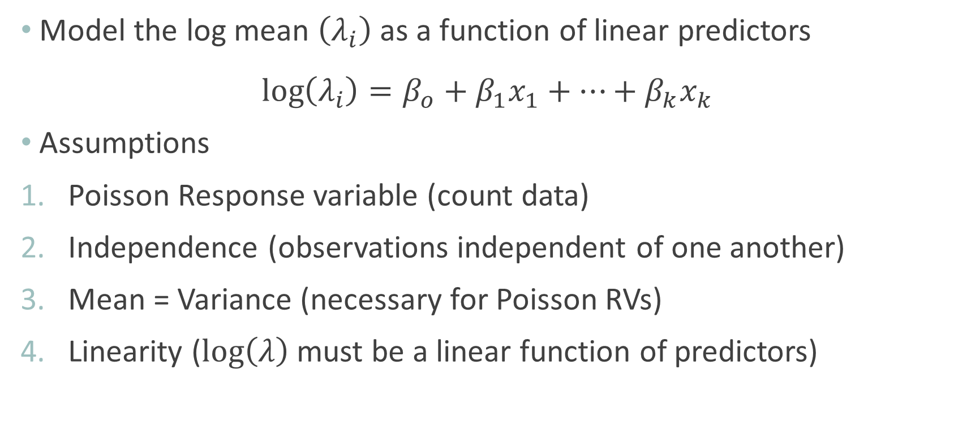
Poisson Regression Model & Assumptions
Model the log mean $\left(λ_{i}\right)$ as a function of linear predictors
$$\log\left(λ_{i}\right)=β_{o}+β_{1}x_{1}+…+β_{k}x_{k}$$
Assumptions
Poisson Response variable (count data)
Independence (observations independent of one another)
Mean = Variance (necessary for Poisson RVs)
Linearity ($\log\left(λ\right)$ must be a linear function of predictors)

Slide 4
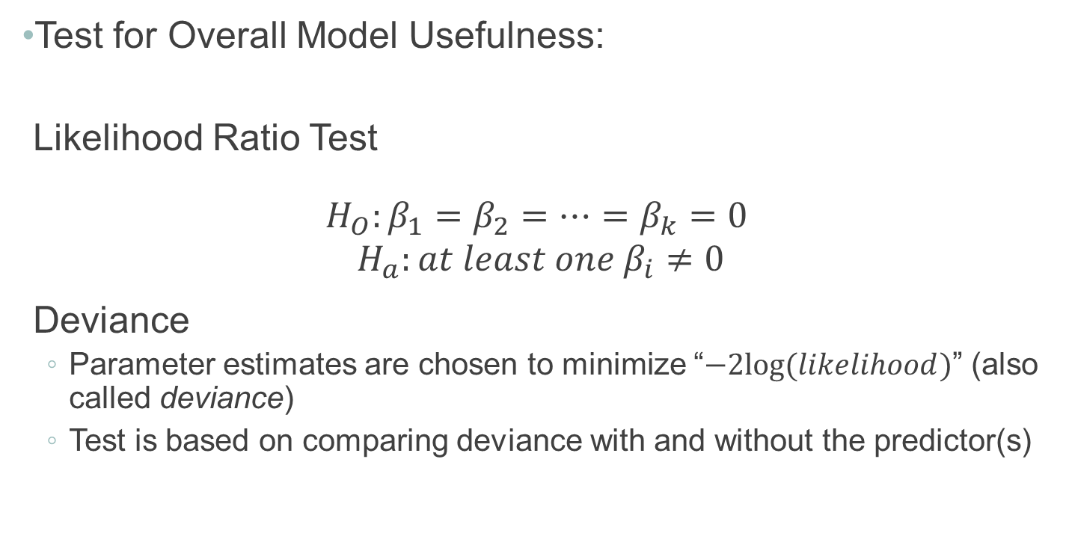
Evaluating Overall Model Utility
Test for Overall Model Usefulness:
Likelihood Ratio Test
$$H_{O}:β_{1}=β_{2}=…=β_{k}=0$$
$$H_{a}:at least one{ β}_{i}≠0$$
Deviance
Parameter estimates are chosen to minimize “$−2log⁡(likelihood)$” (also called deviance)
Test is based on comparing deviance with and without the predictor(s)

Slide 5
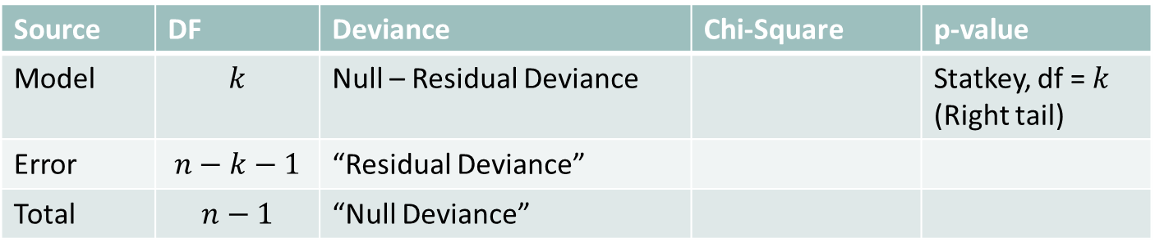
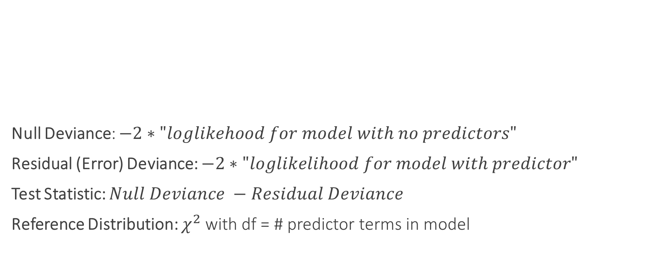
Evaluating Overall Model Utility
Null Deviance: $−2∗"loglikehood for model with no predictors"$
Residual (Error) Deviance: $−2∗"loglikelihood for model with predictor"$
Test Statistic: $Null Deviance −Residual Deviance$
Reference Distribution: $χ^{2}$ with df = # predictor terms in model
Source | DF | Deviance | Chi-Square | p-value
Model | $$k$$ | Null – Residual Deviance |  | Statkey, df = $k$ (Right tail)
Error | $$n−k−1$$ | “Residual Deviance”
Total | $$n−1$$ | “Null Deviance”

Slide 6
Evaluating Subsets of Predictors
Recall: Two models are nested if one model contains all the terms of the second model and at least one additional term

Slide 7
Nested Likelihood Ratio Test (LRT)
P-value: Compare test statistic to $χ_{df}^{2}$ (right tail)
Also called the “drop-in-deviance” test (dropping to the reduced model)

Slide 8
Model Goodness of Fit
If our model is the “true” model for the observed data
$$Residual Deviance \sim χ^{2} with df=Residual df$$
Compute probability of observing a deviance at least this large, if model is true
Compare to $χ^{2}$ with $df=Residual df$
Small “p-value” means there is significant evidence of “lack-of-fit”
Reasons for “lack-of-fit”
Missing covariates
Not enough data
Unusual observations
More (or less) variation than expected

Slide 9
Overdispersion
Means there is more variation in the response than the model allows for
Consequence: Standard Errors are likely too small
One solution (“Quasilikelihood): Add new “overdispersion” parameter $(φ)$ to model
“Adjust” standard errors
$$SE_{Q}\left({\hat{β}}_{i}\right)=\sqrt{\hat{φ}} ∗SE\left({\hat{β}}_{i}\right)$$

Slide 10
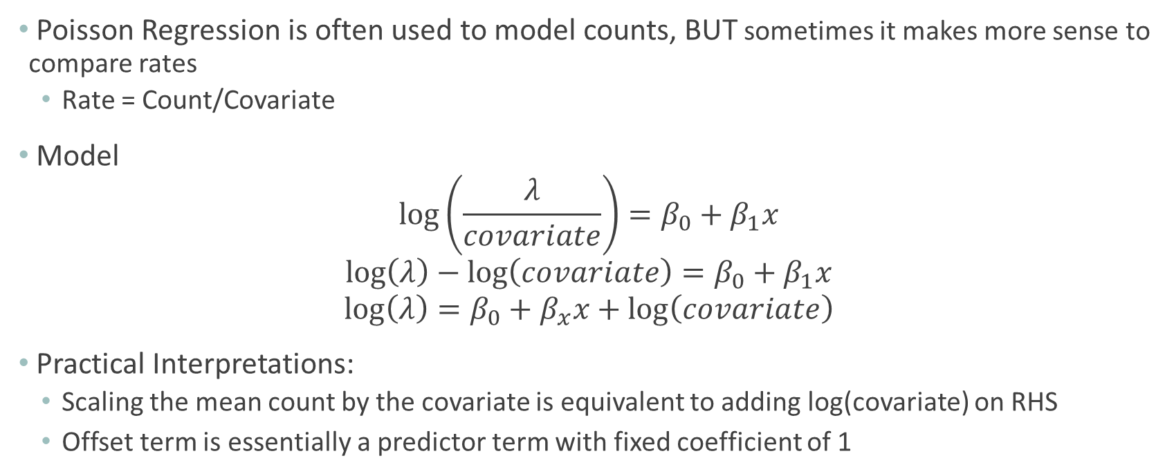
Offset in Poisson Regression
Poisson Regression is often used to model counts, BUT sometimes it makes more sense to compare rates
Rate = Count/Covariate
Model
$$\log\left(\frac{λ}{covariate}\right)=β_{0}+β_{1}x$$
$$\log\left(λ\right)−\log\left(covariate\right)=β_{0}+β_{1}x$$
$$\log\left(λ\right)=β_{0}+β_{x}x+\log\left(covariate\right)$$
Practical Interpretations:
Scaling the mean count by the covariate is equivalent to adding log(covariate) on RHS
Offset term is essentially a predictor term with fixed coefficient of 1

