Slide 1
Netflix Dataset Analysis Using SQL
Objective: Analyze movie trends and performance using SQL
Prepared by: Iram Shaikh
Course: Master in Data Science and Analytics

Slide 2
Project Overview
This project uses SQL to analyze a Netflix dataset.
The objective is to understand movie performance, ratings, and trends.

Slide 3
Dataset Description
The movie dataset contains:
- Show ID
- Title
- Genre
- Release Year
- Rating
- Duration
- Description

Slide 4
Database & Table Structure
Database created in MySQL.
Main table: netflix
Optional tables:
- countries
- ratings
Primary keys ensure unique records.

Slide 5
Data Import Process
Data imported using:
- LOAD DATA INFILE
- INSERT INTO statements
Handled NULL values and data type issues.

Slide 6
Basic SQL Queries Used
SELECT movie_title, genre FROM netflix;
WHERE
ORDER BY
LIMIT 10
To understand content distribution, trends and data quality.

Slide 7
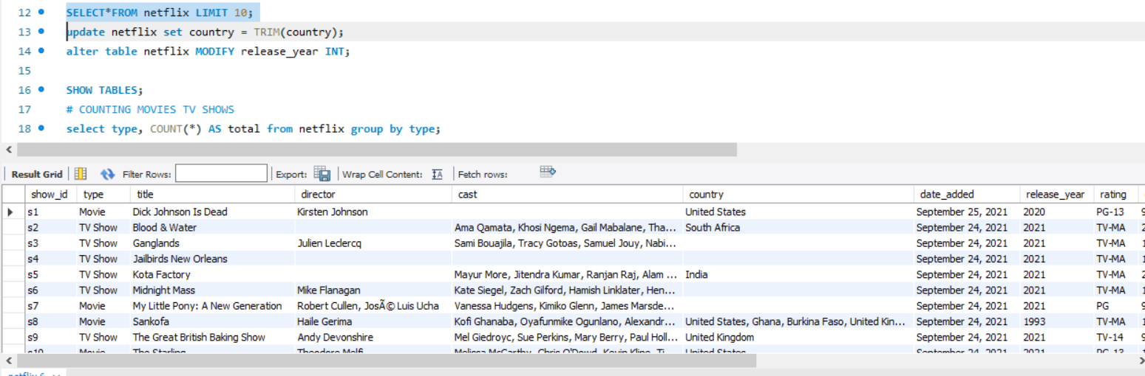

Slide 8
Aggregate Functions
COUNT() – total movies
AVG() – average rating
SUM() – total revenue
MAX() / MIN() – highest and lowest revenue

Slide 9
Joins Used
INNER JOIN netflix and ratings tables
LEFT JOIN netflix and countries tables
Used to combine movie details with ratings and genres

Slide 10
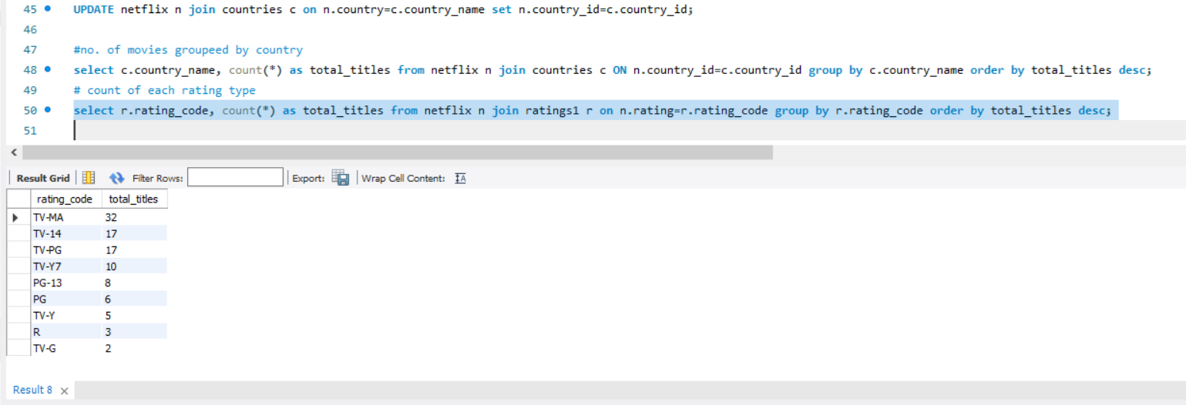

Slide 11
Analysis Performed
Most common rating
Movies released per year
Countries producing most titles
Top directors by number of titles
Movies by genre
Movies released after 2015

Slide 12
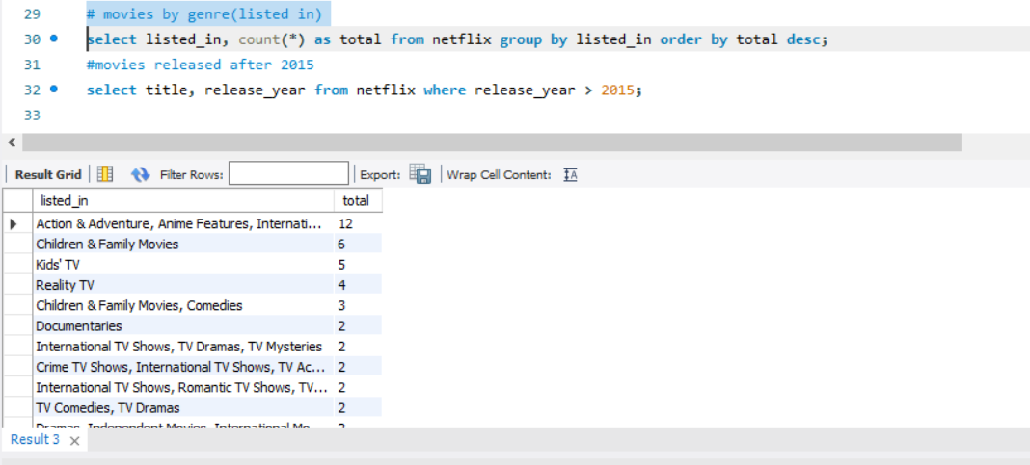
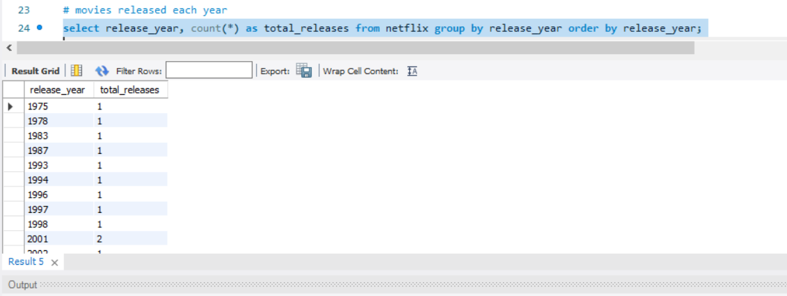

Slide 13
Challenges Faced
Handling missing ratings
Normalizing genre data
Large dataset performance issues

Slide 14
Conclusion
SQL helps extract valuable insights from netflix data.
This project strengthened understanding of queries, joins, and analysis.
Useful for data-driven decision-making.

