Slide 1

The Developer’s Journey : Skills, Salary & Satisfaction Trends
ALI JAHANGIR
2025-02-24

Slide 2



OUTLINE
Executive Summary
Introduction
Methodology
Results
Visualization – Charts
Dashboard
Discussion
Findings & Implications
Conclusion
Appendix

Slide 3

EXECUTIVE SUMMARY
Top programming languages in demand:
• JavaScript, HTML/CSS, Python, C#/PHP/Go, C ,Kotlin , Dart ,VB
Top database skills in demand:
My SQL, Microsoft SQL Server , SQLite, MongoDB ,Redis
Popular platforms:
AWS, Google Cloud, OCI, Digital Ocean, Firebase
Popular Web Frames:
• Nodejs ,Next js ,Angular/Angular.js, React.js, ASP.NET, Express
• Future Technology Trend:
• Python takes the third row, followed by SQL and TypeScript
• Redis and Elasticsearch also place in Top 5
• Android is in the Top 5 demanded platforms, the rest remains
• React.js takes the first row and Vue.js is the latest addition as the last

Slide 4

INTRODUCTION
In the realm of programming and technology,
several key trends have emerged in recent years.
These insights shed light on the evolving landscape
of programming languages, web frameworks, and
the demographics of professional developers.
Stack Overflow conducts an inclusive survey of
individuals engaged in coding globally.
Covering a wide array of topics from preferred
technologies to career aspirations, 2019 marks the
9th consecutive year of survey publication.
Nearly 90,000 developers participated in the 20-
minute survey in 2019 Survey.
Let's explore some of the notable findings.

Slide 5

METHODOLOGY
Data is based on the survey conducted by Stack
Overflow from January 23 to February 14 and
involved 88,883 software developers from 186
countries.
Familiarization with this dataset was achieved through
completing IBM labs on Coursera, which
encompassed topics such as Web Scraping, Dataset
Exploration, Data Wrangling, Exploratory Data
Analysis, and Data Visualization.
Data analysis and visualization was conducted via
IBM Cognos Analytics.

Slide 6
RESULTS
• JavaScript remains the most used programming language.
• Python overtakes C#, becoming the 3rd most preferred
language with significant growth. It stands as the fastest growing major programming language.
• Nodejs is the most widely used among web frameworks, with jQuery surpassing Nextjs in developer usage this year.
• Globally, men represent approximately 90% of respondents, with higher female representation among students than professional developers in regions like the US, India, and the UK.
• Around 3/4 of professional developers globally hold at least a bachelor's degree, aligning with past findings.
• 3/4 of survey respondents in professional developer roles
are under 35 years old.

Slide 7
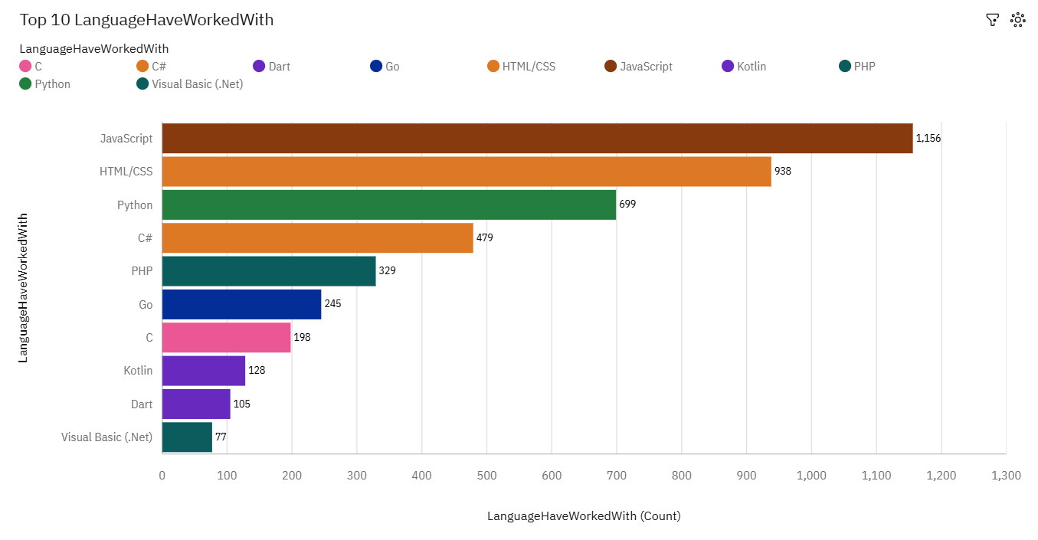
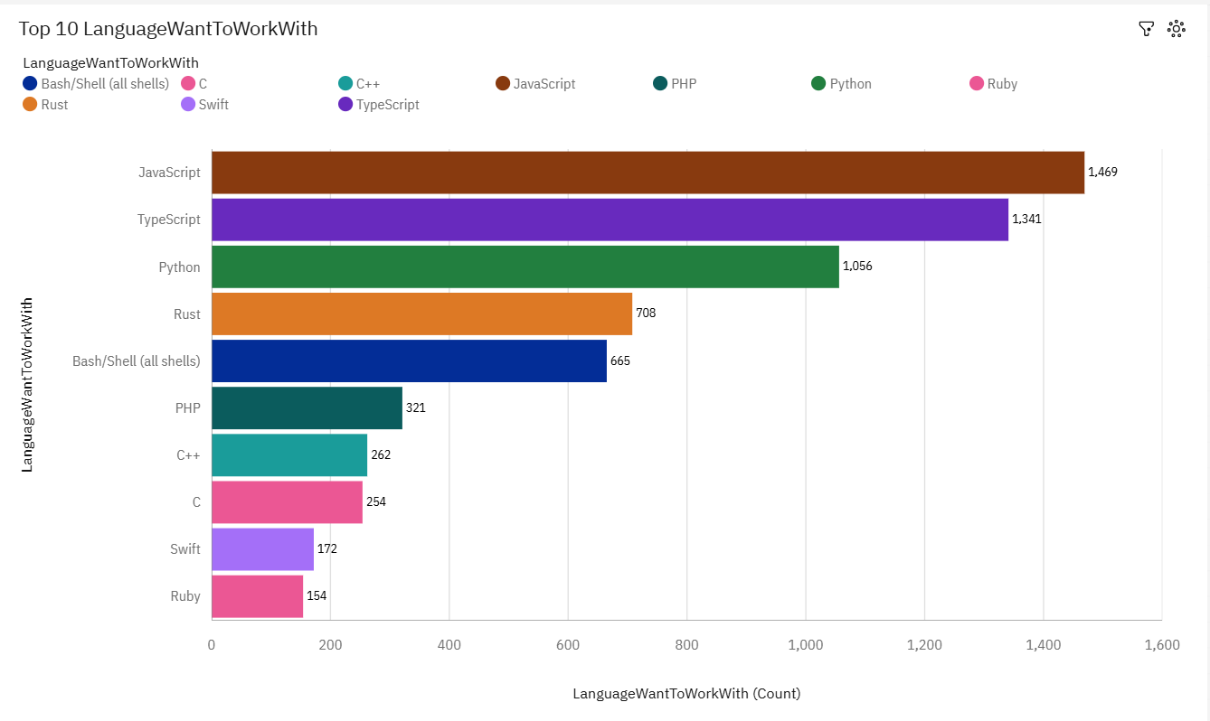
PROGRAMMING LANGUAGE TRENDS
Current Year
Next Year
<Bar chart of top 10 programming languages for the current year goes here.>
< Bar chart of top 10 programming languages for the next year goes here.>

Slide 8
PROGRAMMING LANGUAGE TRENDS - FINDINGS & IMPLICATIONS
Findings
JavaScript leads with 1,156 current users and grows to 1,449 next year, remaining the top language.
Python’s popularity rises from 699 current users to 1,066 next year, driven by data science demand.
Rust and TypeScript gain interest, with 708 and 1,341 developers wanting to use them next year for performance and type safety.
Implications
Companies should prioritize JavaScript and Python training to stay competitive in web and data projects.
Rising interest in Rust and TypeScript may shape future software designs favoring performance and safety.
Developers and educators need to focus on Rust and TypeScript to align with emerging industry needs.

Slide 9
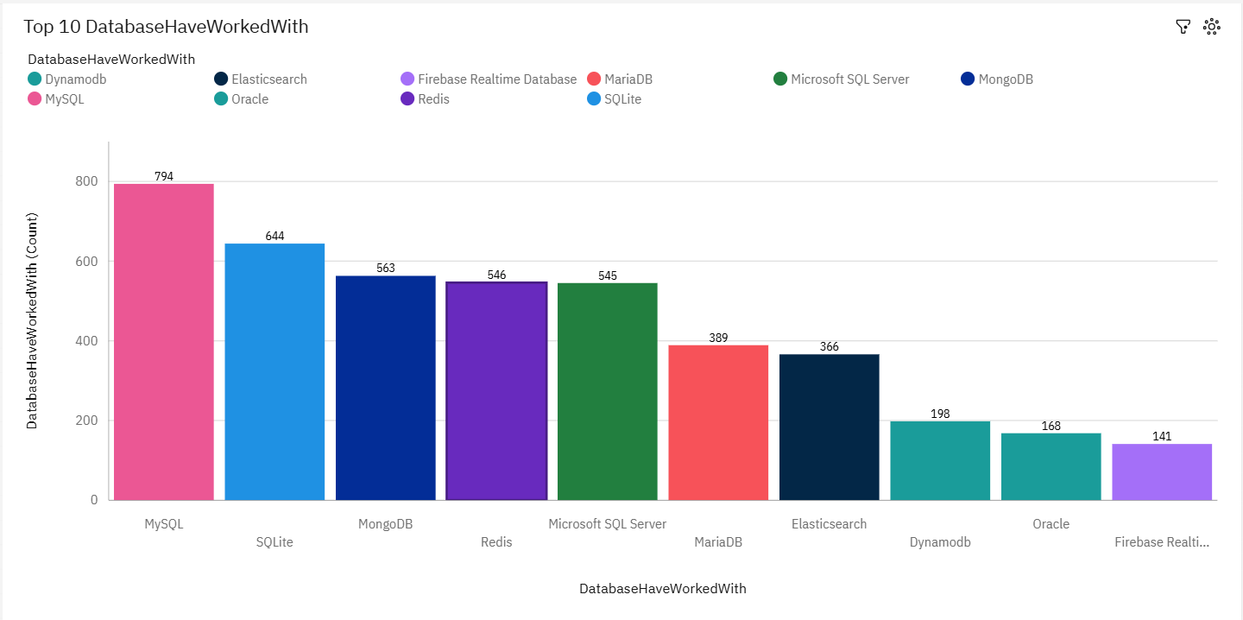
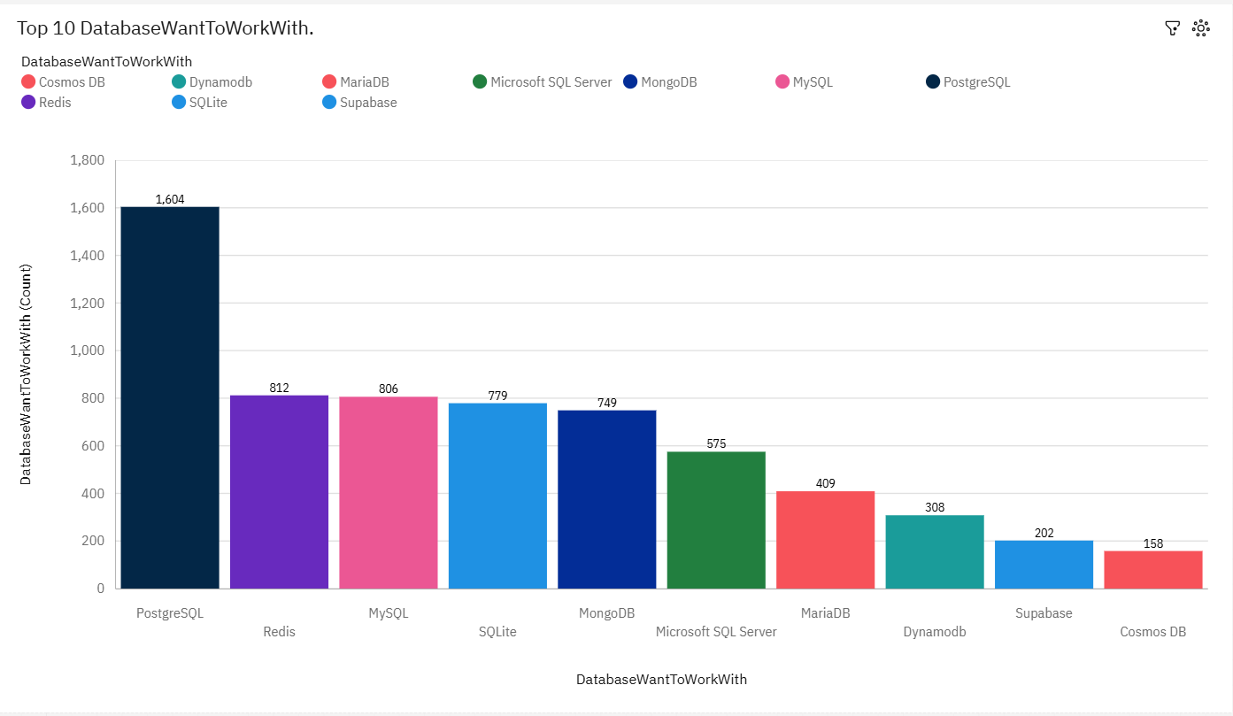
DATABASE TRENDS
Current Year
Next Year
< Bar chart of top 10 databases for the current year goes here >
< Bar chart of top 10 databases for the next year goes here.>

Slide 10
DATABASE TRENDS - FINDINGS & IMPLICATIONS
Findings
MySQL remains the most popular database in the current year with 794 units of usage, but its popularity decreases significantly in the next year to 622 units, indicating a decline in its dominance.
PostgreSQL shows a substantial increase in usage from 672 units in the current year to 1,024 units in the next year, suggesting it is becoming the leading database technology.
Other databases like MongoDB, Microsoft SQL Server, and Redis experience moderate declines or stability in usage, while newer databases like Cosmos DB and Supabase emerge with lower but growing adoption in the next year (115 and 109 units, respectively).
Implications
Organizations may need to prioritize migration strategies or training for PostgreSQL to capitalize on its rising popularity and ensure compatibility with future systems.
The decline in MySQL usage could signal a shift in developer preferences or technological requirements, potentially impacting legacy systems reliant on MySQL.
The emergence of newer databases like Cosmos DB and Supabase suggests a trend toward specialized or cloud-native solutions, which could drive innovation but also require investment in learning and integration.

Slide 11

DASHBOARD
You can find the dashboard link below:
https://github.com/iraniandeveloper1987/IBM-Data-Analyst-Capstone-Project/blob/master/Dashboard/Survey_dashboard.pdf

Slide 12
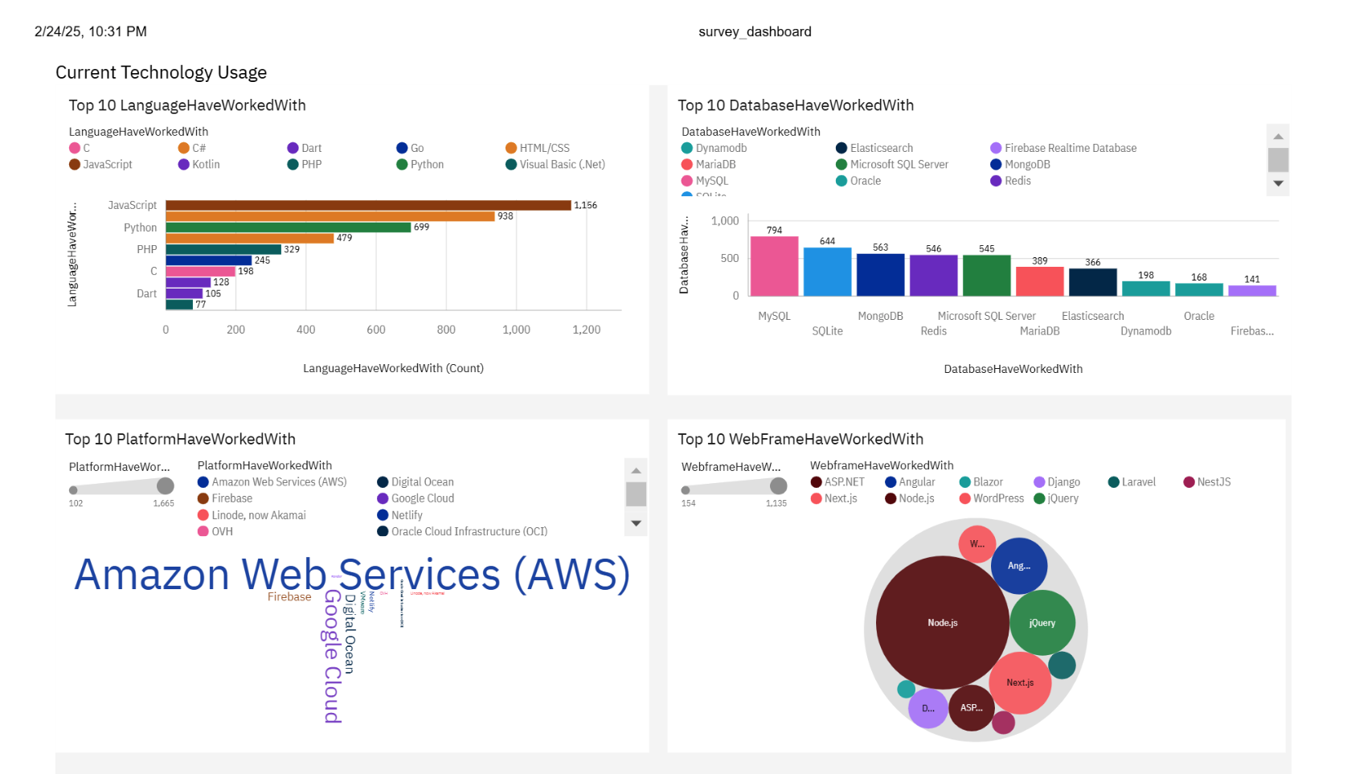
DASHBOARD TAB 1
Screenshot of dashboard tab 1 goes here

Slide 13
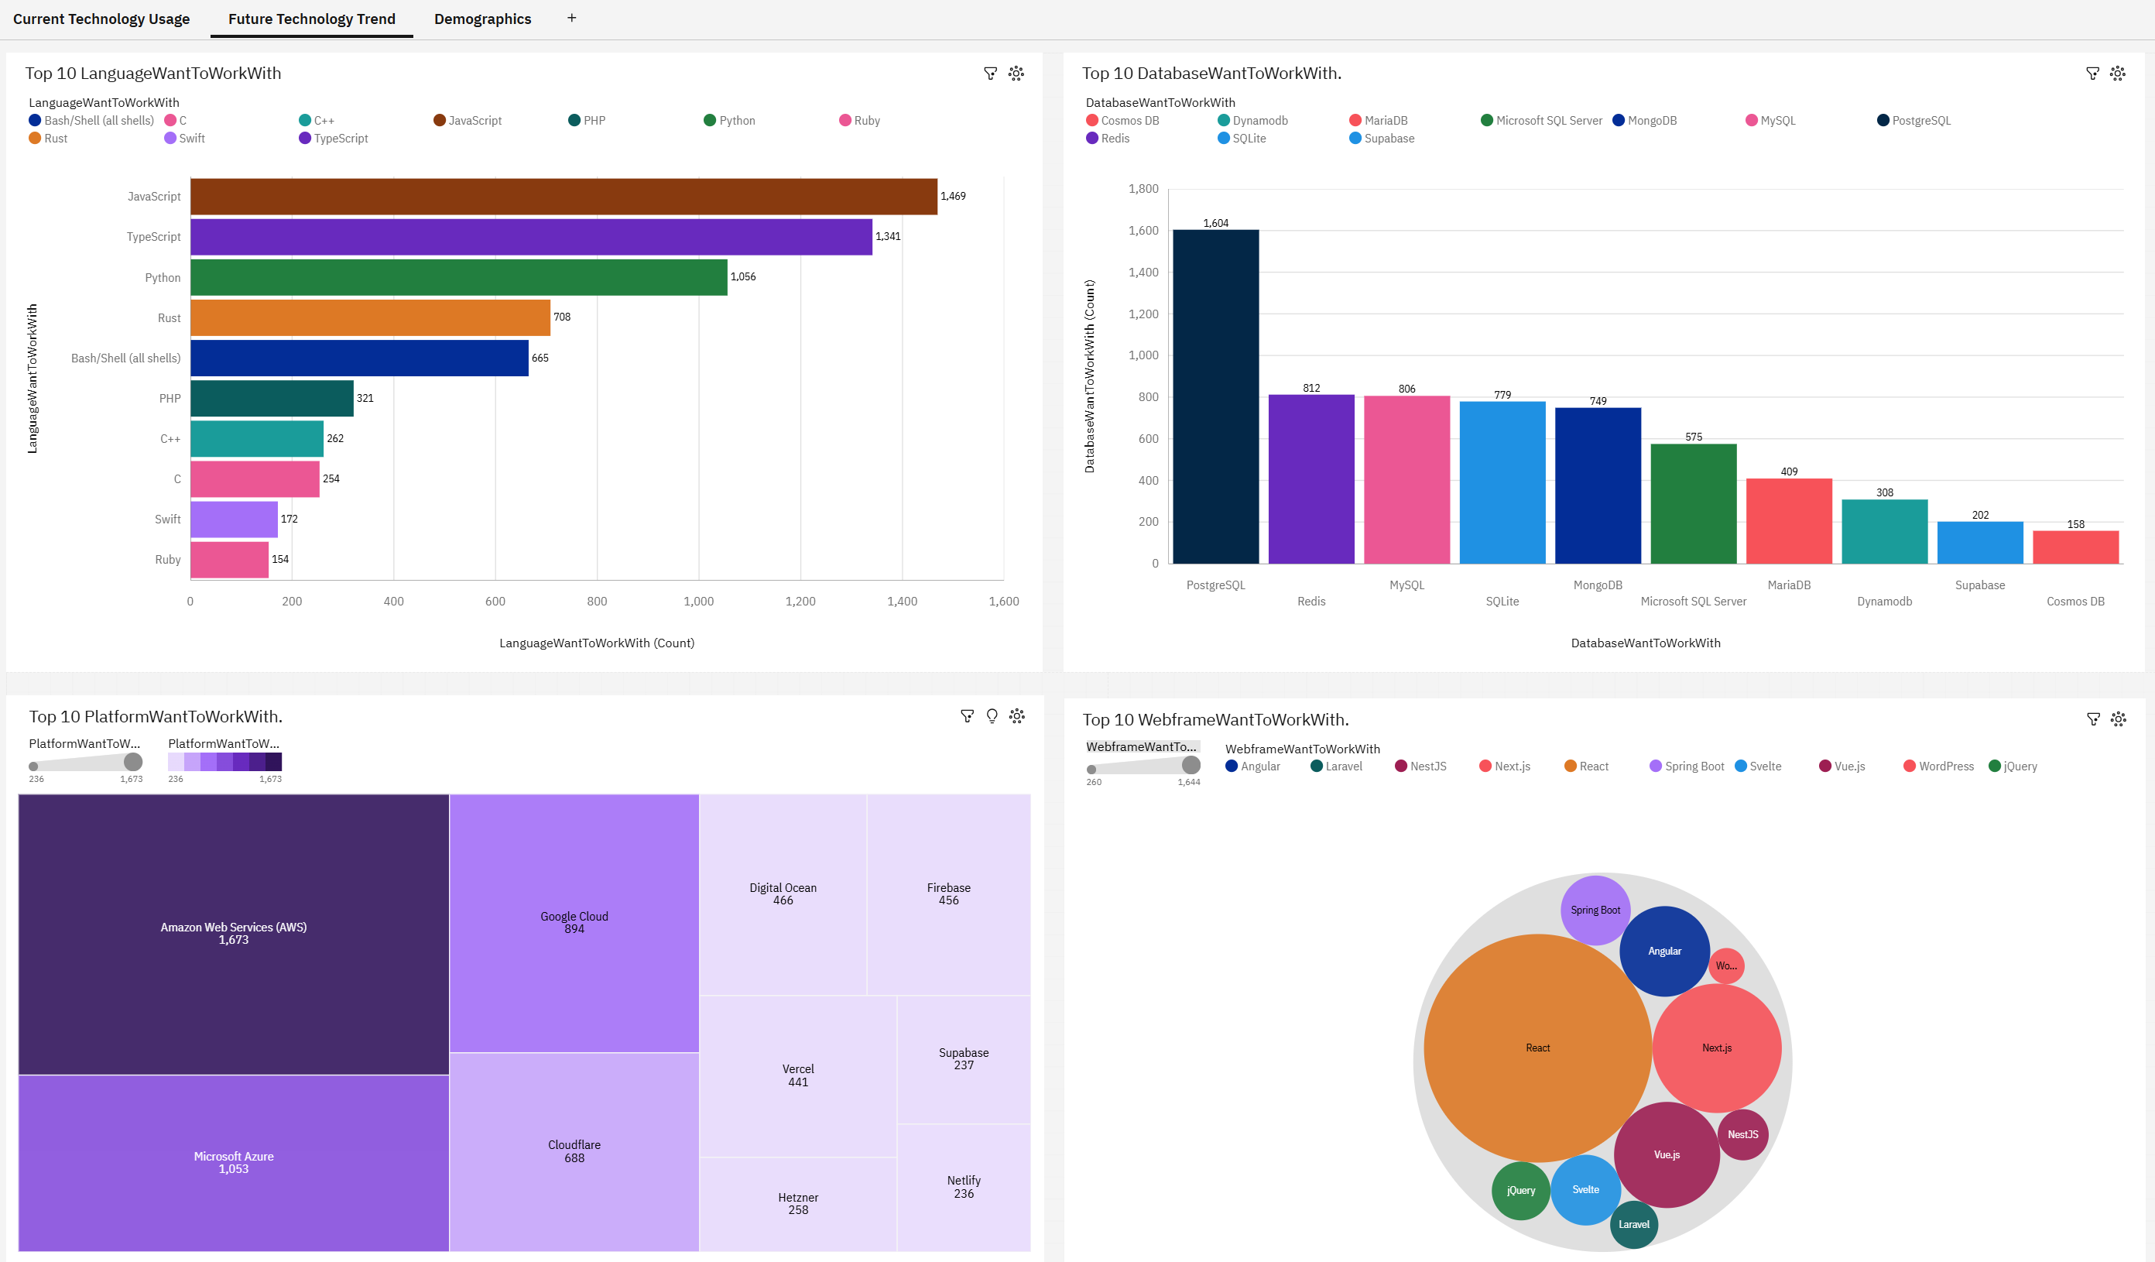
DASHBOARD TAB 2
Screenshot of dashboard tab 2 goes here

Slide 14
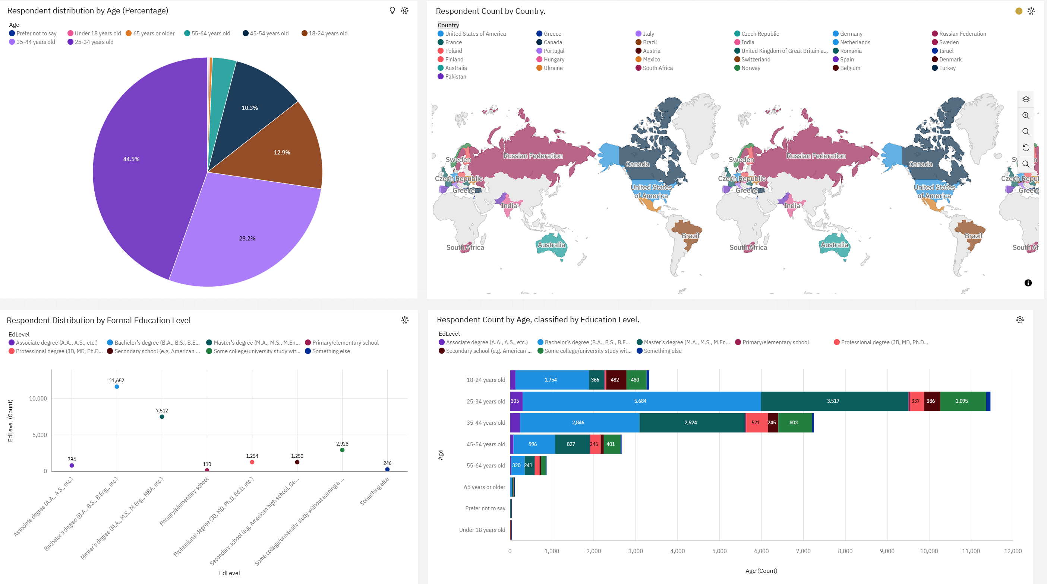
DASHBOARD TAB 3
Screenshot of dashboard tab 3 goes here

Slide 15
DISCUSSION
JavaScript remains the dominant programming language, with usage increasing from 1,156 users in current year to 1,499 in next year, reinforcing its essential role in web development.
PostgreSQL is poised to overtake MySQL as the top database, rising from 672 to 1,024 units, while MySQL declines from 794 to 622 units, indicating a shift toward more robust database solutions.
The strong growth in cloud platforms, led by Amazon Web Services (AWS) increasing from 1,466 to 1,473 users, highlights the industry’s shift toward cloud computing for scalability and innovation.
These trends imply businesses should prioritize JavaScript, PostgreSQL, and cloud technologies to remain competitive, while evaluating transitions to modern solutions for long-term success.

Slide 16
OVERALL FINDINGS & IMPLICATIONS
Findings
Finding 1: JavaScript leads as the top programming language this year with 1,156 users, expected to grow to 1,499 next year, while PostgreSQL surpasses MySQL as the primary database, rising from 672 to 1,024 units as MySQL drops from 794 to 622 units.
Finding 2: AWS dominates platforms with 1,466 users this year, increasing to 1,473 next year, and Python grows from 699 to 1,066 users, with TypeScript surging from 128 to 1,141 users.
Finding 3: Respondents are mostly aged 25-34 (44%) with bachelor’s degrees (7,962), primarily from the U.S. and Russia, while niche technologies like Rust, Ruby, Cosmos DB, and Supabase show modest growth (108–254 units or users).
Implications
Implication 1: Businesses should prioritize investments in JavaScript, PostgreSQL, Python, and cloud platforms like AWS to remain competitive, potentially reshaping training programs and technology stacks to align with these dominant trends.
Implication 2: The decline in MySQL and the rise of PostgreSQL, along with the growth of TypeScript and niche technologies, indicate a need for organizations to evaluate and possibly transition to modern or specialized solutions, which could require resources but offer long-term scalability and innovation benefits.
Implication 3: The demographic focus on younger, highly educated professionals in the U.S. and Russia suggests targeted opportunities for tech companies but also underscores the importance of global accessibility and education initiatives to broaden technology adoption and address regional disparities.

Slide 17

CONCLUSION
a keen understanding of diverse programming languages, such as JavaScript, Python, and TypeScript, is essential to meet modern application demands, enabling developers to create versatile, high-performance software aligned with industry trends and user needs, ensuring successful software development outcomes.
database systems, like PostgreSQL and emerging solutions such as Cosmos DB and Supabase, are vital for efficient data management, scalability, and adaptability, directly contributing to successful project delivery and reliable systems.
staying adaptable to cloud platforms like AWS ensures competitiveness by leveraging scalability, flexibility, and advanced infrastructure, helping organizations meet business needs, reduce costs, and innovate quickly in a cloud-driven market.
embracing emerging tools, such as Rust for performance-critical applications, Ruby for web development, or niche databases like Supabase, fosters innovation, addresses specialized use cases, and positions developers and companies as leaders in cutting-edge technology, maintaining relevance in a rapidly evolving industry.

Slide 18

APPENDIX
Distribution of Coding Engagement Among Respondents

Slide 19
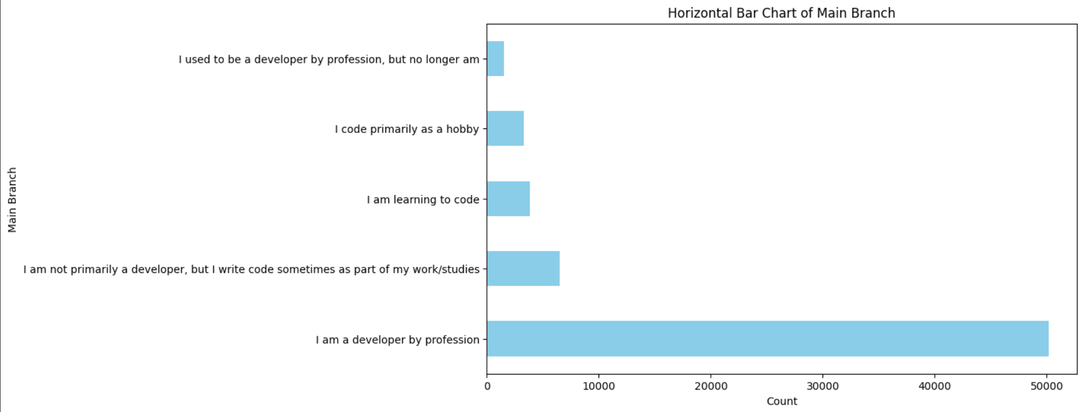
Distribution of Coding Engagement Among Respondents

Slide 20
Findings:
Professional developers dominate, representing approximately 45,000 respondents, far outnumbering other groups.
Part-time coders and learners constitute smaller but significant segments, with around 7,500 and 5,000 respondents, respectively, indicating diverse coding engagement.
Former developers and hobbyists are the smallest groups, each with about 2,500–4,500 respondents, suggesting limited current involvement in coding compared to professionals.

Slide 21
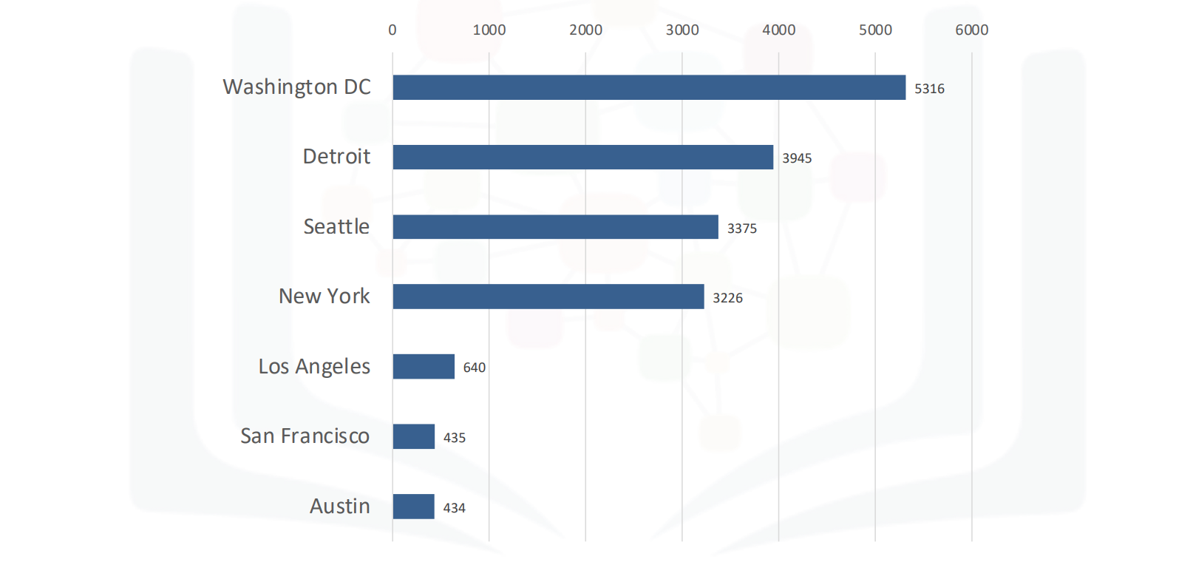
JOB POSTINGS
In Module 1 you have collected the job posting data using Job API in a file named “job-postings.xlsx”. Present that data using a bar chart here. Order the bar chart in the descending order of the number of job postings.

Slide 22
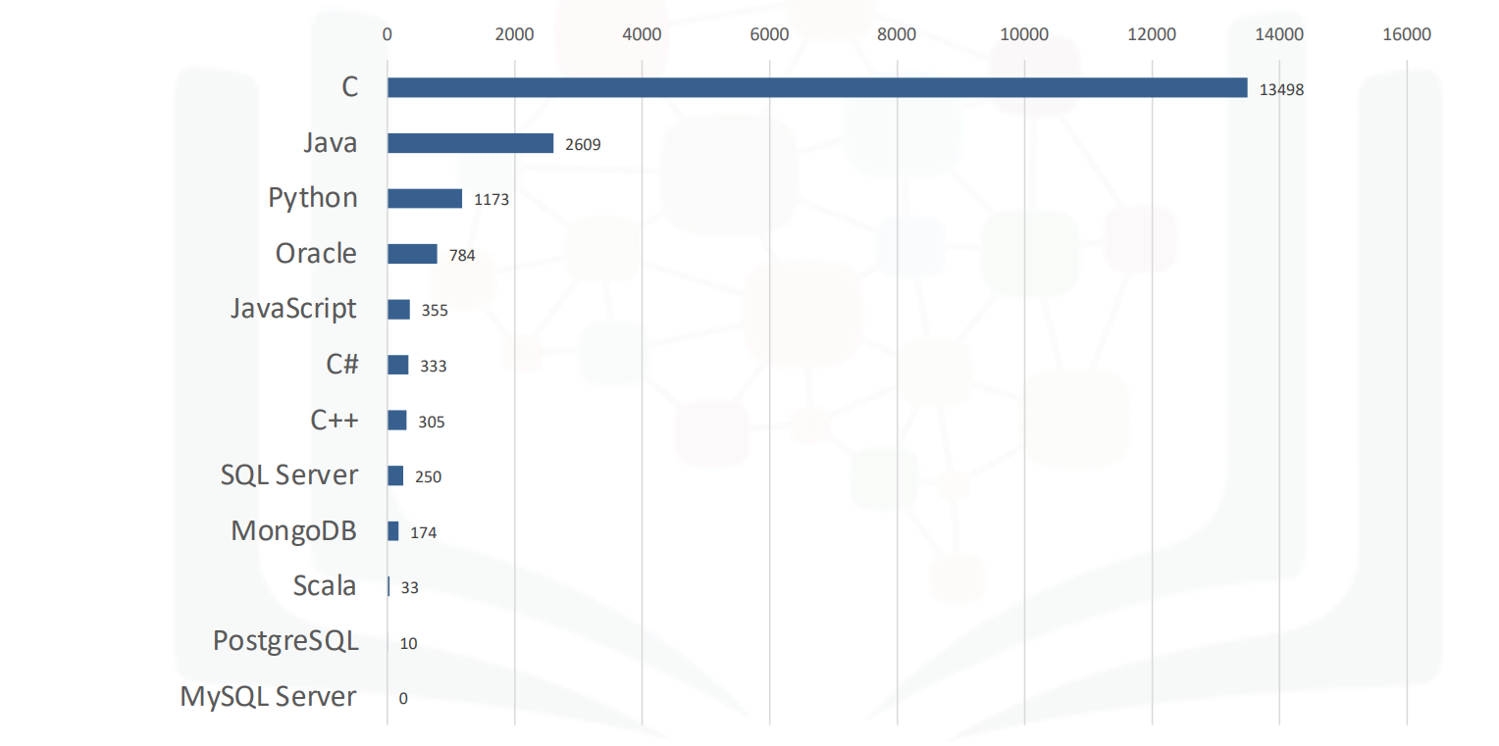
POPULAR LANGUAGES
In Module 1 you have collected the job postings data using web scraping in a file named “popular-languages.csv”. Present that data using a bar chart here. Order the bar chart in the descending order of salary.

