Slide 1
Loan default prediction
Info 6105 - Data science methods and tools
TEAM 4
PRESENTED TO PROF. HANDAN LIU
ASHRITH PRADEEP | ira pantbalekundri | purvang JAYESH thakkar
001388261 | 001423854 | 001387983

Slide 2
overview
Introduction
Goal
Dataset Description
Dataset Snapshot
Data Processing Flow
Exploratory data analysis
Data cleaning and preprocessing
Classifiers
References

Slide 3
Introduction
Lending Club
Borrower
Investors
Lending Club is an online crowdfunding platform for peer to peer lending, facilitating personal loans, business loans, and financing.
Borrowers access loans through an online or mobile interface and investors provide capital in exchange for earning interest (peer-to-peer (P2P) lending).
Being an online-only operation results in cheaper operating costs and overheads, thus this offers lenders higher returns compared to traditional bank products.
Borrowers can borrow money at lower interest rates, even after accounting for platform and credit checking fees.
Interest rates are set by lenders who compete for the lowest rate based on a reverse auction model or a fixed rate based on borrower's credit profile.

Slide 4
goal
To classify if the borrower will default the loan using borrower’s finance history. Given a set of predictor variables, we need to predict the target variable as 1 => Defaulter or 0 => Non-Defaulter.
We have used various classification algorithms like Logistic Regression, Random Forest, XGBoost, Naïve Bayes to identify defaulter’s so lending club will know if the person would be a defaulter or not.

Slide 5
Dataset description
The Dataset was taken from Kaggle: https://www.kaggle.com/wendykan/lending-club-loan-data
The Dataset is derived from 2 input files:
“LoanStats.csv” - loans data for all loans issued including current loan status and payment information
Data set consists of 2.26 million data points and 145 columns
“LCDataDictionary.xlsx” - Data Dictionary containing definitions for all data attributes. The overall dataset is about 2 GB.
Supervised: The labels are included in the training data and the goal is to train a model to learn to predict the labels from the features
Classification: The label is a binary variable, 0 (will repay loan on time), 1 (will have difficulty repaying loan)

Slide 6
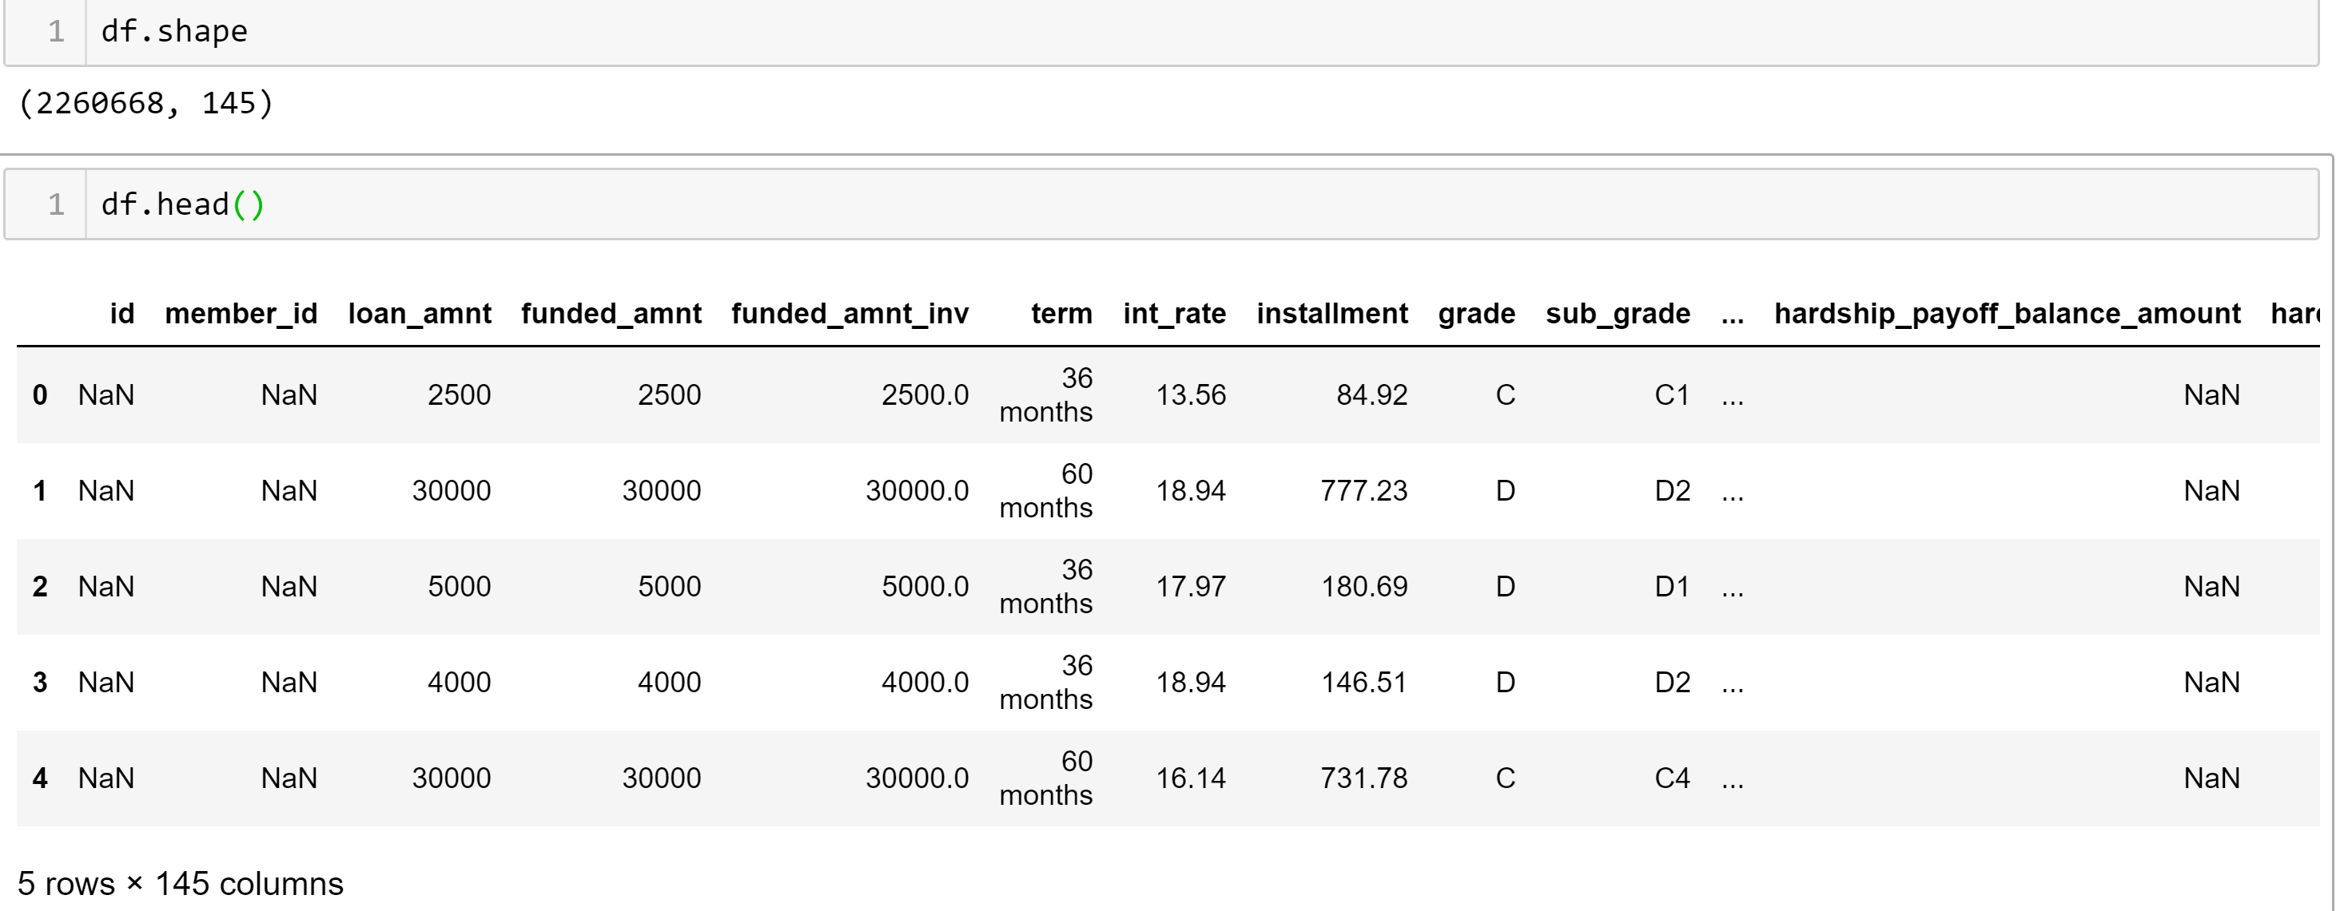
Dataset Snapshot

Slide 7
Data processing flow
Read the source loan.csv
Exploratory Data analysis
Impute Null Values
Split the data into train and test
Train the model using different classifiers
Test and evaluate the model
Compare different classifiers
Clean data having missing values or duplicates
Feature Selection using Random Forest Classifier

Slide 8
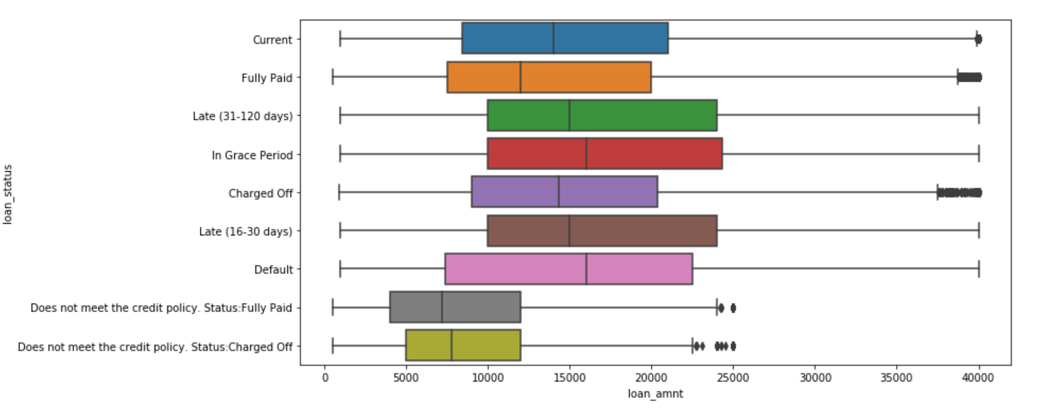
exploratory Data analysis Loan status Stats

Slide 9
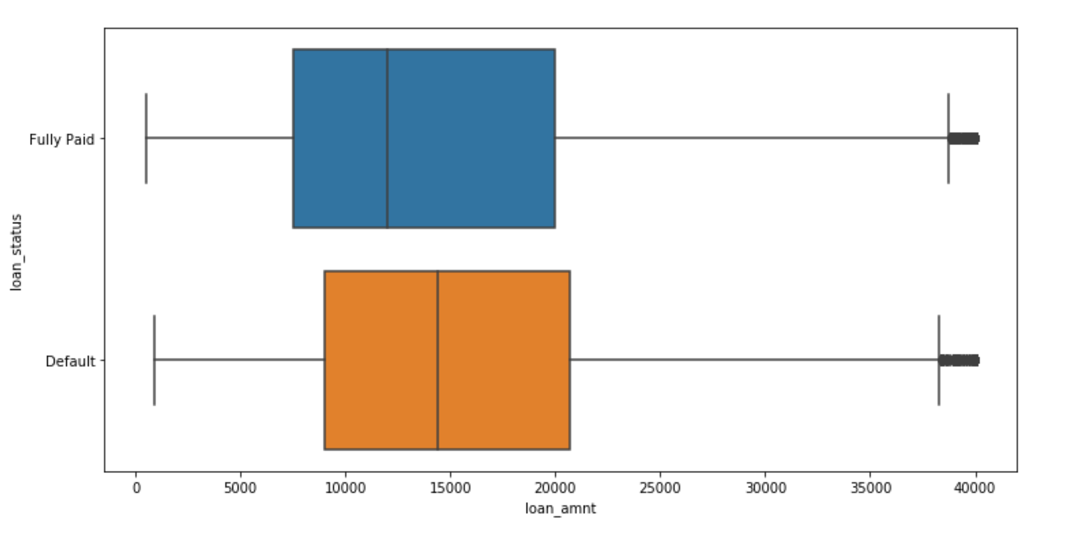
Loan Stats – target variable

Slide 10
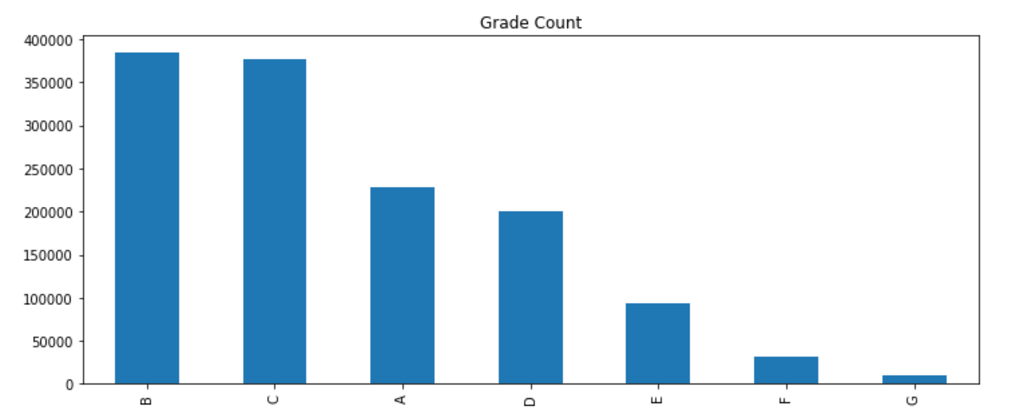
Count of Grade count distribution

Slide 11
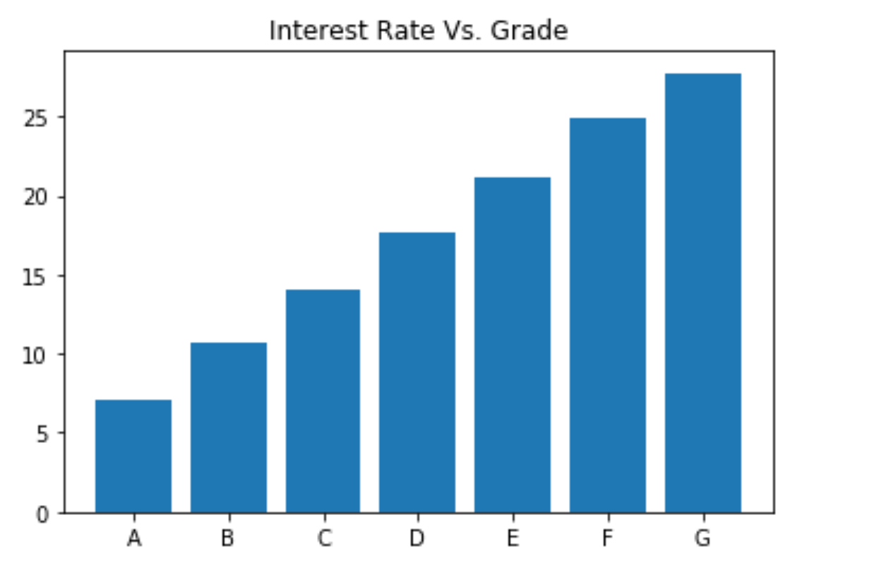
Grade distribution based on interest rate

Slide 12
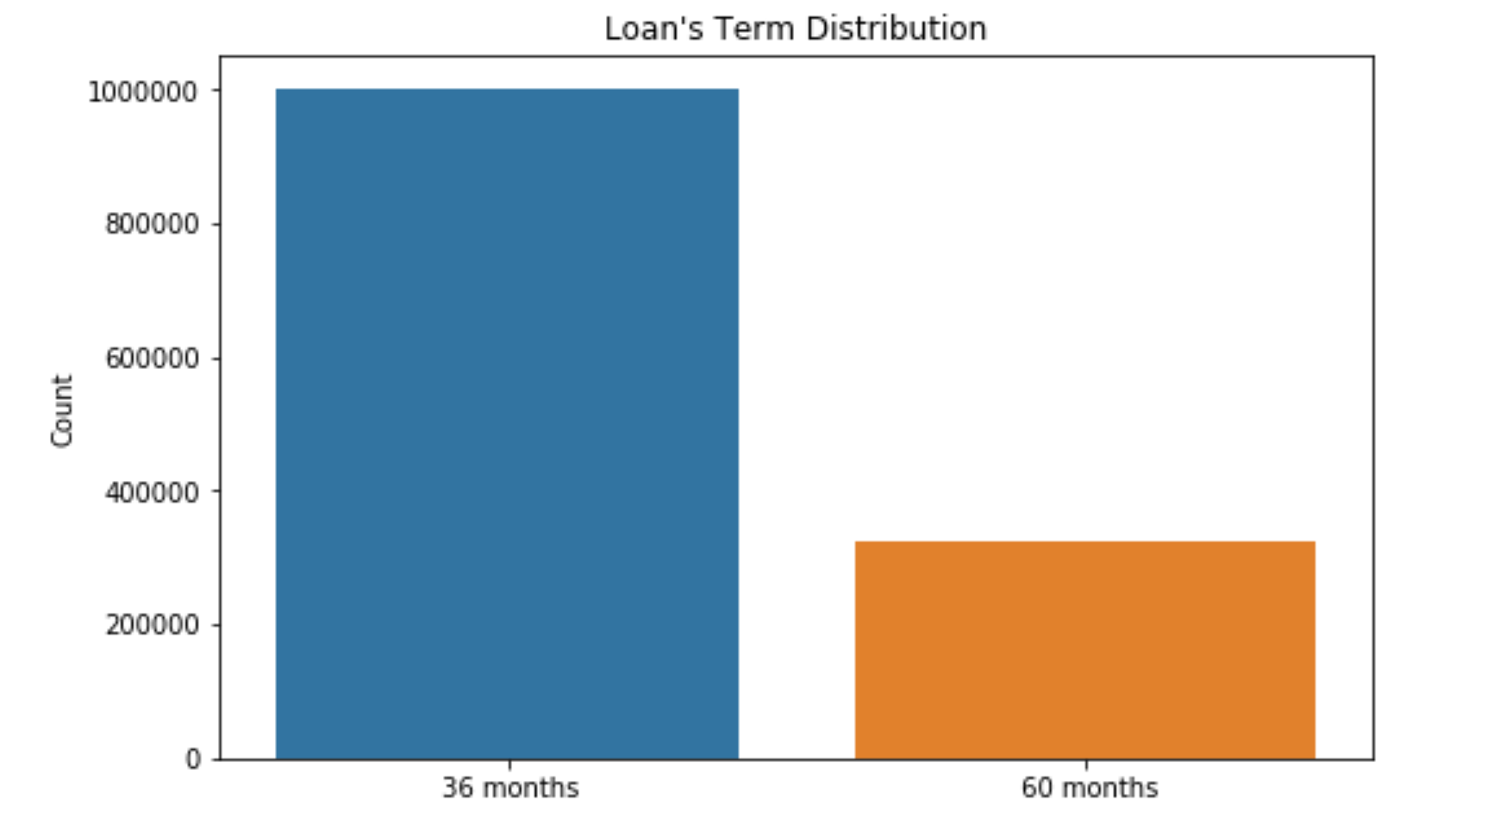
Loan Term distribution

Slide 13
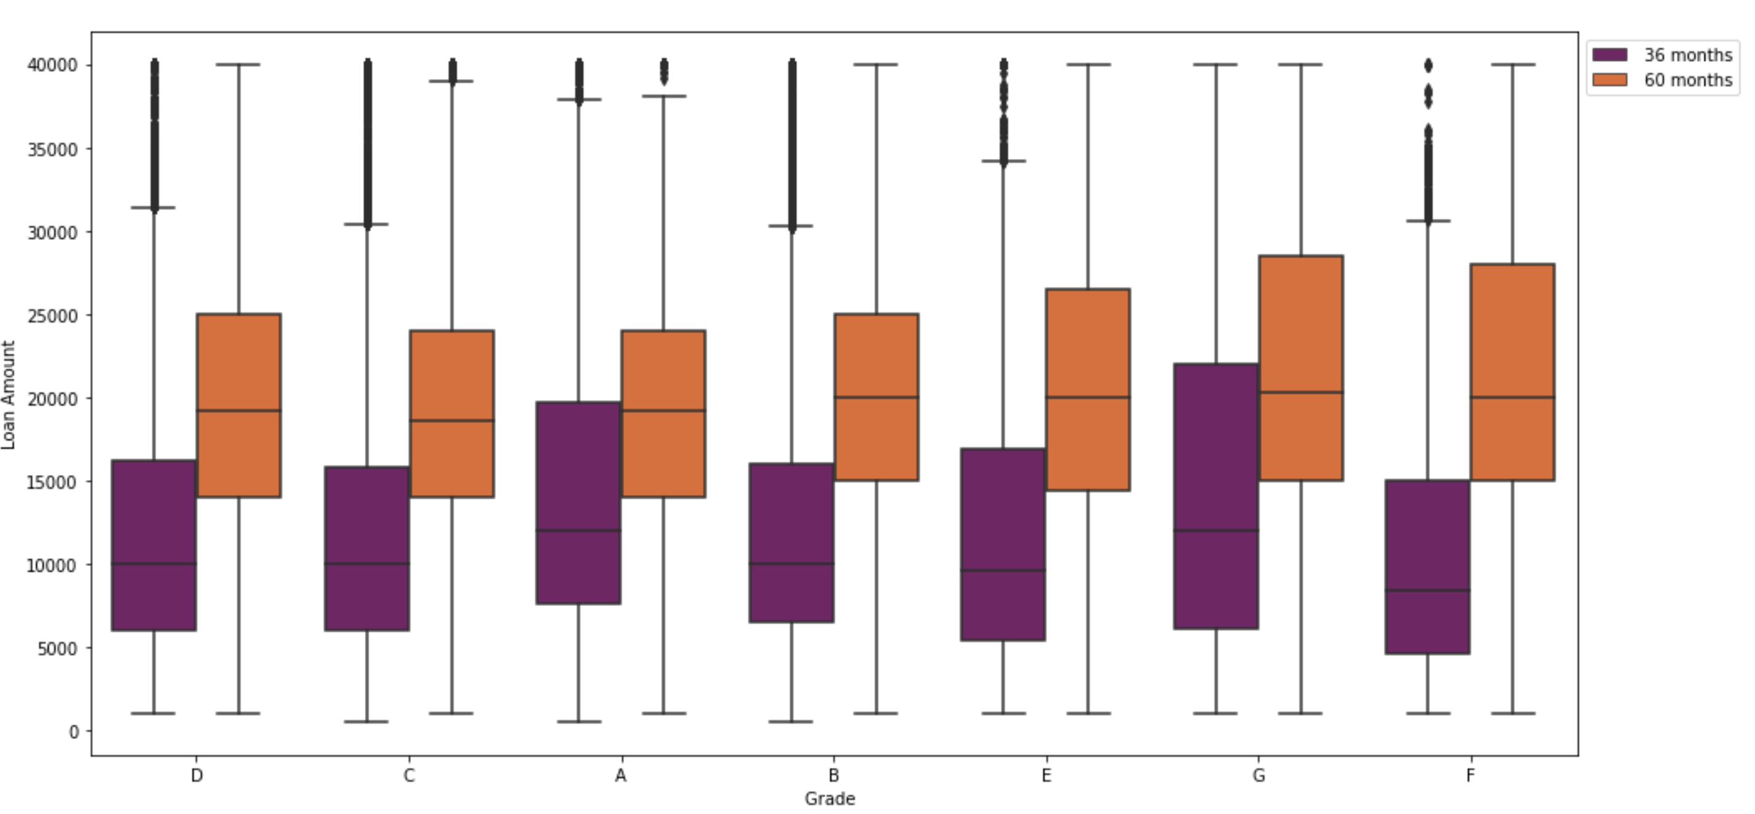
Loan term distribution across various grades

Slide 14
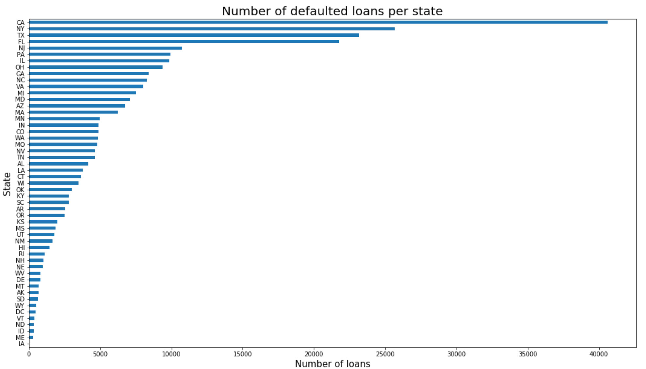
Loan defaulter’s in every state
We visualize the number of defaulters for each state in The U.S.
X- axis being the States we are considering and Y-axis being the number of loans, which has a scale of 5000.

Slide 15
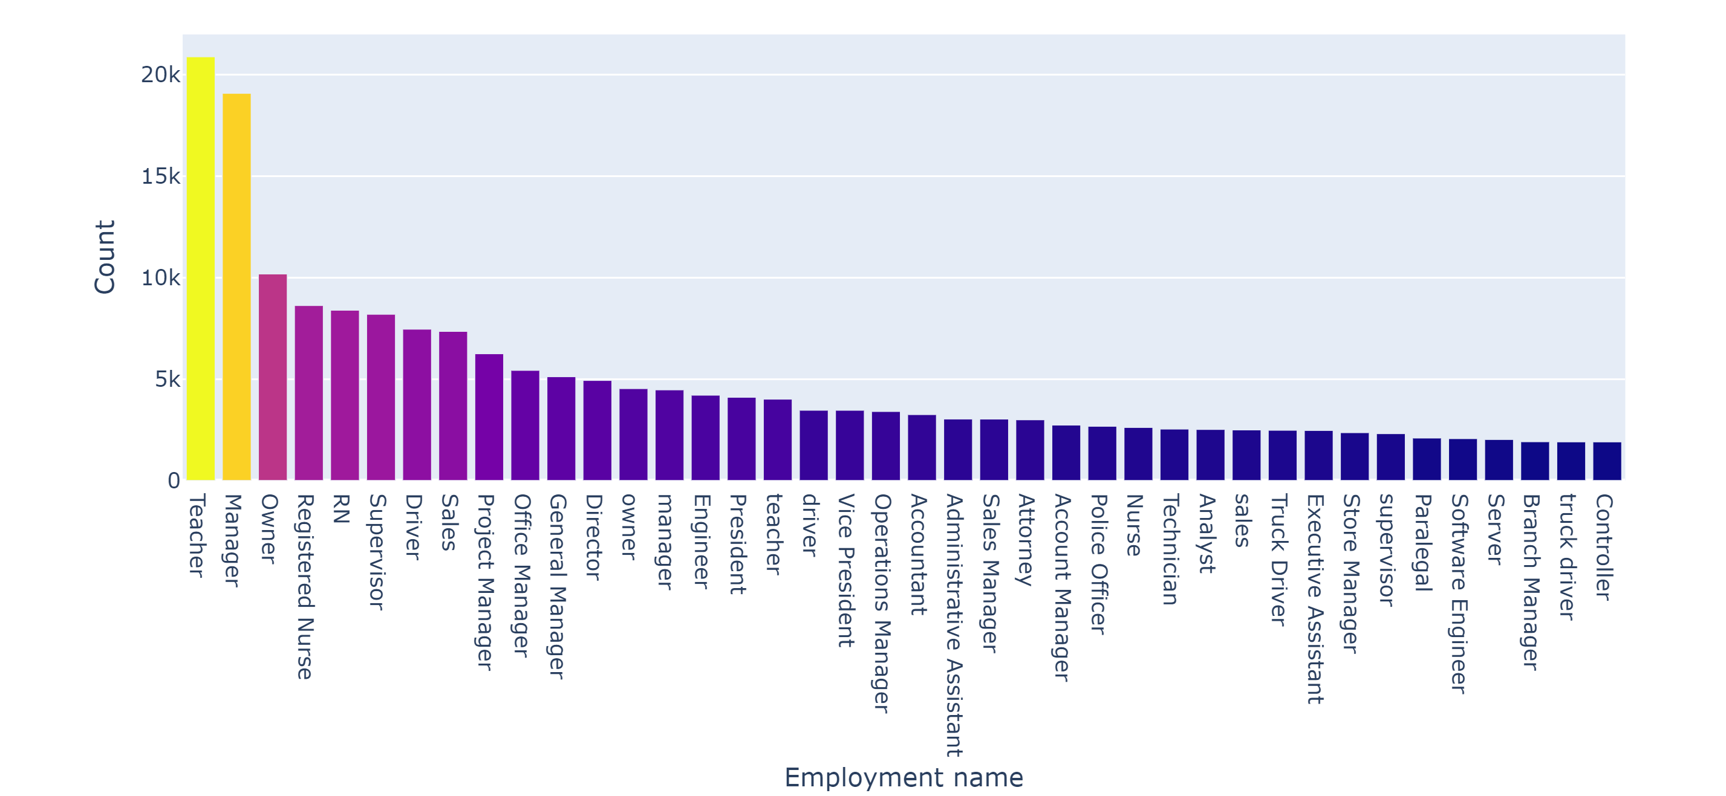
Top 40 employment types based on loan taken

Slide 16
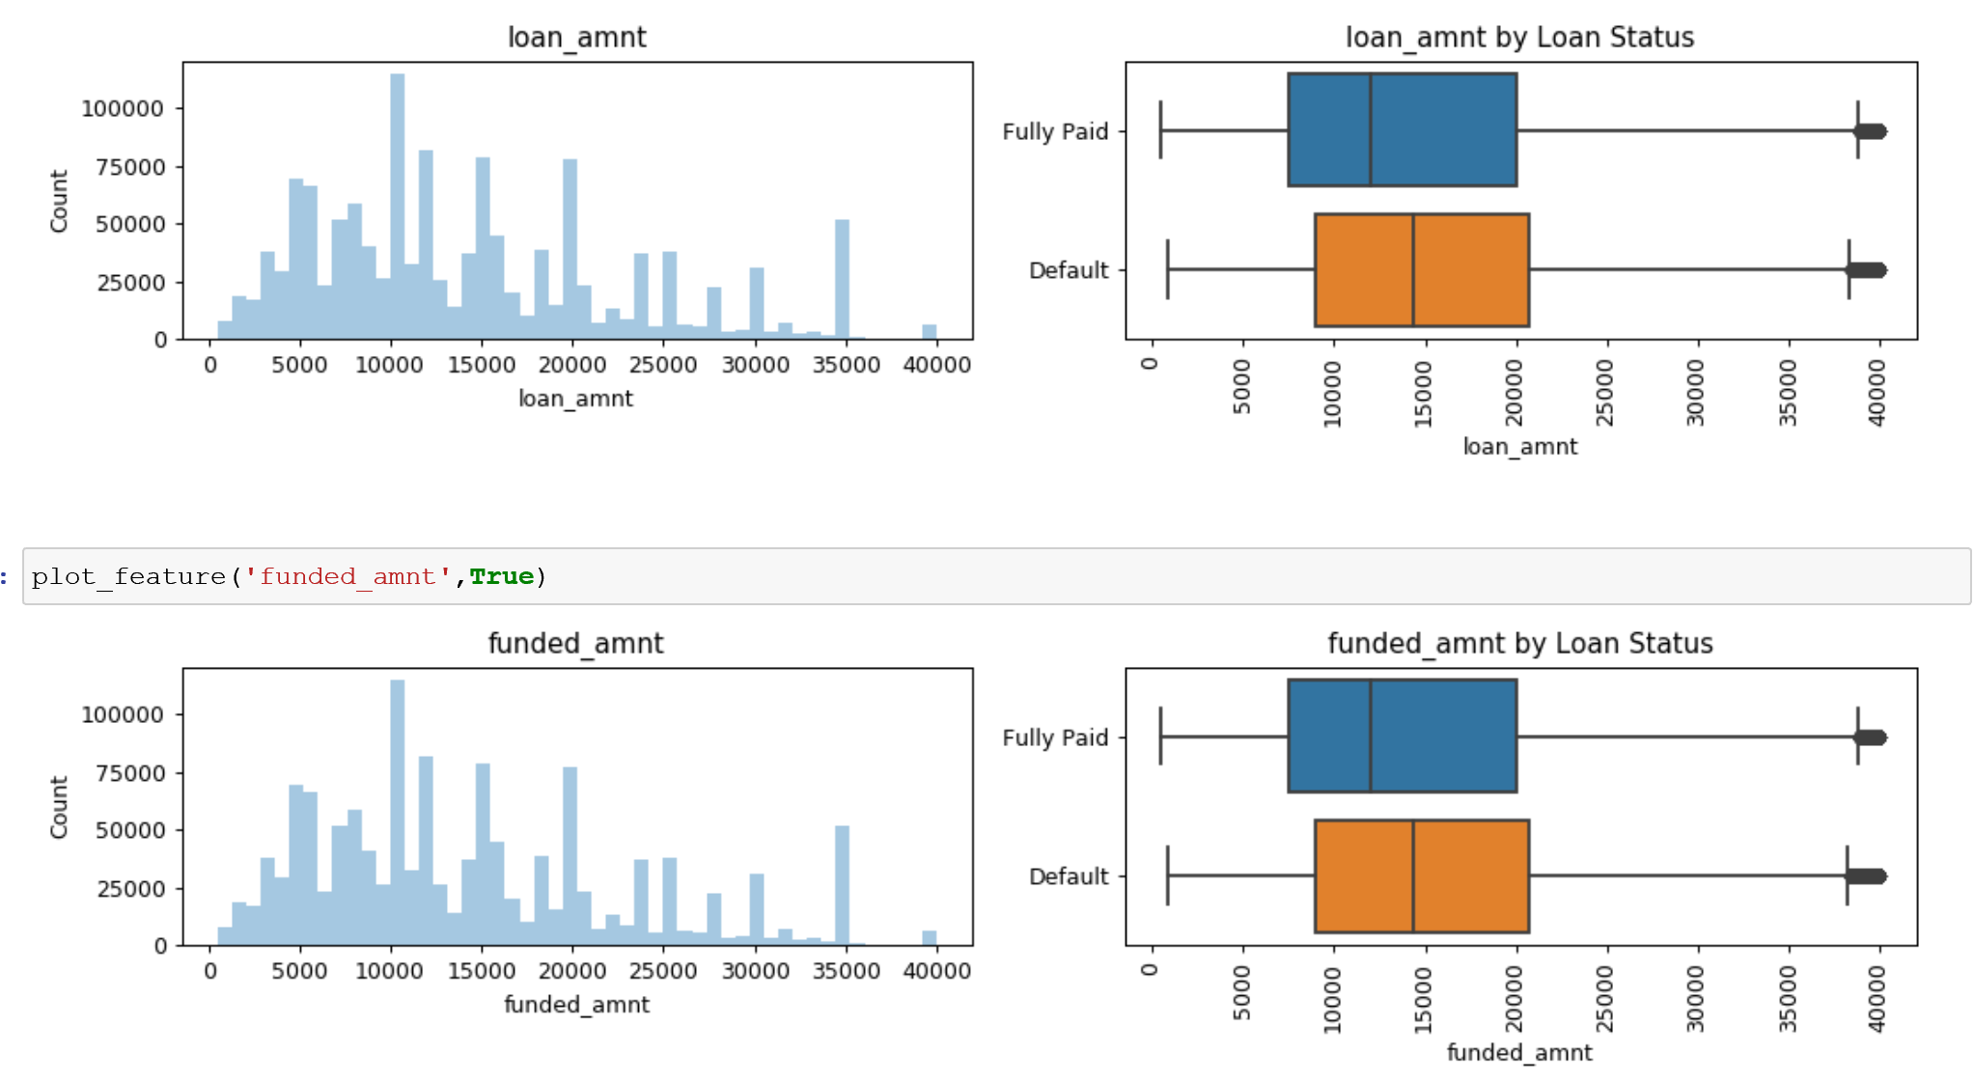
exploratory Data analysis

Slide 17
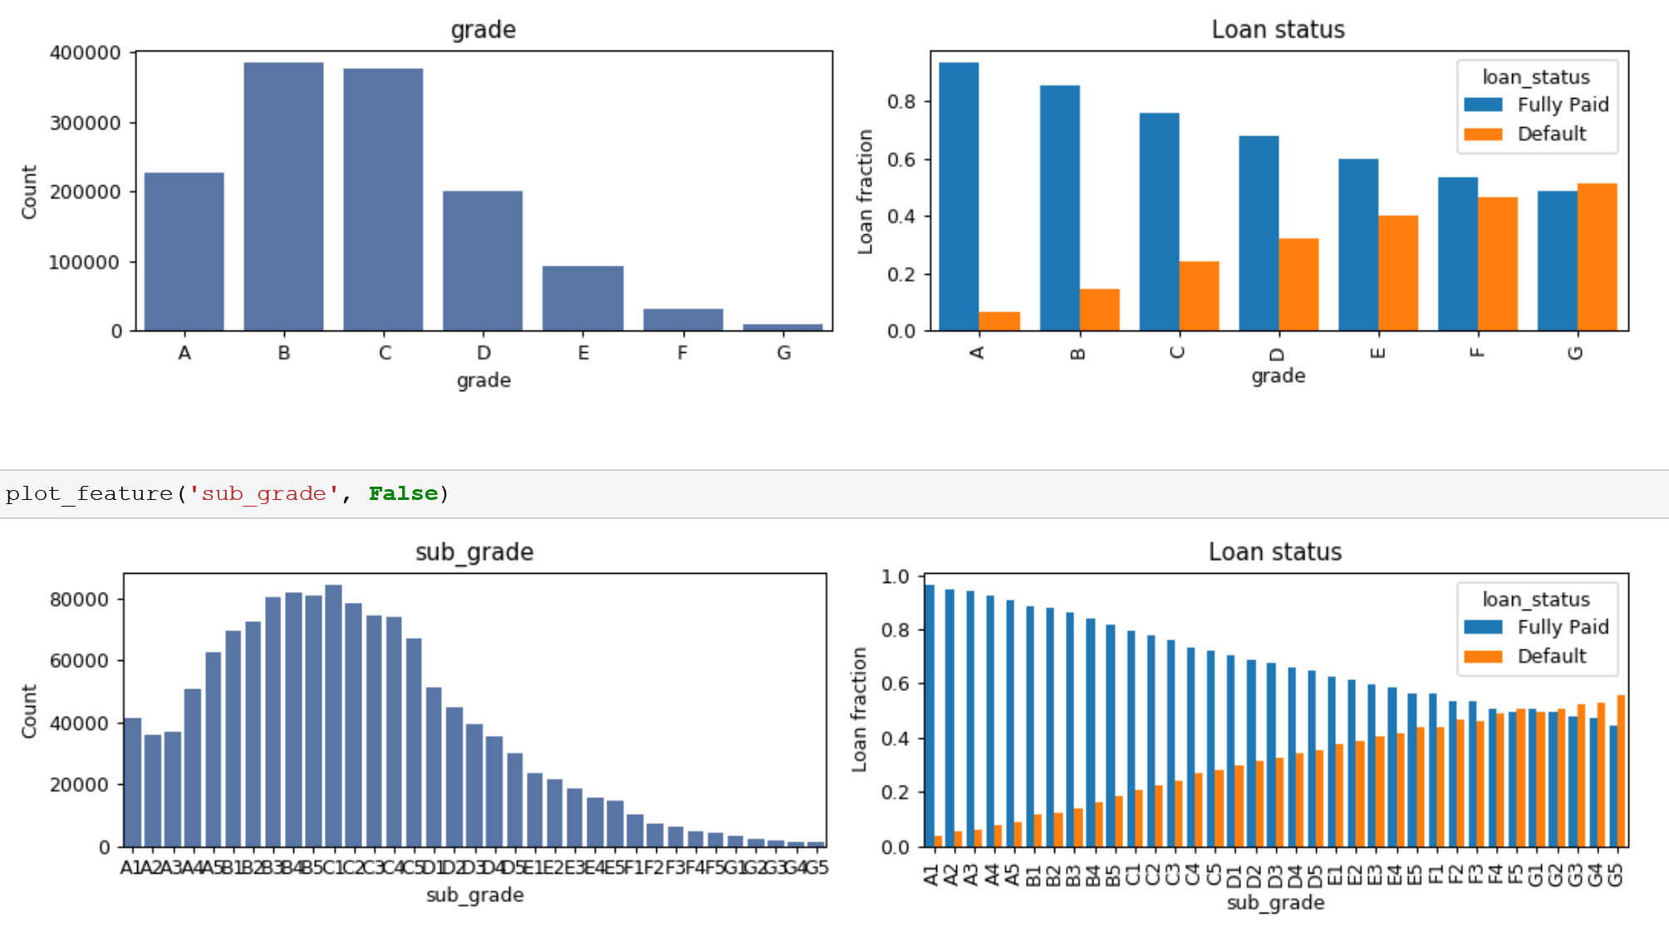
exploratory Data analysis

Slide 18
Data cleaning and preprocessing
The dataset consists of 2.26 M points and 145 columns hence we had to reduce the columns and select only required feature.
We started of with some Exploratory data analysis just to see the correlation between variable and columns which are important
Once we did some EDA we started cleaning the dataset
We removed columns which had majority missing values (>50%)
Based on real world financial importance we kept columns which are required such as loan_amt, credit_score etc.
We started plotting and removed columns which were reduntant. For ex: loan_amt and funded_amt were similar hence we removed funded_amt. In a similar way we removed many columns which were reduntant

Slide 19
Data cleaning and preprocessing
Encoding the Categorical Variable One hot encoding for multiple categories and Label encoding for binary categorical features.
Imputation of Missing Value After feature selection , There are still some columns with missing data. Hence, will impute the missing value with mode which is the most frequent value in the column, moreover, it would apply well on the categorical variable.

Slide 20
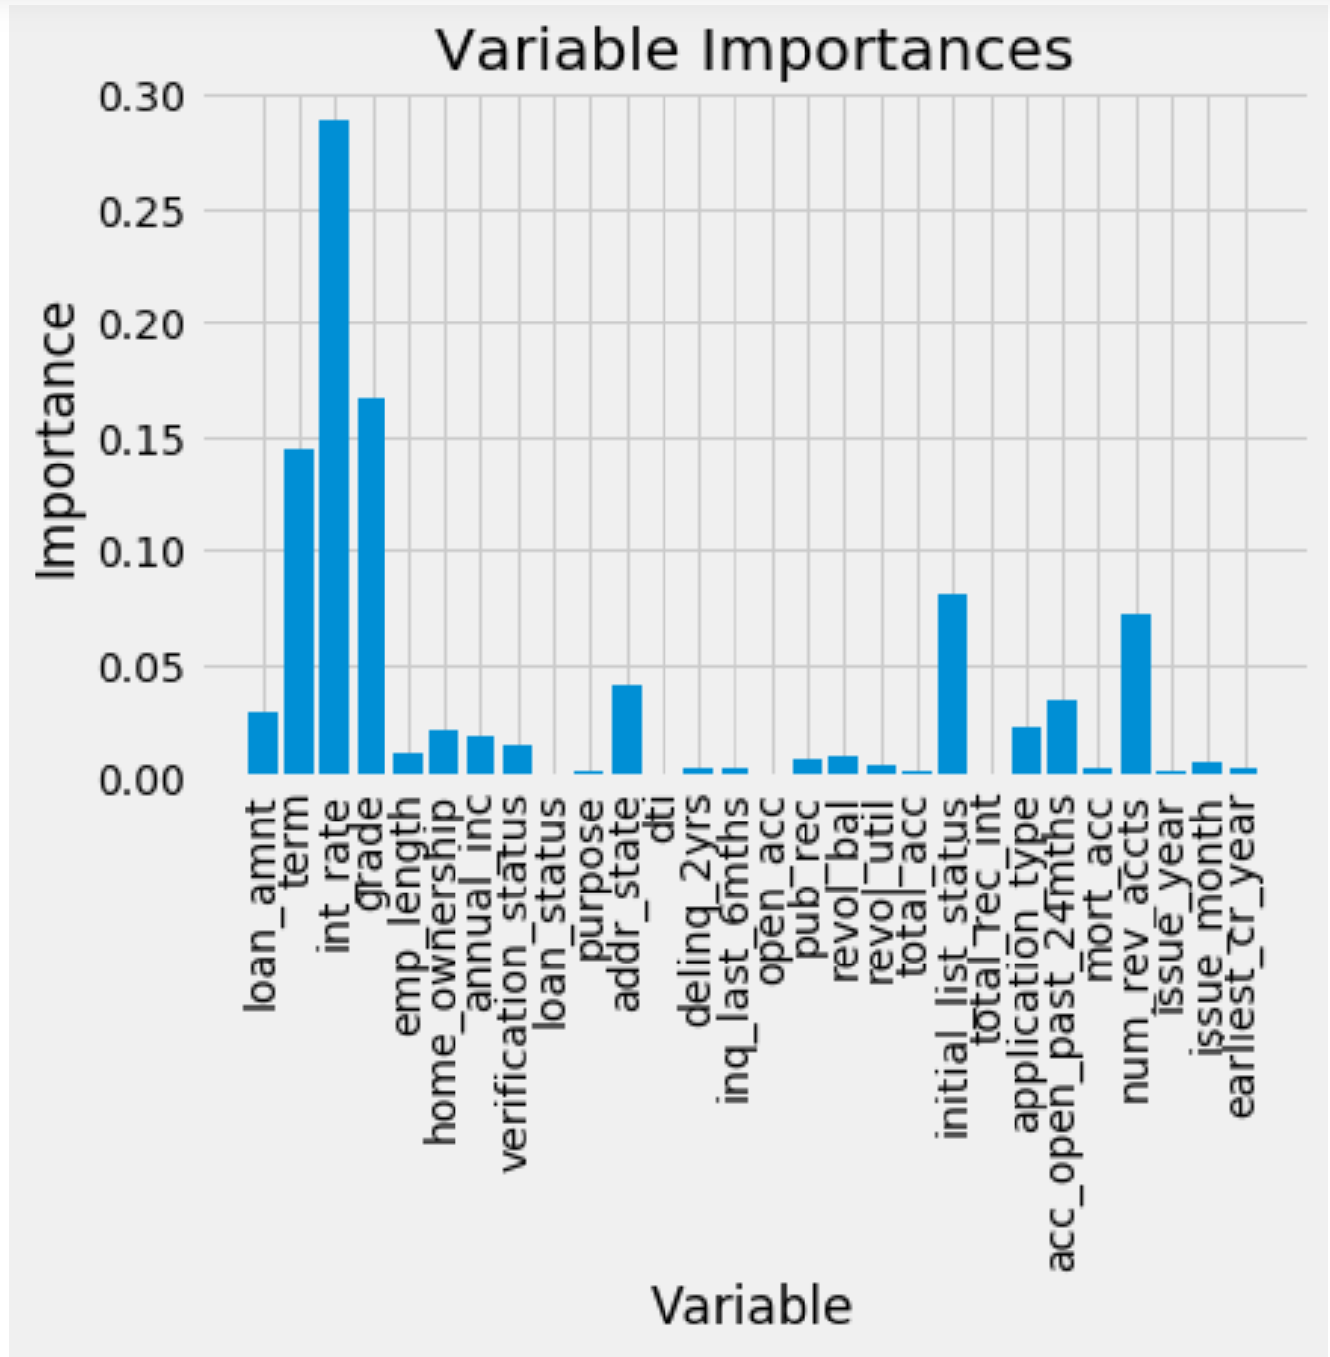
Important features selection using random forest classifier

Slide 21
methodologies
Classifiers | Description
XGBoost | XGBoost is an implementation of gradient boosted decision trees designed for speed and performance
Random Forest | Random forest use the bagging idea, it resamples the data and features which will decrease the variance in the model
Logistic Regression | Logistic regression is the appropriate regression to conduct when the dependent variable is dichotomous
Naïve Bayes | Naïve Bayes classifiers are working based on the Bayes’ theorem, which describes the probability of an event

Slide 22
METRICS
Confusion Matrix
MAE
MSE
R2

Slide 23
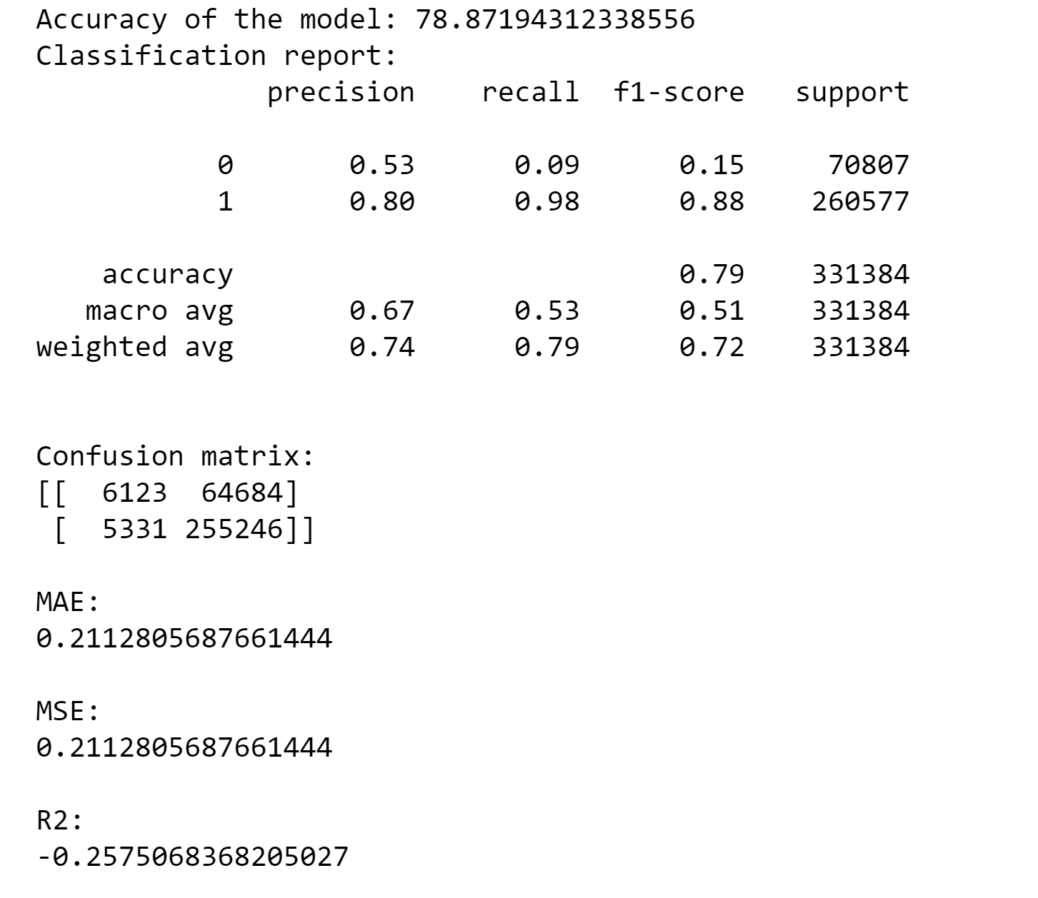
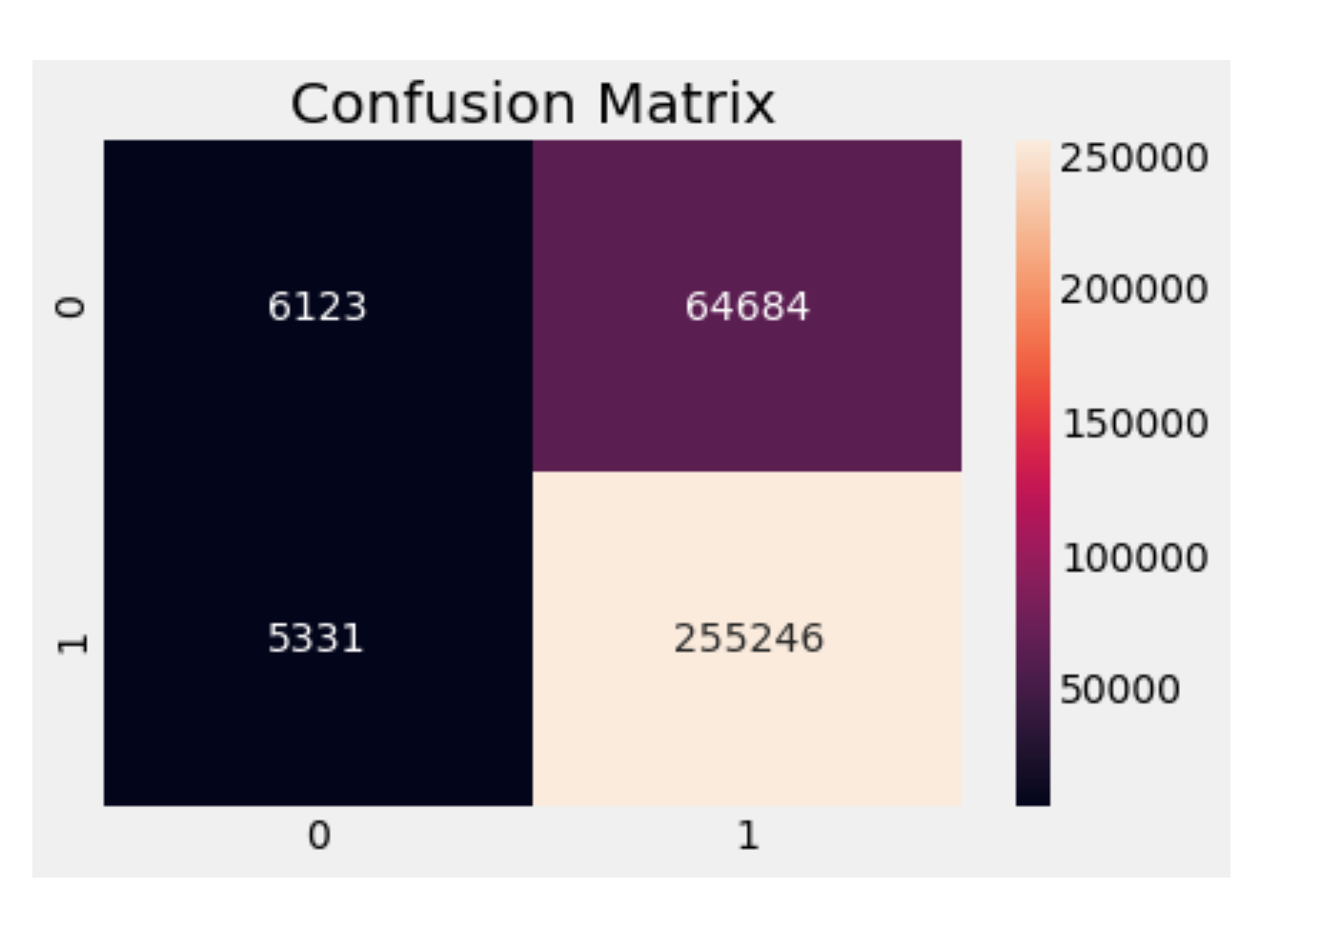
Logistic regression

Slide 24
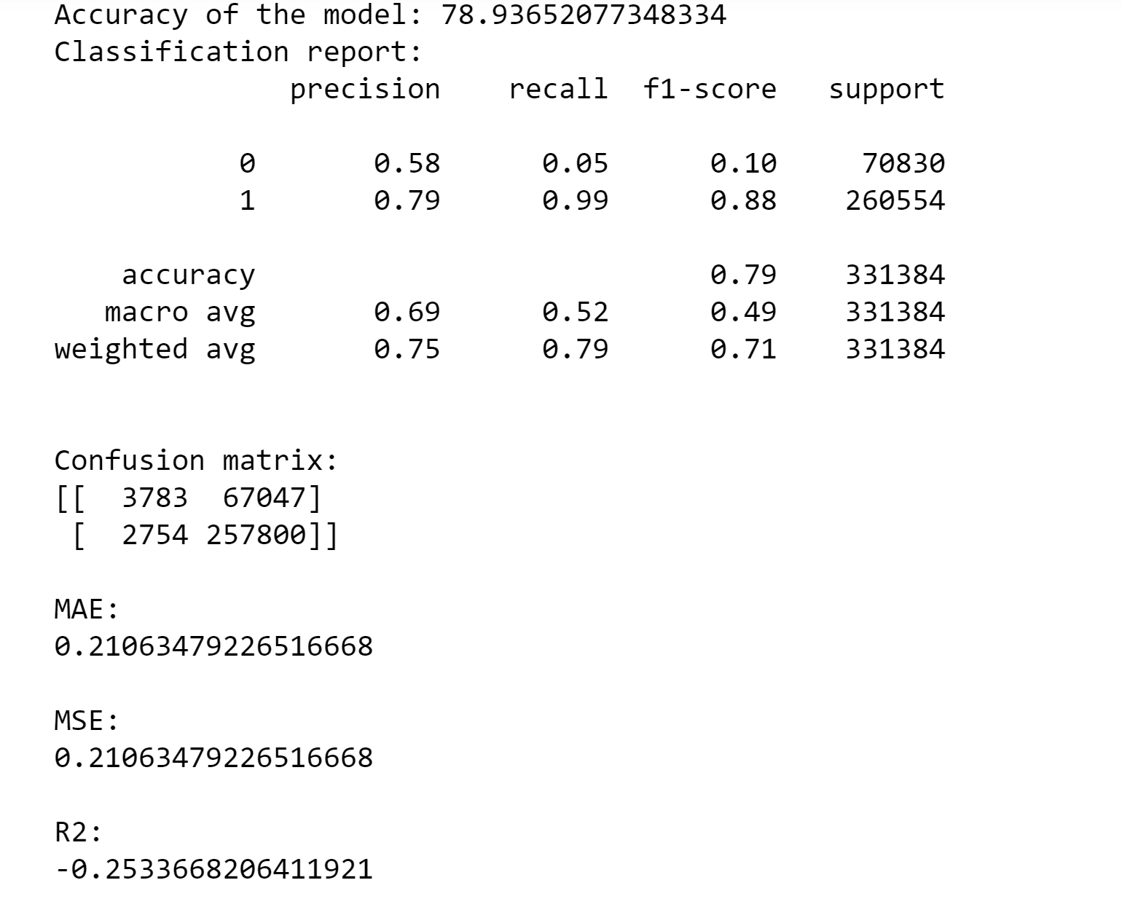
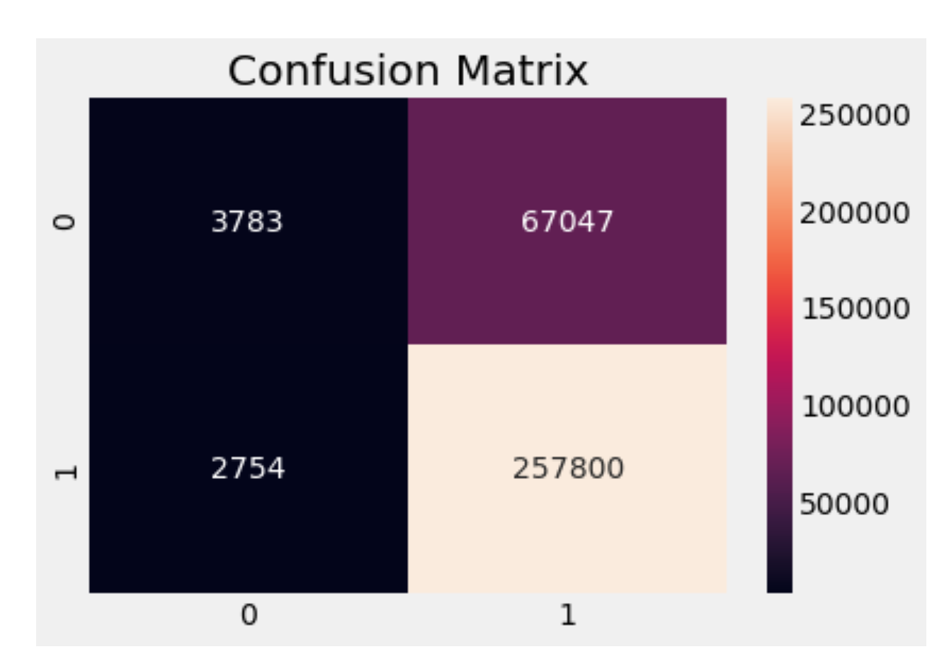
Random forest

Slide 25
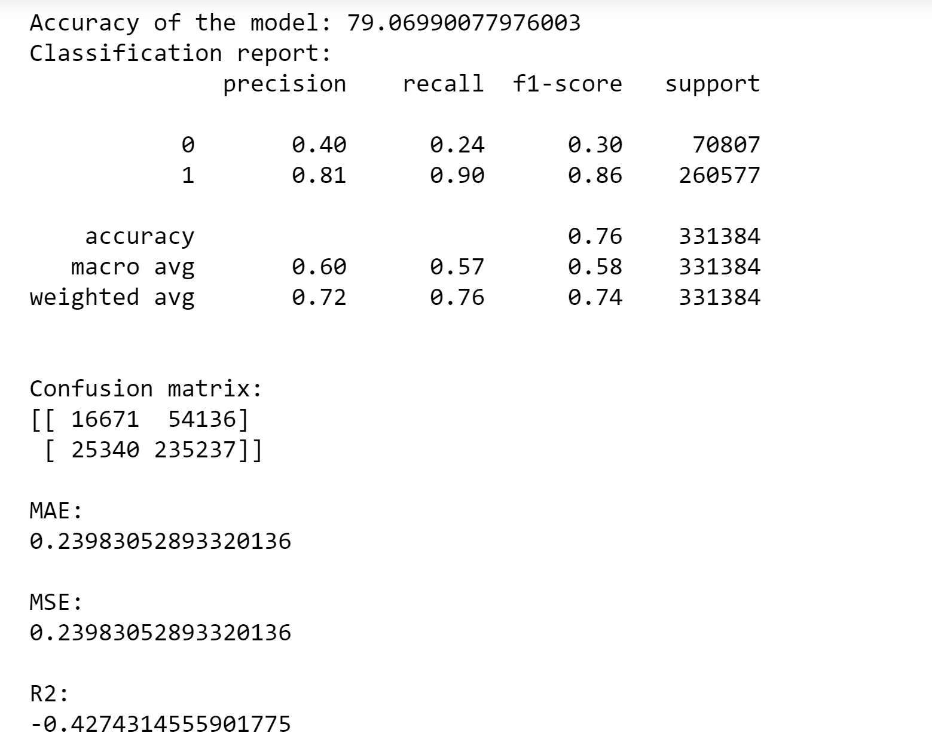
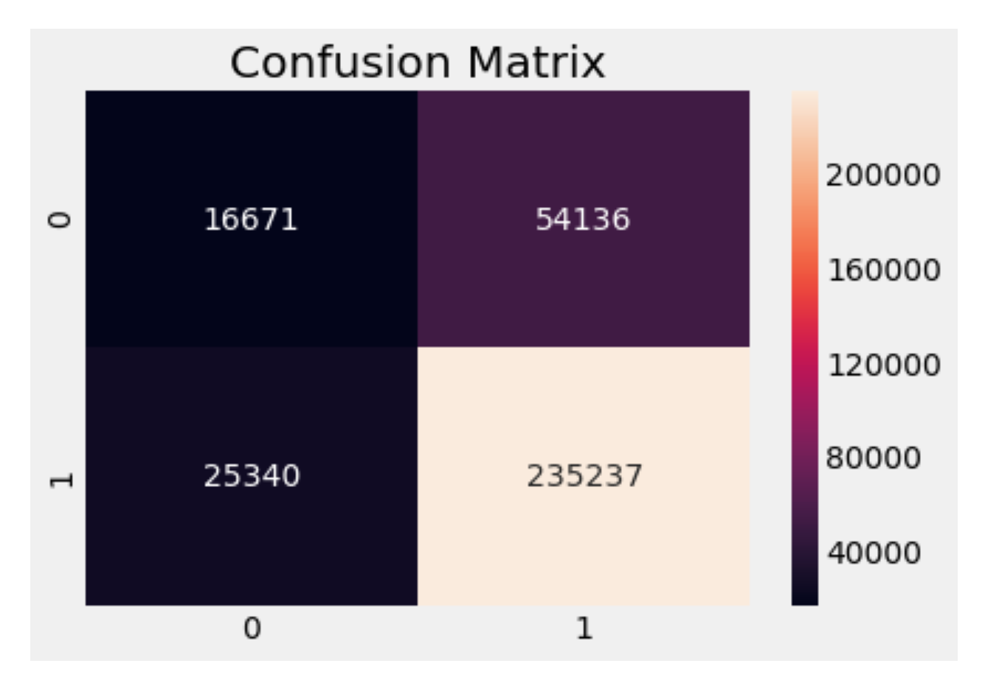
xgbOOST

Slide 26
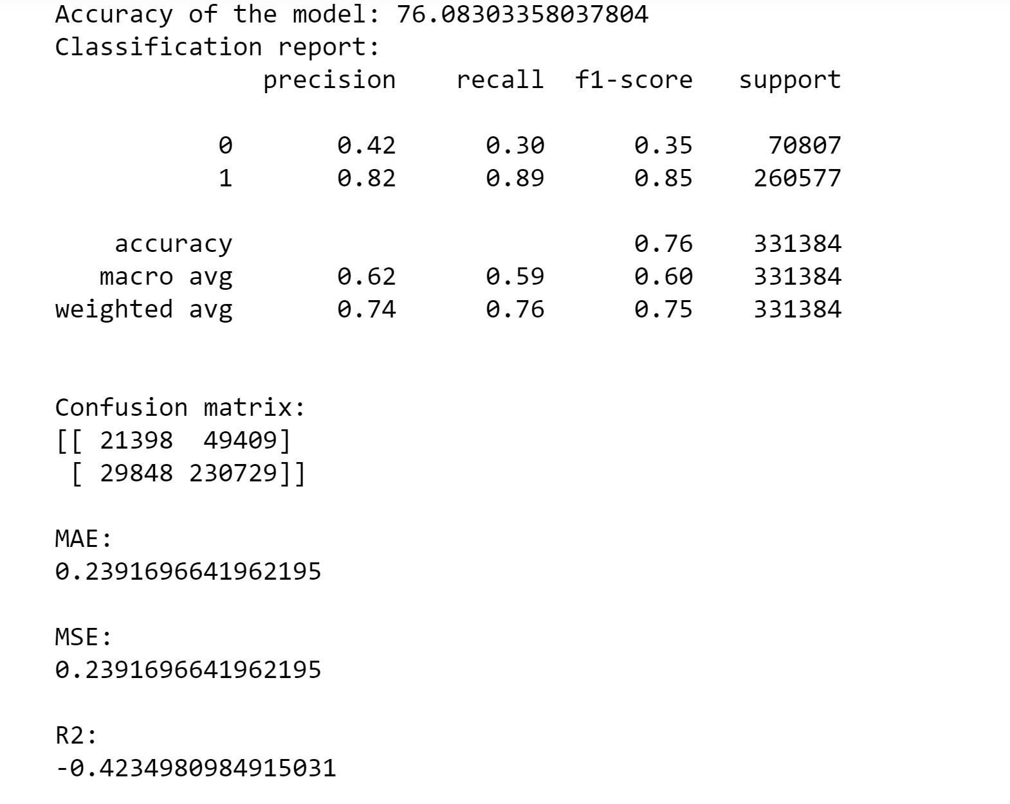
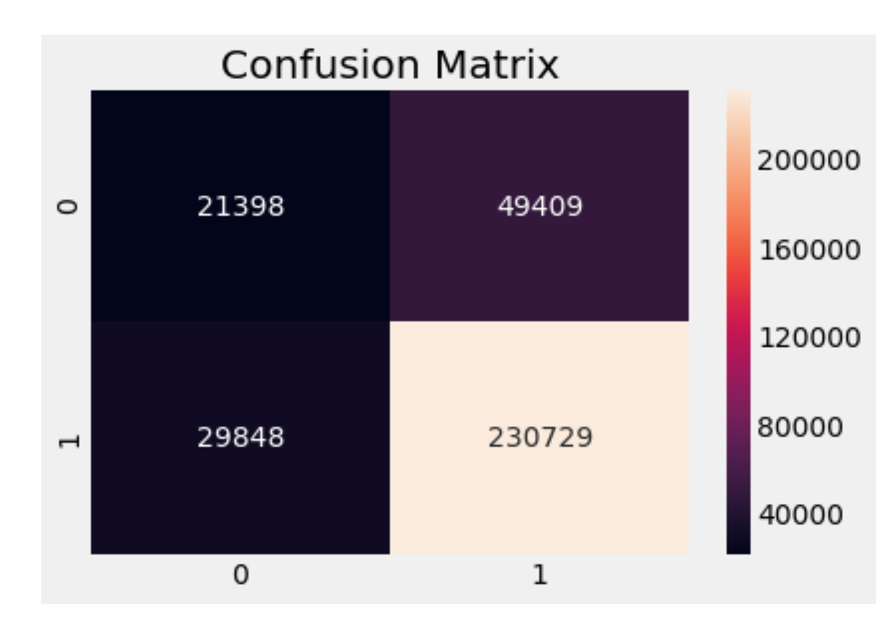
Naïve Bayes

Slide 27
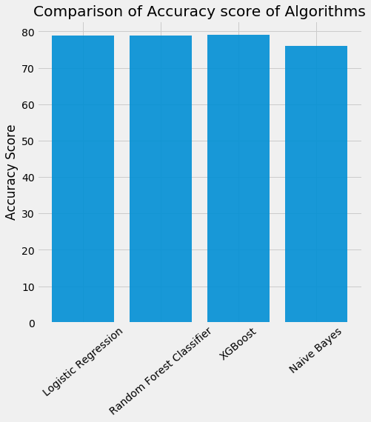
Comparison of algorithms

Slide 28
results
Classifiers | Precision | Recall | F1 score | Accuracy
XGBoost | 0.81 | 0.91 | 0.86 | 79.06%
Naïve Bayes | 0.82 | 0.89 | 0.85 | 76.08%
Logistic Regression | 0.80 | 0.98 | 0.88 | 76.87%
Random Forest | 0.81 | 0.98 | 0.88 | 78.01%

Slide 29
Future work
Use different machine learning algorithms in feature selection and also perform manual feature engineering.
Evaluate the performance of three different models on validation set using their precision, recall and f1-score.
Use various other algorithms such as Neural networks and boosting algorithms

Slide 30
References
https://towardsdatascience.com/introduction-to-logistic-regression-66248243c148
https://machinelearningmastery.com/
https://towardsdatascience.com/understanding-random-forest-58381e0602d2
https://www.kaggle.com/wendykan/lending-club-loan-data

Slide 31
Thank you

