Slide 1
252-0027
Introduction to Programming
Exercises
Week 8: Classes, Loop Invariants
Rares Iordache
Department of Computer Science
ETH Zurich

Slide 2
Organization
My name: Rares Iordache
For questions: riordache@ethz.ch
  Please put «[EProg26]» in the subject
New exercises: Tuesday evening (normally)
Submit exercises by Tuesday evening (23:59) following week
  Always submit via Git
  Solutions in a separate Git project

Slide 3
Review

Slide 4
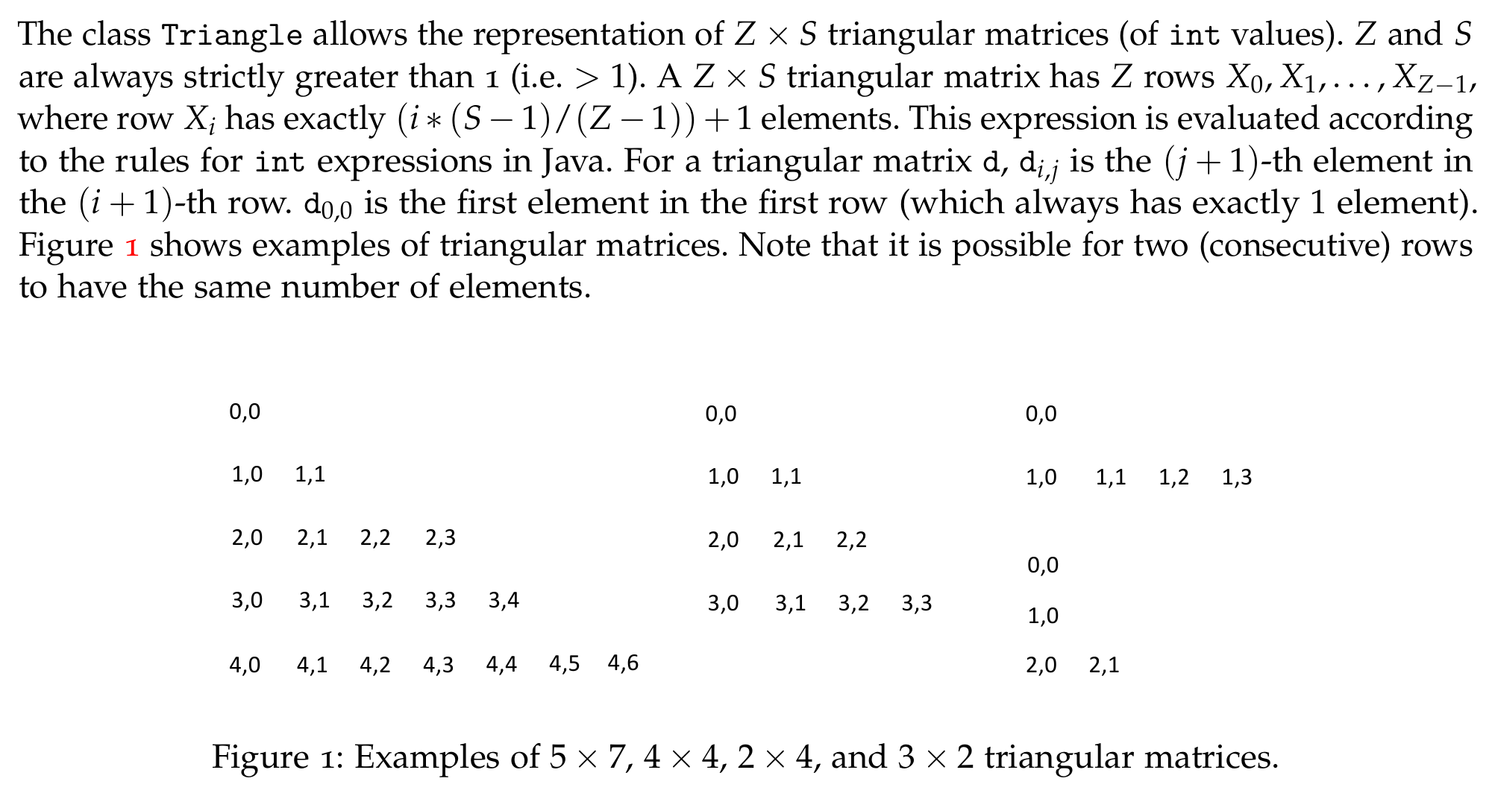
Exercise 1: Triangle Matrix

Slide 5
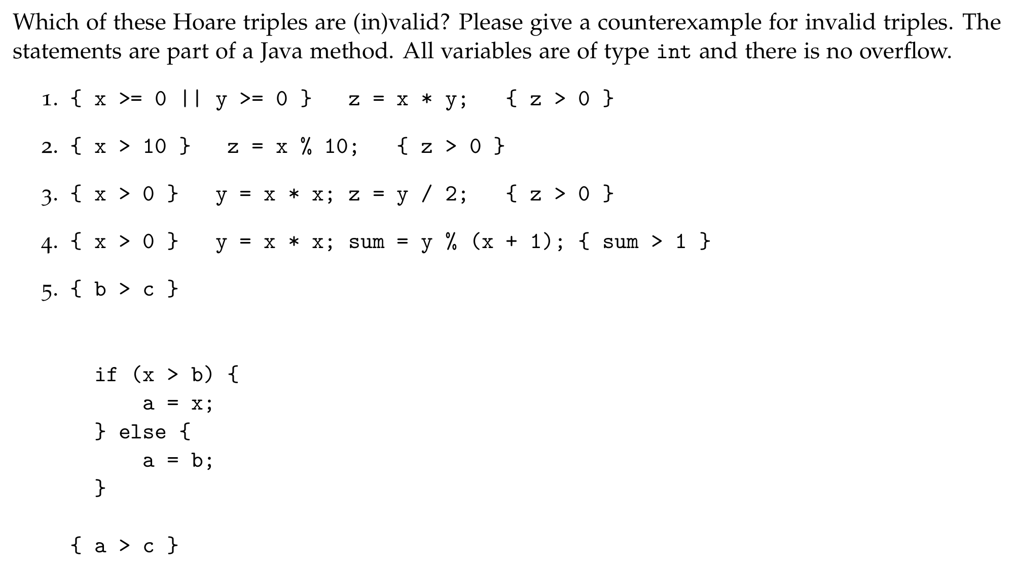
Exercise 2: Hoare Triple

Slide 6
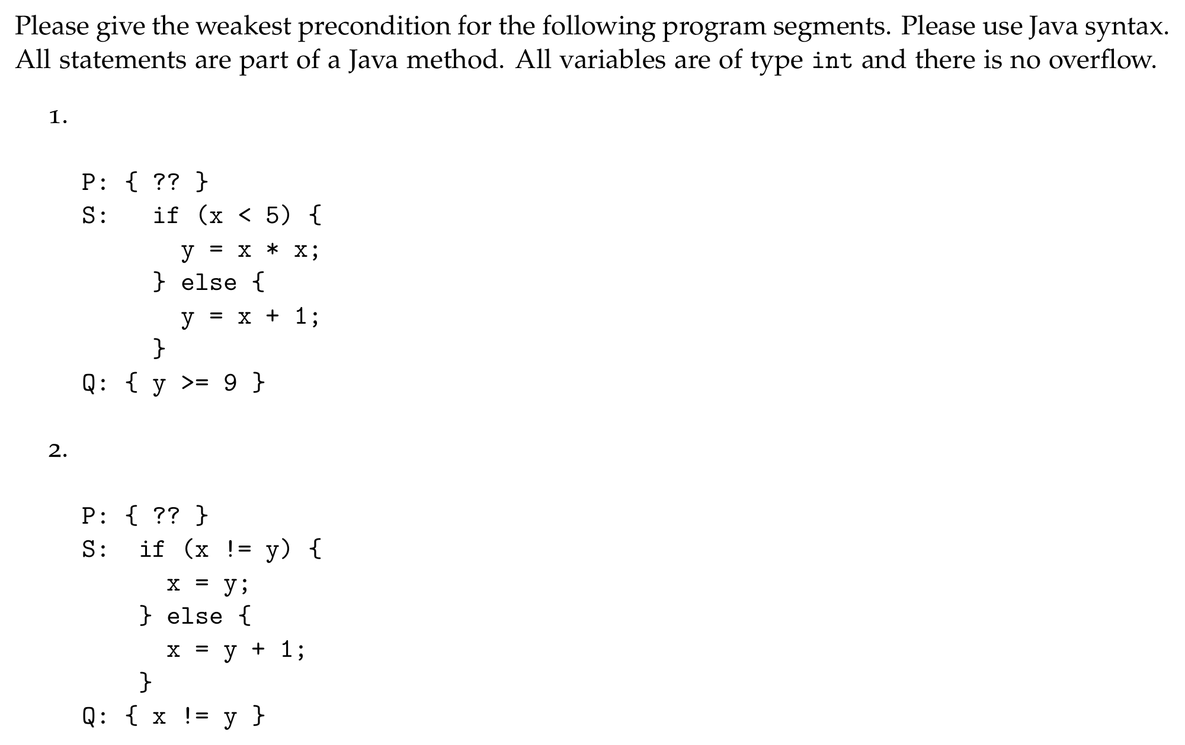
Exercise 3: Weakest Precondition

Slide 7
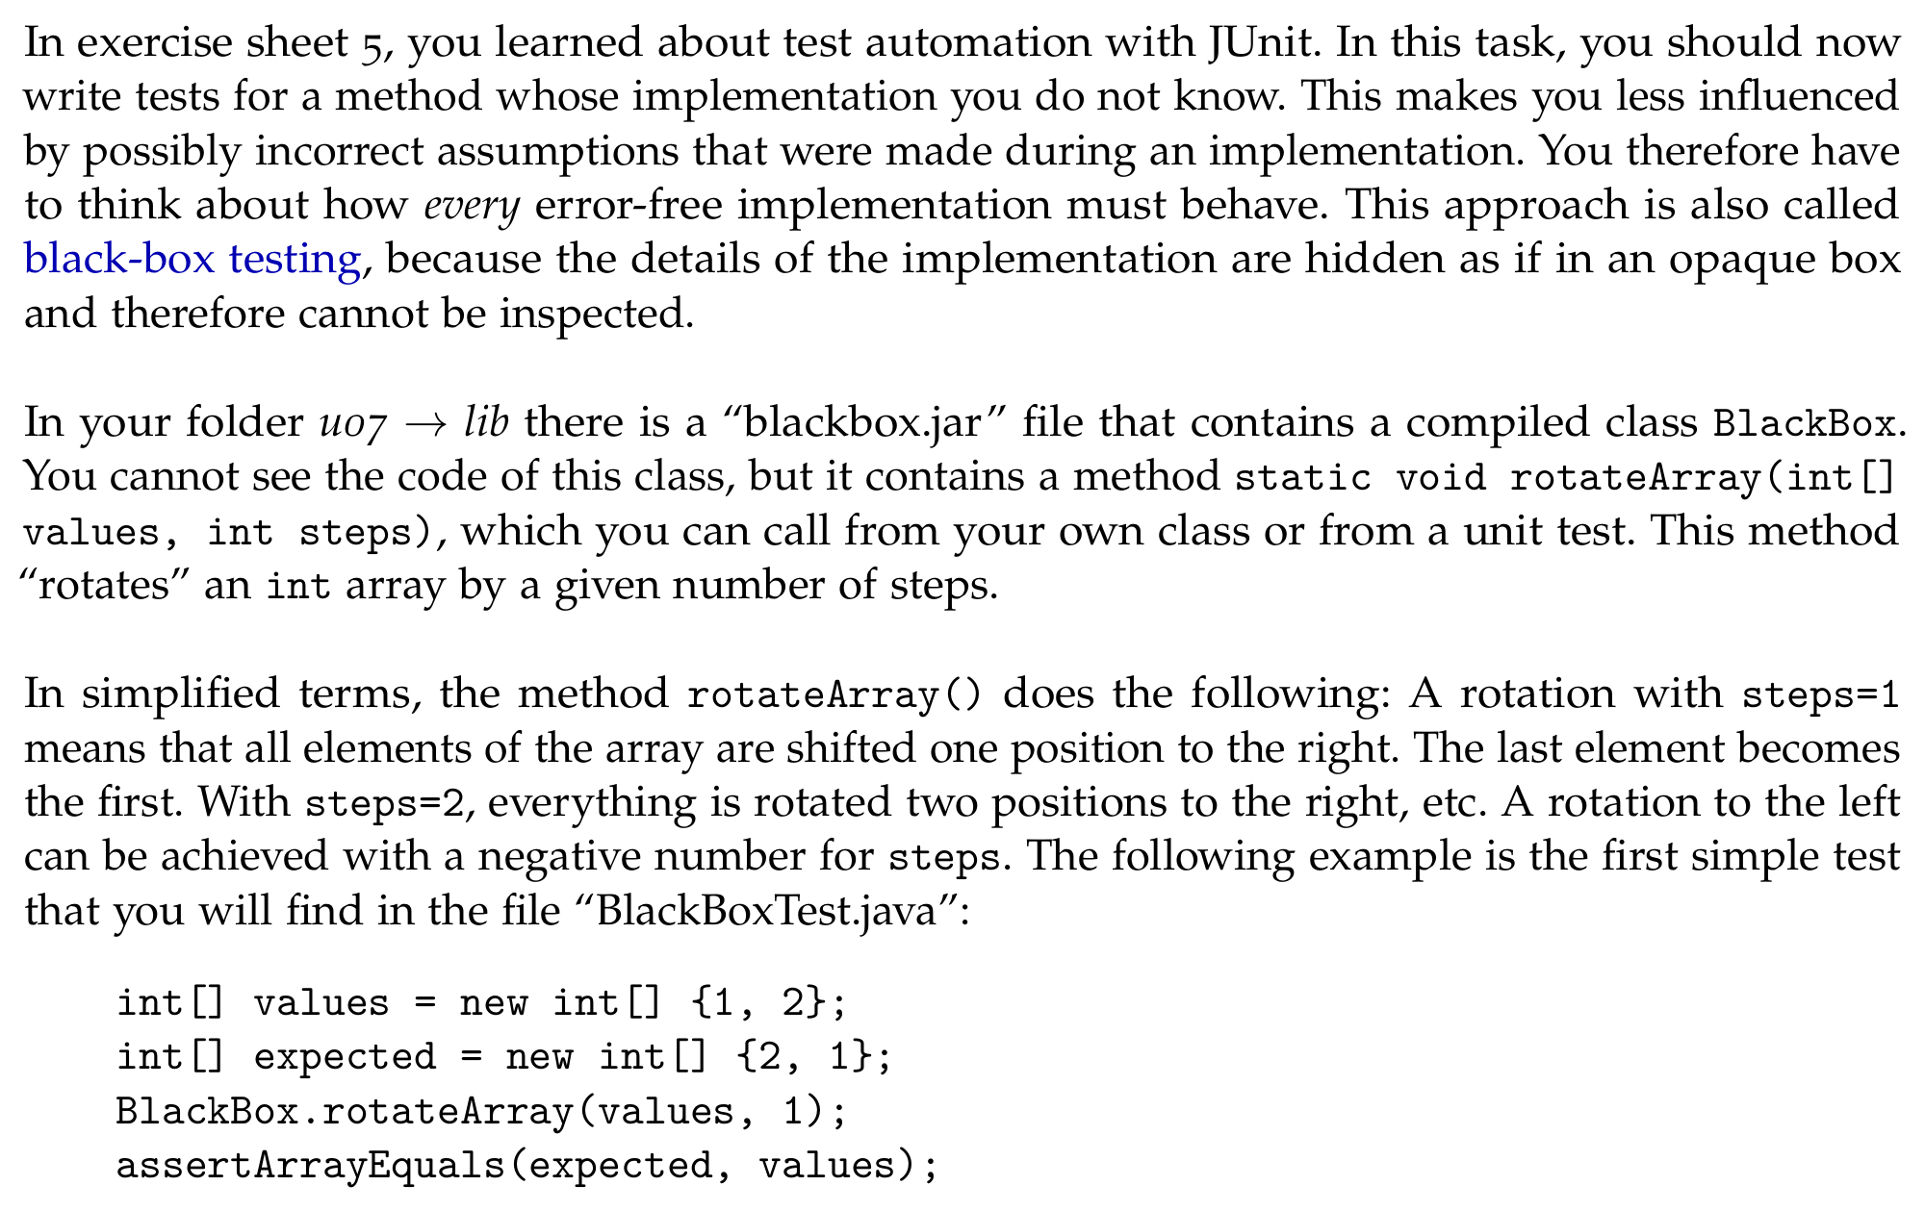
Exercise 4: Blackbox Testing

Slide 8
Loop Invariants

Slide 9
public int compute(int a, int b) {
// Precondition: a >= 0
int x;
int res;
x = a;
res = b;
// Loop-Invariante: ??
while (x > 0) {
x = x - 1;
res = res + 1;
}
// Postcondition: res == a + b
return res;
}
Intuition
The loop invariant is …
before the loop,
after every execution of the while body,
after the loop
…satisfied.

Slide 10
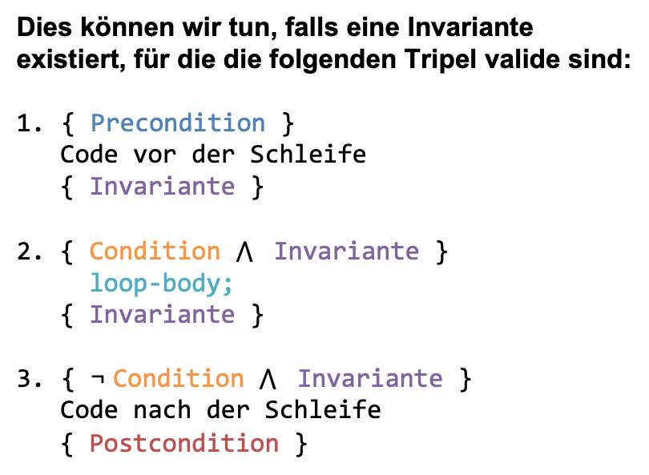
public int compute(int a, int b) {
// Precondition: a >= 0
int x;
int res;
x = a;
res = b;
// Loop-Invariante: ??
while (x > 0) {
x = x - 1;
res = res + 1;
}
// Postcondition: res == a + b
return res;
}
Intuition
The loop invariant is …
before the loop,
after every execution of the while body,
after the loop
…satisfied.
Motivation
We want to prove the following Hoare triple:
{ Precondition }
while ( Condition ) { Body };
{ Postcondition }
We can do this if an invariant exists for which the following triples are valid:
{ Precondition }
Code before the loop
{ Invariant }
2. { Condition ∧ Invariant }
loop-body;
{ Invariant }
{ ¬ Condition ∧ Invariant }
  Code after the loop
{ Postcondition }

Slide 11

Intuition
The loop invariant is …
before the loop,
after every execution of the while body,
after the loop
…satisfied.
Motivation
We want to prove the following Hoare triple:
{ Precondition }
while ( Condition ) { Body };
{ Postcondition }
public int compute(int a, int b) {
// Precondition: a >= 0
int x;
int res;
x = a;
res = b;
// Loop-Invariante: ??
while (x > 0) {
x = x - 1;
res = res + 1;
}
// Postcondition: res == a + b
return res;
}
We can do this if an invariant exists for which the following triples are valid:
{ Precondition }
Code before the loop
{ Invariant }
2. { Condition ∧ Invariant }
loop-body;
{ Invariant }
{ ¬ Condition ∧ Invariant }
  Code after the loop
{ Postcondition }

Slide 12
public int compute(int a, int b) {
// Precondition: a >= 0
int x;
int res;
x = a;
res = b;
// Loop-Invariante: ??
while (x > 0) {
x = x - 1;
res = res + 1;
}
// Postcondition: res == a + b
return res;
}
Derivation Example with Table
Iteration | res | x

Slide 13
public int compute(int a, int b) {
// Precondition: a >= 0
int x;
int res;
x = a;
res = b;
// Loop-Invariante: ??
while (x > 0) {
x = x - 1;
res = res + 1;
}
// Postcondition: res == a + b
return res;
}
Derivation Example with Table
Iteration | res | x
0 | b | a

Slide 14
public int compute(int a, int b) {
// Precondition: a >= 0
int x;
int res;
x = a;
res = b;
// Loop-Invariante: ??
while (x > 0) {
x = x - 1;
res = res + 1;
}
// Postcondition: res == a + b
return res;
}
Derivation Example with Table
Iteration | res | x
0 | b | a
1 | b + 1 | a - 1

Slide 15
public int compute(int a, int b) {
// Precondition: a >= 0
int x;
int res;
x = a;
res = b;
// Loop-Invariante: ??
while (x > 0) {
x = x - 1;
res = res + 1;
}
// Postcondition: res == a + b
return res;
}
Derivation Example with Table
Iteration | res | x
0 | b | a
1 | b + 1 | a - 1
2 | b + 2 | a - 2

Slide 16
public int compute(int a, int b) {
// Precondition: a >= 0
int x;
int res;
x = a;
res = b;
// Loop-Invariante: ??
while (x > 0) {
x = x - 1;
res = res + 1;
}
// Postcondition: res == a + b
return res;
}
Derivation Example with Table
Iteration | res | x
0 | b | a
1 | b + 1 | a - 1
2 | b + 2 | a - 2
3 | b + 3 | a - 3

Slide 17
public int compute(int a, int b) {
// Precondition: a >= 0
int x;
int res;
x = a;
res = b;
// Loop-Invariante: ??
while (x > 0) {
x = x - 1;
res = res + 1;
}
// Postcondition: res == a + b
return res;
}
Derivation Example with Table
Iteration | res | x
0 | b | a
1 | b + 1 | a - 1
2 | b + 2 | a - 2
3 | b + 3 | a - 3
… | … | …

Slide 18
public int compute(int a, int b) {
// Precondition: a >= 0
int x;
int res;
x = a;
res = b;
// Loop-Invariante: ??
while (x > 0) {
x = x - 1;
res = res + 1;
}
// Postcondition: res == a + b
return res;
}
Derivation Example with Table
Iteration | res | x
0 | b | a
1 | b + 1 | a - 1
2 | b + 2 | a - 2
3 | b + 3 | a - 3
… | … | …
i | b + i | a - i

Slide 19
public int compute(int a, int b) {
// Precondition: a >= 0
int x;
int res;
x = a;
res = b;
// Loop-Invariante: ??
while (x > 0) {
x = x - 1;
res = res + 1;
}
// Postcondition: res == a + b
return res;
}
Derivation Example with Table
Iteration | res | x
0 | b | a
1 | b + 1 | a - 1
2 | b + 2 | a - 2
3 | b + 3 | a - 3
… | … | …
i | b + i | a - i
LI: res == b + a - x

Slide 20


{ Precondition }
Code before the loop
{ Invariant }
2. { Condition ∧ Invariant }
loop-body;
{ Invariant }
{ ¬ Condition ∧ Invariant }
  Code after the loop
{ Postcondition }
public int compute(int a, int b) {
// Precondition: a >= 0
int x;
int res;
x = a;
res = b;
// Loop-Invariante: ??
while (x > 0) {
x = x - 1;
res = res + 1;
}
// Postcondition: res == a + b
return res;
}
LI: res == b + a - x
Is that enough?

Slide 21
{ Precondition }
Code before the loop
{ Invariant }
2. { Condition ∧ Invariant }
loop-body;
{ Invariant }
{ ¬ Condition ∧ Invariant }
  Code after the loop
{ Postcondition }
public int compute(int a, int b) {
// Precondition: a >= 0
int x;
int res;
x = a;
res = b;
// Loop-Invariante: ??
while (x > 0) {
x = x - 1;
res = res + 1;
}
// Postcondition: res == a + b
return res;
}
res == b + a – x && x >= 0

Slide 22
Example 2

Slide 23
public static int factorial(int n) {
// Precondition: n >= 0
int counter;
int result;
counter = n;
result = 1;
// Loop-Invariante: ??
while (counter > 0) {
result = result * counter;
counter = counter - 1;
}
// Postcondition: result = n!
return result;
}
Derivation Example with Table
Iteration | result | counter

Slide 24
public static int factorial(int n) {
// Precondition: n >= 0
int counter;
int result;
counter = n;
result = 1;
// Loop-Invariante: ??
while (counter > 0) {
result = result * counter;
counter = counter - 1;
}
// Postcondition: result = n!
return result;
}
Derivation Example with Table
Iteration | result | counter
0 | 1 | n

Slide 25
public static int factorial(int n) {
// Precondition: n >= 0
int counter;
int result;
counter = n;
result = 1;
// Loop-Invariante: ??
while (counter > 0) {
result = result * counter;
counter = counter - 1;
}
// Postcondition: result = n!
return result;
}
Derivation Example with Table
Iteration | result | counter
0 | 1 | n
1 | n | n – 1

Slide 26
public static int factorial(int n) {
// Precondition: n >= 0
int counter;
int result;
counter = n;
result = 1;
// Loop-Invariante: ??
while (counter > 0) {
result = result * counter;
counter = counter - 1;
}
// Postcondition: result = n!
return result;
}
Derivation Example with Table
Iteration | result | counter
0 | 1 | n
1 | n | n – 1
2 | n * (n – 1) | n – 2

Slide 27
public static int factorial(int n) {
// Precondition: n >= 0
int counter;
int result;
counter = n;
result = 1;
// Loop-Invariante: ??
while (counter > 0) {
result = result * counter;
counter = counter - 1;
}
// Postcondition: result = n!
return result;
}
Derivation Example with Table
Iteration | result | counter
0 | 1 | n
1 | n | n – 1
2 | n * (n – 1) | n – 2
3 | n * (n – 1) * (n – 2) | n – 3

Slide 28
public static int factorial(int n) {
// Precondition: n >= 0
int counter;
int result;
counter = n;
result = 1;
// Loop-Invariante: ??
while (counter > 0) {
result = result * counter;
counter = counter - 1;
}
// Postcondition: result = n!
return result;
}
Derivation Example with Table
Iteration | result | counter
0 | 1 | n
1 | n | n – 1
2 | n * (n – 1) | n – 2
3 | n * (n – 1) * (n – 2) | n – 3
… | … | …

Slide 29
public static int factorial(int n) {
// Precondition: n >= 0
int counter;
int result;
counter = n;
result = 1;
// Loop-Invariante: ??
while (counter > 0) {
result = result * counter;
counter = counter - 1;
}
// Postcondition: result = n!
return result;
}
Derivation Example with Table
Iteration | result | counter
0 | 1 | n
1 | n | n – 1
2 | n * (n – 1) | n – 2
3 | n * (n – 1) * (n – 2) | n – 3
… | … | …
i | n! / (n – i)! | n – i

Slide 30
public static int factorial(int n) {
// Precondition: n >= 0
int counter;
int result;
counter = n;
result = 1;
// Loop-Invariante: ??
while (counter > 0) {
result = result * counter;
counter = counter - 1;
}
// Postcondition: result = n!
return result;
}
Derivation Example with Table
Iteration | result | counter
0 | 1 | n
1 | n | n – 1
2 | n * (n – 1) | n – 2
3 | n * (n – 1) * (n – 2) | n – 3
… | … | …
i | n! / (n – i)! | n – i
LI: result == n! / counter!

Slide 31
public static int factorial(int n) {
// Precondition: n >= 0
int counter;
int result;
counter = n;
result = 1;
// Loop-Invariante: ??
while (counter > 0) {
result = result * counter;
counter = counter - 1;
}
// Postcondition: result = n!
return result;
}
{ Precondition }
Code before the loop
{ Invariant }
2. { Condition ∧ Invariant }
loop-body;
{ Invariant }
{ ¬ Condition ∧ Invariant }
  Code after the loop
{ Postcondition }
LI: result == n! / counter!
Is that enough?

Slide 32
public static int factorial(int n) {
// Precondition: n >= 0
int counter;
int result;
counter = n;
result = 1;
// Loop-Invariante: ??
while (counter > 0) {
result = result * counter;
counter = counter - 1;
}
// Postcondition: result = n!
return result;
}
{ Precondition }
Code before the loop
{ Invariant }
2. { Condition ∧ Invariant }
loop-body;
{ Invariant }
{ ¬ Condition ∧ Invariant }
  Code after the loop
{ Postcondition }
LI: result == n! / counter!
&& counter >= 0

Slide 33
Recipe for Loop Invariants

Slide 34

There are no perfect recipes!
Being able to solve loop invariants correctly is a matter of practice.
The following recipe has proven useful for many students in the past.

Slide 35
public int compute(int n, int k){
// Precondition: n >= 0
int i = 0;
int result = 1;
// Loop-Invariante: ??
while (i < n) {
result = result * k;
i = i + 1;
}
// Postcondition result == k^n
return result;
}
Combine loop condition and termination.
2. Combine postcondition and loop body.
3. Conditions due to methods used or necessary preconditions.*
* Not necessary in all cases in EProg.

Slide 36
public int compute(int n, int k){
// Precondition: n >= 0
int i = 0;
int result = 1;
// Loop-Invariante: ??
while (i < n) {
result = result * k;
i = i + 1;
}
// Postcondition result == k^n
return result;
}
Combine loop condition and termination.
{𝒊<=𝒏}
2. Combine postcondition and loop body.
{𝒓𝒆𝒔𝒖𝒍𝒕==𝒌^{𝒏}}→{𝒓𝒆𝒔𝒖𝒍𝒕==𝒌^{𝒊}}
3. Conditions due to methods used or necessary preconditions.*
{𝒏≥𝟎}
{ i <= n && result == k^i && n >= 0}
* Not necessary in all cases in EProg.

Slide 37
Kahoot!
Join at kahoot.it

Slide 38
Classes
Notes:
The goal is for a class to be designed as independently as possible and to draw attention to object invariants (e.g. no number of minutes > 59).

Slide 39
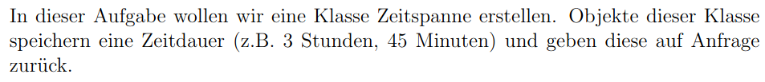
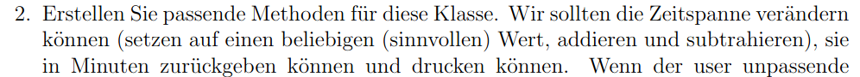
Solving Problems: Zeitspanne
Notes:
Exercise: students should think about what is sensible -> what requirements and restrictions does the class have (0 <= minutes < 60, no negative time)
Important attributes, (several) constructors
It is not important how illegal situations are handled, only that they are handled; for print, it is useful to implement toString()
Compare sensible attributes (e.g. minutes); emphasize the difference between one class and several objects of this class that can be compared with each other

Slide 40
public class Zeitspanne {
public int minutes;
public int hours;
}

Slide 41
public class Zeitspanne {
public int minutes;
public int hours;
}
Not necessary…
94 minutes ⋍ 1 hour and 34 minutes

Slide 42
public class Zeitspanne {
public int minutes;
}
Attributes should be private!
Access to attributes via getter / setter methods.

Slide 43
public class Zeitspanne {
private int minutes;
// Getter Methoden
public int getTimeInMin() {
return this.minutes;
}
public int getFullHours() {
return this.minutes / 60;
}
}
A user would surely also want to know the number of
hours.

Slide 44
public class Zeitspanne {
private int minutes;
// Getter Methoden
public int getTimeInMin() {
return this.minutes;
}
public int getFullHours() {
return this.minutes / 60;
}
}

Slide 45
(…)
public int getFullHours() {
return this.minutes / 60;
}
// Setter Methoden
public void setMinutes(int minutes) {
this.minutes = minutes;
}
}
Should a user have (indirect) access
to the minutes attribute?
Here: yes
But this is often not the case!

Slide 46
(…)
// Setter Methoden
public void setMinutes(int minutes) {
this.minutes = minutes;
}
public void setTime(int hours, int minutes) {
this.minutes = hours * 60 + minutes;
}
}
Users should not have to convert
time units from hours and minutes
into minutes.
We give the user a method.

Slide 47
(…)
// Setter Methoden
public void setMinutes(int minutes) {
this.minutes = minutes;
}
public void setTime(int hours, int minutes) {
this.minutes = hours * 60 + minutes;
}
}
Methods for every class:
Constructors
toString method
More later…

Slide 48
public class Zeitspanne {
private int minutes;
public Zeitspanne() {
this.minutes = 0;
}
public Zeitspanne(int hours, int minutes) {
this.minutes = minutes + hours * 60;
}
(…)
}
        Constructors:
Default constructor
Explicit constructors
(parameterized or parameterless)

Slide 49
public class Zeitspanne {
private int minutes;
(…)
public Zeitspanne(int hours, int minutes) {
this.minutes = minutes + hours * 60;
}
public Zeitspanne(int minutes) {
this.minutes = minutes;
}
public Zeitspanne(Zeitspanne other) {
this.minutes = other.minutes;
}
(…)
}
        Constructors:
Default constructor
Explicit constructors
(parameterized or parameterless)
Copy constructor
Why?
We create an object with
another object as
a template.

Slide 50
public class Zeitspanne {
private int minutes;
(…)
public Zeitspanne(int hours, int minutes) {
this.minutes = minutes + hours * 60;
}
public Zeitspanne(int minutes) {
this.minutes = minutes;
}
public Zeitspanne(Zeitspanne other) {
this.minutes = other.minutes;
}
(…)
}
        Constructors:
Default constructor
Explicit constructors
(parameterized or parameterless)
Copy constructor
Always exists, unless you write your own constructor.

Slide 51
public class Zeitspanne {
private int minutes;
(…)
public Zeitspanne(int hours, int minutes) {
this.minutes = minutes + hours * 60;
}
public Zeitspanne(int minutes) {
this.minutes = minutes;
}
public Zeitspanne(Zeitspanne other) {
this.minutes = other.minutes;
}
(…)
}
Very repetitive…

Slide 52
public class Zeitspanne {
private int minutes;
public Zeitspanne(int minutes) {
this.minutes = minutes;
}
public Zeitspanne() {
this(0) ;
}
public Zeitspanne(int hours, int minutes) {
this(minutes + hours * 60);
}
public Zeitspanne(Zeitspanne other) {
this(other.minutes);
}
(…)
}
One parameterized constructor.
All other constructors call this one.

Slide 53
public class Zeitspanne {
private int minutes;
public Zeitspanne(int minutes) {
this.minutes = minutes;
}
public Zeitspanne() {
this(0) ;
}
public Zeitspanne(int hours, int minutes) {
this(minutes + hours * 60);
}
public Zeitspanne(Zeitspanne other) {
this(other.minutes);
}
(…)
}

Slide 54
// Our code
Zeitspanne t = new Zeitspanne(125);
System.out.println(t);
// What println does (simplified)
public void println(Object x) {
String s = x.toString();
// print s, then a new line
}
// Output without our toString():
Zeitspanne@1b6d3586
// Output with our toString():
2:5
How does println print an object?
println needs a String, so it calls t.toString()
Every class automatically has a toString() method (inherited from Object)
The default version only prints the class name and a hash code: not useful!
So we write our own toString() and decide what gets printed.
Same for "Time: " + t

Slide 55
public class Zeitspanne {
(…)
public void setTime(int hours, int minutes) {
this.minutes = hours * 60 + minutes;
}
public String toString() {
int hours = this.minutes / 60;
int minutes = this.minutes % 60;
return hours + ":" + minutes;
}
}
Methods for every class:
Constructors
toString method

Slide 56
public class Zeitspanne {
(…)
public void setTime(int hours, int minutes) {
this.minutes = hours * 60 + minutes;
}
public String toString() {
int hours = this.minutes / 60;
int minutes = this.minutes % 60;
return hours + ":" + minutes;
}
}
We will do these calculations several
times…
We write a method!

Slide 57
public class Zeitspanne {
(…)
public int[] toHourMin() {
int hours = this.minutes / 60;
int minutes = this.minutes % 60;
return new int[] {hours, minutes};
}
public String toString() {
int[] split = toHourMin();
return split[0] + ":" + split[1];
}
}
We will do these calculations several
times…
We write a method!

Slide 58
public class Zeitspanne {
(…)
public Zeitspanne(int hours, int minutes) {
this(minutes + hours * 60);
}
public void setTime(int hours, int minutes) {
this.minutes = hours * 60 + minutes;
}
}
We do these calculations several times…
We write a method!

Slide 59
public class Zeitspanne {
(…)
public static int getMinutes(int hours, int minutes) {
return hours * 60 + minutes;
}
public Zeitspanne(int hours, int minutes) {
this(minutes + hours * 60);
}
public void setTime(int hours, int minutes) {
this.minutes = hours * 60 + minutes;
}
}
We will do these calculations several
times…
We write a method!

Slide 60
public class Zeitspanne {
(…)
public static int getMinutes(int hours, int minutes) {
return hours * 60 + minutes;
}
public Zeitspanne(int hours, int minutes) {
this(getMinutes(hours, minutes));
}
public void setTime(int hours, int minutes) {
this.minutes = getMinutes(hours, minutes);
}
}
We will do these calculations several
times…
We write a method!

Slide 61
public class Zeitspanne {
(…)
public void addTime(int hours, int minutes) {
this.minutes += getMinutes(hours, minutes);
}
public void subTime(int hours, int minutes) {
this.minutes -= getMinutes(hours, minutes);
}
}

Slide 62
public class Zeitspanne {
(…)
public void addTime(int hours, int minutes) {
this.minutes += getMinutes(hours, minutes);
}
public void subTime(int hours, int minutes) {
this.minutes -= getMinutes(hours, minutes);
}
}
What if the minutes
would become negative?
Now: boolean return value that says whether the operation was successful.
Later: Exceptions / Errors

Slide 63
public class Zeitspanne {
(…)
public void addTime(int hours, int minutes) {
this.minutes += getMinutes(hours, minutes);
}
public boolean subTime(int hours, int minutes) {
int minutesToSub = getMinutes(hours, minutes);
if(this.minutes >= minutesToSub) {
this.minutes -= minutesToSub;
return true;
}
return false;
}
}
Now: boolean return value that says whether the operation was successful.
Later: Exceptions / Errors

Slide 64
public class Zeitspanne {
(…)
public boolean isMoreThan(Zeitspanne other) {
return this.getTimeInMin() > other.getTimeInMin();
}
}

Slide 65
StackOverflow Error

Slide 66
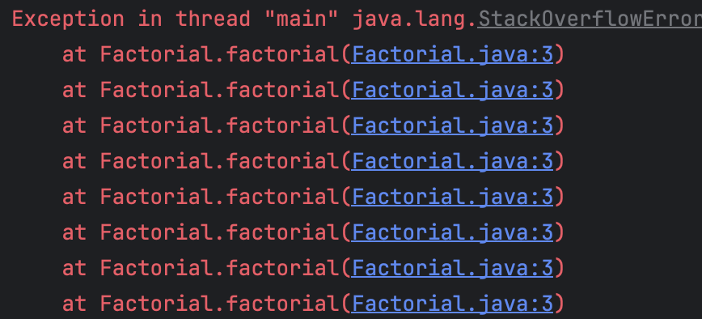

public class Factorial {
public static int factorial(int n) {
return n * factorial(n - 1);
}
}
Scenario: You are supposed to write the method factorial(int n), which should compute 𝑛!.
You know the formula for 𝑛! and implement the method.
You run the method and see the following:

Slide 67
public class Factorial {
public static int factorial(int n) {
return n * factorial(n - 1);
}
}
Scenario: You are supposed to write the method factorial(int n), which should compute 𝑛!.
You know the formula for 𝑛! and implement the method.
You run the method and see the following: Exception in thread "main" java.lang.StackOverflowError
What do we do now?
    Forgot the base case?

Slide 68
public class Factorial {
public static int factorial(int n) {
if(n == 0) {
return 1;
}
return n * factorial(n - 1);
}
}
Scenario: You are supposed to write the method factorial(int n), which should compute 𝑛!.
You know the formula for 𝑛! and implement the method.
You run the method and see the following: Exception in thread "main" java.lang.StackOverflowError
What do we do now?
    Forgot the base case? Here yes!
    Often, however, too many method calls are generated!
    Then you have to think about how to
    prevent certain method calls in the
    recursion.

Slide 69
Exercise

Slide 70
Exercise: We Are Data Scientists!
// rows: stations, columns: days
Mon Tue Wed
Zurich 12.5 14.0 11.5
Bern 10.0 13.5 12.0
public class Matrix {
private double[][] m;
private int nrLines;
private int nrCol;
}
We work at a weather service and get new measurements every day.
n weather stations, m days: that is a table of numbers, an n × m matrix.
We want a class Matrix that can store this data and do calculations with it.
We build it step by step: one new feature per slide.

Slide 71
Part 1: Building a Matrix
public Matrix(double[][] data) {
// copy data into m
}
// Usage
double[][] data = {{1, 2}, {3, 4}};
Matrix a = new Matrix(data);
The simplest case: we already have our data in a double[][].
Write a constructor that builds a Matrix from it.
Copy the values! Otherwise changing data later would also change our matrix.

Slide 72
Part 2: Reading a Matrix
public Matrix(Scanner s,
int nrLines, int nrCol)
// Input
12.5 14.0 11.5
10.0 13.5 12.0
// Usage
Matrix a = new Matrix(sc, 2, 3);
The data comes from a Scanner (console or file).
We know the size: nrLines × nrCol values, row by row.
Reuse Part 1 with this(...)!
Careful: this(...) must be the first statement in the constructor.

Slide 73
Part 3: Printing a Matrix
public String toString()
// Usage
System.out.println(a);
// Output
1.0 2.0
3.0 4.0
We want to look at our data: System.out.println(a);
Remember: println calls toString() for us!
Write a toString() that puts one row per line, values separated by spaces.

Slide 74
Part 4: Getters
public int getNrLines()
public int getNrCol()
public int getSize()
// getSize() = nrLines * nrCol
// Example: 2 stations, 3 days
getNrLines() -> 2
getNrCol() -> 3
getSize() -> 6
How big is our data set?
The attributes are private, so we add getters.
Number of stations, number of days, and number of measurements in total.

Slide 75
Part 5: Adding and Subtracting
public static Matrix
addSubtractMatrix(Matrix a,
Matrix b, int sign)
// Usage
Matrix c = Matrix.addMatrix(a, b);
a.subMatrix(b); // changes a
// Example
| 1 2 | | 5 6 | | 6 8 |
| 3 4 | + | 7 8 | = | 10 12 |
Morning rain + evening rain = daily total.
This year − last year = how much warmer it got.
Trick: one helper for both, a + sign * b with sign = 1 or −1.
Static version returns a new matrix, instance version changes this.

Slide 76
Part 6: Element-wise Multiplication
public static Matrix multipMatrix(
Matrix a, Matrix b)
// Example
| 1 2 | | 5 6 | | 5 12 |
| 3 4 | o | 7 8 | = | 21 32 |
Every sensor has its own correction factor for every day.
Multiply each value with the matching factor.
Same size required: res[i][j] = a[i][j] * b[i][j]
Careful: this is not the matrix product (Part 11)!

Slide 77
Part 7: Cropping a Matrix
public Matrix crop(
int nrLines, int nrCol,
int startLine, int startCol)
// Example: crop(2, 2, 0, 1)
| 1 2 3 |
| 4 5 6 | -> | 2 3 |
| 7 8 9 | | 5 6 |
We only care about a few stations and a few days.
Keep a block of nrLines × nrCol values, starting at (startLine, startCol).
There is also a static version: Matrix.crop(x, ...)

Slide 78
Part 8: Pasting a Matrix
public void copyData(Matrix x,
int startLine, int startCol)
// big.copyData(small, 1, 1)
big: small: big after:
| 0 0 0 | | 8 9 | | 0 0 0 |
| 0 0 0 | | 0 8 9 |
| 0 0 0 | | 0 0 0 |
Some stations measured a few days again with better sensors.
Copy the smaller matrix into this, starting at (startLine, startCol).
This changes this in place.
The small matrix has to fit inside the big one!

Slide 79
Part 9: Sum
public double sum()
// Example
| 1 2 |
| 3 4 | -> 10
How much rain fell in total, over all stations and all days?
Add up all entries of the matrix.
We will reuse this method later!

Slide 80
Part 10: Average
public double avg()
// Example
| 1 2 |
| 3 4 | -> 2.5
What was the average temperature over all stations and all days?
Sum of all entries divided by the number of entries.
Reuse sum() and getSize()!

Slide 81
Part 11: Matrix Product
public static Matrix realProduct(
Matrix a, Matrix b)
(n x m) * (m x k) = (n x k)
// Example
| 1 2 | | 5 6 | | 19 22 |
| 3 4 | * | 7 8 | = | 43 50 |
We have daily values (n × m) and want weekly sums.
Multiplying with an m × k "day to week" matrix does exactly that.
Columns of a must equal rows of b.
res[i][j] = sum over k of a[i][k] * b[k][j]

Slide 82
Part 12: Convolution
public Matrix convolute(Matrix x)
// Example: matrix and kernel
| 1 2 3 |
| 4 5 6 | | 1 1 |
| 7 8 9 | | 1 1 |
// result
| 12 16 |
| 24 28 |
// top left: 1 + 2 + 4 + 5 = 12
Our sensors are noisy, so we want to smooth the data.
Slide a small matrix x (the kernel) over our matrix. At every position: multiply element-wise and sum up.
Result size: (n - k + 1) × (m - l + 1) for a k × l kernel.
Hint: Parts 7, 6 and 9 do almost all of the work!

Slide 83
Good Further Ideas for Development

Slide 84
Idea: Multiplying by a Constant
public Matrix scale(double c)
// Example
| 1 2 | | 2 4 |
2 * | 3 4 | = | 6 8 |
A colleague measured rain in inches, but we need millimetres.
Multiply every value by 25.4.
Every entry is multiplied by the same constant c.

Slide 85
Idea: Determinant
public double determinant()
// 2 x 2:
det | a b | = a*d - b*c
| c d |
// n x n (Laplace, along row 0):
det(A) = sum over j of
(-1)^j * A[0][j] * det(A_0j)
// A_0j: A without row 0, col j
Final boss: the determinant!
It tells us e.g. whether a system of linear equations has exactly one solution.
Only defined for square matrices.
Hint: expand along the first row and use recursion! Part 7 helps to build the smaller matrices.

Slide 86
Preview

Slide 87
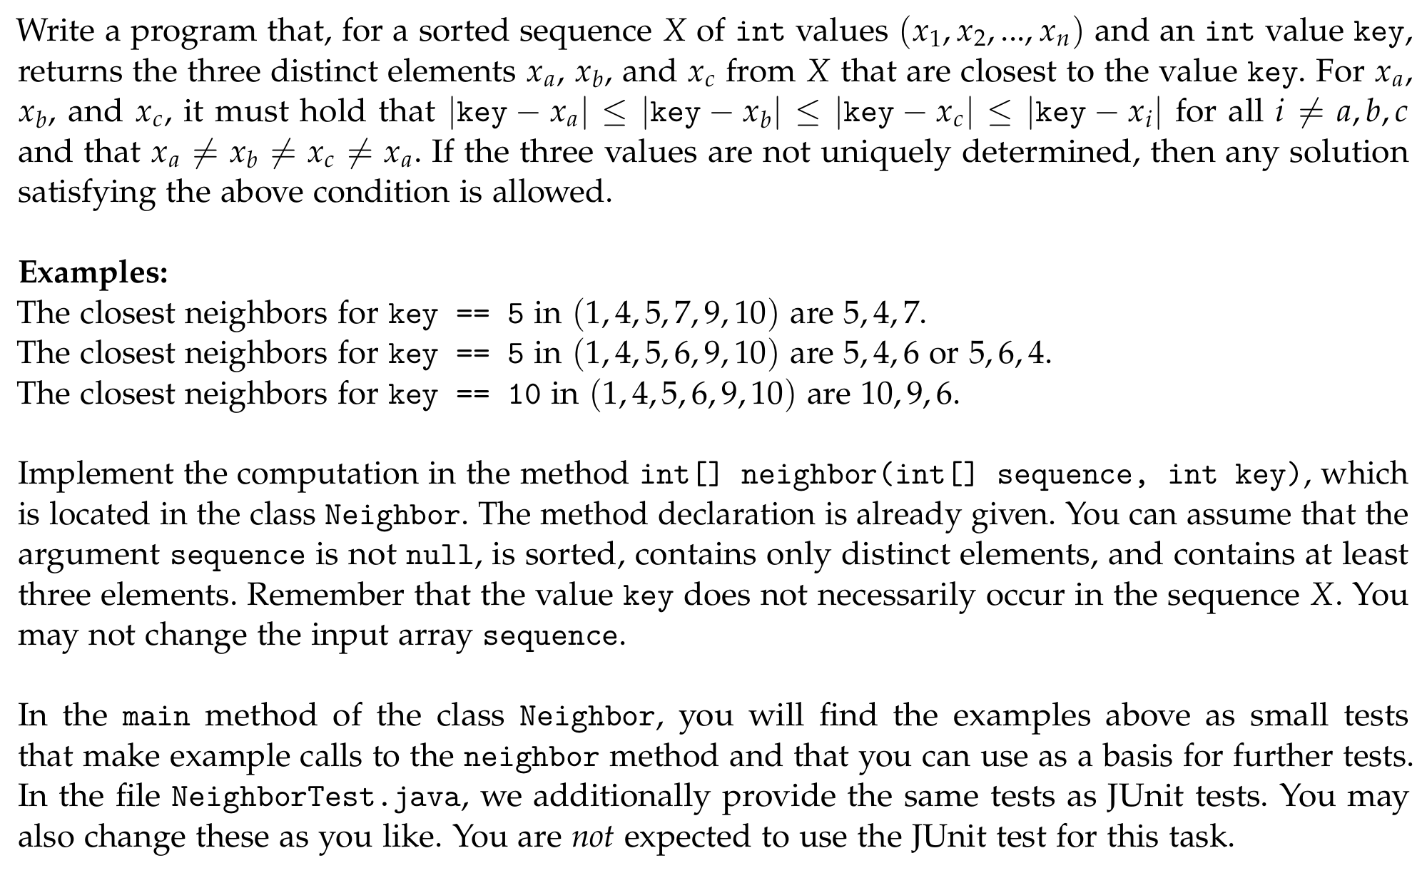
Exercise 1: Close Neighbors

Slide 88
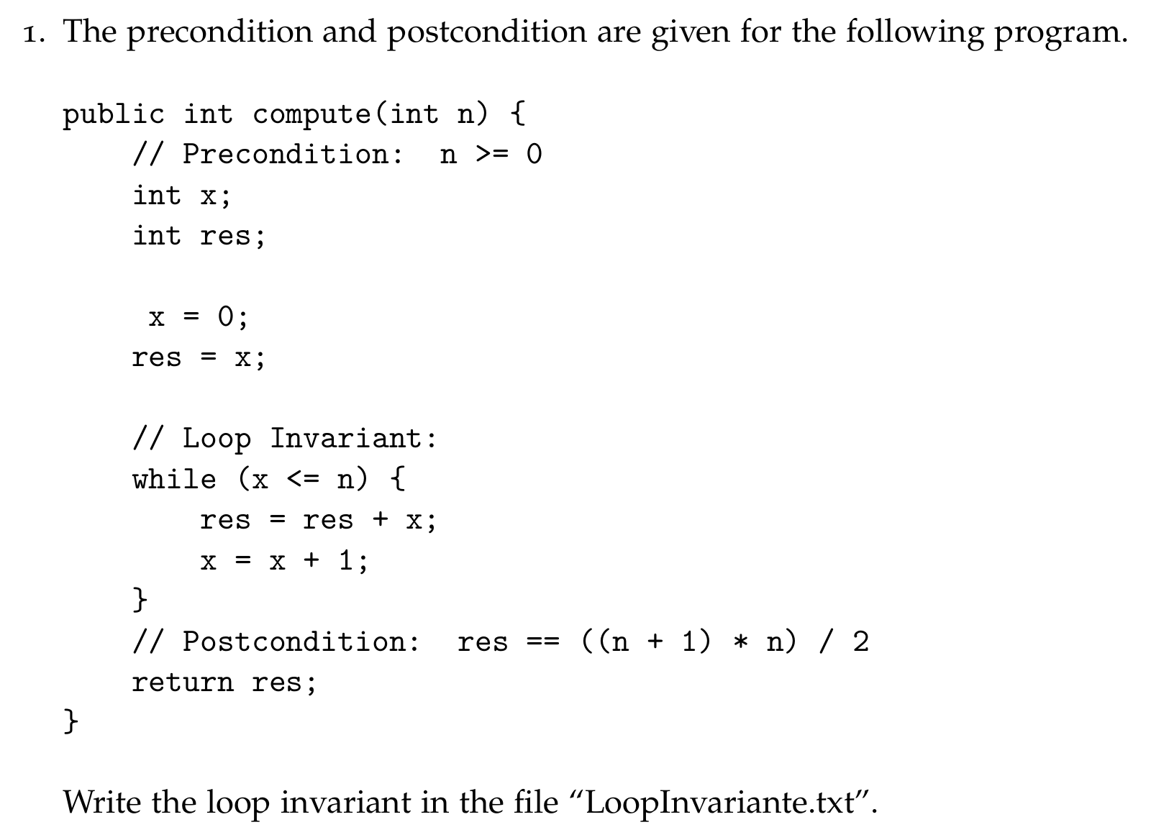
Exercise 2: Loop Invariant

Slide 89
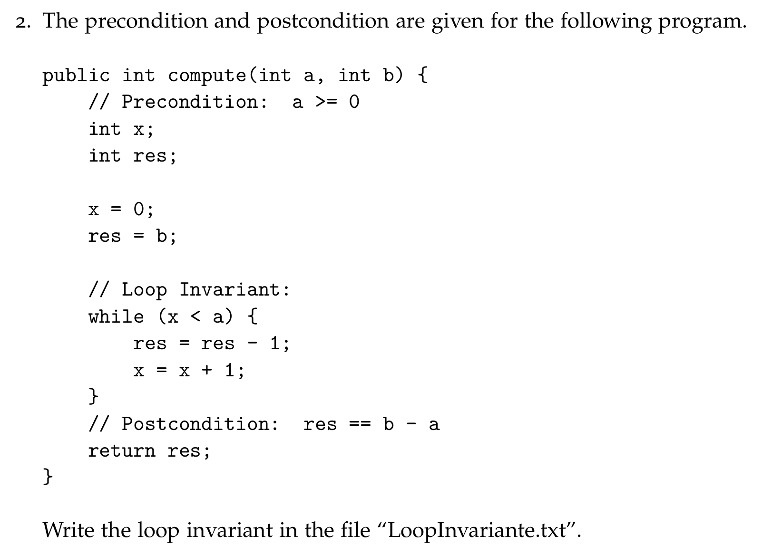
Exercise 2: Loop Invariant

Slide 90
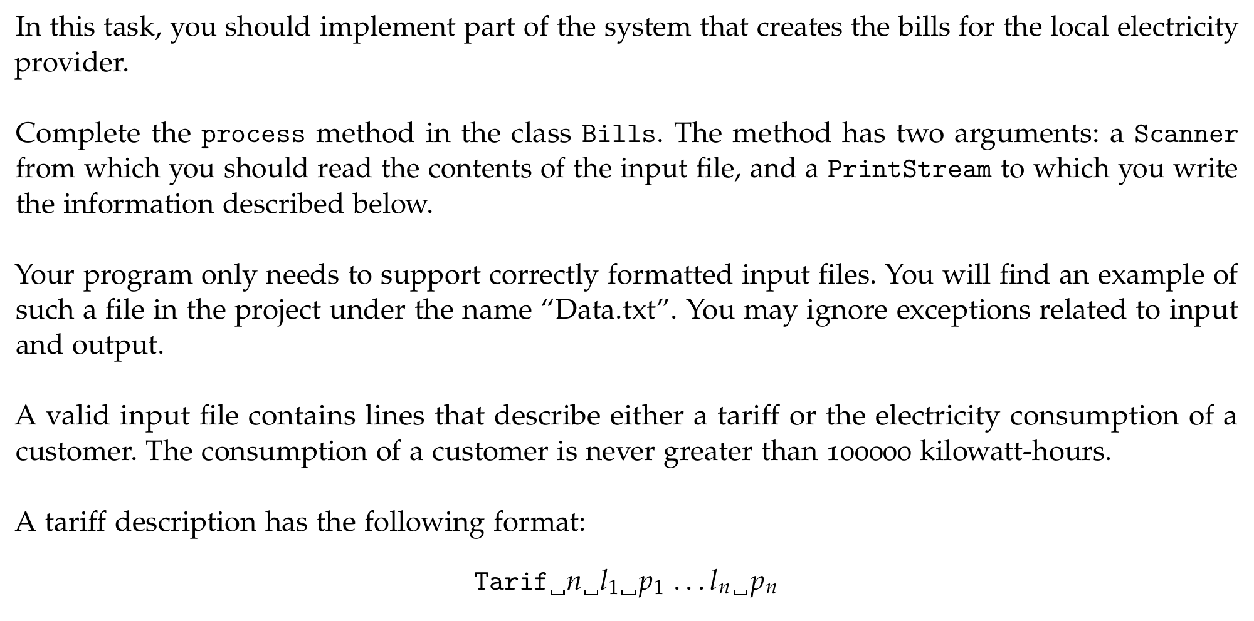
Exercise 3: Bills

Slide 91
Exercise 3: Bills
Files will be covered in more detail later!
  You will only have to interact with a PrintStream object, using the method println.
  With println you can, just like with System.out create a new line.
  Here, however, the new line is not created in the console but in the corresponding file.

Slide 92
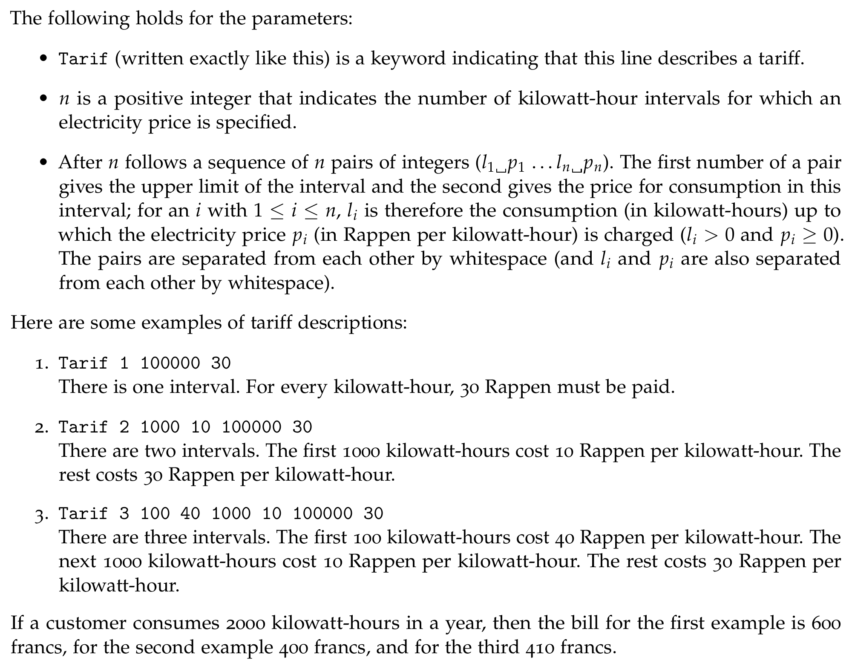
Exercise 3: Bills

Slide 93
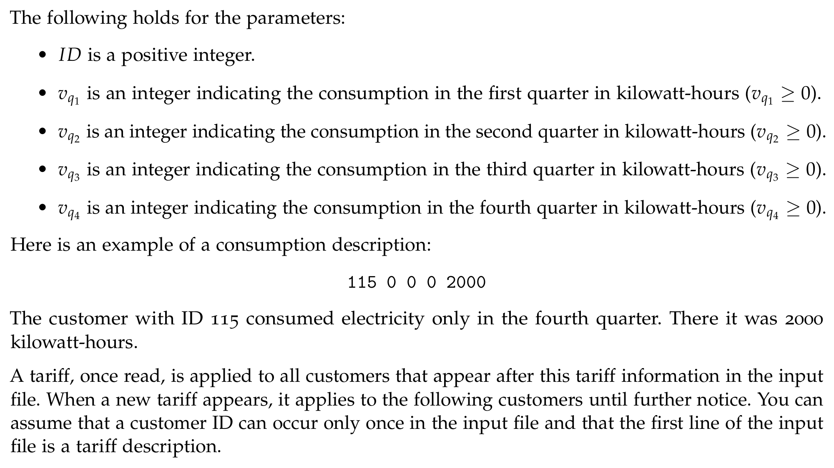
Exercise 3: Bills

Slide 94
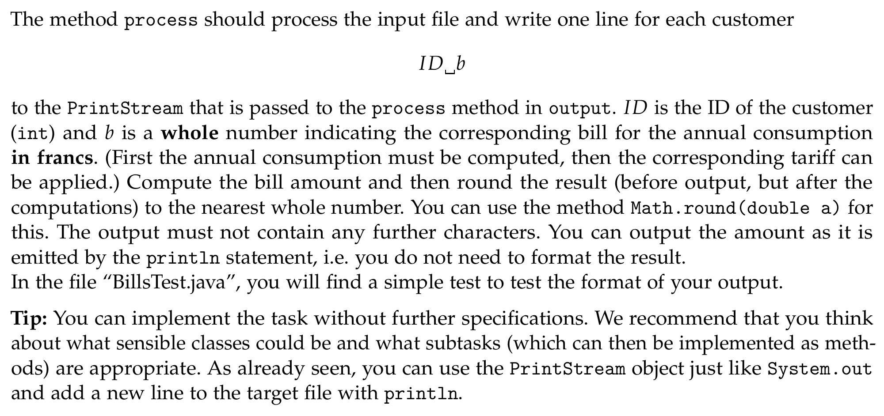
Exercise 3: Bills

Slide 95
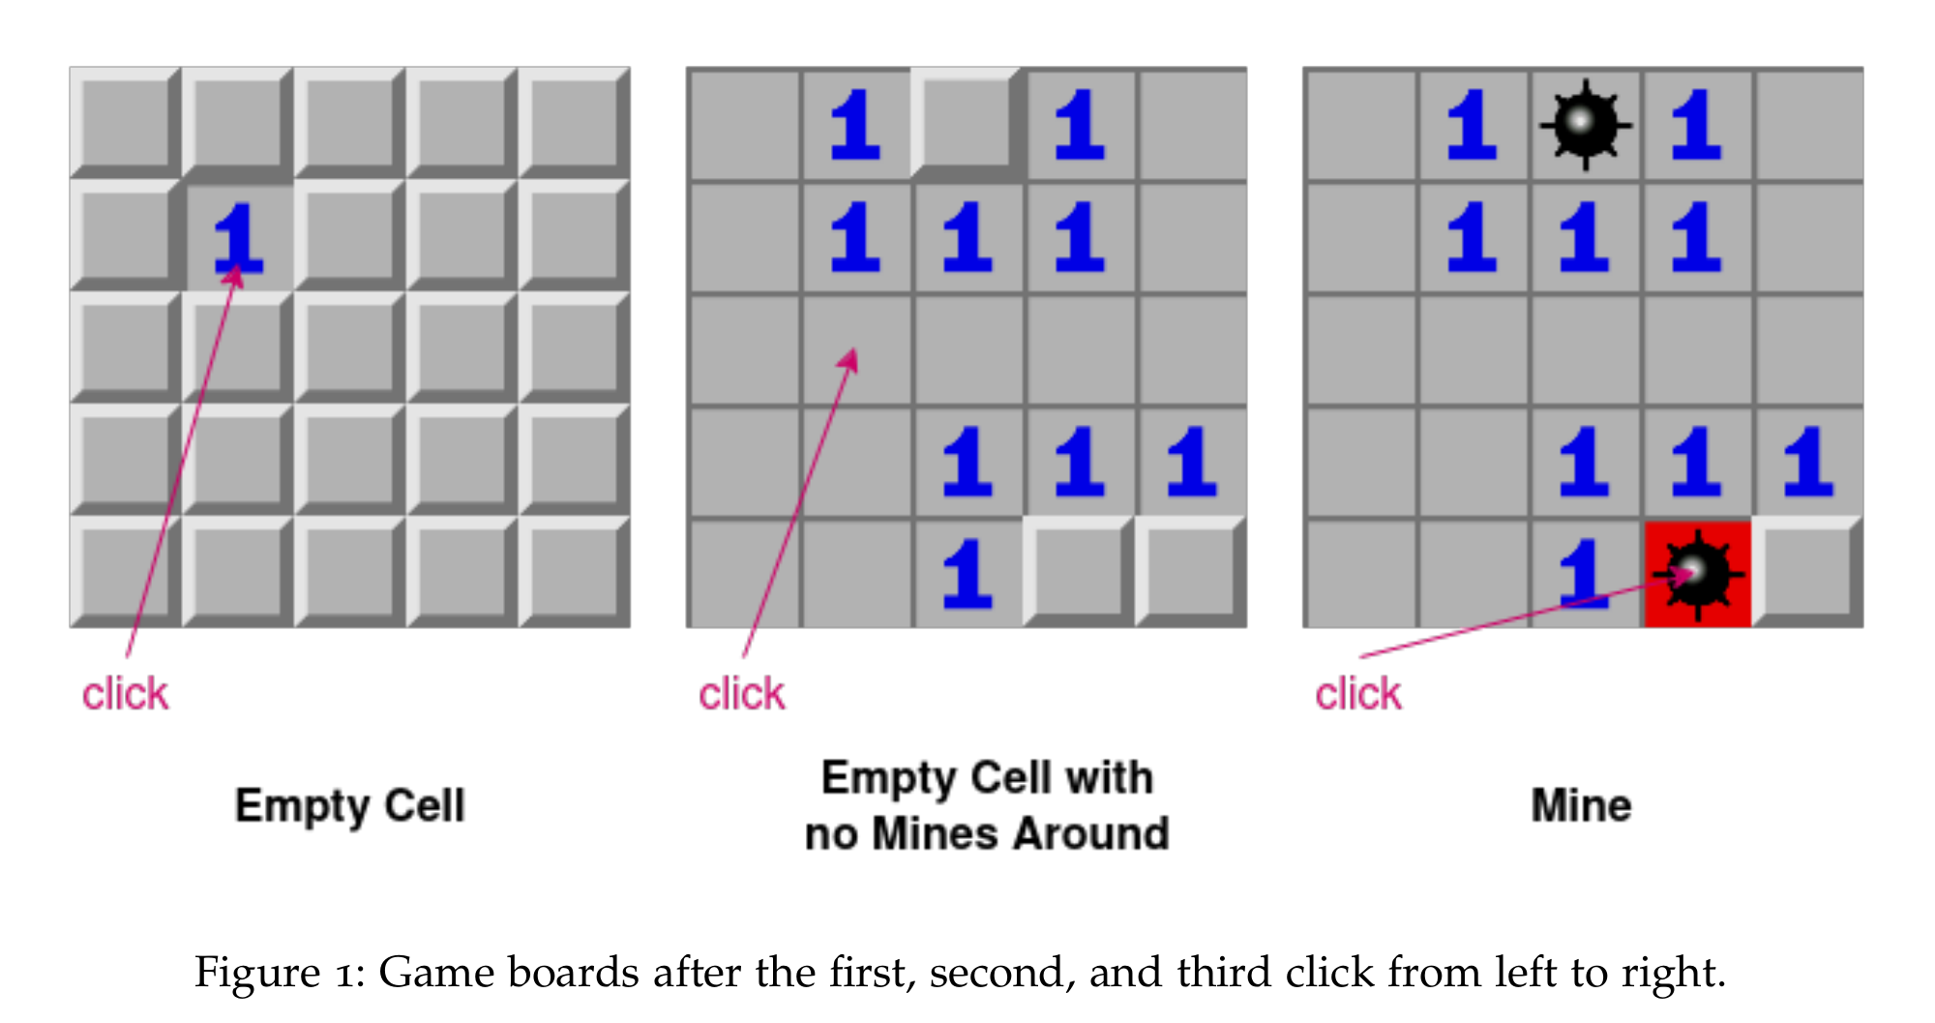
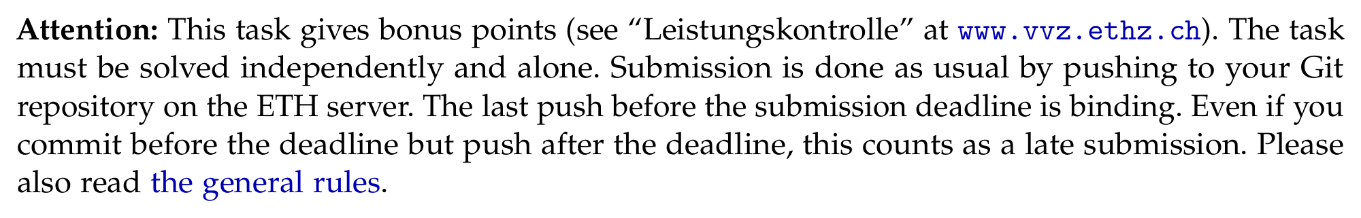
Exercise 4: Minesweeper (Bonus)

