Slide 1
HTTP CACHING
Yurong Tao

Slide 2
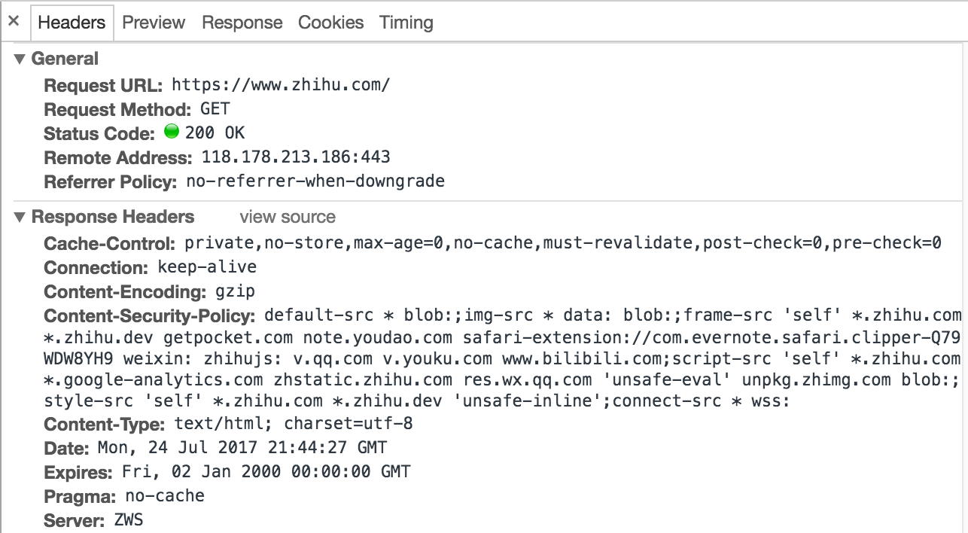

Slide 3
HTTP Caching - Why
Finish the most expensive work.
Respond to user action.
Show loading page
Content delivered.
0s
100ms
1s
User = Traffic = Money

Slide 4
HTTP Caching - Why
Improved responsiveness
Decreased network costs
Example: 12306

Slide 5
HTTP Caching - How
Fresh Content
a.css
Client
Cache
Server
Origin Server
a.css

Slide 6
HTTP Caching - How
Stale Content
a.css
validate
Client
Cache
Server
Origin Server
a.css
is valid
Refresh expiration time

Slide 7
Cache Location
Browser Cache
Intermediary caching proxies - CDN
Reverse Cache

Slide 8
What can be cached?
Images
CSS
General Javascript files
Downloadable Content
Media Files

Slide 9
What can not be cached?
Assets related to sensitive data (banking info, etc.)
User-specific content
Frequently changing content

Slide 10
Cache Headers
Cache-Control
Etag
Last-Modified
Expires

Slide 11
Cache-Control
no-cache
no-store
public
private
max-age
s-maxage
must-revalidate
proxy-revalidate

Slide 12
Invalidating and Updating Cached Responses

Slide 13
Long Term Cache
Long expire time.
Use fingerprint for static resources.
Use CDN for static resources.
Publish without replace.

