Slide 1
Sprint #7
Team Members
Brandon Tu, Affan Khan, Himmat Mahal , Chris Fitzgerald, Mussab Bin Imran , and Ibrahim Rather

Slide 2
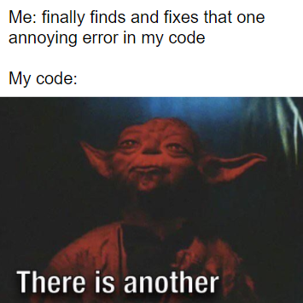
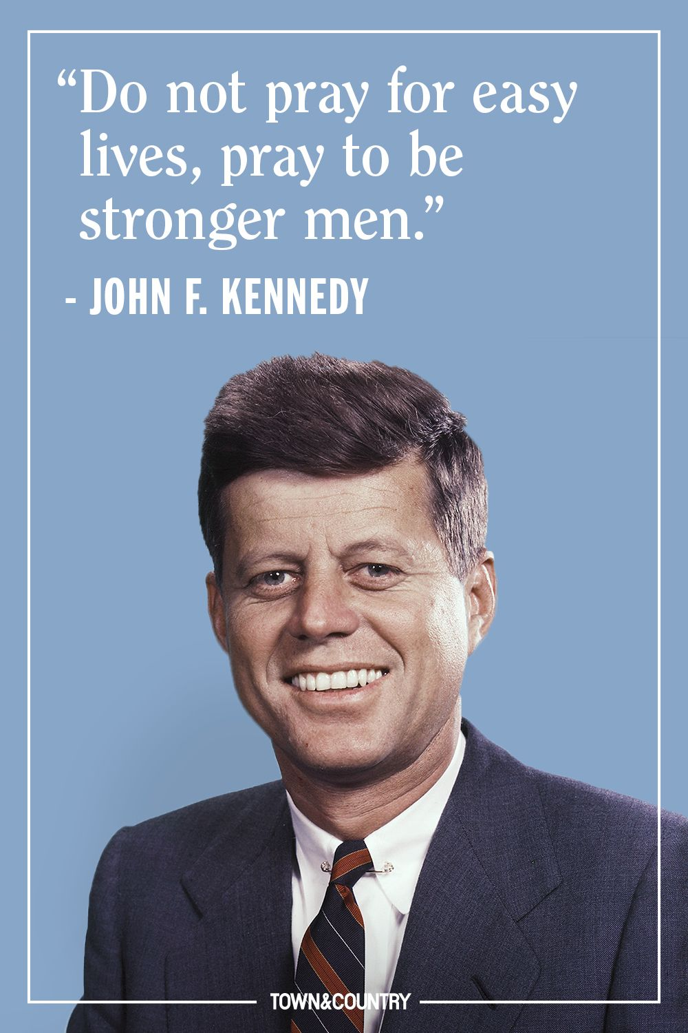


Slide 3
What went well
Finally got a self-signed SSL cert
Chrome displays a security warning so we thought initially this was not right
Self-signed certs have this problem and there’s no workaround other than paying money for one
We did a good job anticipating all the tasks required for this sprint

Slide 4
Things to improve on
On-prem SOCS Infrastructure caused challenges
VPN still does not allow off-campus access
We should coordinate further in advance who has to go to campus to test it out but we didn’t anticipate the VPN being broken for this long

Slide 5
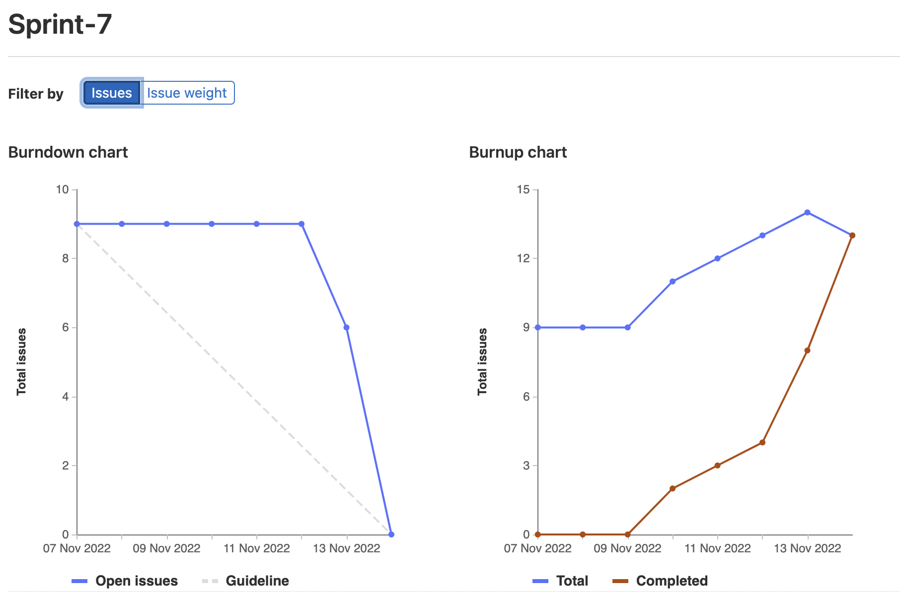
Burndown & Burnup chart(s)

Slide 6
Sprint 6 Highlights - Brandon Tu (1047332)
(3) Researching how to setup the gitlab CI/CD pipeline
(2) Setting up the pipeline to lint the python portion of the repo after successful merge
(2) Setting up the pipeline to lint the react/js portion of the repo after successful merge
(2) Setting up the pipeline to run jest on the react/js portion of the repo after successful merge
Total: ~11

Slide 7
Sprint 6 highlight - Mussab Bin Imran (1111908)
Research gitlab CI (3)
Testing and documentation (2)
Fixing linter errors in python with himmat (3)
Total (10)

Slide 8
Sprint 7 Highlight - Chris Fitzgerald
Cleaned up the repo branches
Set up unit tests with Affan
Set up SSL
Total Weight: 12

Slide 9
Sprint 6 Highlight - Affan Khan(1095729)
Made Unit tests for react with Chris
Final testing and documentation
Tested and researched gitlab ci
Total weight: 11

Slide 10
Sprint 7 highlights - Himmat Mahal (1094444)
Research gitlab ci individually
Fixed pylint errors & warnings
Meetings, documentation, and testing, miscellaneous
Total Weight: 11

Slide 11
Sprint 6 Highlight - Ibrahim Rather (1097660)
Researched gitlab CI/CD
Fixed isort, buildes-lint, and flake8 errors in pipeline
Modularized react components
Total Weight: 14

