Slide 1
Sprint #8
Team Members
Brandon Tu, Affan Khan, Himmat Mahal , Chris Fitzgerald, Mussab Bin Imran , and Ibrahim Rather

Slide 2
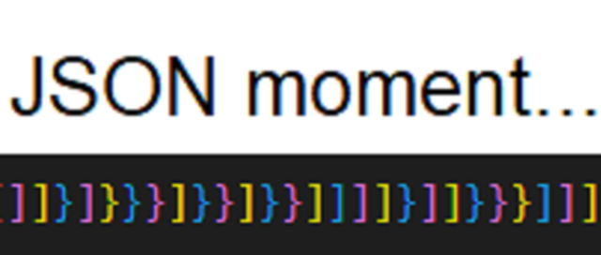
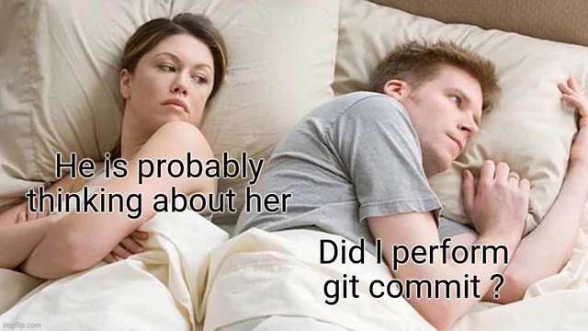
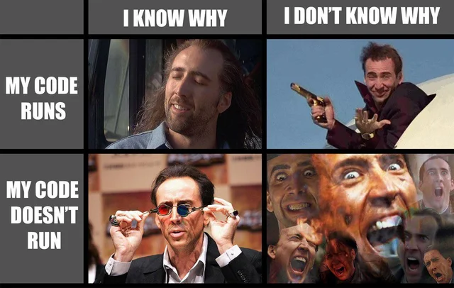

Slide 3
What went well
Lot more organized this time around
Finally got the chance to re design the UI a little bit (will do more this week)
Nomachine is working so now we can update prod without making a pilgrimage to campus

Slide 4
Things to improve on
We didn’t have the time to fully implement everything we wanted so we need to have more realistic goals
Implementing a more robust search
Fully update the UI (especially the colour scheme)

Slide 5
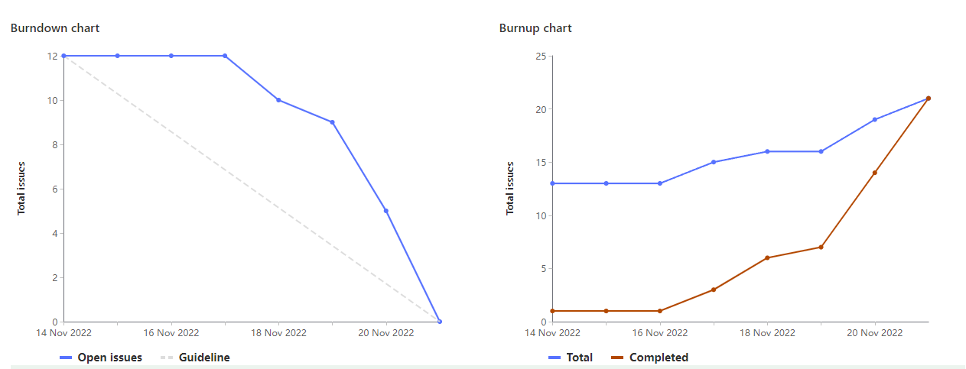
Burndown & Burnup chart(s)

Slide 6
Sprint 8 Highlights - Brandon Tu (1047332)
(2) remove course button and functionality
(3) Changing the card colour depending if its a lab/lec/sem etc
(4) Updating the style of the site
Total: ~21

Slide 7
Sprint 8 highlight - Mussab Bin Imran (1111908)
Looking for libraries or other methods to implement a popup (2)
Implementing the popup (4)
Updating the style of the site (4)
Total (22)

Slide 8
Sprint 8 Highlight - Chris Fitzgerald
Made some updates to the dropdown functionality with Ibrahim
Got noMachine working
Remade some course suggestion functionality with Affan
Last minute bugfixes
Total Weight: 23

Slide 9
Sprint 8 Highlight - Affan Khan(1095729)
Created front end buttons for grabbing user inputs
Suggested up to 5 courses to the schedule with chris
Implemented backend functionality for radio button F22 W23.
Add radio button switch from F22 to W23 UI
Total weight: 21

Slide 10
Sprint 8 highlights - Himmat Mahal (1094444)
Research
Updated parser to parse the both F22 and W23 data
Paired with Affan to implement W23 or F22 scheduler option (radio button)
Total Weight: 21

Slide 11
Sprint 8 Highlight - Ibrahim Rather (1097660)
Researched front end automation
Worked with Chris to fix course dropdown
Now able to show all matching courses, select a course and autofill search box
Worked with Brandon and Affan to update UI styling for website
Total Weight: 20

