Slide 1
PROJECT 11 : Australian AIDS Survival Data.
By. Ary Kurniadi Irawan

Slide 2
Introduction/Motivation.
HIV cannot be cured yet, but some treatments can be used to slow the progression of the disease. This treatment will also make the sufferer live longer, so they can lead a normal life. With early HIV diagnosis and effective treatment, people with HIV will not turn into AIDS. AIDS is the final stage of HIV infection.
By using survival analysis, health workers can make predictions about the likelihood that a patient infected with AIDS will survive how long it has been since the patient is diagnosed. Survival analysis corresponds to a set of statistical approaches used to investigate the time it takes for an event of interest to occur.

Slide 3
Methods
1. Kaplan Meiers.
2. Cox Proportional Hazards.
3. Weibull Proportional Hazards.
4. Exponential Proportional Hazards.

Slide 4
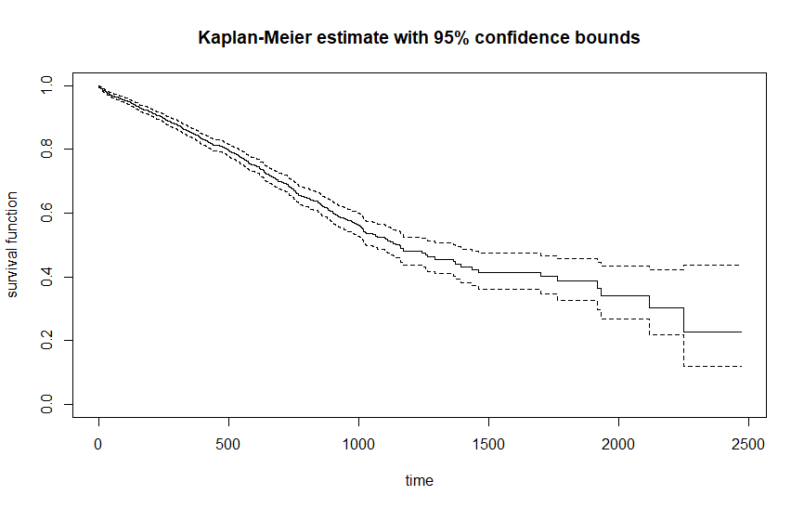
Kaplan Meiers

Slide 5
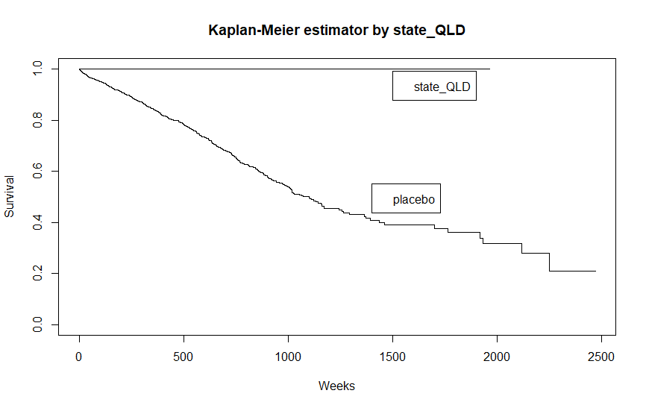
Kaplan Meier Probabilities Survival Curve Comparing state_QLD and state_VIC variable.

Slide 6
The Result of Log-rank Test using Kaplan Meier Method.
The log-rank test for difference in survival gives a p-value of p = 2e⁻¹¹ (Mantel-Haenszel test) and p = 4e-¹¹ (Peto & Peto modification of the Gehan-Wilcoxon test), indicating that the state groups differ significantly in survival. By looking at the p-value of the observation, we can see that there are no reasons to reject the null hypothesis stating that the survival functions are not identical. The chi-square statistic for a test of equality which gives almost the same quality and both of the test has the same strata which are 1 degree of freedom.

Slide 7
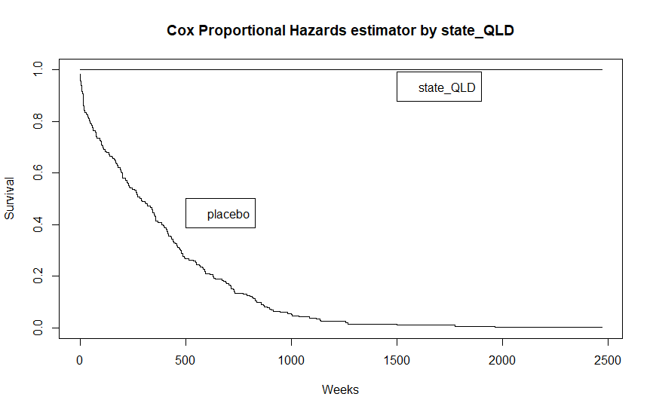
Cox Proportional hazards.

Slide 8
Proportional Hazards assumptions
Based on Wald test, it gives conclusion that the model is not gives significant result because the p value is greater than 5%. The hazard for the state_QLD group is 7.886 times the hazard for the state_VIC group. The value 7.886 is calculated as exp(coefficient of the state_VIC variable); that is, e to the 2.279 equals 7.886. The 95% confidence interval for the treatment effect is given by the range of values 0 – Inf.

Slide 9
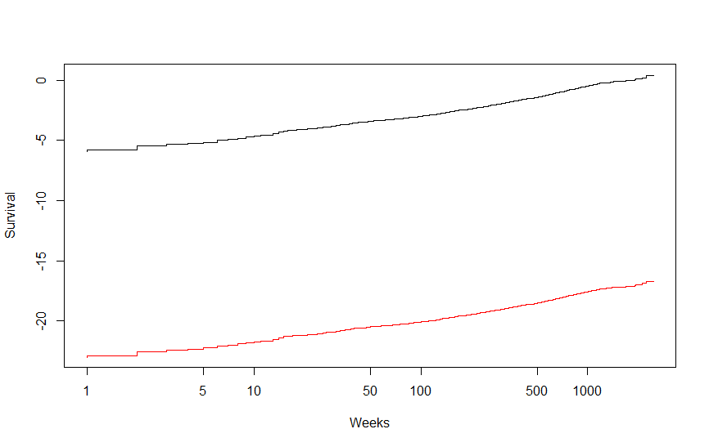
Log-log plots

Slide 10
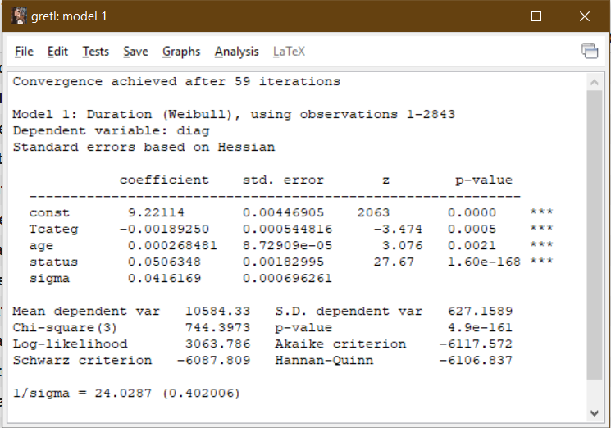
Parametric Proportional Hazards (PH) and Acceleration Failure Time (AFT)
Weibull Proportional Hazards Model.

Slide 11
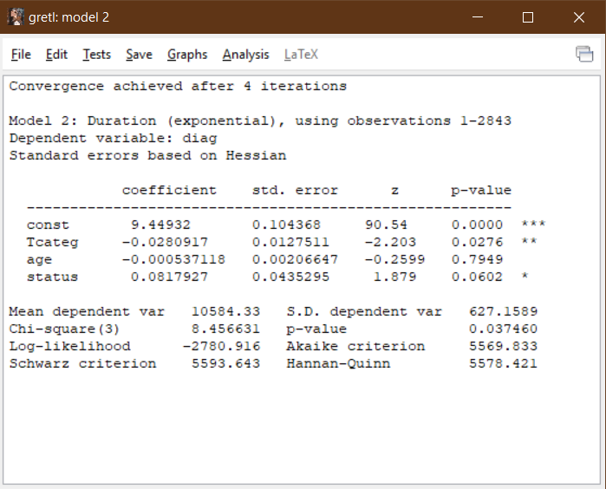
Exponential Proportional Hazards Model.

