Slide 1
A Tour of Model-View-Controller and Supporting Patterns
Lee A. Butler

Slide 2
What is MVC?
Model-View-Controller is the concept introduced by Smalltalk's inventors (TrygveReenskaug and others) of encapsulating some data together with its processing (the model) and isolate it from the manipulation (the controller) and presentation (the view) part that has to be done on a User Interface

Slide 3
Model-View-Controller
Model
Holds data, serializes to/from disk
Defines valid operations on data
Performs actual data manipulation
Notifies the world when changes are made
Zero coupling (no knowledge of View or Controller)
View
Visual presentation of data (table, list, sliders, etc.)
Interacts with user
Requests changes on behalf of the user
Minor coupling to model in worst case (may know how to query Model)
Controller
Contains the “business logic”
Synchronizes views with model
Validates user data change requests (permission, etc)
Coupled to model and view (glue that makes the application work)
User
Action
Model
updates
View
Notifies
Controller
updates

Slide 4
Why MVC?
Combine data with valid operations on it (OOP)
Isolate business/application logic from data representations
Isolate view / interaction controls from application and data
Allow multiple views of single data
Graphs, trees, tables, 3D display
Multiple table layouts of the same data
User
Action
Model
updates
View
Notifies
Controller
updates
View
User
Action
Any datum has only 1 authoritative location
Any operation has only 1 implementation
Enables code re-use and refactoring
Improves robustness
Notes:
This practice is critical for maintaining consistency when there are multiple views of data.
The entire view module could be removed/replaced and the application would still function correctly without any change to the model
Don’t copy code. If it looks mostly the same this is

Slide 5
Simple (Worst) Example: Main
main.cpp:
#include <QApplication>
#include <QThread>
#include "Controller.h"
int main(int argc, char *argv[])
{
QApplication a(argc, argv);
Controller controller;
while ( controller.wakeUp() ) {
a.processEvents();
QThread::msleep(200);
}
return 0;
}
Notes:
This is a simple application which polls the temperature sensor

Slide 6
Simple (Worst) Example: Controller
Controller.h:
#include <QLabel>
#include "TemperatureSensor.h"
class Controller
{
public:
explicit Controller();
bool wakeUp();
private:
QLabel *m_label;
TemperatureSensor m_sensor;
};
Controller.cpp:
#include "Controller.h"
Controller::Controller() : m_mainWindow(new QLabel)
{
m_label->show();
}
bool Controller::wakeUp()
{
double hot = m_sensor.getCurrentTemperature();
QString stringHot = QString("%1").arg(hot);
m_label->setText(stringHot);
return m_label->isVisible();
}
Question: What if the temperature doesn’t change?
Notes:
At the start of each event loop the wakeup() method is invoked. It reads the temperature sensor and sets a text label. This is good MVC, but it is a lot of work if the temperature hasn’t changed.

Slide 7
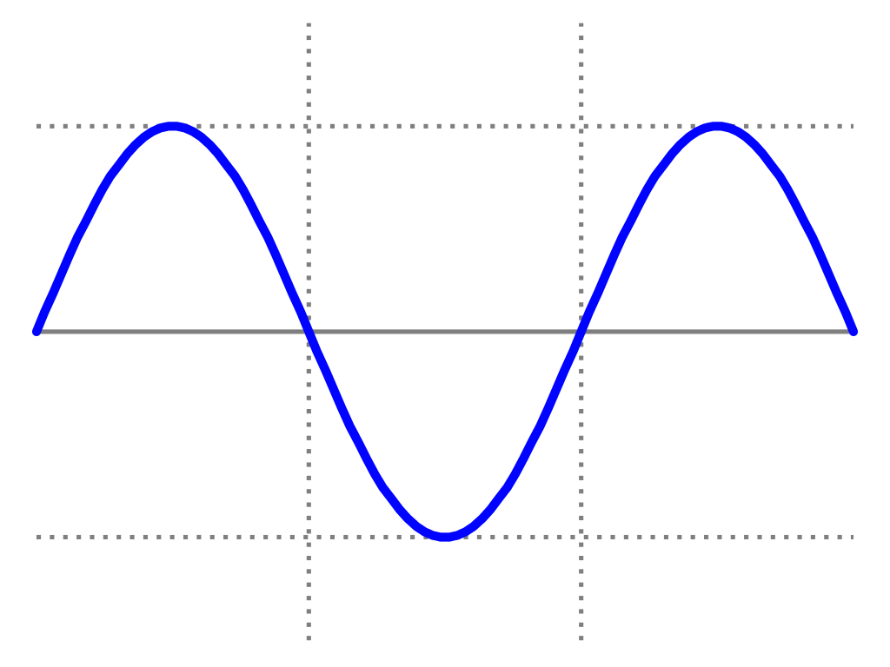
Simple (Worst) Example: Temperature Sensor
class TemperatureSensor
{
public:
explicit TemperatureSensor();
double getCurrentTemperature(); ///< update time & get temp
private:
void updateTimeOfDay(); ///< Move “clock” forward m_timeStep
double tempFromTimeOfDay(); ///< temperature for current time
double m_lastTemperature; ///< Last reported temperature
double m_timeOfDay; ///< Current time
double m_timeStep; ///< How much time steps forward
double m_tempSpan; ///< The delta of temperature over the day
double m_lowTemp; ///< night low temperature
};
85º
temperature
55º
^{0:00}
^{12:00}
^{24:00}
time
Notes:
Our temperature sensor class simply provides a varying temperature over the course of the day. It keeps a “timeOfDay” and moves it forward

Slide 8
Simple (Worst) Example: Temperature Sensor
TemperatureSensor.cpp:
#include "TemperatureSensor.h"
TemperatureSensor::TemperatureSensor()
: m_lastTemperature(0.0)
, m_timeOfDay(0.0), m_timeStep(.50)
, m_tempSpan(30.0), m_lowTemp(55.0)
{
}
double TemperatureSensor::getCurrentTemperature()
{
updateTimeOfDay();
double t = tempFromTimeOfDay();
if (t != m_lastTemperature)
m_lastTemperature = t;
return m_lastTemperature;
}
void TemperatureSensor::updateTimeOfDay()
{
m_timeOfDay += m_timeStep;
if (m_timeOfDay >= 24.0) m_timeOfDay -= 24;
}
double TemperatureSensor::tempFromTimeOfDay()
{
double mult;
if (m_timeOfDay <= 12.0) mult = m_timeOfDay * (1.0/12.0);
else mult = (24.0-m_timeOfDay) * (1.0/12.0);
mult = mult * mult * (3.0 - 2.0 * mult);
return m_lowTemp + m_tempSpan * mult;
}
Notes:
getCurrentTemperature() advances the clock, and gives the temperature back.
updateTimeOfDay keeps time in the range 0..24
tempFromTimeOfDay() gives a smoothly varying tempearture

Slide 9
Interaction Diagram: Temperature Change
Black=method
TemperatureSensor
getCurrentTemperature()
TemperatureTextReadout
setText()
A
Controller
wakeUp ()
B

Slide 10
Good MVC, But Polling Is Evil
Can spend a lot of time finding out that nothing needs to be done
Can miss changes that happen faster than the polling rate
Creates undesirable coupling between classes

Slide 11
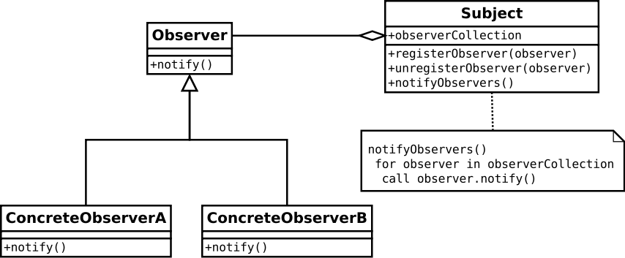
Improvement 1: Observer Pattern
Observer / Subject behavior
Observers register with Subject they wish to observe.
Subject keeps list of observers
Subject “notifies” observers in response to specific events (eg. Data change)
The “Controller” might Observe the “Model” and the “View(s)”
Only coupling is the notify()
method signature.

Slide 12
Observer/Subject
Subject.h:
#include <QVector> // super-vector. Used for brevity
#include “Observer.h”
class Subject
{
public:
void registerObserver(Observer *obs)
{ m_observers.push_back(obs); }
void unregisterObserver(Observer *obs)
{ m_observers.removeAll(obs); }
void notifyObservers()
{ foreach (Observer *obs, m_observers)
obs->notify();
}
private:
QVector<Observer *> m_observers;
};
Observer.h:
class Observer
{
public:
virtual void notify() = 0;
};

Slide 13
Observer Pattern: TemperatureSensor.h
class TemperatureSensor
{
public:
explicit TemperatureSensor();
double getCurrentTemperature();
private:
void updateTimeOfDay();
double tempFromTimeOfDay();
double m_lastTemperature;
double m_timeOfDay;
double m_timeStep;
double m_tempSpan;
double m_lowTemp;
};
#include "Subject.h"
class TemperatureSensor : public Subject
{
public:
explicit TemperatureSensor();
double getCurrentTemperature() const { return m_lastTemperature; }
void clockTick();
private:
void updateTimeOfDay();
double tempFromTimeOfDay();
double m_lastTemperature;
double m_timeOfDay;
double m_timeStep;
double m_tempSpan;
double m_lowTemp;
};
Notes:
TemperatureSensor becomes a “Subject”. getCurrentTemperature() now just returns the last temperature. clockTick() polls the actual hardware sensor (ok, computes the value)

Slide 14
Observer Pattern: TemperatureSensor.cpp
#include "TemperatureSensor.h"
TemperatureSensor::TemperatureSensor()
: m_lastTemperature(0.0)
, m_timeOfDay(0.0), m_timeStep(.50)
, m_tempSpan(30.0), m_lowTemp(55.0)
{
}
double TemperatureSensor::getCurrentTemperature()
{
updateTimeOfDay();
double t = tempFromTimeOfDay();
if (t != m_lastTemperature)
m_lastTemperature = t;
return m_lastTemperature;
}
#include "TemperatureSensor.h"
TemperatureSensor::TemperatureSensor()
: m_lastTemperature(0.0)
, m_timeOfDay(0.0), m_timeStep(0.50)
, m_tempSpan(30.0), m_lowTemp(55.0)
{
}
void TemperatureSensor::clockTick()
{
updateTimeOfDay();
double t = tempFromTimeOfDay();
if (t != m_lastTemperature) {
m_lastTemperature = t;
notifyObservers();
}
}

Slide 15
Observer Pattern: Controller.h
Old Controller.h:
#include <QLabel>
#include "TemperatureSensor.h"
class Controller
{
public:
explicit Controller();
bool wakeUp();
private:
QLabel *m_label;
TemperatureSensor m_sensor;
};
Controller.h:
#include <QLabel>
#include "TemperatureSensor.h"
#include "Observer.h“
class Controller : public Observer
{
public:
explicit Controller();
bool wakeUp();
void notify() override;
private:
QLabel *m_label;
TemperatureSensor m_sensor;
};

Slide 16
Observer Pattern: Controller.cpp
Old Controller.cpp:
#include "Controller.h"
Controller::Controller() : m_mainWindow(new QLabel)
{
m_label->show();
}
bool Controller::wakeUp()
{
double hot = m_sensor.getCurrentTemperature();
QString stringHot = QString("%1").arg(hot);
m_label->setText(stringHot);
return m_label->isVisible();
}
Controller.cpp:
#include "Controller.h"
Controller::Controller() : m_mainWindow(new QLabel)
{
m_sensor.registerObserver(this);
m_label->show();
}
bool Controller::wakeUp()
{
m_sensor.clockTick(); // Yes, technically still polling.
return m_label->isVisible();
}
void Controller::notify()
{
double hot = m_sensor.getCurrentTemperature();
QString stringHot = QString("%1").arg(hot);
m_label->setText(stringHot);
}
Notes:
Body of wakeup becomes notify(). The wakeup() method now just asks the sensor to do clockTick(). If the sensor were actually in an independent thread (as it will be shortly) then Controller wouldn’t actually do anything with the sensor.

Slide 17
Interaction Diagram: Temperature Change
Black=method
TemperatureSensor
clockTick()
TemperatureTextReadout
setText()
A
Controller
B
C
wakeUp ()
notify ()

Slide 18
Observer Wrap-up
Notify provides no information beyond an “alarm”
What if you want to observe multiple objects?
In reality, each Subject-derived class needs its own specialized Observer class. Otherwise the name “notify()” quickly becomes the bottleneck. Observers don’t know which Subject notified them.
A variety of “enhancements” to Observer have been developed to address these issues…

Slide 19
Improvement 2: Signal-Slot Pattern (Boost / Qt)
Extends the notify() method concept from Observer pattern with named, parameterized notifications.
SignalName(datatype, datatype, datatype)
Subject declares signals, Observers declare slots.
Controller “connects” signals to slots (vs “registration” coupling)
Allows bypass setup
Meta-class auto-generated for handling connection table and signal list
Anonymizes transactions
Not as harsh as throwing exceptions
No caller hierarchy necessary
Processing can continue after signal

Slide 20
Signal Example Class
#include <QObject>
class MySubject : public QObject
{
Q_OBJECT
public:
MySubject(QObject *parent = nullptr) : QObject( parent ), m_oldValue(0.0) {}
void checkValue()
{
double val = getNewValue();
if (val != m_oldValue) {
m_oldValue = val;
emit newValue(m_oldValue);
}
}
signals:
void newValue(double);
private:
double m_oldValue;
}

Slide 21
Slot Example Class
#include <QObject>
#include <iostream>
class MyObserver : public QObject
{
Q_OBJECT
public:
MyObserver(QObject *parent = nullptr) : QObject( parent ) {}
public slots:
void doSomethingWhenNewValue(double newValue)
{
std::cout << “new value is:” << newValue << std::endl;
}
}

Slide 22
Signal/Slot Controller Example Class
#include <QObject>
class MyController
{
Q_OBJECT
public:
MyController() {
connect(&sig_object, SIGNAL(newValue(double)),
&slotObj, SLOT(doSomethingWhenNewValue(double)) );
}
private:
MySubject sigObj;
MyObserver slotObj;
}
Note: Neither the signal class nor slot class have any reference to the other!

Slide 23
Interaction Diagram: Temperature Change
Orange=signal
Black=method
TemperatureSensor
newTemperature()
TemperatureTextReadout
setText()
clockTick ()
B
C
Controller
Timer
A
temperatureHasChanged ()
timeout()

Slide 24
Signal/Slot main (End of Polling)
Old main.cpp:
#include <QApplication>
#include <QThread>
#include "Controller.h"
int main(int argc, char *argv[])
{
QApplication a(argc, argv);
Controller controller;
while ( controller.wakeUp() ) {
a.processEvents();
QThread::msleep(200);
}
return 0;
}
main.cpp:
#include "MainWindow.h"
#include <QApplication>
int main(int argc, char *argv[])
{
QApplication a(argc, argv);
MainWindow w;
w.show();
return a.exec();
}
MainWindow is the “Controller” now. It owns the User interface elements.
Awkward naming, but a convention.

Slide 25
Signal/Slot MainWindow.h (Controller)
MainWindow.h:
#include <QMainWindow>
#include "TemperatureSensor.h"
namespace Ui { class MainWindow; }
class MainWindow : public QMainWindow
{
Q_OBJECT
public:
explicit MainWindow(QWidget *parent = 0);
~MainWindow();
private slots:
void temperatureHasChangedTo(double temperature);
private:
void setupSensor();
Ui::MainWindow *ui; // the view
TemperatureSensor m_sensor;
};

Slide 26
Signal/Slot MainWindow.cpp (Controller)
#include "MainWindow.h"
#include "ui_MainWindow.h"
MainWindow::MainWindow(QWidget *parent) :
QMainWindow(parent),
ui(new Ui::MainWindow)
{
ui->setupUi(this);
setupSensor();
}
MainWindow::~MainWindow()
{
delete ui;
}
void MainWindow::setupSensor()
{
connect(&m_sensor, SIGNAL(newTemperature(double)),
this, SLOT(temperatureHasChangedTo(double)));
}
void MainWindow::temperatureHasChangedTo(double temperature)
{
ui->temperatureLabel->setText(QString("%1").arg(temperature));
}

Slide 27
Signal/Slot TemperatureSensor.h
#include "Subject.h“
class TemperatureSensor : public Subject
{
public:
explicit TemperatureSensor();
double getCurrentTemperature() const
{ return m_lastTemperature; }
void clockTick();
private:
void updateTimeOfDay();
double tempFromTimeOfDay();
// … unchanged
};
#include <QObject>
#include <QTimer>
class TemperatureSensor : public QObject
{
Q_OBJECT
public:
explicit TemperatureSensor(QObject *parent = 0);
double getCurrentTemperature() const
{ return m_lastTemperature; }
signals:
void newTemperature(double);
private slots:
void clockTick();
private:
// … unchanged
};

Slide 28
Signal/Slot Temperature Sensor.cpp
#include "TemperatureSensor.h"
TemperatureSensor::TemperatureSensor()
: m_lastTemperature(0.0)
, m_timeOfDay(0.0), m_timeStep(0.50)
, m_tempSpan(30.0), m_lowTemp(55.0)
{
}
void TemperatureSensor::clockTick()
{
updateTimeOfDay();
double t = tempFromTimeOfDay();
if (t != m_lastTemperature) {
m_lastTemperature = t;
notifyObservers();
}
}
#include "TemperatureSensor.h"
TemperatureSensor::TemperatureSensor(QObject *parent)
: QObject(parent), m_lastTemperature(0.0)
, m_timeOfDay(0.0), m_timeStep(0.50)
, m_tempSpan(30.0), m_lowTemp(55.0)
{
m_pollTimer.setInterval(250);
connect(&m_pollTimer, SIGNAL(timeout()),
this, SLOT(clockTick()));
m_pollTimer.start();
}
void TemperatureSensor::clockTick()
{
updateTimeOfDay();
double t = tempFromTimeOfDay();
if (t != m_lastTemperature)
emit newTemperature(m_lastTemperature = t);
}

Slide 29
Adding a Set-Point

Slide 30
Adding a Set-Point (& Furnace)
SetPoint = Threshold for turning heat on/off (& deadband/tolerance)
User interface: both numeric and analog control
Must be kept synchronized
Temptation: UI elements have a “value” field, why not just store the value in there?
Which one is “authoritative” for the value? Which updates the other (bad coupling)? What if a third readout or input is created?
What if the application needs to use a completely different display mechanism?
Inserting business logic into user interface is bad.

Slide 31
The Set Point
SetPoint.cpp:
#include "SetPoint.h"
SetPoint::SetPoint(int desiredTemp, QObject *parent)
: QObject(parent)
, m_desiredTemperature(desiredTemp)
, m_deadBand(2)
{
}
void SetPoint::announceControlChanges(int curTemp)
{
if (curTemp < (m_desiredTemperature - m_deadBand))
emit newControlState(true);
if (curTemp > (m_desiredTemperature + m_deadBand))
emit newControlState(false);
}
void SetPoint::setDesiredTemperature(int setPointTemp)
{
if (setPointTemp == m_desiredTemperature ) return;
m_desiredTemperature = setPointTemp;
emit newSetPoint(m_desiredTemperature);
}
SetPoint.h:
class SetPoint : public QObject
{
Q_OBJECT
public:
explicit SetPoint(int setPointTemp, QObject *parent = 0);
int currentValue() const { return m_desiredTemperature; }
// Determine if on/off toggle is needed
void announceControlChanges(int curTemp);
signals:
void newSetPoint(int); // set point has changed
void newControlState(bool); // temp below set point
public slots:
void setDesiredTemperature(int setPointTemp);
private:
int m_desiredTemperature;
int m_deadBand;
};

Slide 32
Controller
When the temperature changes
if it is below the set point, turn on the furnace
If it is above the set point, turn off the furnace
When the set point changes,
If it is below the temperature, turn off the furnace
If it is above the temperature, turn on the furnace

Slide 33
Final MainWindow.h
#include <QMainWindow>
#include "TemperatureSensor.h"
#include "Furnace.h"
#include "SetPoint.h"
namespace Ui { class MainWindow; }
class MainWindow : public QMainWindow
{
Q_OBJECT
public:
explicit MainWindow(QWidget *parent = 0);
~MainWindow() {delete ui; }
private slots:
void temperatureHasChangedTo(double temperature);
void setpointHasChanged(int val);
private:
void setupSensor();
void setupFurnace();
void setupUiControls();
Ui::MainWindow *ui; // the view
TemperatureSensor m_sensor;
Furnace m_furnace;
SetPoint m_setPoint;
};

Slide 34
Final MainWindow.cpp
void MainWindow::setupFurnace()
{
connect(&m_furnace, SIGNAL(heating(bool)),
ui->isHeatingRadioButton, SLOT(setChecked(bool)));
connect(&m_setPoint, SIGNAL(newControlState(bool)),
&m_furnace, SLOT(setOn(bool)));
}
void MainWindow::setupUiControls()
{
connect(ui->setPointSpinBox, SIGNAL(valueChanged(int)),
&m_setPoint, SLOT(setDesiredTemperature(int)));
connect(ui->setPointSlider, SIGNAL(valueChanged(int)),
&m_setPoint, SLOT(setDesiredTemperature(int)));
connect(&m_setPoint, SIGNAL(newSetPoint(int)),
this, SLOT(setpointHasChanged(int)));
setpointHasChanged(m_setPoint.currentValue());
}
#include "MainWindow.h"
#include "ui_MainWindow.h"
MainWindow::MainWindow(QWidget *parent) :
QMainWindow(parent), ui(new Ui::MainWindow),
m_setPoint(68)
{
ui->setupUi(this);
setupSensor(); // unchanged
setupFurnace();
setupUiControls();
}

Slide 35
Final MainWindow.cpp
void MainWindow::temperatureHasChangedTo(double temperature)
{
// Keep both views in sync
ui->temperatureLabel->setText(QString("%1").arg(temperature));
ui->temperatureSlider->setValue(int(temperature));
m_setPoint.announceControlChanges(temperature);
}
void MainWindow::setpointHasChanged(int val)
{
ui->setPointSlider->setValue(val);
ui->setPointSpinBox->setValue(val);
m_setPoint.announceControlChanges(
int(m_sensor.getCurrentTemperature()) );
}

Slide 36
Furnace
#include <QObject>
class Furnace : public QObject
{
Q_OBJECT
public:
explicit Furnace(QObject *parent = 0);
signals:
void heating(bool); // emitted when furnace turns on/off
public slots:
void setOn(bool turnOn); // request state change
private:
bool m_isOn;
};
#include "Furnace.h"
Furnace::Furnace(QObject *parent)
: QObject(parent), m_isOn(false)
{
}
void Furnace::setOn(bool turnOn)
{
if (turnOn != m_isOn) {
m_isOn = turnOn;
emit heating(m_isOn);
}
}
Notes:
Arguably just a Boolean with signal capability. Could live in Controller, if it weren’t for the example. However, perhaps it would have a power input that would make the signal conditional on the switch setting and the availability of power.

Slide 37
Interaction Diagram: Temperature Change
Orange=signal
Black=method
TemperatureSensor
newTemperature(double)
TemperatureTextReadout
setText()
clockTick ()
A
Controller
TemperatureSlider
B
Timer
temperatureHasChangedTo (double)
setValue()
timeout()
setPointHasChanged (double)
SetPoint
SetPointSpinner
announceControlChanges(bool)
setValue(int)
C
valueChanged(int)
newControlState(bool)
newSetPoint(int)
SetPointSlider
setDesiredTemperature(int)
setValue(int)
D
This connection is fine because Controller does not have any other operation to perform and Furnace knows nothing about the radio button.
valueChanged(int)
Furnace
heating(bool)
E
isHeatingRadioButton
setChecked(bool)
setOn(bool)

Slide 38
Interaction Diagram: Temperature Change
Orange=signal
Black=method
TemperatureSensor
newTemperature(double)
TemperatureTextReadout
setText()
Controller
TemperatureSlider
temperatureHasChangedTo (double)
setValue()
D
setPointHasChanged (double)
C
SetPoint
SetPointSpinner
announceControlChanges(bool)
setValue(int)
B
valueChanged(int)
newControlState(bool)
newSetPoint(int)
A
SetPointSlider
setDesiredTemperature(int)
setValue(int)
E
valueChanged(int)
Furnace
heating(bool)
setOn(bool)
F
isHeatingRadioButton
setChecked(bool)

Slide 39
View-Delegate
Model (Delegate)
Announces changes
View
Accepts user input & validates
displays changes
View “knows” about model
View class depends on model, not vice-versa.
Useful for “state change only” applications
Can off-load controller in MVC applications
Creates coupling between view and model (but not vice-versa)
1 User Action
Model
View
2 Notifies
View
1 User Action

Slide 40
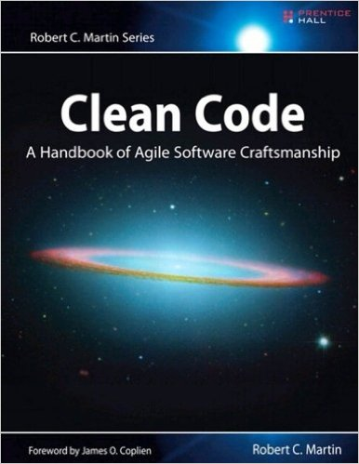
References
http://wiki.c2.com/?ModelViewController
https://blog.codinghorror.com/understanding-model-view-controller/
Source code: https://github.com/iraytrace/MVCdemo.git

