Slide 1
CI/CD pipelines
Boghiu Răzvan-Iulian
SCPD

Slide 2
Overview
Available on GitHub: https://github.com/iraz8/cicd_pipeline
Components:
Git Fetcher
Agents Orchestrator
Technologies:
Java 21
Spring Boot 3
Maven
Thymeleaf
Docker

Slide 3
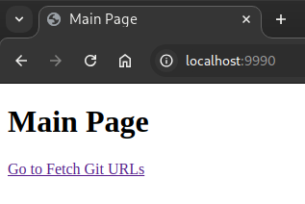
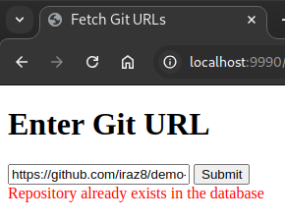
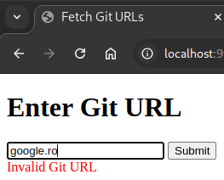
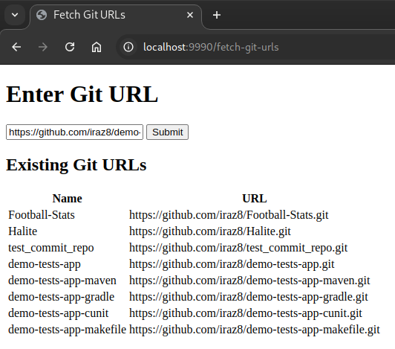
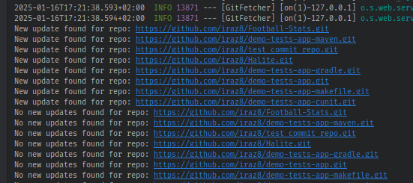
Git Fetcher

Slide 4
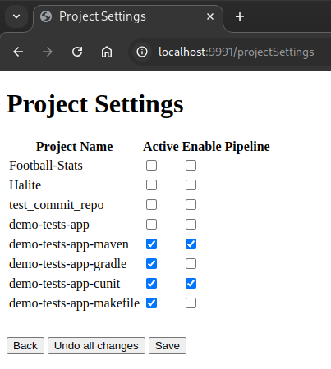
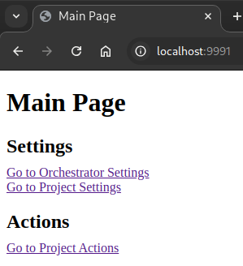
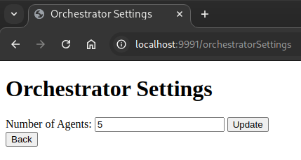
Agents Orchestrator

Slide 5
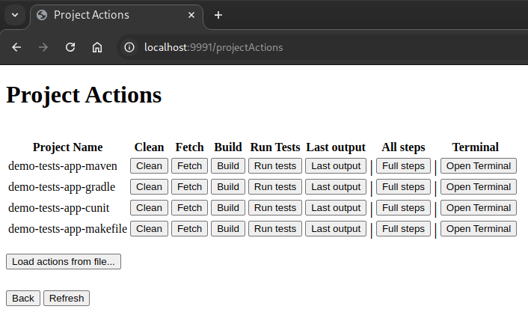

Slide 6
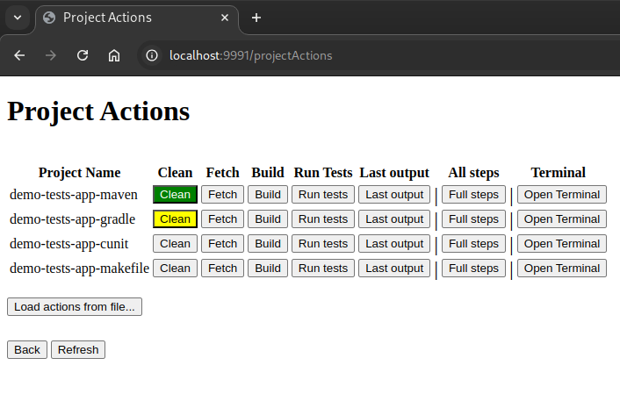

Slide 7
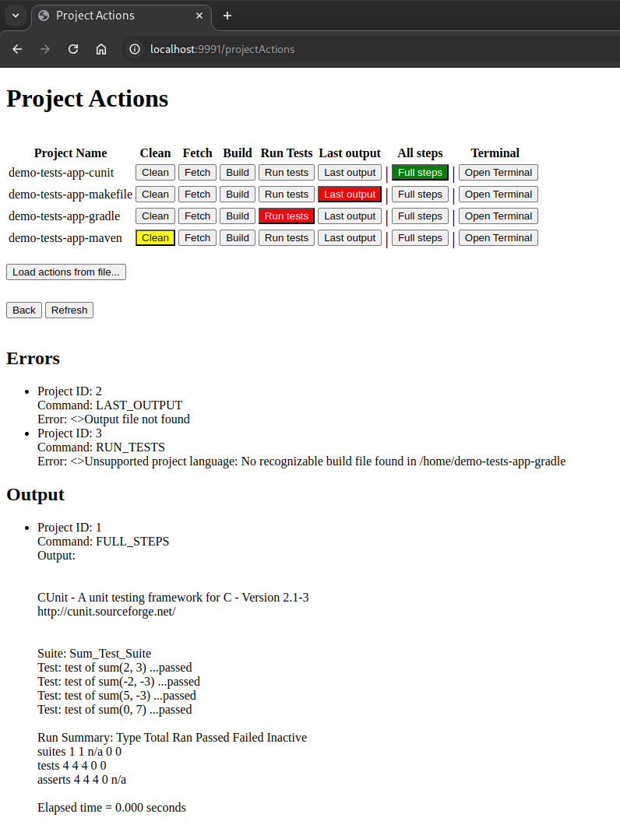

Slide 8
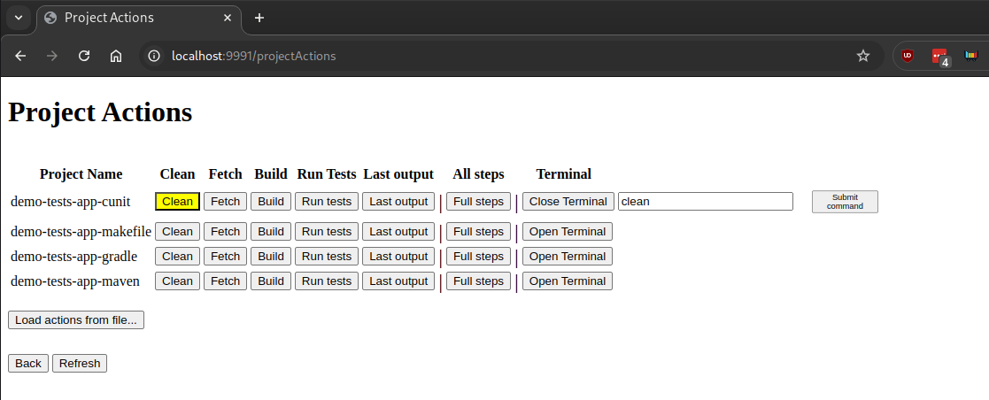

Slide 9
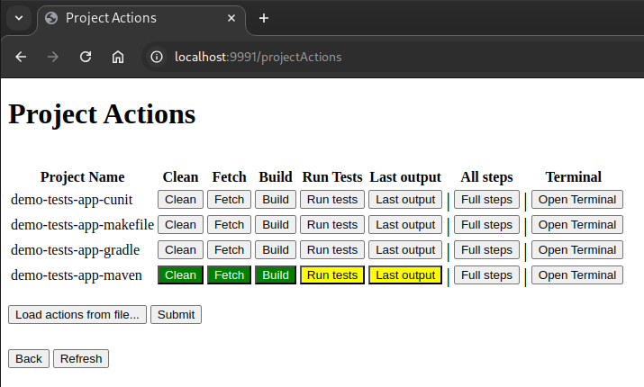

Slide 10
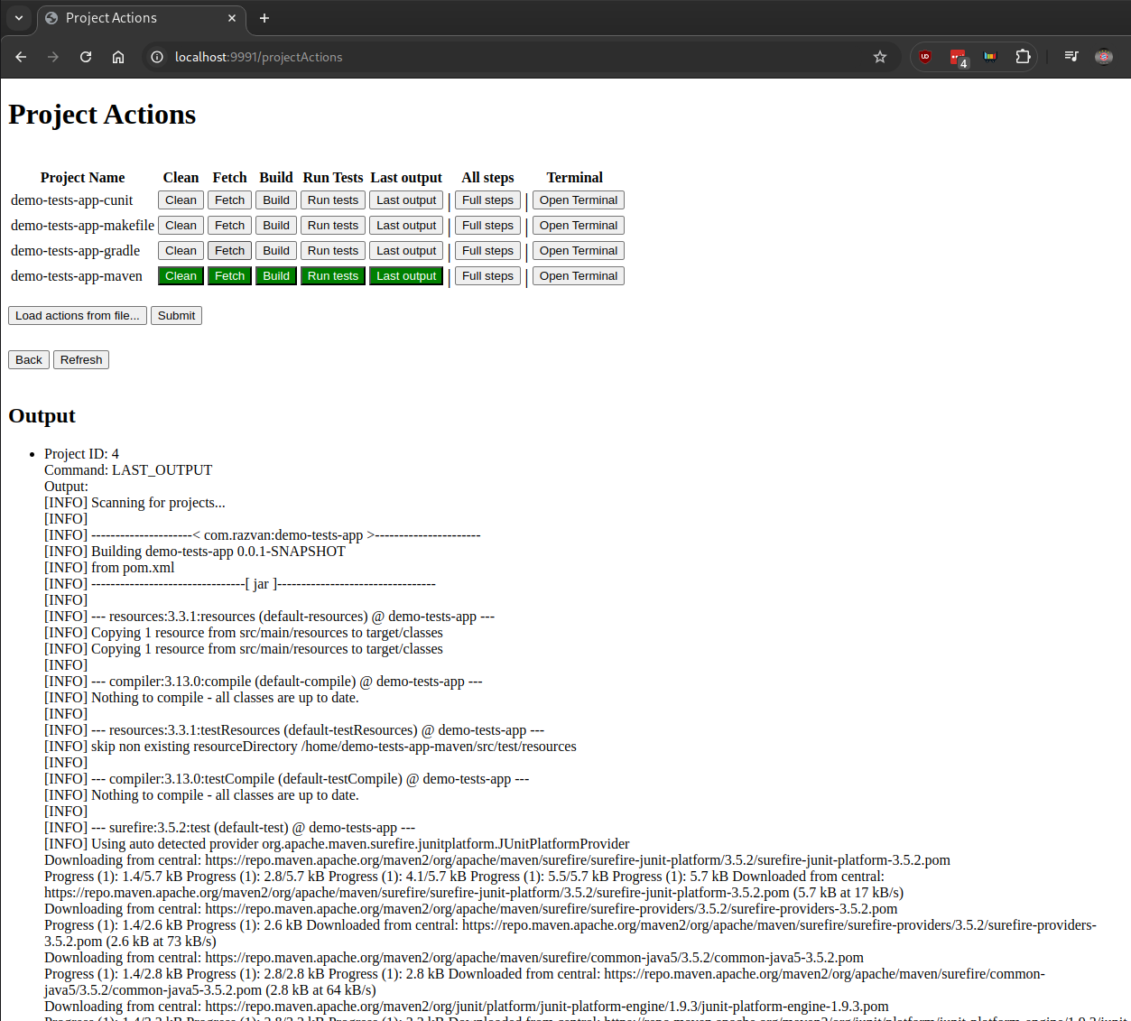

Slide 11
Thanks!

