Slide 1

Spot Communications Spot
CMPS115 – Project Presentation
12/3/2013
Ian Blake - Project Owner
Ryan Cori
James York
Jeff Sweeney
David Zeppa
HuJun Cui

Slide 2
Problem Statement
Spot aims to provide an ad-hoc, anonymous, peer-to-peer, and proximity based chat client for Android devices. With Spot, users can anonymously chat with others nearby without relying on any internet connection.

Slide 3
What is Spot?
Mobile, ad-hoc peer-to-peer chat client
Proximity based
Anonymous

Slide 4
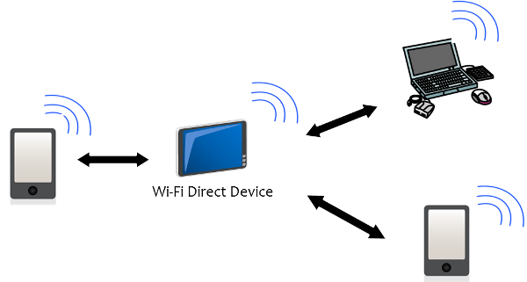
What is WiFi Direct?
Wireless networks without a router
One of the devices acts as the group owner
No SSID, no passphrase

Slide 5
Accomplishments
Utilize the Android WiFi direct communication protocol
Send chat data over WiFi
Discover nearby chat rooms
Create and leave rooms

Slide 6
Setbacks
Regular access to sufficient development devices
Majority of team new to Android developmen Underestimated ed the difficulty and amount of time required to develop basic functionality

Slide 7
User Stories
As a developer I want functioning netcode so that we can connect multiple phones together.
As a user, I want to be able to send messages to other users so I can chat with them.

Slide 8
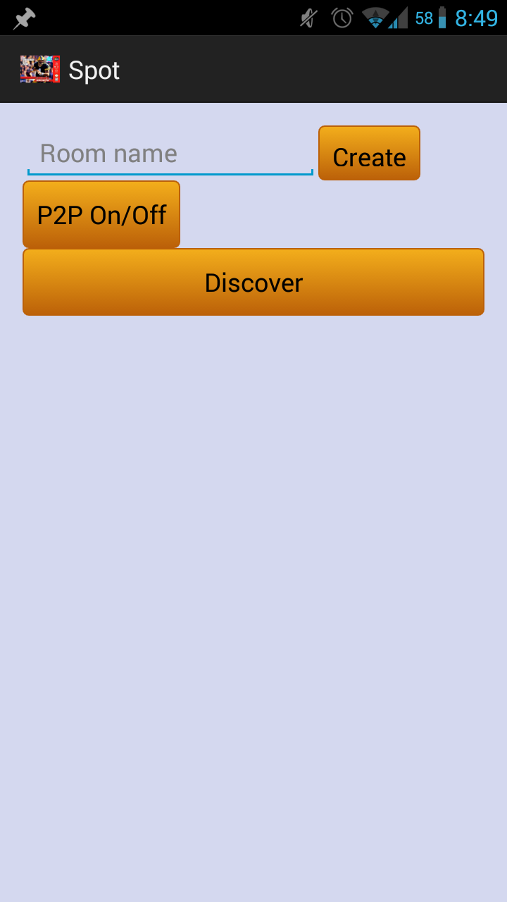
Demo
Enable WiFi direct
Create group
Discover group
Join group
Chat

Slide 9

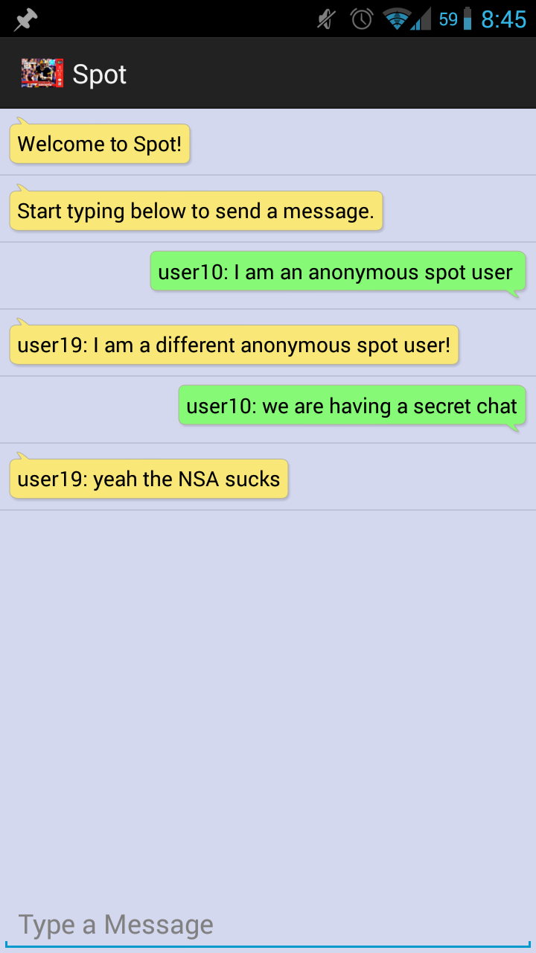
Demo

