Slide 1
CNA detection from ExomeSeq data
가톨릭대학교 의과대학
인간 유전체 다형성 연구소
노규형

Slide 2
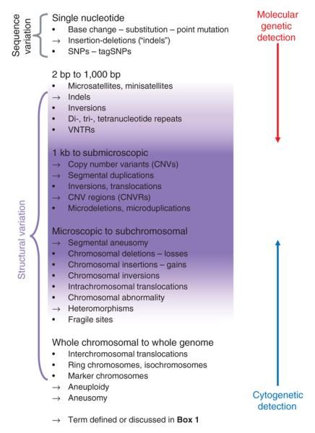
Genomic Variation
Scherer et al. 2007

Slide 3
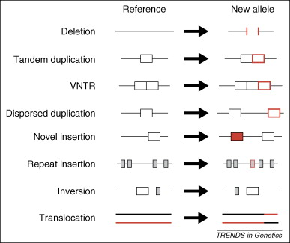
Types of Structural Variation
Hurles et al. 2008

Slide 4
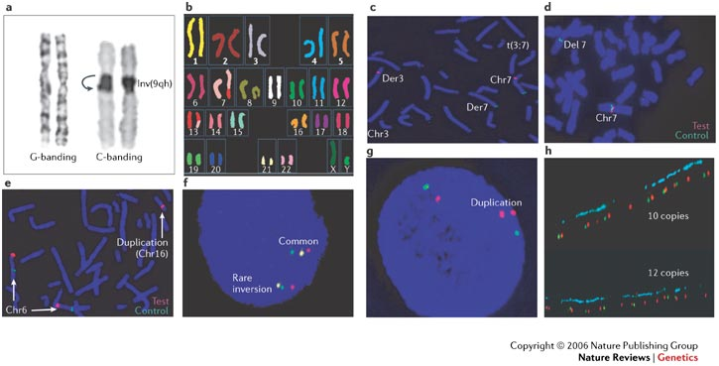
Copy number {variation, aberration}: structural variation

Slide 5
The resolution gaps in SV analysis
10⁰
10¹
10²
10³
10⁴
10⁵
10⁶
10⁷
10⁸
10⁹
[bp]
Microscope
Sanger sequencing
BAC-, oligo/SNP array, (FISH)
HR-CGH-arrays
Breakpoint prediction to within PCR range
454-PEM
(short-read)
2nd-gen sequencing
[adapted from Lupski et al. Nat Genet 2007]
From M. Snyder’s PPT (2010)

Slide 6
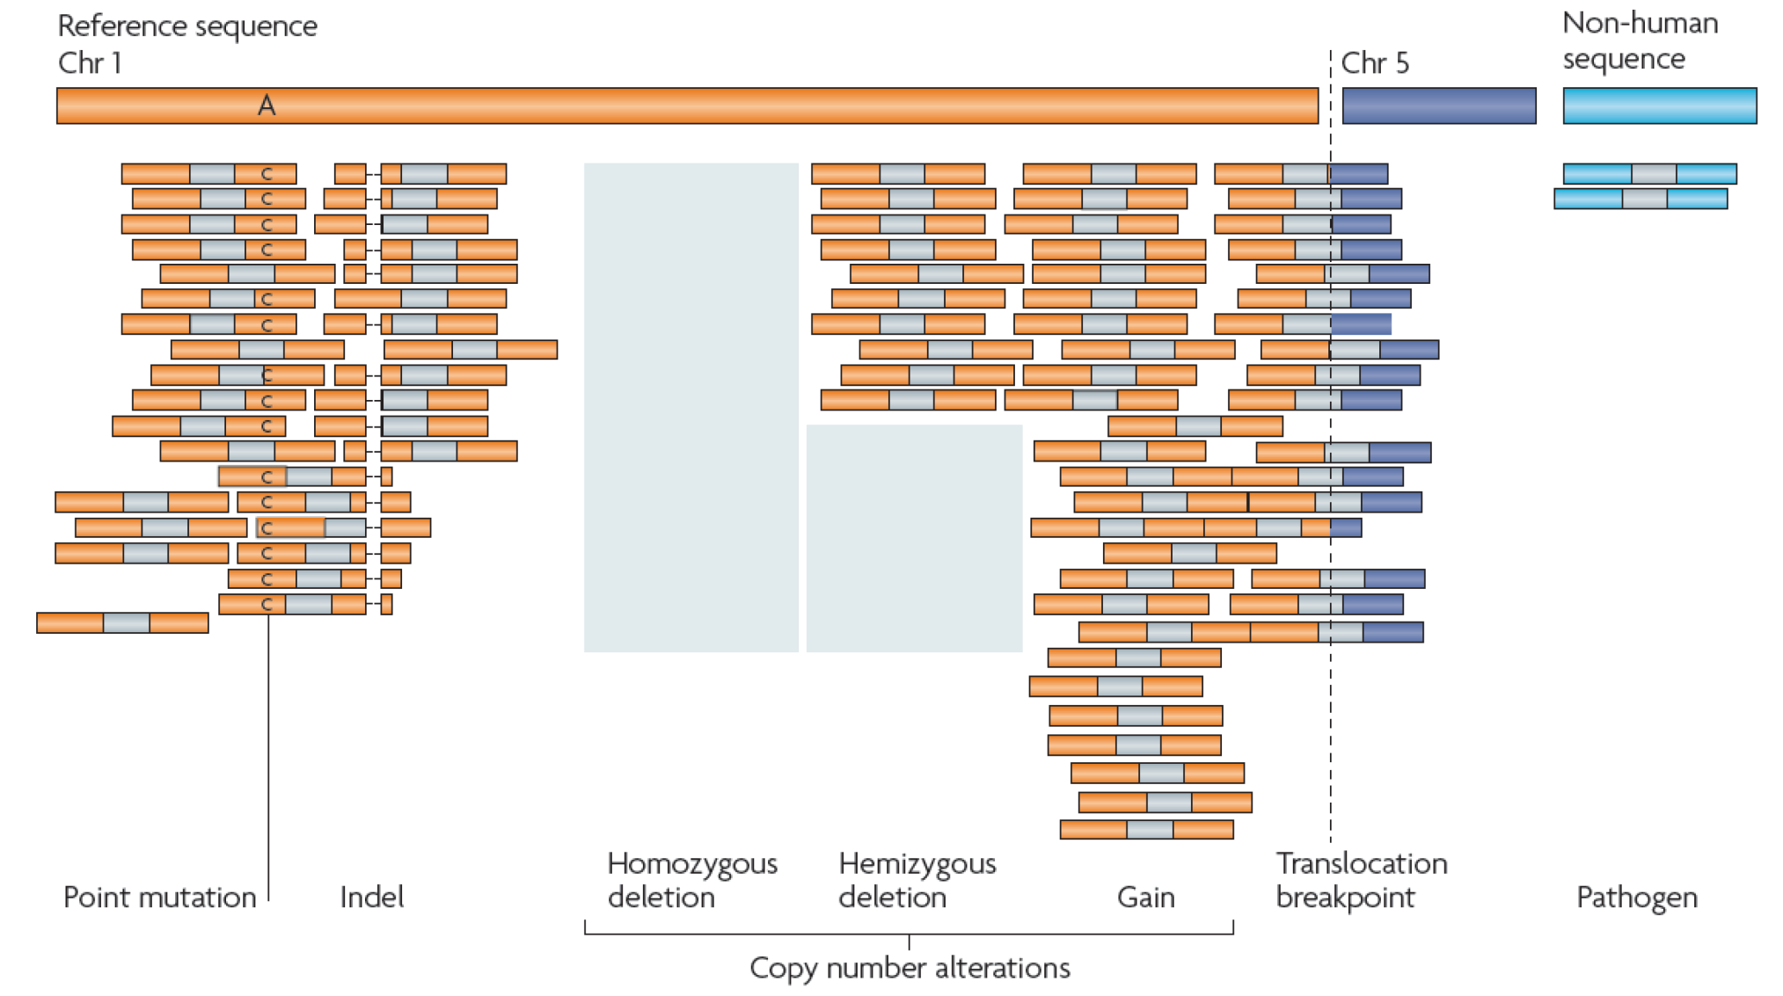
NGS: base-level analysis
Eric Lander and Mat Meyerson, 2010

Slide 7
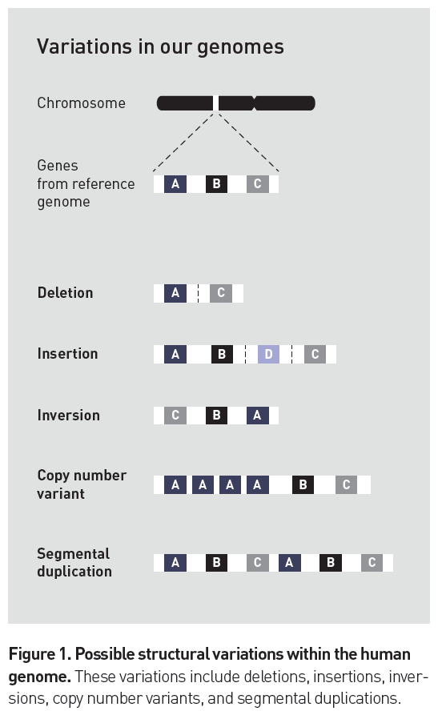
CNV? CNA?
Copy number variation:
Polymorphism in population
Copy number aberration
somatic CNA in Cancer
Ion torrent App. Note

Slide 8
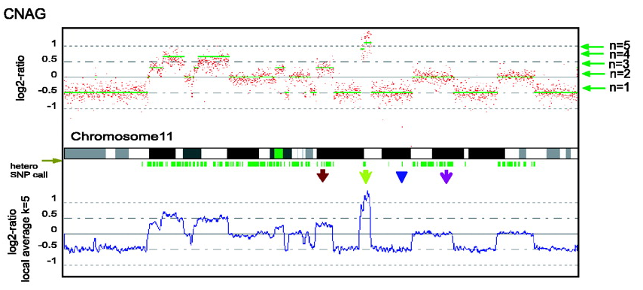
Copy number in Cancer
Many tumors have gross CN changes
Nannya et al, Cancer Res 2005;65:6071-6079
Notes:
A lung cancer cell line vs matched normal lymphoblast,
from Nannya et al Cancer Res 2005;65:6071-6079

Slide 9
CNA as mutation driver
Mutation driver
Subtle mutations (substitutions and indels)
Copy Number Aberrations
Translocations (ERG, ALK, RET fusions)
Germline mutations related to hereditary syndromes
Mutation driver genes with CNA
10 oncogenes that were recurrently amplified (e.g. MYC family)
3 tumor suppressors that were homozygously deleted (e.g. MAP2K4)

Slide 10
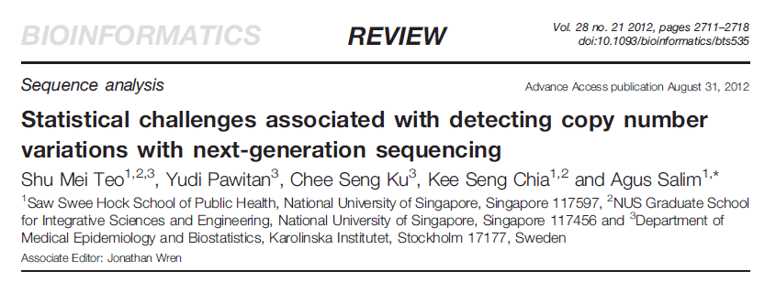
Review

Slide 11
Why is SV calling challenging?
Artifacts
Millions of chimeric molecules generated during library construction
Read depth varies across the genome and libraries
Alignment algorithms are misled by the genome’s repeats
Low coverage sequencing
False discoveries can accumulate across genomes
Deeply sequenced genomes
Increased depth can help, but methodology is more important
source: http://www.broadinstitute.org/software/genomestrip/workshop-presentations

Slide 12
Five CNV detection methods using NGS
DOC (Depth of Coverage)
PEM (Paired End Mapping)
SR (Split Read)
Assembly Based
5) Combinatorial approach (ex. DOC + PEM)
→ 1) ~ 3) require first mapping reads to a known reference genome

Slide 13
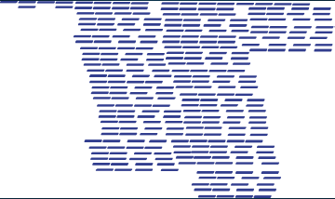

DOC (Depth of Coverage)
Most DOC methods count the number of reads that fall in each pre-specified window of a certain size
Similar to intensity data in aCGH: two samples can be compared to detect relative gains and losses
A lower than expected DOC indicates deletion and a higher than expected DOC indicates duplication.
100 bp
100 bp

Slide 14
DOC (cont.)
DOC algorithm assumes that sequencing process is uniform : the number of reads mapped to a region is proportional to the number of copies
Biases such as GC-content and mappability cause this assumption to be unrealistic
Most DOC algorithms correct for GC-content bias,
by using ratios between reads from the target and reference genome
by using SNP heterozygosity information or ‘B allele frequency’ information to call CNVs and loss of heterozygosity (LOH) regions

Slide 15
DOC (cont.)
DOC algorithms usually detect large CNVs
They cannot detect copy neutral events such as inversions and translocations.
Single-end or paired-end data may be used for this analysis.

Slide 16
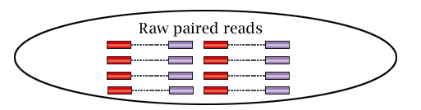
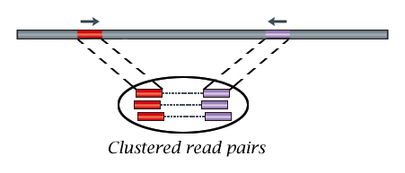
PEM (Paired End Mapping)
PEM detects CNVs through discordantly mapped reads. A discordant mapping is produced if the distance between two ends of a read pair is significantly different from the average insert size
Figure source: http://bioinfo.mc.vanderbilt.edu/CNVannotator/links.cgi

Slide 17
PEM (cont.)
A concordant or discordant mapping of the two ends of a paired-end read is determined by their mapped orientations and by comparing their mapped distances with the known insert size
Advantages :
PEM can detect dosage-invariant SVs,
higher sensitivity for detecting smaller SVs,
the precision of localizing the breakpoint.
Disadvantages :
limited power in detecting insertions larger than the insert size.

Slide 18
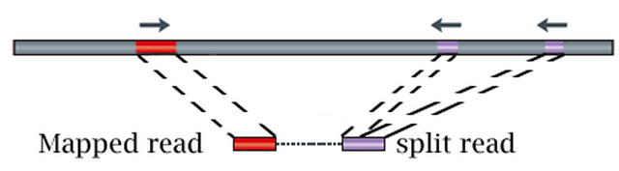
SR (Split Read)
SR based methods use incompletely mapped read from each read pair to identify small CNVs
Figure source: http://bioinfo.mc.vanderbilt.edu/CNVannotator/links.cgi

Slide 19
SR (cont.)
Mapped read is used as an anchor to narrow down the search space for the SR alignment of the unmapped read
Advantages :
pinpoint the location of the breakpoints
identifies breakpoints of large deletions (1~10 kb) and medium sized insertions (1~20 bp)

Slide 20
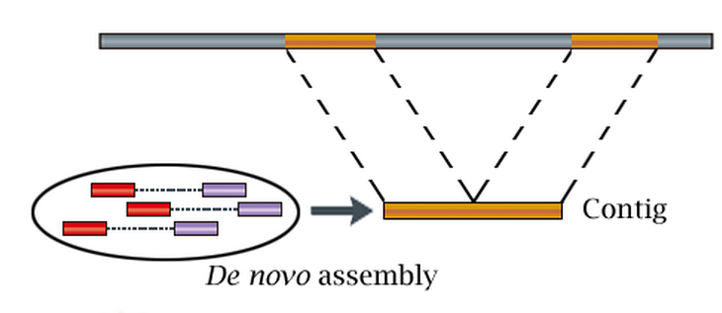
Assembly Based
Assembly based approach detects CNVs by mapping contigs to the reference genome.
Figure source: http://bioinfo.mc.vanderbilt.edu/CNVannotator/links.cgi

Slide 21
Assembly Based (cont.)
AS methods do not align the reads to a known reference but construct the genome piece-by-piece → known as de novo sequencing
Advantage : AS can discover new non-reference sequence insertions.
AS methods work best for small genomes such as bacterial genomes
AS are less widely used in human NGS sequencing because the short reads from NGS makes assembly in repeat regions difficult

Slide 22
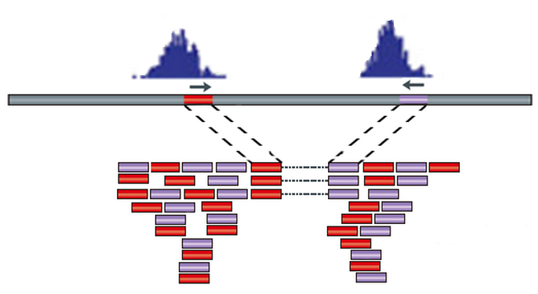
Combinatorial approach
The combinatorial approach combines the results from the above four methods (ex. DOC + PEM)
Figure source: http://bioinfo.mc.vanderbilt.edu/CNVannotator/links.cgi

Slide 23
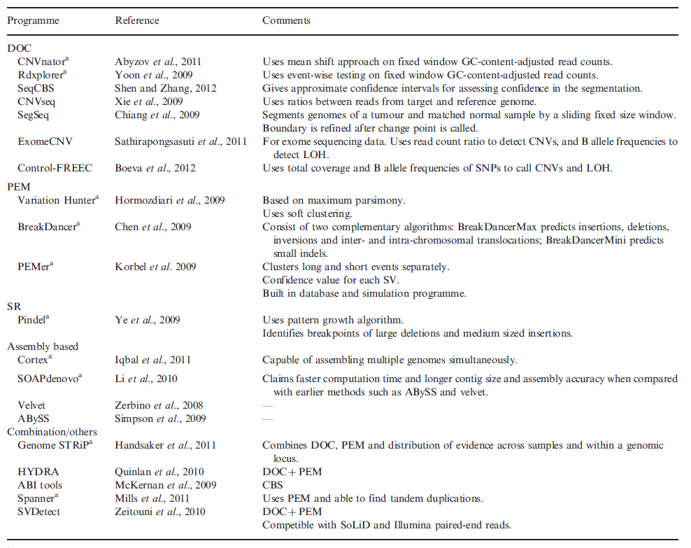
CNV detection software

Slide 24
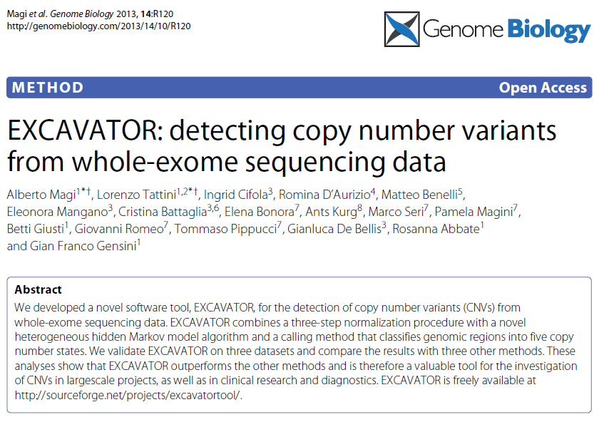
Excavator

Slide 25
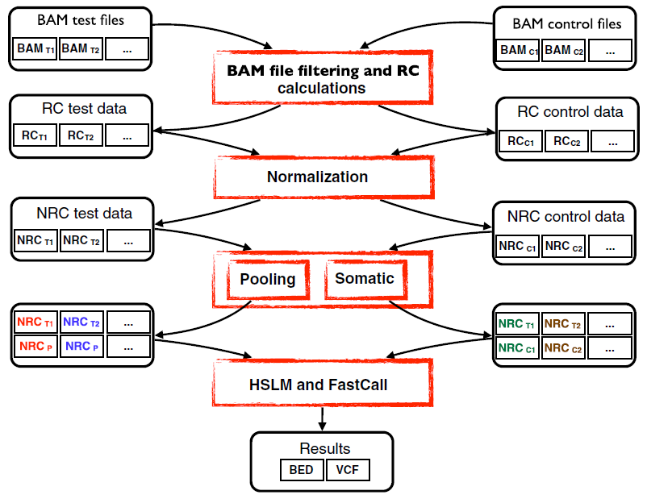
EXCAVATOR workflow

Slide 26





EMRC (Exon mean read count)

Slide 27
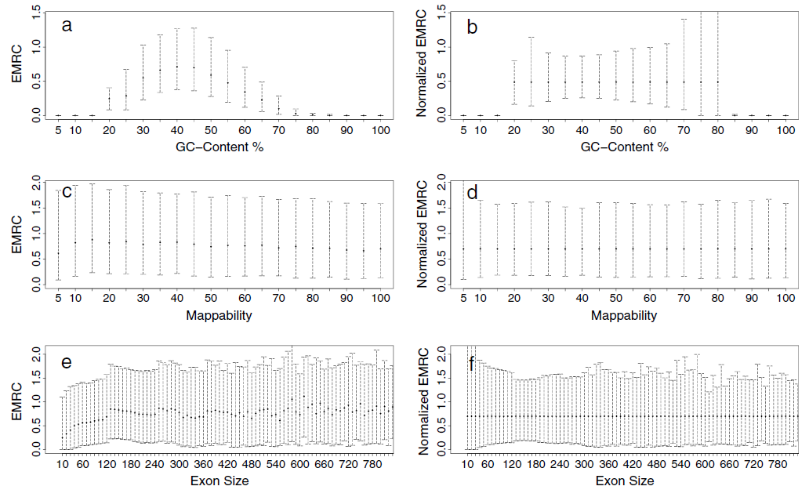
EMRC and normalized EMRC

Slide 28
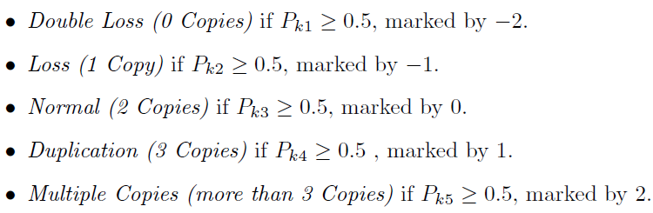
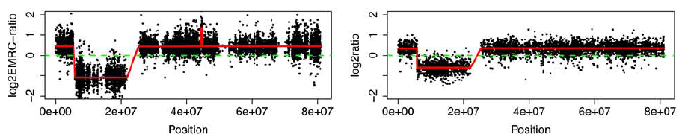
Calling algorithm: FastCall Model
Classification rules
Example result
Notes:
HSLM (Heterogeneous Shifting Level Model): A sort of HHMM (Heterogeneous Hidden Markov Model)
FastCall: Gaussian Mixture model

Slide 29
Installation guide
Requirements
R >= 2.14.0 (Hmisc package installed)
samtools >= 0.1.17
Perl >= 5.8.8
Installation
Open the compressed EXCAVATOR package
Let’s say here $EXCAVATOR_HOME
cd $EXCAVATOR_HOME/LIB folder
R CMD SHLIB F4R.f
R CMD SHLIB FastJointSLMLibraryI.f

Slide 30
TargetPerla.pl
Code: perl TargetPerla.pl SourceTarget.txt SureSelect50M.bed TargetName
Input:
SourceTarget.txt
uniqueome.coverage.base-space.25.1.wig /path/to/ucsc.hg19.fasta
SureSelect50M.bed
chr1 14467 14587 0 chr1 14639 14883 0 chr1 14943 15064 0 chr1 15671 15990 0
TargetName
SureSelect50M
Output
$EXCAVATOR_HOME/data/targets/hg19/SureSelect50M/
Filtered.txt
SureSelect50M_chromosome
SureSelect50M.Rdata
GCC (directory)
MAP (directory)
Notes:
real 203m16.840s = 3H 30M
user 111m4.957s
sys 60m19.430s

Slide 31
ReadPerla.pl
Code: perl ReadPerla.pl ReadInput.txt /path/to/OutputFolder –mode [somatic|pooling]
Input:
ReadInput.txt
SureSelect50M hg19 WES/01234567T.bam 01234567T T1
SureSelect50M hg19 WES/01234568T.bam 01234568T T2
SureSelect50M hg19 WES/01234569T.bam 01234569T T3
SureSelect50M hg19 WES/01234567N.bam 01234567N C1
SureSelect50M hg19 WES/01234568N.bam 01234568N C2
SureSelect50M hg19 WES/01234569N.bam 01234569N C3
/path/to/OutputFolder
OutputFolder
- Data (directory)
- ParameterFile_XXXXX.txt
- Plots (directory)
Mode
somatic: Paired samples (Tumor vs Control)
pooling: N normal samples
Notes:
Analyzed samples:
CHET_58_1D CHET_58_ND
real 30m43.641s
user 39m13.003s
sys 4m8.588s

Slide 32
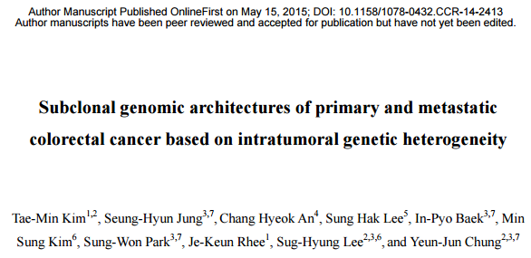
Sample data: CRC4 1D, ND

Slide 33
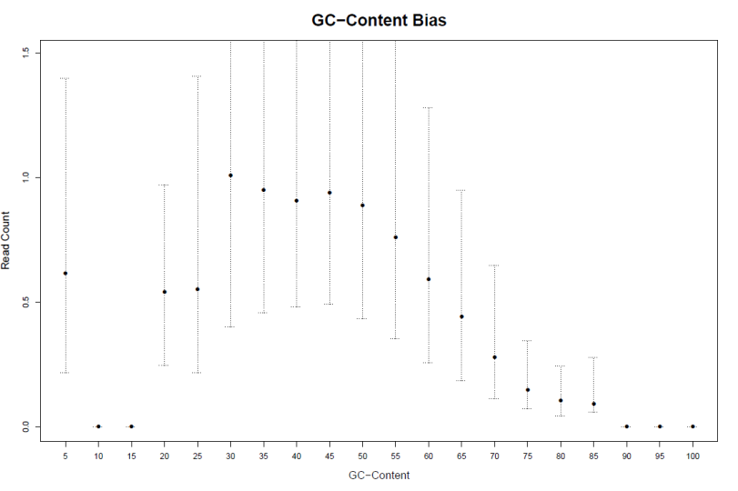
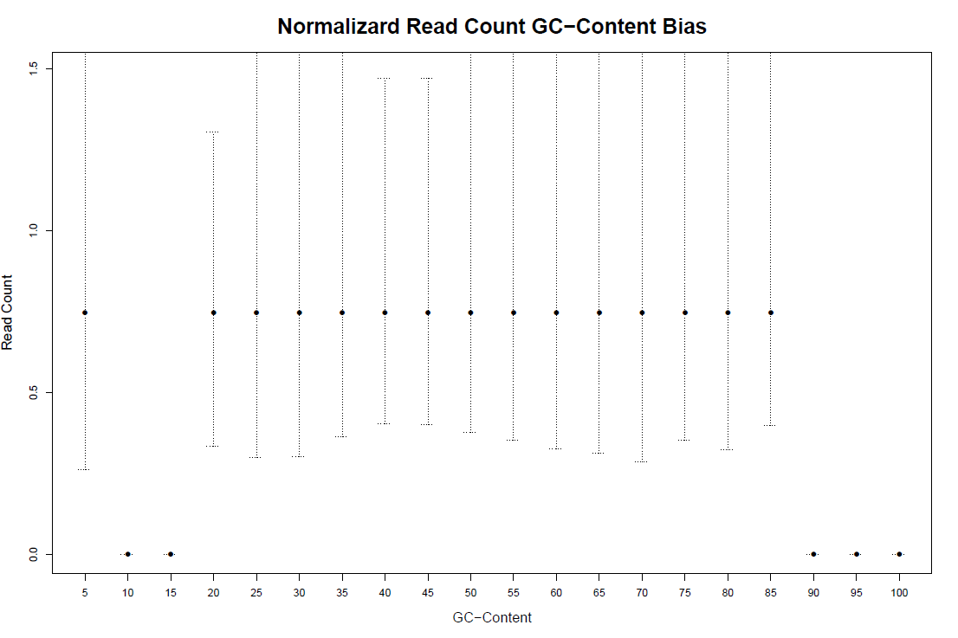
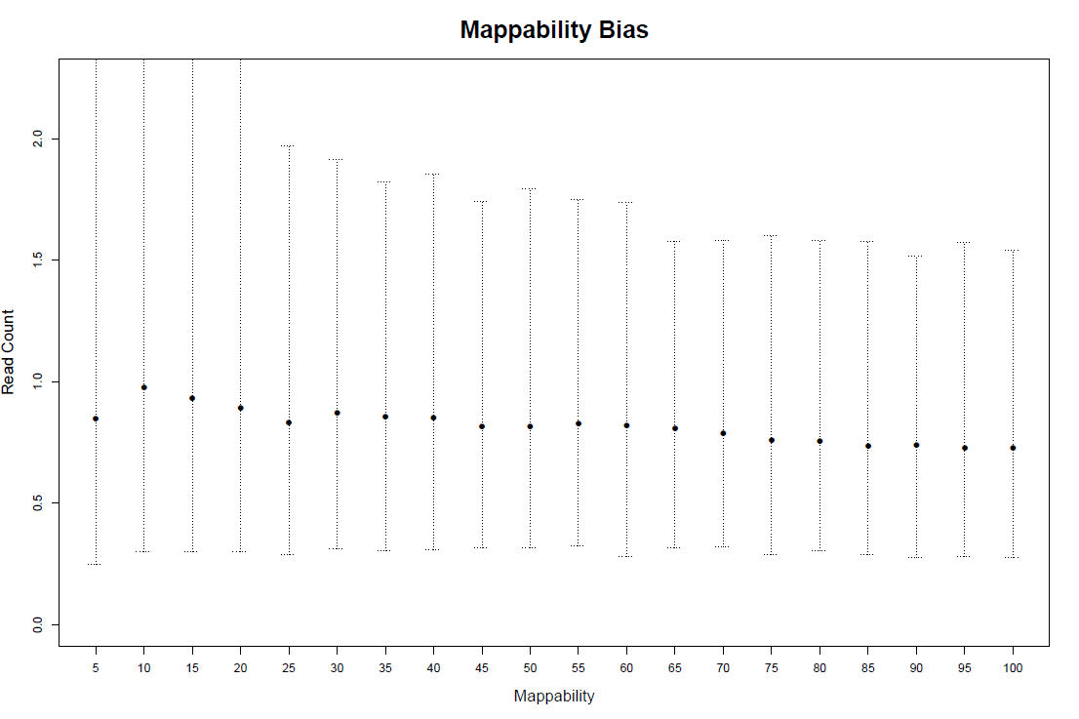
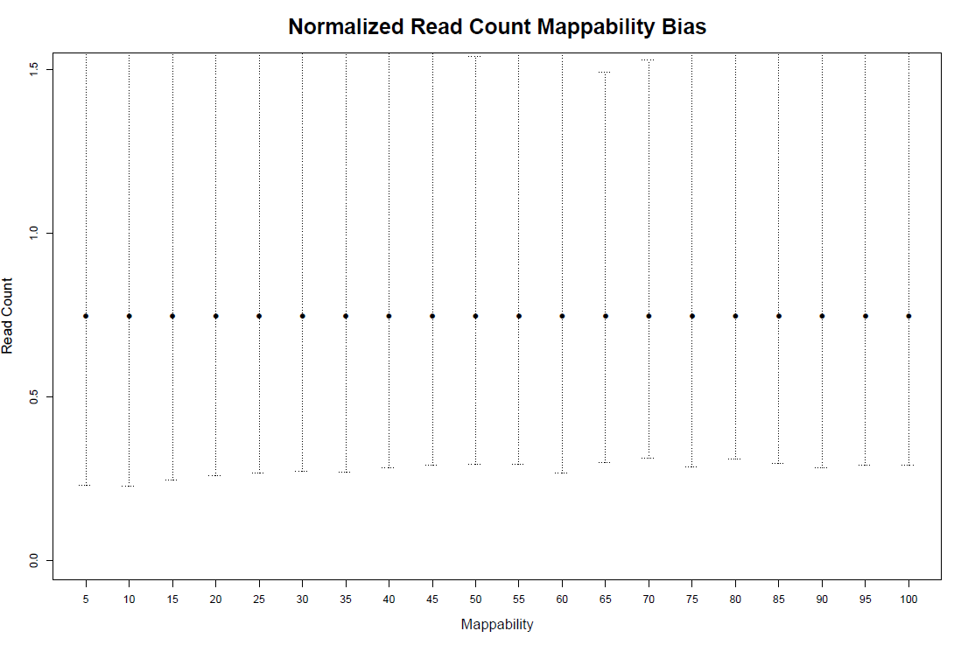
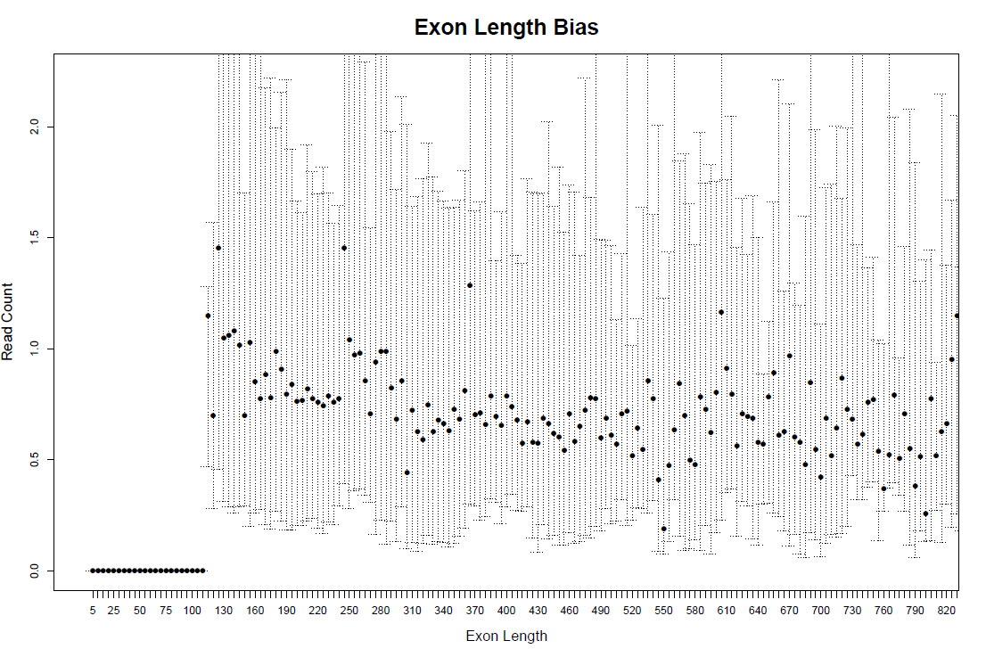
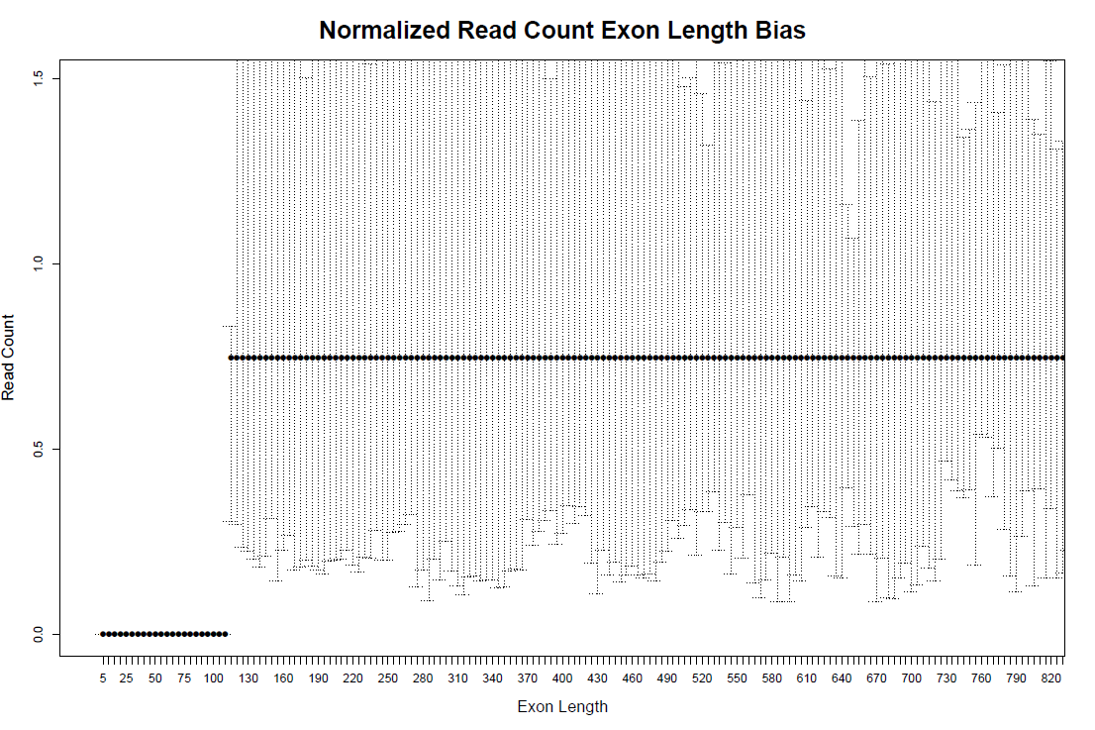
CRC4 1D

Slide 34
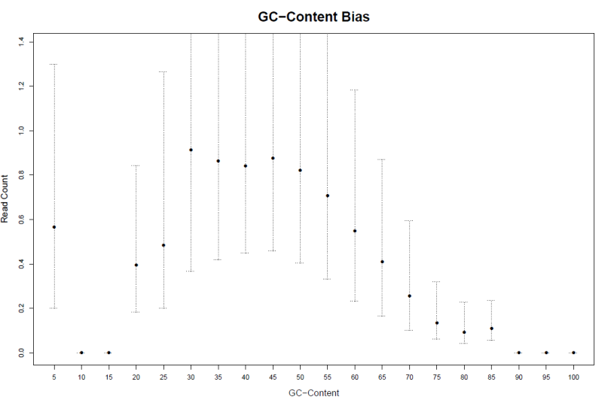
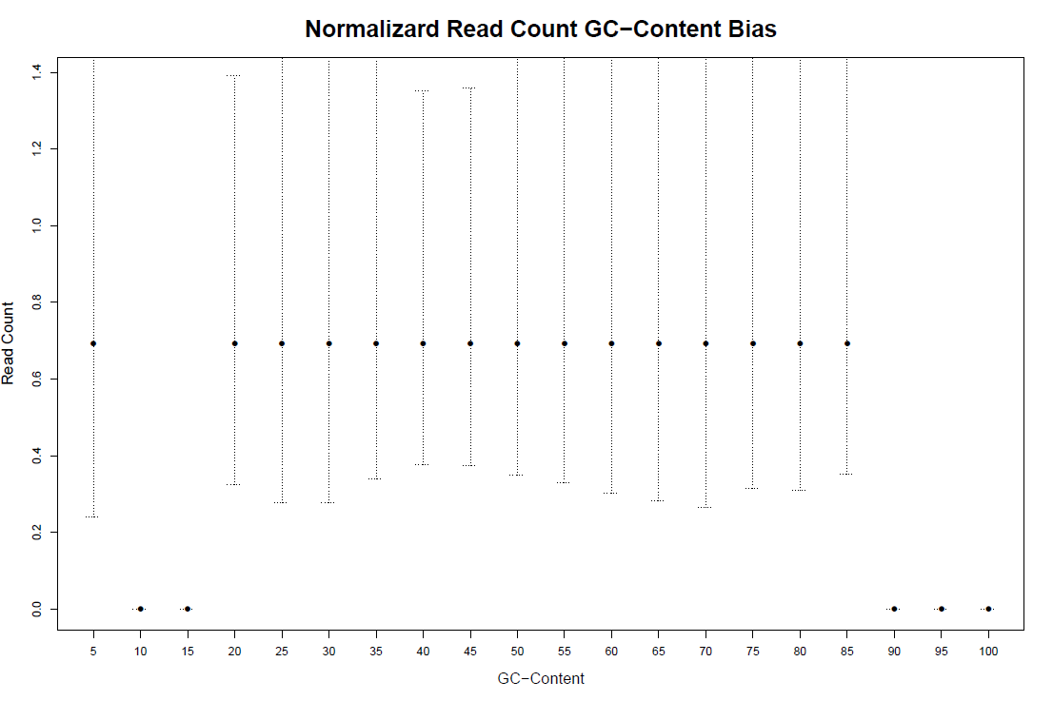

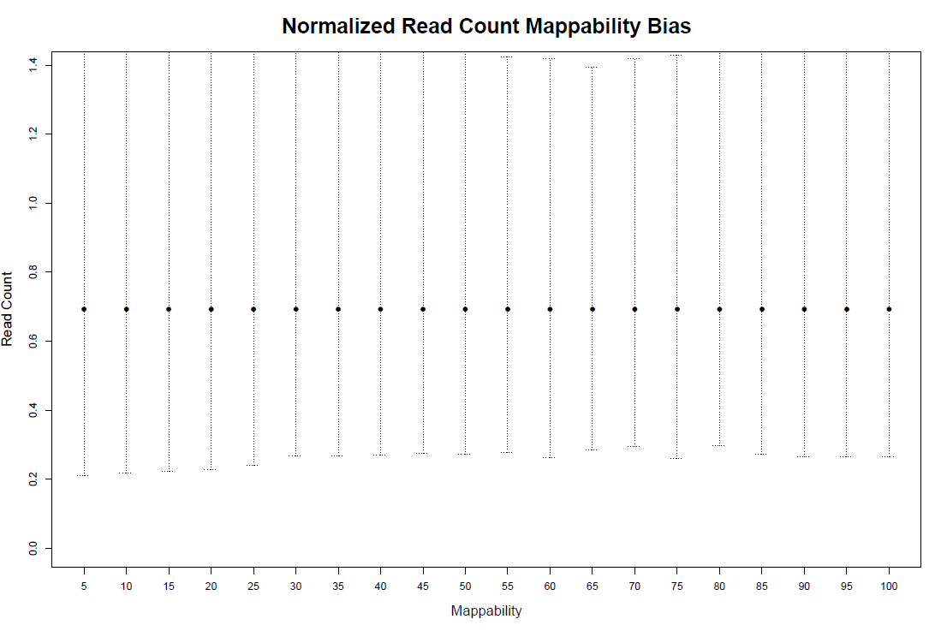

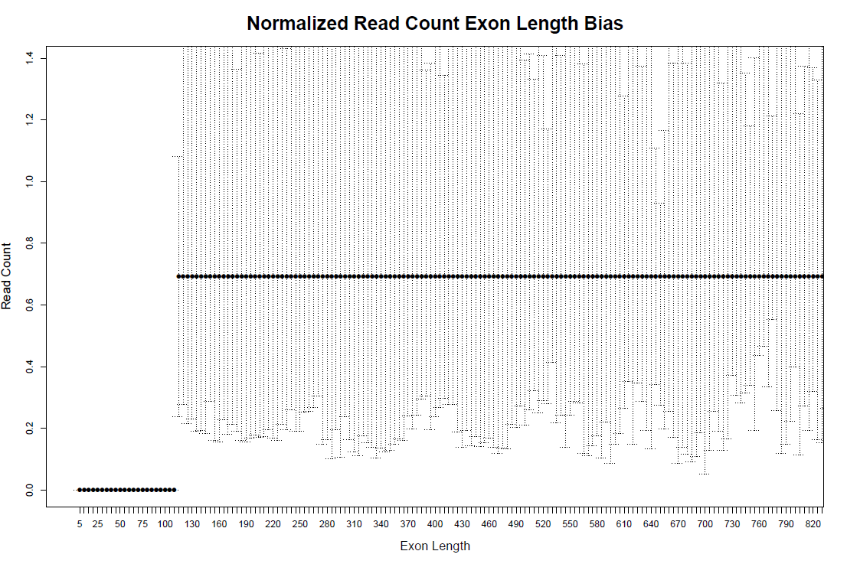
CRC4 ND

Slide 35
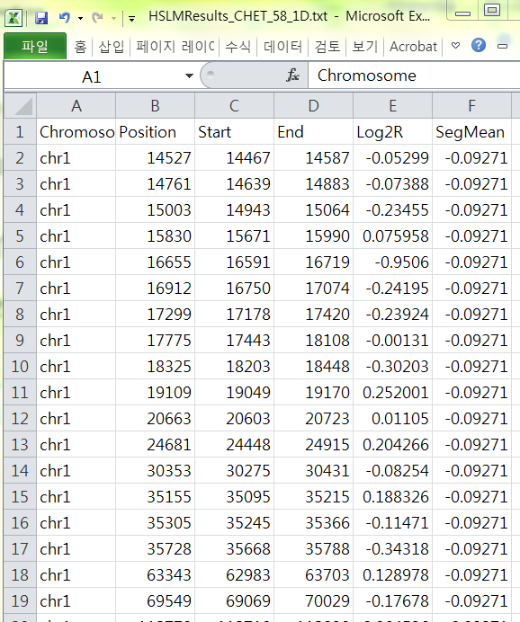
HSLM (segmentation) result

Slide 36
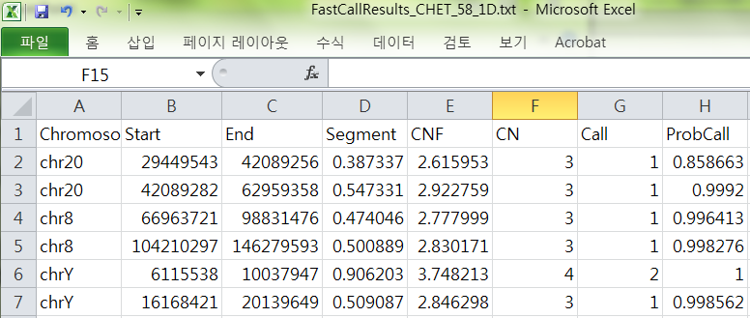
FastCall classification result

Slide 37
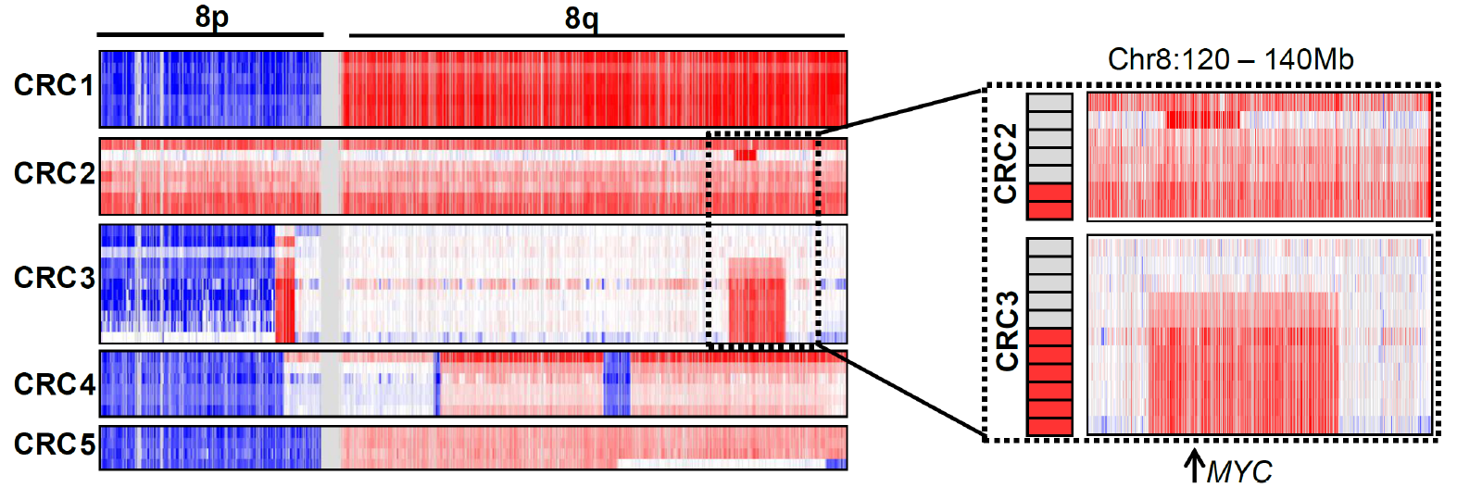
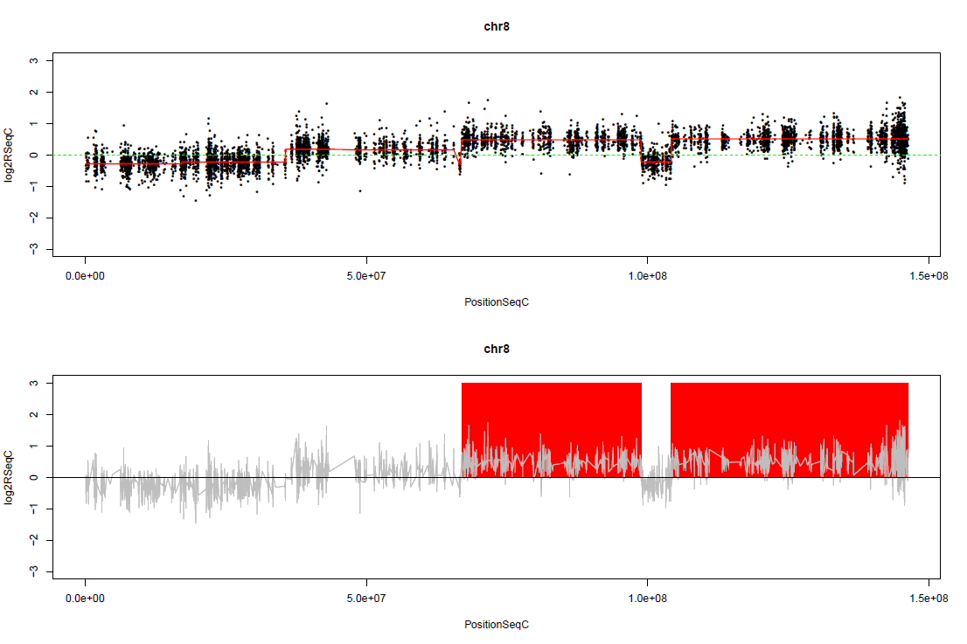
Plot reporting HSLM and Fastcall: CRC4 chromosome 8

