Slide 1
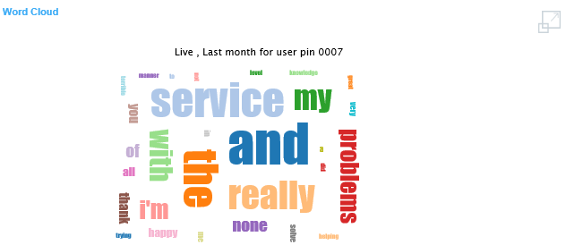

Can we make titles higher – wasted space
Preferences for wordcloud (see below for example)
Single colour/ multiple shades
Shaped into an elipse
Better font
Less space between words
Not Centred

Slide 2
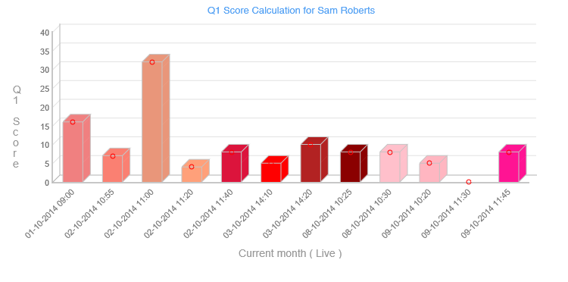

Total Score wrong – eg 32 shown here when max survey score is 30
Heading wrong – this is showing the total score for Sam Roberts
Y-AXIS Midpoint set to 20 – but graph not changed
Y Axis wrong (should be Total Score”
Colours of new graphs not good – can we go back to mainly primary colours, blue, yellow, red, green etc?

Slide 3
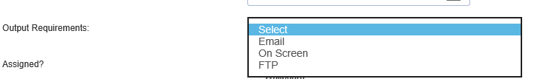
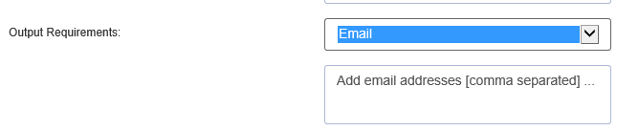
Current Set Up in reports – FTP should only be an option if Detail reports selected.
Currently shown
Now
Daily
Weekly
Monthly
Add tickboxes to schedule reports – daily = last 24 hours sent midnight, weekly sent on Monday morning for previous 7 days, monthly – sent on 1st for the previous calendar month

Slide 4
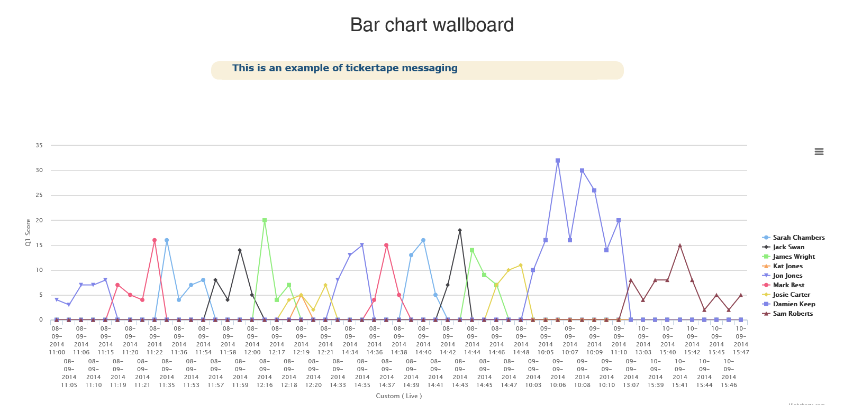
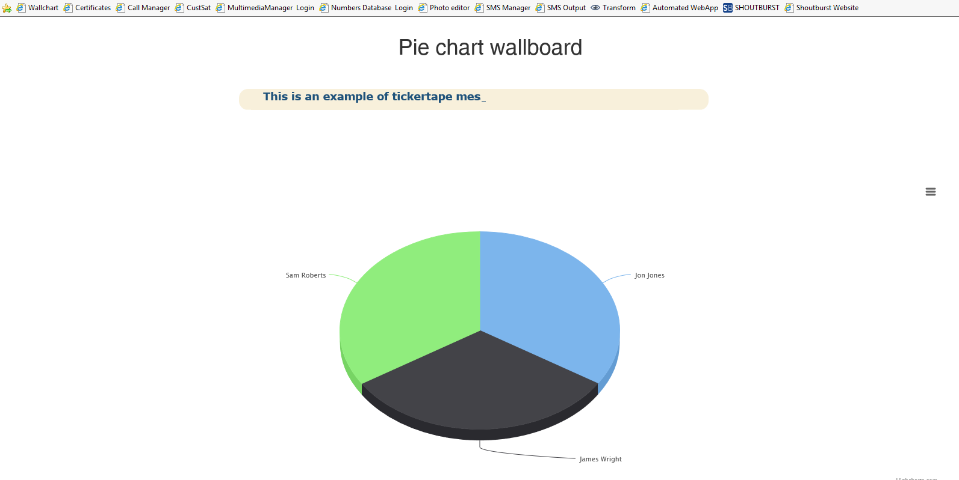
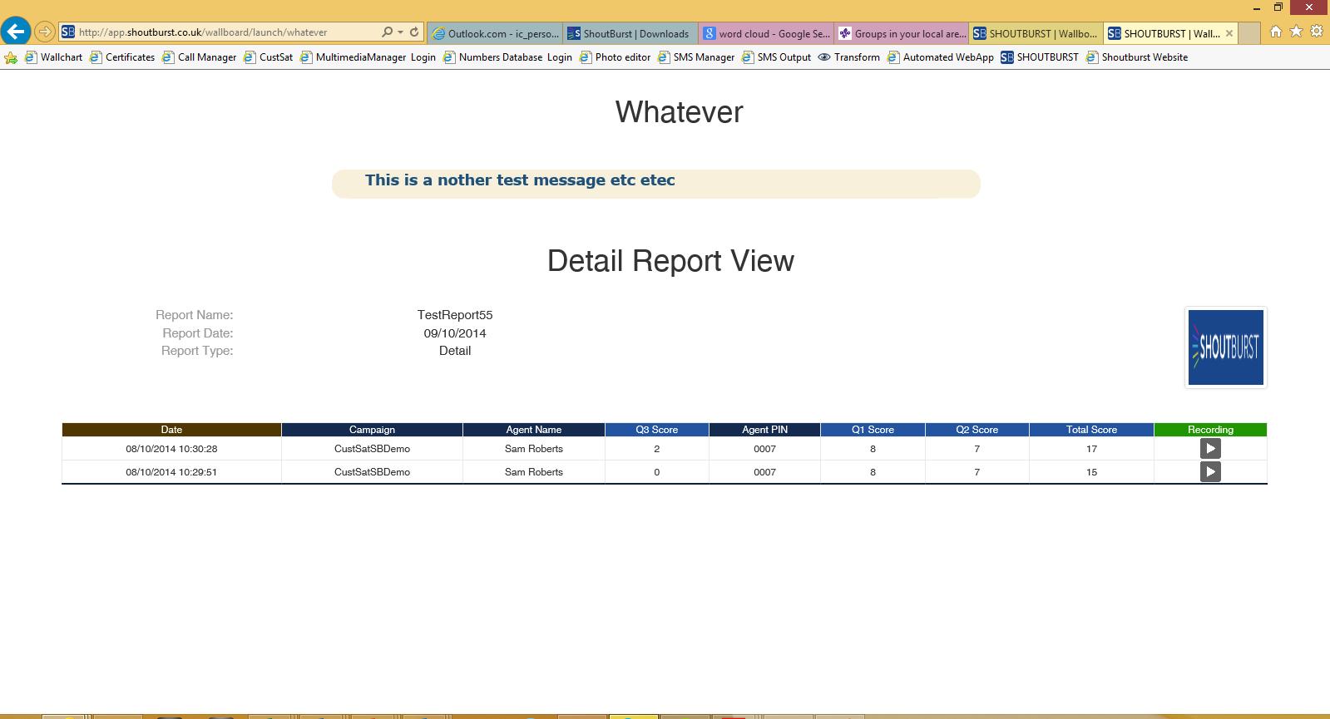
Remove the labels at the bottom, and make bigger if possible
Make the pie chart bigger as wasted space here
Remove & move the data up higher

Slide 5
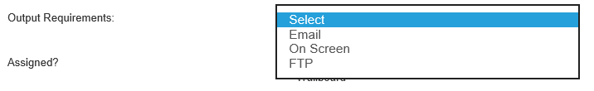
Issue 21
Should be ‘On Screen’ as default

Slide 6
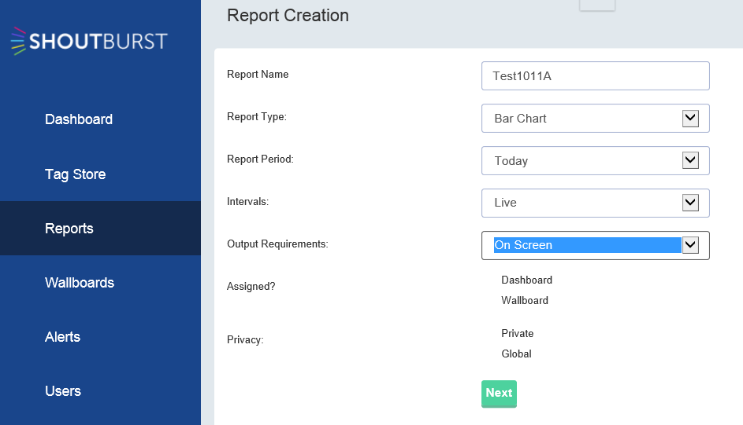
Issue 22

