Slide 1
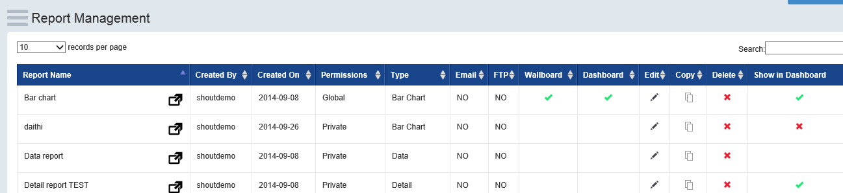
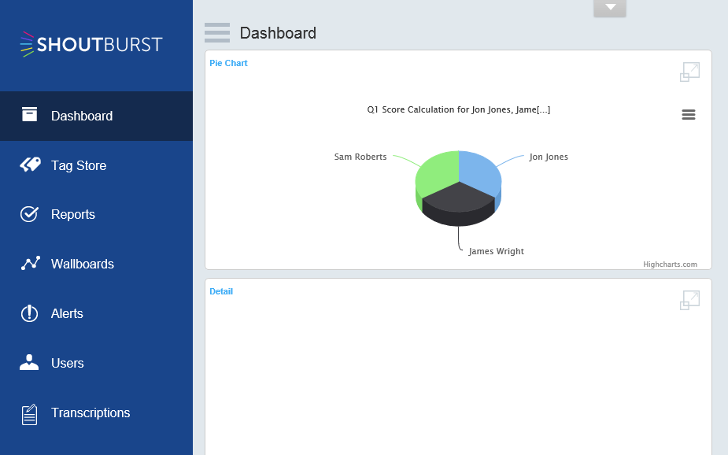
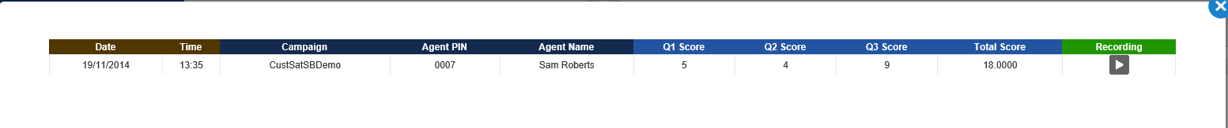
This is the report – as you can see the dashboard display is ticked
Expanding the quadrant shows the report – but should be showing in the quadrant
Showing blank …

Slide 2
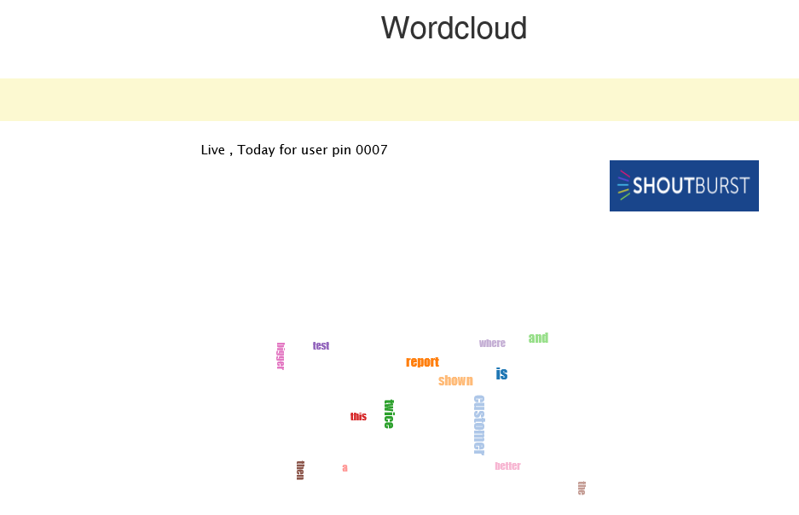
Logo should be in top right corner
Shouldn’t be there
Wordcloud too small

