Slide 1
بِسْمِ اللهِ الرَّحْمٰنِ الرَّحِيْم

Slide 2
Water Level Controller of Overhead Tanks Using Water Level Sense
Electronics-I [EEE231]
Semester Project
Irfan Danish [CIIT/FA15-BEL-012/ISB]
Hammad Munir [CIIT/FA15-BEL-034/ISB]
Bilal Naeem [CIIT/FA15-BEL-007/ISB]

Slide 3
Contents:
Background
Introduction
Goal
Components & Their Narrative
Working
Further Extension & Applications
Cost & Market Value Assessment

Slide 4
Background:
Water tank overflow is a common problem in households nowadays.
Especially in this part of the world where load shedding is an everyday problem, people undergo water loss or high electricity bills.
It is one of our sole duty to use our resources sustainably so that the generations to come could be in ease.

Slide 5
Introduction:
In a third world country like Pakistan, it is very essential for people to have a smart solution to unnecessary electricity bills and wastage of water.
In a country where average income is $1,513 a year people need a device that could automatically save their money.

Slide 6
Introduction:
Wastage of water is becoming common nowadays and one of the biggest reason is the overflowing of water from overhead tanks.
It propelled our concern for an automatic water level controller which is the best solution for both of above described problems.

Slide 7
Goal:
This system is an Arduino based water level controller; it controls the motor by sensing the water level in the overhead tank.
This system prevents the unnecessary functioning of motor. It also prevents the overflowing of water.

Slide 8
Components & Their Narrative:
Some of the components used in the project are:
Voltage Regulator to provide balanced supply of voltage.
Arduino UNO an AVR Platform Based Microcontroller.
Ultrasonic Sensor to measure the water level.
Darlington Pair for current amplification.
Relay to switch the motor pump.

Slide 9
Arduino (AVR) Platform:
The Arduino Uno is a microcontroller board based on the AVR ATmega328.
This is the one of the most important component of our project it provides the functionality of brain.
It has 14 digital input/output pins & 6 analog inputs.
Arduino Uno comes with 16 MHz crystal oscillator.
It has 10 bit ADC(Analog to Digital Converter).

Slide 10
Ultrasonic Sensor:
The Ultrasonic sound waves has an extremely high pitch that humans cannot hear and is also free from external noises from passive or active sources.
This ultrasonic distance sensor (HC-SR04) provides steady and accurate distance measurements within the range of 2cm to 450cm.
It has a focus of less than 15 degrees and an accuracy of about 3mm.

Slide 11
Ultrasonic Sensor:
This particular sensor transmits an ultrasonic sound that has a frequency of about 40 kHz.
The sensor has two main parts- transducer that creates an ultrasonic sound wave while the other part listens to its echo.

Slide 12
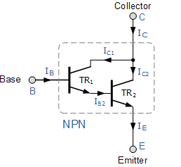
Darlington Pair:
Darlington Transistor or Darlington Pair is circuitry in which two transistors are cascaded in such a way that we get the current gain equal to the product of respective current gain of each transistor.
In this project we used this
device to drive a relay.

Slide 13
Voltage Regulator
Voltage regulator is an electrical or electronic device that maintains the voltage of a power source within acceptable limits.
We used voltage regulator to provide safe voltage parameters to the components used.
In this project, we used LM7805 (3-terminal IC) from 78xx series, which provides fixed 5V at output.
It can deliver up to 1.5 A of output current.

Slide 14
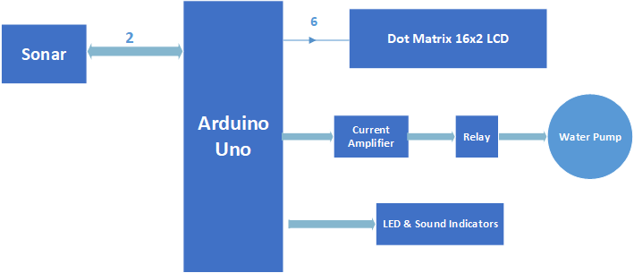
Working (Block Diagram):

Slide 15
Working:
The major contribution in this project is of the ultrasonic sensor module. It emits ultrasonic waves of 40 KHz from its trigger.
These waves hit the water in the overhead tank and then echoes back to the receiver.

Slide 16
Working:
The time taken for the echo to return determines the distance of the water which is used to calculate the water level in the tank.
We have programmed our controller in such a way that it will create two zones.
The respective water level percentage is displayed on LCD.

Slide 17
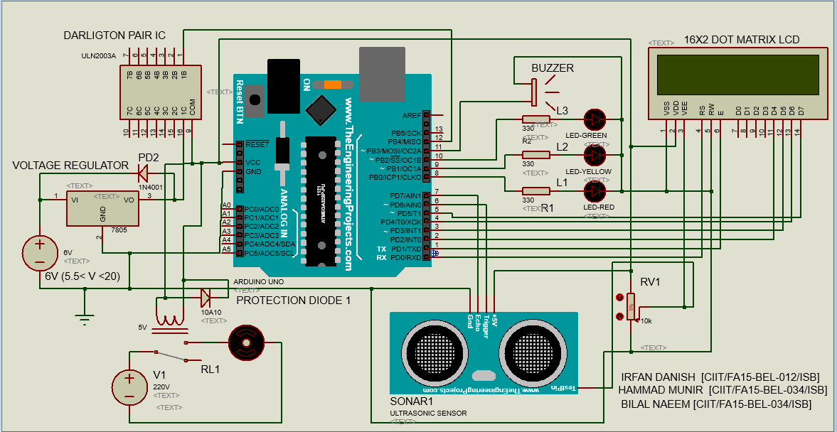
Working (Schematic):

Slide 18
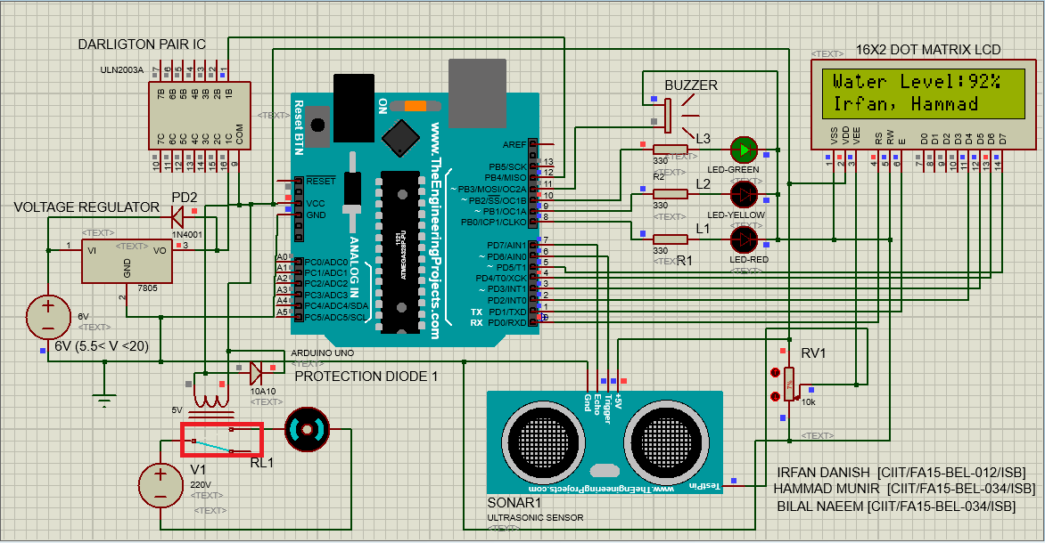
Water Level 1: Tank is Full

Slide 19
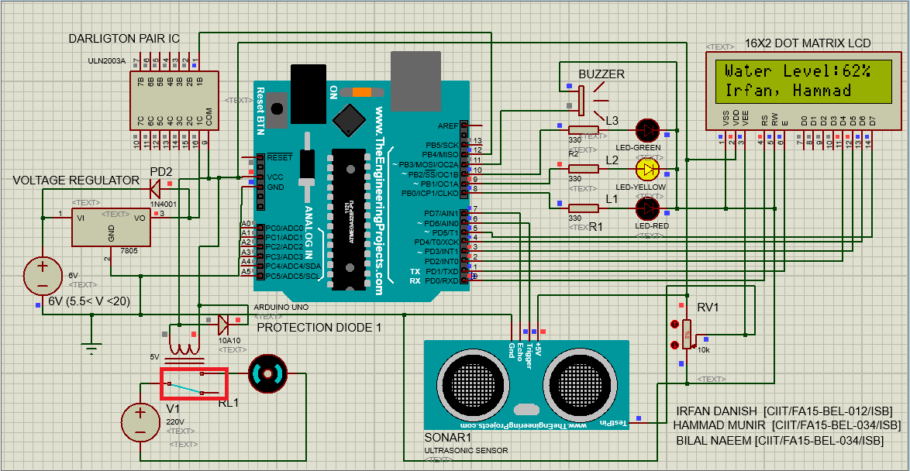
Water level starts falling, a high to low transition of water level

Slide 20

Water Level 1: drops to 10%

Slide 21
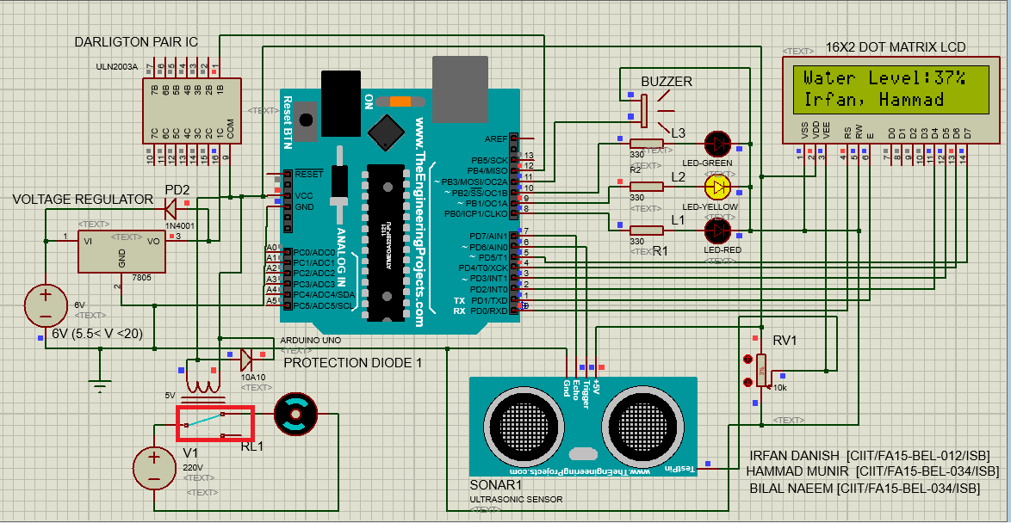
Low to high transition of water level

Slide 22
Water level reaches the 90%

Slide 23
Extensions:
By adding Wi-Fi (Controller Node MCU or Wi-Fi Module), we can control our water pump even if we are somewhere else in the world.

Slide 24
Cost & Market Value Assessment
The total cost on this project is 1240 PKR or approximately $12 only.
By Eliminating 16x2 Display, we will have this controller in 1040 PKR ($10) & if there is need to reduce the cost further.
We can use a non-ready microcontroller instead microcontroller board, which will reduce the cost approximately to 900 PKR ($9) only.

Slide 25
Thanks

