Slide 1
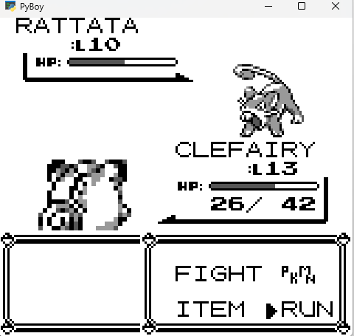
X = 15,Y=14
X = 9,Y=14
ID = 0
ID = 1

Slide 2
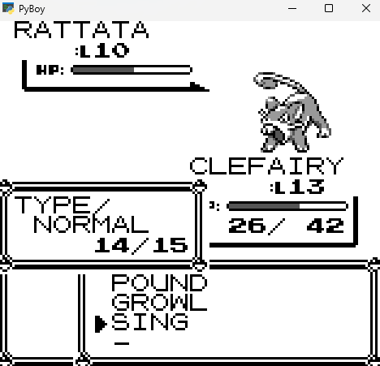
ID = 0
ID = 1
X = 5,Y=12

