Slide 1
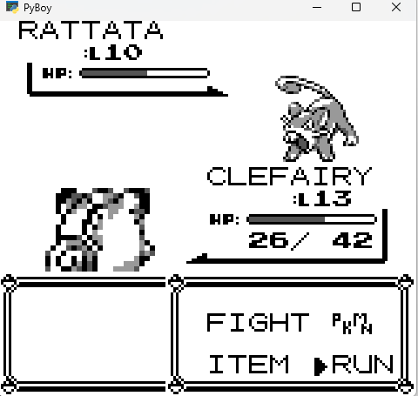
Tile pointer: 0xC1C4
X = 15,Y=14
X = 9,Y=14
ID = 0
ID = 1

Slide 2
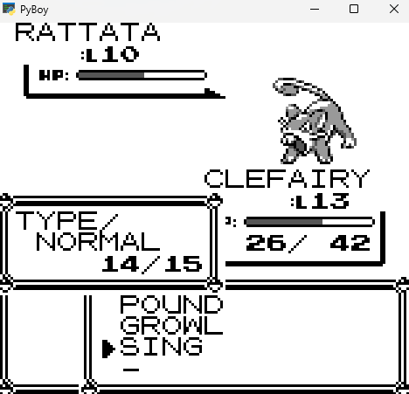
Tile pointer: 0xA9C4
ID = 1
ID = 2
X = 5,Y=12

Slide 3
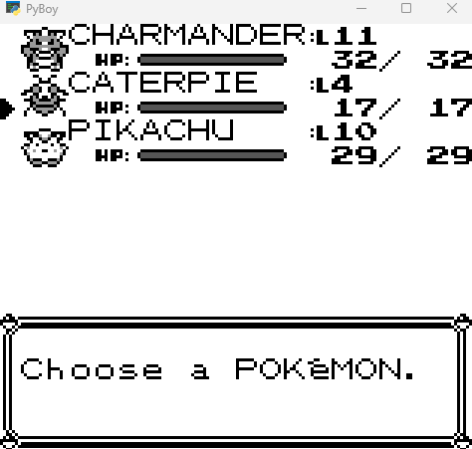
X = 0,Y=1
ID = 0
ID = 1
ID = 2

Slide 4
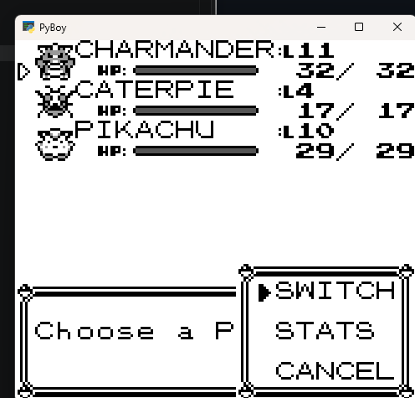
X = 12,Y=12
ID = 0
ID = 1
ID = 2

Slide 5
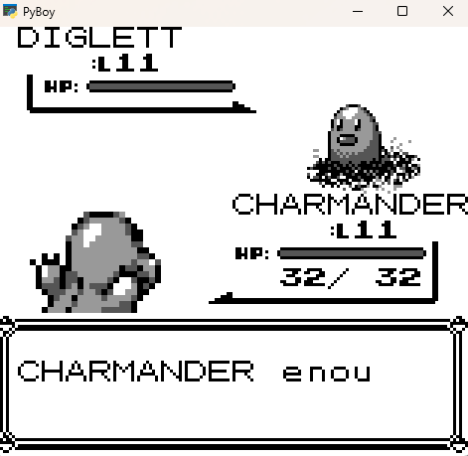
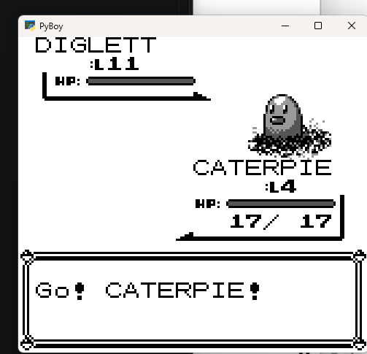
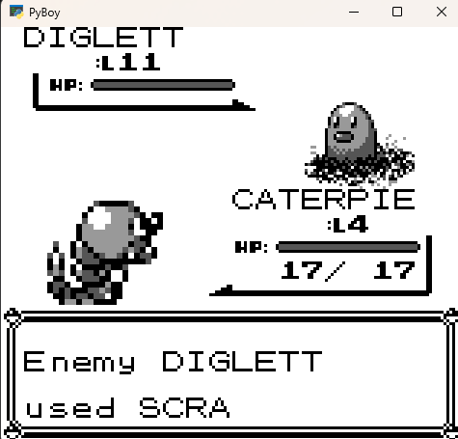
Just after switching pkm

