Slide 1
Adding CF Attributes to an HDF5 File
Isayah Reed
The HDF Group

Slide 2
Climate and Forecast Conventions
Metadata conventions for earth science data
Included in same file as data
Description of what the data represents
Uses values of universal attribute
Extension of COARDS* conventions
Allows comparison of data from different sources
*Cooperative Ocean/Atmosphere Research Data Service
URL: http://cf-pcmdi.llnl.gov/documents/cf-conventions/1.5/cf-conventions.pdf
Notes:
Not enough

Slide 3
Overview
Programming examples that add CF attributes to an HDF5 file
HDF5
C, FORTRAN90, Python
netCDF4
C, FORTRAN90
HDF5-EOS5
C, FORTRAN77
HDFView to add CF attributes

Slide 4
Problem Set
Examples are based on a simple application
Field | Description
temp | Temperature 180x360 array
lat | Latitude 1-D array, size 180
lon | Longitude 1-D array, size 360
Notes:
Change the Overview( wrong words)

Slide 5
CF attributes added
Attribute | Description
long_name | A long descriptive name for the data.
units | The quantity of measurement.
coordinates | A list of the associated coordinate variable names of the variable.
_FillValue | A missing or undefined value.
Notes:
Short the description

Slide 6
HDF5-C Example
Create the HDF5 file:
file = H5Fcreate(H5FILE_NAME, H5F_ACC_TRUNC, H5P_DEFAULT, H5P_DEFAULT);
Create temperature dataset:
dimsa[0] = 180;
dimsa[1] = 360;
dataset= H5Dcreate(file, “temp”, H5T_NATIVE_FLOAT, H5Screate_simple(2, dimsa, NULL), H5P_DEFAULT);
Write temperature dataset:
H5Dwrite(dataset, H5T_NATIVE_FLOAT, H5S_ALL, H5S_ALL, H5P_DEFAULT, temp_array);
Add the _FillValue:
H5Acreate(dataset, “_FillValue”, H5T_NATIVE_FLOAT, H5Screate(H5S_SCALAR), H5P_DEFAULT);
H5Awrite(attr, H5T_NATIVE_FLOAT,&value);
Notes:
dimsa[0]= 180;
dimsa[1]= 360;
Figure 4.2 Add the units attribute
stringType= H5Tcopy(H5T_C_S1);
stringSpace= H5Screate(H5S_SCALAR);
H5Tset_size(stringType, (hsize_t)strlen(“kelvin”));
attr= H5Acreate(dataset, “units”, stringType, stringSpace,
H5P_DEFAULT);
H5Awrite(attr,stringType,”kelvin”);
float value= -999.0;
floatSpace= H5Screate(H5S_SCALAR);
floatType= H5Tcopy(H5T_NATIVE_FLOAT);
attr= H5Acreate(dataset, “_FillValue”, floatType, floatSpace,
H5P_DEFAULT);
H5Awrite(attr,floatType,&value);

Slide 7
HDF5-C Example
Add the units attribute:
H5Tset_size(stringType, (hsize_t)strlen(“kelvin”));
attr= H5Acreate(dataset, “units”, stringType, H5S_SCALAR,
H5P_DEFAULT);
H5Awrite(attr, stringType, ”kelvin”);
Add the long_name attribute:
H5Tset_size(stringType, (hsize_t) strlen("temperature"));
attr= H5Acreate(dataset, “long_name”, stringType, stringSpace,
H5P_DEFAULT, H5P_DEFAULT);
H5Awrite(attr, stringType, "temperature");
Add the coordinates attribute:
arraySpace = H5Screate_simple(1, &dimsa[0], NULL);
H5Tset_size(arrayType, H5T_VARIABLE);
attr= H5Acreate(dataset, “coordinates”, arrayType, arraySpace,
H5P_DEFAULT);
H5Awrite(attr, arrayType, coorlist);
Notes:
dimsa[0]= 180;
dimsa[1]= 360;
Figure 4.2 Add the units attribute
stringType= H5Tcopy(H5T_C_S1);
stringSpace= H5Screate(H5S_SCALAR);
H5Tset_size(stringType, (hsize_t)strlen(“kelvin”));
attr= H5Acreate(dataset, “units”, stringType, stringSpace,
H5P_DEFAULT);
H5Awrite(attr,stringType,”kelvin”);
float value= -999.0;
floatSpace= H5Screate(H5S_SCALAR);
floatType= H5Tcopy(H5T_NATIVE_FLOAT);
attr= H5Acreate(dataset, “_FillValue”, floatType, floatSpace,
H5P_DEFAULT);
H5Awrite(attr,floatType,&value);

Slide 8
FORTRAN90 Example
Initialize FORTRAN interface and create the HDF5 file:
CALL h5open_f(hdferr)
CALL h5fcreate_f(FILENAME, H5F_ACC_TRUNC_F, file, hdferr)
Create temperature dataset:
CALL h5screate_simple_f(2, temp_dims, space, status)
!! temp_dims = (360, 180)
CALL h5dcreate_f(file, TEMPERATURE, h5t_ieee_f32le, space, dset, status)
Write temperature dataset:
CALL h5dwrite_f(dset, H5T_NATIVE_DOUBLE, temp_data, &
temp_dims, status)
Add the _FillValue:
CALL h5screate_f(H5S_SCALAR_F, space, status)
CALL h5tcopy_f(h5t_ieee_f32le, atype_id, status)
CALL h5acreate_f(dset, FILLVALUE, atype_id, space, &
attr_id, status)
CALL h5awrite_f(attr_id, H5T_NATIVE_DOUBLE, -999, 1, status)
Notes:
dimsa[0]= 180;
dimsa[1]= 360;
Figure 4.2 Add the units attribute
stringType= H5Tcopy(H5T_C_S1);
stringSpace= H5Screate(H5S_SCALAR);
H5Tset_size(stringType, (hsize_t)strlen(“kelvin”));
attr= H5Acreate(dataset, “units”, stringType, stringSpace,
H5P_DEFAULT);
H5Awrite(attr,stringType,”kelvin”);
float value= -999.0;
floatSpace= H5Screate(H5S_SCALAR);
floatType= H5Tcopy(H5T_NATIVE_FLOAT);
attr= H5Acreate(dataset, “_FillValue”, floatType, floatSpace,
H5P_DEFAULT);
H5Awrite(attr,floatType,&value);

Slide 9
FORTRAN90 Example
Add the units attribute:
CALL h5screate_f(H5S_SCALAR_F, space, status)
CALL h5tcopy_f(H5T_NATIVE_CHARACTER, atype_id, status)
CALL h5tset_size_f(atype_id, 6, status)
CALL h5acreate_f(dset, UNITS, atype_id, space, attr_id, status)
CALL h5awrite_f(attr_id, atype_id, "kelvin", dimsf, status)
Add the long_name attribute:
CALL h5tset_size_f(atype_id, strlen, status)
CALL h5acreate_f(dset, “long_name”, atype_id, space, &
attr_id, status)
CALL h5awrite_f(attr_id, atype_id, “temperature”, 1, status)
Add the coordinates attribute:
CALL h5screate_simple_f(1, 2, space, status)
CALL h5tset_size_f(atype_id, strlen, status)
CALL h5acreate_f(dset, “coordinates”, atype_id, space, &
attr_id, status)
CALL h5awrite_f(attr_id, atype_id, coorlist, 2, status)
Notes:
dimsa[0]= 180;
dimsa[1]= 360;
Figure 4.2 Add the units attribute
stringType= H5Tcopy(H5T_C_S1);
stringSpace= H5Screate(H5S_SCALAR);
H5Tset_size(stringType, (hsize_t)strlen(“kelvin”));
attr= H5Acreate(dataset, “units”, stringType, stringSpace,
H5P_DEFAULT);
H5Awrite(attr,stringType,”kelvin”);
float value= -999.0;
floatSpace= H5Screate(H5S_SCALAR);
floatType= H5Tcopy(H5T_NATIVE_FLOAT);
attr= H5Acreate(dataset, “_FillValue”, floatType, floatSpace,
H5P_DEFAULT);
H5Awrite(attr,floatType,&value);

Slide 10
H5PY
A Python interface to the HDF5 library
Supports nearly all HDF5-C features
Combines advantages of Python and C
Shorter and simpler function calls
Powerful computational abilities
Requires numpy and scipy
URL: http://code.google.com/p/h5py

Slide 11
H5PY Example
Create an HDF5 file:
file = h5py.File ("cf_example.h5", 'w')
Create/write dataset:
temp_dset = file.create_dataset ('temp', data=temp_array)
Add the _FIllValue:
temp_dset.attrs.create ('_FillValue', data=-999.0, dtype ='f')

Slide 12
H5PY Example
Add the units attribute:
temp_dset.attrs["units"] = "kelvin”
Add the long_name attribute:
temp_dset.attrs["long_name"] = "temperature”
Add the coordinates attribute:
vlen = h5py.special_dtype (vlen = str)
temp_dset.attrs.create ('coordinates', data = ['lat', 'lon'],
dtype=vlen)

Slide 13
netCDF-4
Extends netCDF3
Built on the HDF5 library
Uses HDF5 for storage and performance
Chunking and compression
C and FORTRAN libraries
Simple function calls
URL: http://www.unidata.ucar.edu/software/netcdf/docs/netcdf
Notes:
Reduce the words

Slide 14
C Example
Create a netCDF4 file:
nc_create(FILE_NAME, NC_NETCDF4|NC_CLOBBER, &ncid)
Define the temperature variable:
nc_def_var(ncid, “temp”, NC_FLOAT, 2,dimsa, &varid);
Add the _FillValue:
nc_def_var_fill(ncid, varid, 0, &fillvalue);
Write the temperature data:
nc_put_var_float(ncid, varid, &temp_array[0][0]));

Slide 15
C Example
Add the units attribute:
nc_put_att_text(ncid, varid, “units”, strlen(“kelvin”), “kelvin”);
Add the long_name attribute:
nc_put_att_text(ncid, varid, “long_name”, strlen(“temperature”), “temperature”);
Add the coordinates attribute:
char *coorlist[2]= {"lat", "lon"};
nc_put_att_string(ncid, varid, “coordinates”, 2, (const char**)&coorlist);

Slide 16
FORTRAN90 Example
Create the netCDF4 file:
nf90_create(path=filename, cmode=IOR(NF90_CLOBBER,NF90_HDF5), ncid=ncid)
Define the temperature variable:
nf90_def_var(ncid, “temp”, NF90_FLOAT, (/180,360/), varid)
Add the _FillValue:
nf90_def_var_fill(ncid, varid, 0, -999)
Write the temperature data:
nf90_put_var(ncid, varid, temp_data)

Slide 17
FORTRAN90 Example
Add the units attribute:
nf90_put_att(ncid, varid, “units, "kelvin")
Add the long_name attribute:
nf90_put_att(ncid, varid, “long_name”, "temperature")
Add the coordinates attribute:
nf90_put_att(ncid, varid, “coordinates”, “latitude”)
nf90_put_att(ncid, varid, “coordinates”, “longitude”)

Slide 18
HDF-EOS5
Built on HDF5
extends HDF5
uses HDF5 library calls as a foundation
Associates geolocation data to scientific data
Additional definitions
points, swaths, grids
URL: http://newsroom.gsfc.nasa.gov/sdptoolkit/docs/HDF-EOS_UG.pdf

Slide 19
C Example
Create a swath:
HE5_SWcreate(file, "Swath 1");
Define dimensions:
HE5_SWdefdim(swid, "GeoXtrack", 180);
HE5_SWdefdim(swid, "GeoTrack", 360);
Define temperature data field:
HE5_SWdefdatafield(swid, “temp”, "GeoTrack,GeoXtrack", NULL,
H5T_NATIVE_FLOAT, 0);
Set _FillValue:
HE5_SWsetfillvalue(swid, “temp”, H5T_NATIVE_FLOAT, &value);
Write the temperature data:
HE5_SWwritefield(swid, “temp”, NULL, NULL, NULL, temp_array);

Slide 20
C Example
Add units attribute:
size= strlen("Kelvin");
HE5_SWwritelocattr(swid, TEMP, UNITS, H5T_C_S1,
&size[0], (void*)kelvin);
Add long_name:
size= strlen("temperature");
HE5_SWwritelocattr(swid, “temp”, “long_name”, H5T_C_S1,
&size, (void*)temperature);
Add coordinates:
size= 2;
dtype= H5Tcopy(H5T_C_S1);
H5Tset_size(dtype, H5T_VARIABLE);
HE5_SWwritelocattr(swid, “temp”, “coordinates”, dtype,
&size, coorlist);

Slide 21
FORTRAN77 Example
Create a swath:
swid = he5_swcreate(swfid, "Swath1")
Define the dimensions:
he5_swdefdim(swid, "GeoXtrack", 180)
he5_swdefdim(swid, "GeoTrack", 360)
Add the _FillValue:
he5_swsetfill(swid, "temp", HE5T_NATIVE_FLOAT, value)
Define the datafield:
he5_swdefdfld(swid, "temp", "GeoTrack,GeoXtrack", " ", HE5T_NATIVE_FLOAT, 0)

Slide 22
FORTRAN77 Example
Write the temperature data:
start= 0
stride= 1
edge(1)= 360
edge(2)= 180
he5_swwrfld(swid, "temp", start, stride, edge, temp_data)
Add the units attribute attribute:
he5_swwrlattr(swid,"temp","units", HE5T_NATIVE_CHAR, 6, "kelvin")
Add the long_name attribute:
he5_swwrlattr(swid, “temp”, “long_name”, HE5T_NATIVE_CHAR, 11, "temperature”)
Add the coordinates attribute:
he5_swwrlattr(swid, “temp”, “coordinates”, HE5T_NATIVE_CHAR, 3, "lat")
he5_swwrlattr(swid, “temp”, “coordinates”, HE5T_NATIVE_CHAR, 3, "lon")

Slide 23
HDFView
A java tool used to browse and modify HDF4 and HDF5 files
Easy-to-use GUI for fast editing

Slide 24
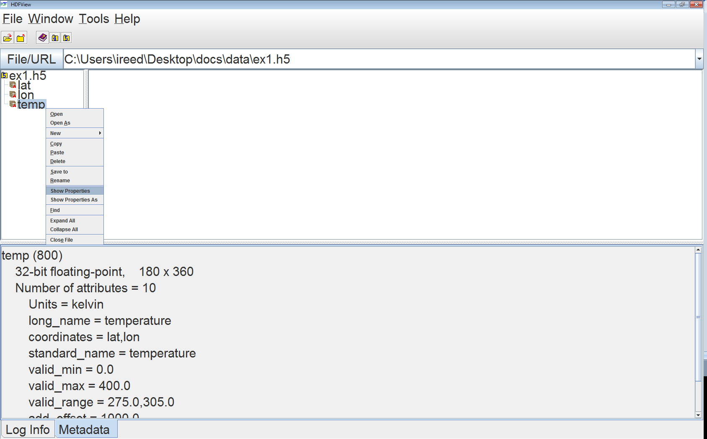
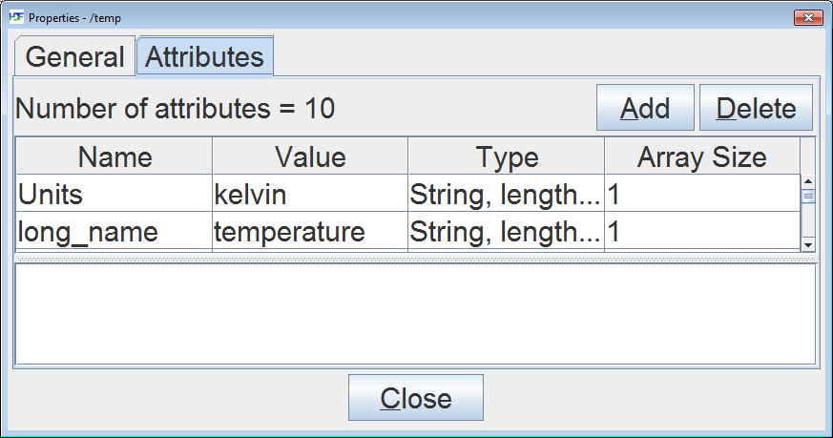
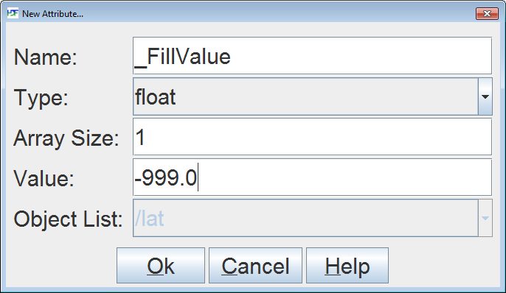
HDFView
Step 1: Select an existing dataset
Step 2: Open the dataset attributes
Step 3: Add the attribute
Notes:
Bigger font and animation

Slide 25
URLs

Slide 26
Future Work
h5edit to add CF attributes

Slide 27
Thank You!

Slide 28
Acknowledgements
This work was supported by cooperative agreement number NNX08AO77A from the National Aeronautics and Space Administration (NASA).
Any opinions, findings, conclusions, or recommendations expressed in this material are those of the author[s] and do not necessarily reflect the views of the National Aeronautics and Space Administration.

Slide 29
Questions/comments?

Slide 30
Dimension Scales
API included with HDF5
HDF5 datasets with additional metadata
shows relationship to a dataset
independent of a dataset
URL: http://www.hdfgroup.org/HDF5/doc/HL/RM_H5DS.html

Slide 31
Programming Example
Uses same code as HDF5 example
Declare datasets as a dimension scale:
hid_t dataset[3];
// declare latitude and longitude datasets as a dimension scale
H5DSset_scale(dataset[1], “lat”);
H5DSset_scale(dataset[2], LON);
Attach the dimension scale:
// attach latitude to the temperature dataset
H5Dsattach_scale(dataset[0], dataset[1], 0);
// attach longitude to the temperature dataset
H5Dsattach_scale(dataset[0], dataset[2], 1);

