Slide 1

MA477 Project 3
CDT Ethan Collins & CDT Ireland McCauley

Slide 2

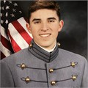
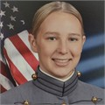
Meet the Team
Ethan Collins
CEO
Data Science Undergraduate, USMA
Ireland McCauley
CTO
Data Science Undergraduate, USMA

Slide 3
Problem
“According to the WHO, proper brain tumor diagnosis involves detection, brain tumor location identification, and classification of the tumor on the basis of malignancy, grade, and type” (Nickparvar).
Early, accurate cancer diagnosis is crucial for a positive prognosis. Leads to:
  Improved patient outcomes
  Personalized treatment
  Increased survival rates and quality of life

Slide 4
Objective
NeuroVis seeks to utilize ML methods to improve brain cancer tumor diagnosis.

Slide 5
Pitch
We are seeking 175 course points in exchange for 100% equity in NeuroVis.

Slide 6
Data Description
Brain Tumor MRI Dataset:
7023 images of human brain MRI images
  4 classes: glioma, meningioma, no tumor, and pituitary
  Combination of 3 Datasets
  5712 Training, 1311 Testing
  Sourced from Kaggle: https://www.kaggle.com/datasets/masoudnickparvar/brain-tumor-mri-dataset/data

Slide 7
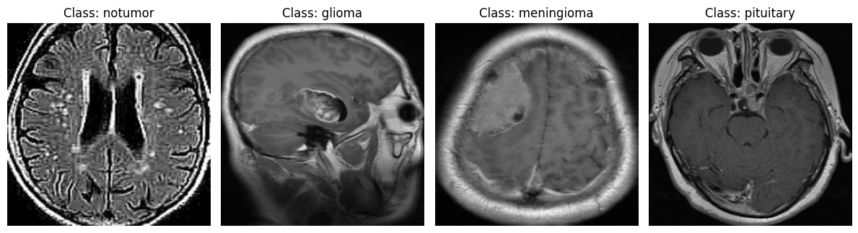
Example Images
Images are taken in either the axial or sagittal plane.

Slide 8
Methodology
Our analysis pipeline is a robust process designed to create the most accurate models for tumor classification.
Image Preprocessing
Model Development
Model Tuning
Compare and Refine Models
Model Selection & Deployment

Slide 9
Results
The ResNet50 model performed the best in every category, including recall, our most relevant metric.
Model | Accuracy | Precision | Recall | F1 Score
ResNet50 | 0.9879 | 0.9879 | 0.9879 | 0.9879
VGG19 | 0.8910 | 0.8894 | 0.8910 | 0.8898
InceptionV3 | 0.9508 | 0.9505 | 0.9508 | 0.9505

Slide 10
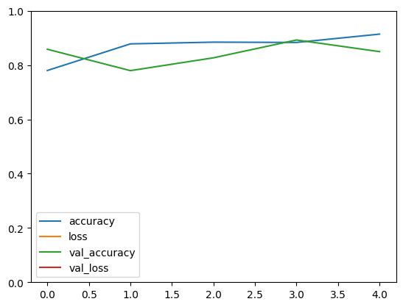
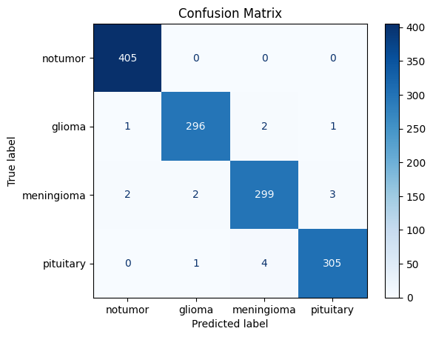
Results: Best Model
Fine-tuning the hyperparameters (.01 learning rate & number of fine-tuning layers, 100) gave us the most accurate ResNet50 model.
Accuracy by Number of Epochs
Epochs

Slide 11
Business Model
Application: NeuroVis software will be integrated into radiology workflows to assist in early-stage brain tumor detection.
Competitors: Butterfly Network, Aidoc, Tempus
Novelty:
  Focused specifically on subtyping brain cancer tumors
  Targeted toward DoD members and VA patients
  Most affordable and accessible on the market

Slide 12
Competitive Analysis & Potential
Total Addressable Market (TAM):
  ~ 350,000 new brain tumor diagnoses/year * $200 per radiologist interpretation = $70 million
Serviceable Addressable Market (SAM):
  ~ 8 million VA patients + 1 million active-duty = 9 million personnel
    Assume ~ 10,000 brain MRIs interpretations/year
  10,000 * $200 = $2 million/year

Slide 13
Growth Milestones & Market Strategy
Market Strategy:
Target government healthcare
Build trust via peer-reviewed validations
Offer free trial to academic institutions
Proof-of-concept
Pilot Testing
FDA Submission
Licensing
Now
Fall 2025
Fall 2026
Spring 2027

Slide 14
Conclusion
The future of brain tumor classification is here with NeuroVis.
Please consider an investment in this revolutionary company.

Slide 16
Backup Slides

Slide 17
References
Ilic, Irena, and Milena Ilic. "International Patterns and Trends in the Brain Cancer Incidence and Mortality: An Observational Study Based on the Global Burden of Disease." Heliyon, vol. 9, no. 7, 2023, p. e18222. https://doi.org/10.1016/j.heliyon.2023.e18222.
Nickparvar, Masoud. Brain Tumor MRI Dataset. Kaggle, https://www.kaggle.com/datasets/masoudnickparvar/brain-tumor-mri-dataset. Accessed 30 Apr. 2025.
Ruby Hall Clinic. "Early Detection in Brain Tumor Diagnosis." Ruby Hall Clinic – Hinjawadi, https://hinjawadi.rubyhall.com/early-detection-in-brain-tumor-diagnosis/. Accessed 30 Apr. 2025.
Rosenthal, Jeanne Pinder. "How Much Does an MRI Cost?" ClearHealthCosts, 30 Nov. 2012, https://clearhealthcosts.com/blog/2012/11/how-much-does-an-mri-cost-2/. Accessed 30 Apr. 2025.
Jones, Bradley. "The Changing Face of America’s Veteran Population." Pew Research Center, 8 Nov. 2023, https://www.pewresearch.org/short-reads/2023/11/08/the-changing-face- of-americas-veteran-population/. Accessed 30 Apr. 2025.

