Slide 1

Prova finale di ingegneria del software Prof. San Pietro
Group 25:
Irene Lo Presti, Matteo Lussana, Riccardo Lodelli, Andrea Giacalone

Slide 2
Project features
Complete italian rules
Socket: the client-server communication is implemented employing the TCP/IP Stream Socket network protocol.
RMI: the client-server communication is also implemented employing the RMI network protocol.
TUI
GUI: implemented using JavaFX.
3 Additional features
At the beginning of the game the player can choose between Socket or RMI connection (in both scenarios the player has to insert the IP address of the Server) and between Text or Graphical User Interface.

Slide 3
Additional features
Disconnection Resilience:
When the client’s connection drops, the client can reconnect to the game inserting their previous nickname and selecting the «continue game» option.
In the meanwhile, the other players continue to play and the one disconnected skips their turn.
If there is only one player connected to the game, at least one of the others players has 30 sec to reconnect otherwise the last player connected wins.
Persistence:
If Server’s connection drops, the Server can reset the old games reading the information from text files, and players can rejoin them and resume the game.
Players’ reconnection is managed as the additional feature «Disconnection Resilience».

Slide 4
Additional features
Multiple Parallel Games:
If a Lobby is full (it has reached the number of players required), the Server creates a new one.
The first player of each Lobby has to set the number of players for that game.
Note: Chat:
Each one of the connected players can send public or private messages to the others.
TUI: chat can be accessed only at the end of a turn, with a maximum limit of 3 available messages, avoiding possible time wasting of a player (due to formatting reasons and limits of the TUI).
GUI: real-time chat, without private messages.

Slide 5
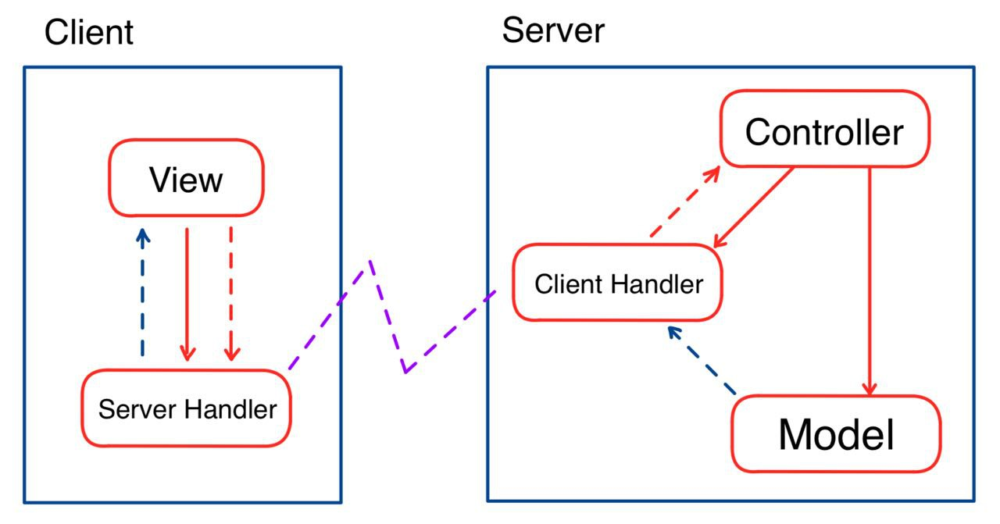
MVC
We implemented the Model-View-Controller (MVC)
Simplified UML url: github/simplifiedUML
Complete UML and Sequence Diagrams url: github/completeUML

