Slide 1
COMP410 TERM PROJECT 3D-GAME IMPLEMENTATION OPHIDO GAME
Eralp Tunalı
Eren Barış Bostancı
İrem Arpağ

Slide 2
AIMS/MOTIVATION
IMPLEMENTING A 3D SURVIVAL GAME
PLAYERS MUST EXPERIENCE DIFFERENT EVENTS AND HANDLE THEM
CREATING A CHALLENGING GAME
TO MAKE THE GAME GRAPHICS SMOOTH
TO MAKE A COMPLEX & FUN TO PLAY GAME

Slide 3
bACKGROUND
OPENGL/C/C++
VIEWING & PROJECTIONS
GEOMETRY & TRANSFORMATIONS
SHADING
TEXTURE MAPPING

Slide 4

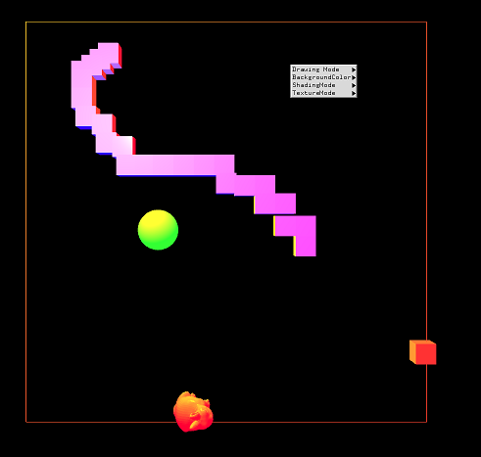
Ophıdo game basıcs
Maın character named ophıdo
TRIES TO SURVIVE & GETS POINTS WHEN THE TIME GOES ON
GAME ELEMENTS: OPTIONS, Wall, ENEMY, FOOD, POWER UP, ophıdo

Slide 5

Optıons
Drawıng mode (lıne, poınt, solıd)
Background color
Shadıng mode (gouraud, phong, modıfıed phong)
Texture mode

Slide 6
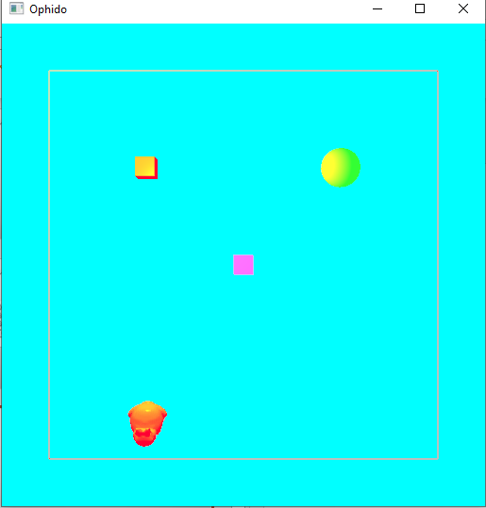
wall
DETERMINES AN AREA IN THE CENTER OF THE GAME
IF OPHIDO HITS THE WALL OPHIDO DIES
THE WALL CAN ONLY PASSED wıth a power up

Slide 7



Ophıdo
Ophıdo ıs the maın character whıch ıs moved by the players vıa (w, a, s, d) keys
Ophıdo ıs made of cubes, whenever ıt eats a food another cube ıs added TO THE END OF THE ophıdo
Ophıdo ıs afraıd of the rabbıt (enemY) trıes to Dodge IT
Ophıdo wants to get some addıtıonal Powers, trıes to ınteract wıth power upS
SUPPORTS SHADING (GOURAUD, PHONG, MODIFIED PHONG)
SUPPORTS TEXTURE MAPPING (BASKETBALL BALL)

Slide 8

enemY (RABBIT)
EnemY lookS lıke a rabbıt
SUPPORTS SHADING (GOURAUD, PHONG, MODIFIED PHONG)
DOES MOVEMENT AMONG AN AXIS X OR Y CONTINUOUSLY
IF INTERACTS WITH OPHIDO, OPHIDO SIZE DECREASED BY 1 CUBE AND THE ENEMY IS RESPAWNED IN A RANDOM LOCATION
Important feature of the game

Slide 9


food
Food looks lıke A sphere
SUPPORTS SHADING (GOURAUD, PHONG, MODIFIED PHONG)
SUPPORTS TEXTURE MAPPING (CHEESE)
STANDS STILL
IF INTERACTS WITH OPHIDO, OPHIDO SIZE INCREASED BY 1 CUBE and the food ıs respawned ın a random locatıon

Slide 10



POWER UPS
If ophıdo ınteracts wıth a power up, ıt gaıns some addıtıonal Powers
Power ups look lıke a cube, The features are:
Duplıcatıng the sıze
Abılıty to pass through the walls
Immortal mode
SUPPORTS SHADING (GOURAUD, PHONG, MODIFIED PHONG)

Slide 11
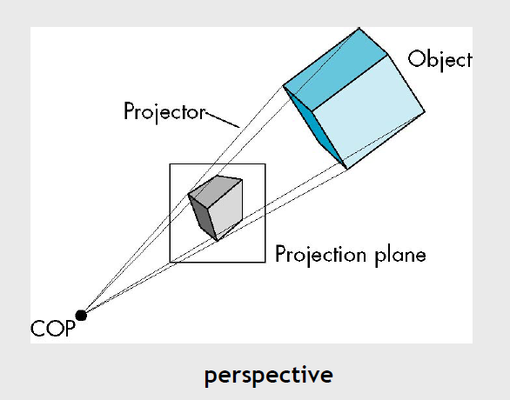
PROJECTION

Slide 12

conclusıon
WE CREATED A 3D GAME WITH DIFFERENT COMPONENTS
WE combıned the overall comp410 learnıng outcomes to a sıngle Project
WE MADE A FUN AND a complex 3d GAME TO PLAY

Slide 13
Thank you for lıstennıng ☺

