Slide 1

Mental health: the burden of depression
Irene Marras, 22279A
Luca Marras, 922686

Slide 2
“Mental health is a state of mental well-being that enables people to cope with the stresses of life, realize their abilities, learn well and work well, and contribute to their community.”
- World Health Organization

Slide 3
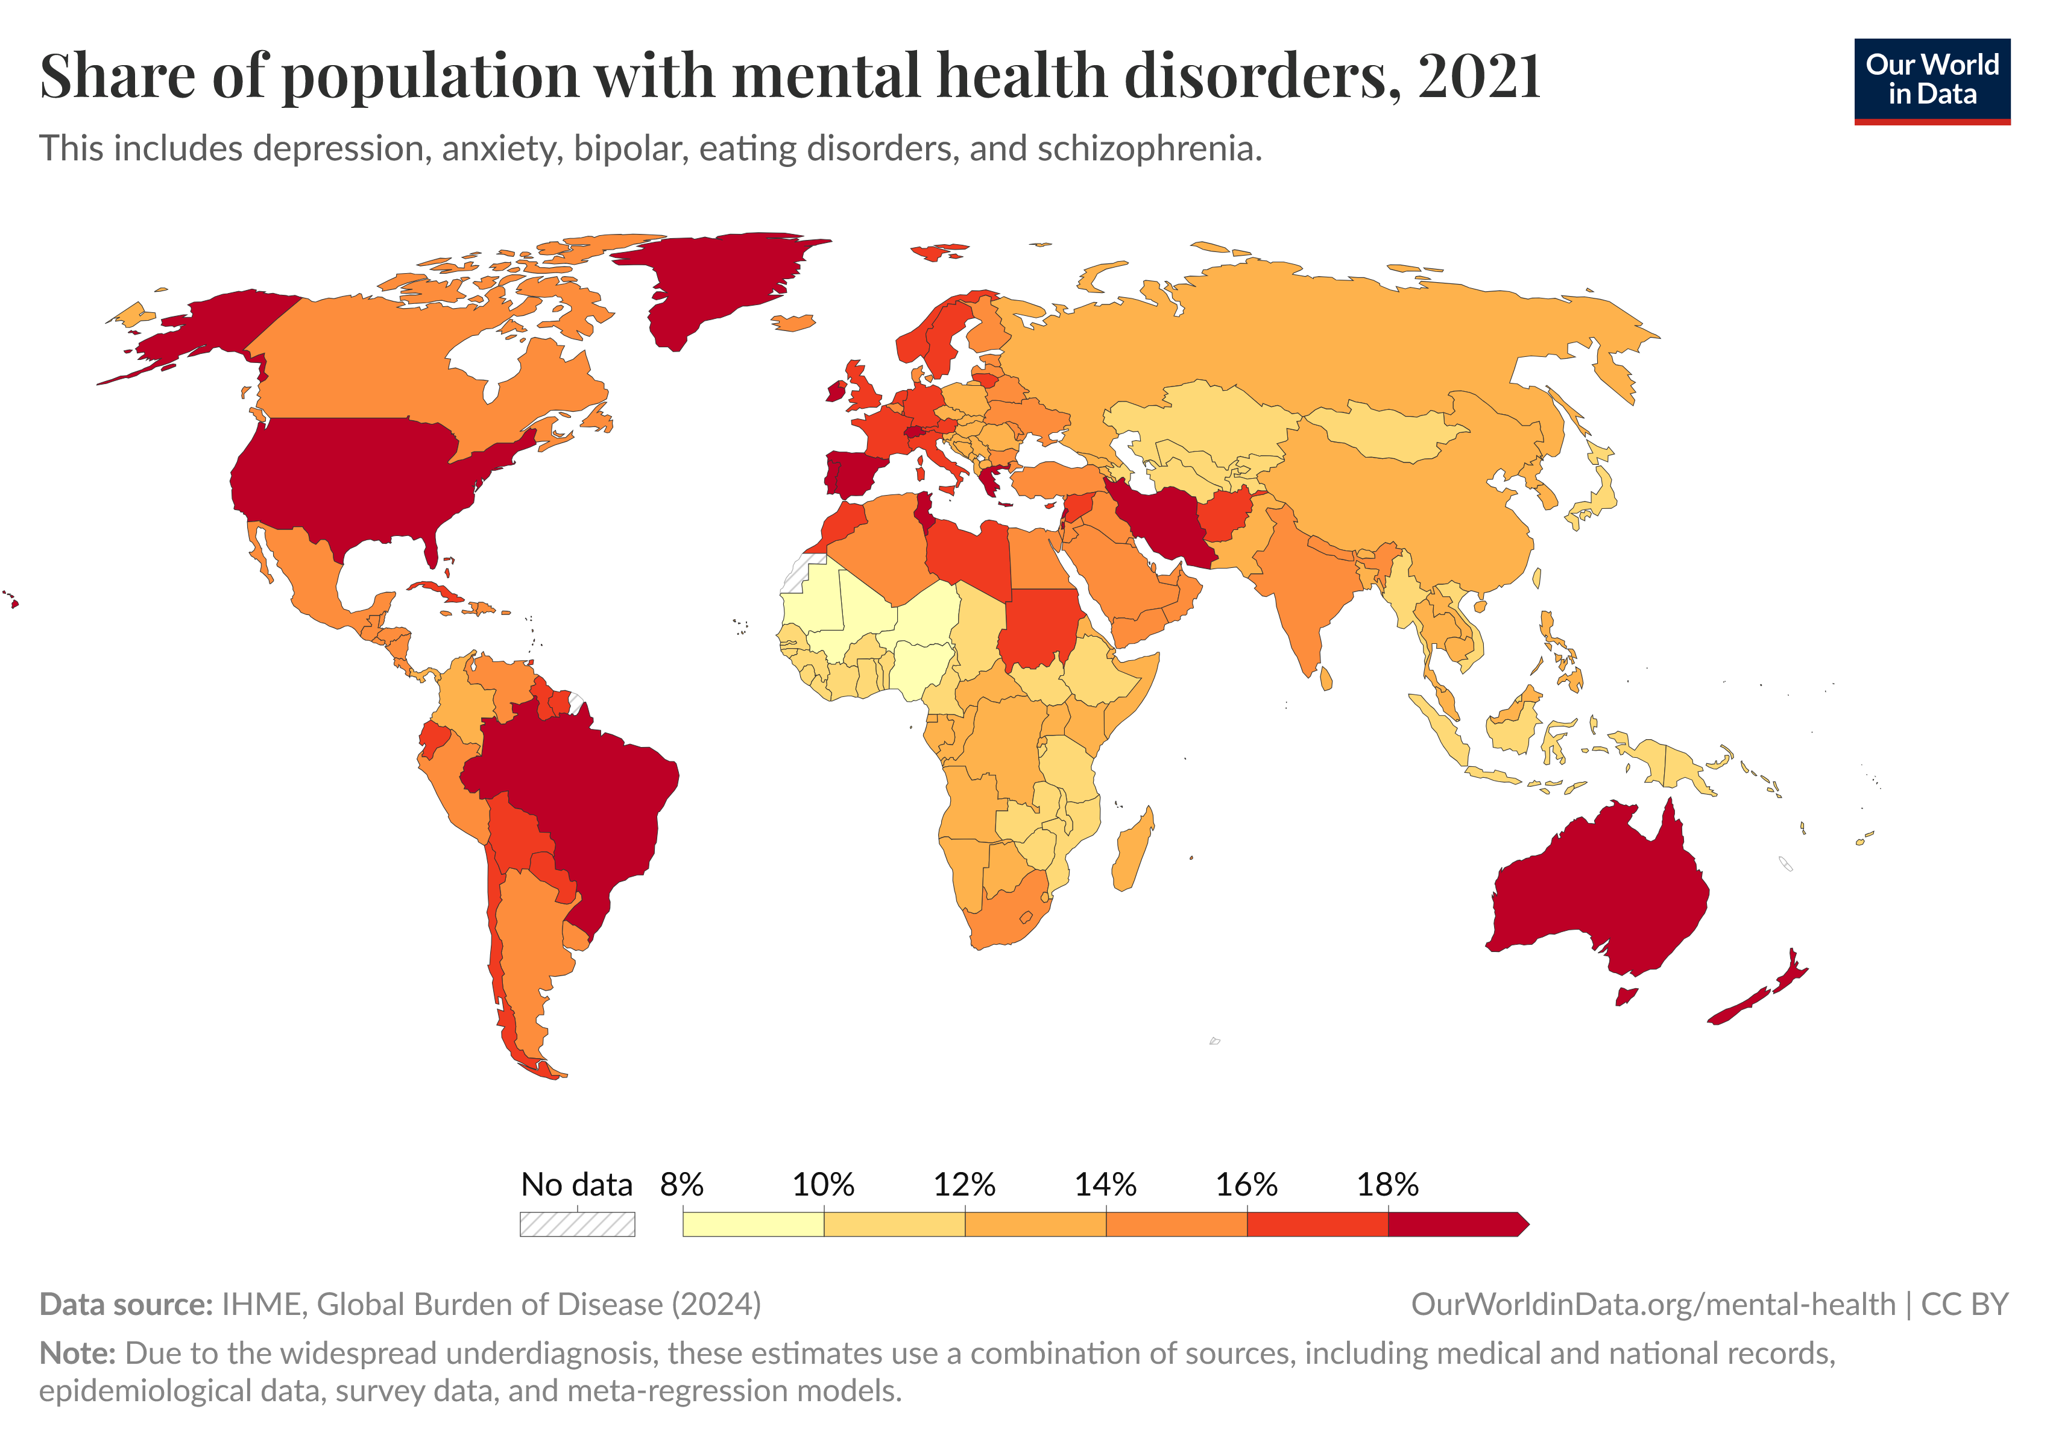

Slide 4
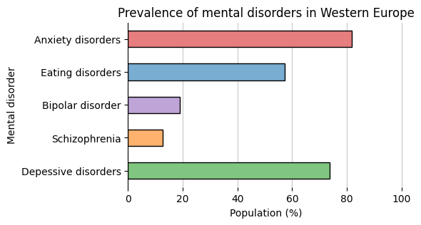
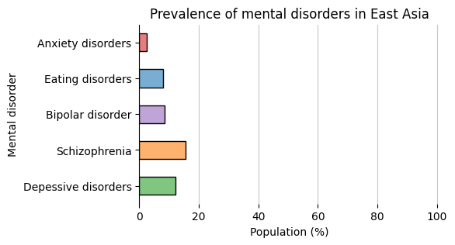
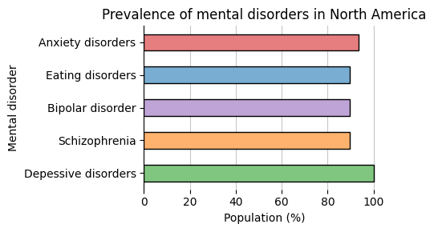
Coverage
Coverage is the share of the adult population in a region for which prevalence data on mental illnesses has been collected by age group and gender.

Slide 5

North America has good coverage for depression, let’s go more in depth!

Slide 6
Depression in the USA
Major Depressive Disorder
Intense depressive episodes lasting at least 2 weeks
Symptoms are severe and disabling
Strong impact on daily functioning
Episodes may be single or recurrent
Chronic Depression (Dysthymia)
Persistent low mood lasting at least 2 years
Symptoms are mild, but long-lasting
People can often still function day to day
Feels like a constant background sadness

Slide 7
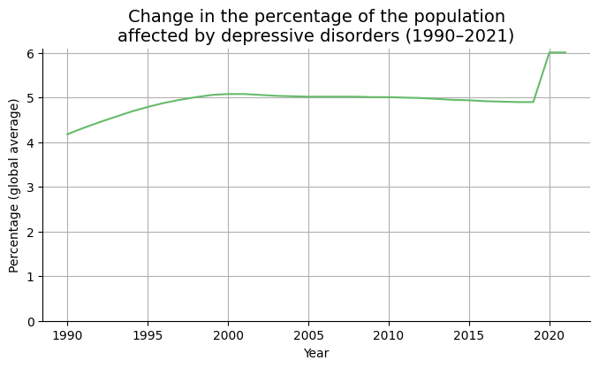
Since 1990, the prevalence of depressive disorders has increased by 43.78 percent.

Slide 8
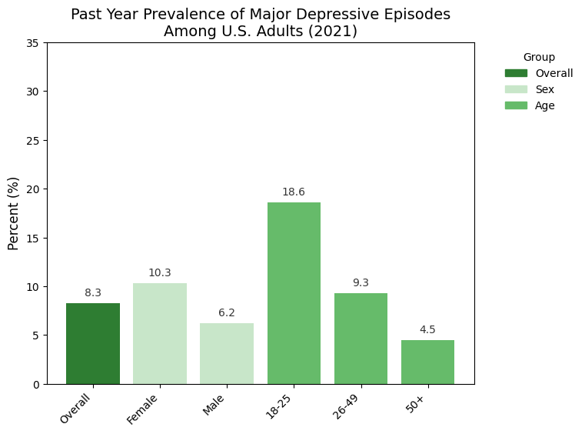
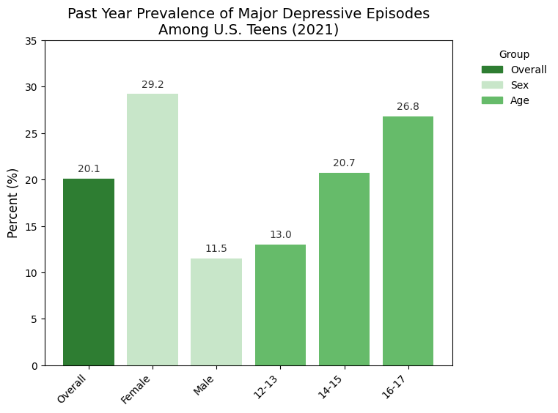
In the US, teens face depressive episodes at more than twice the rate of adults (20% vs. 8%).

Slide 9







Causes of teenage depression
Environment
Social Media
Hormones
Brain Chemistry
Psychology
Trauma
Genetics

Slide 10
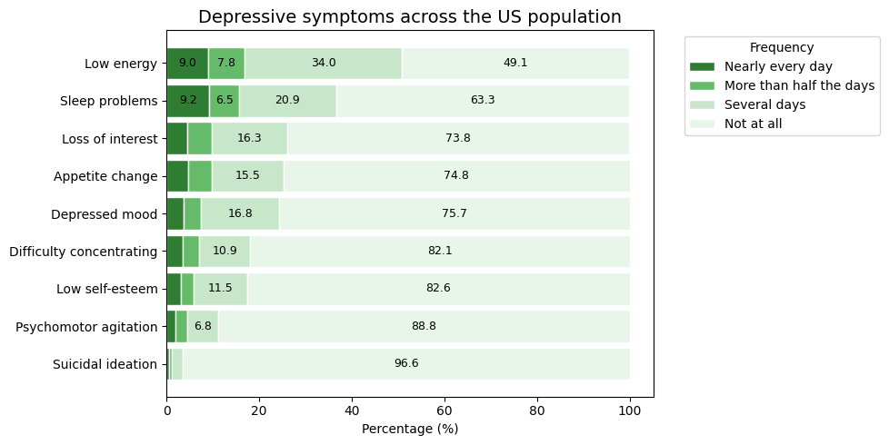
Common symptoms and their prevalence

Slide 11
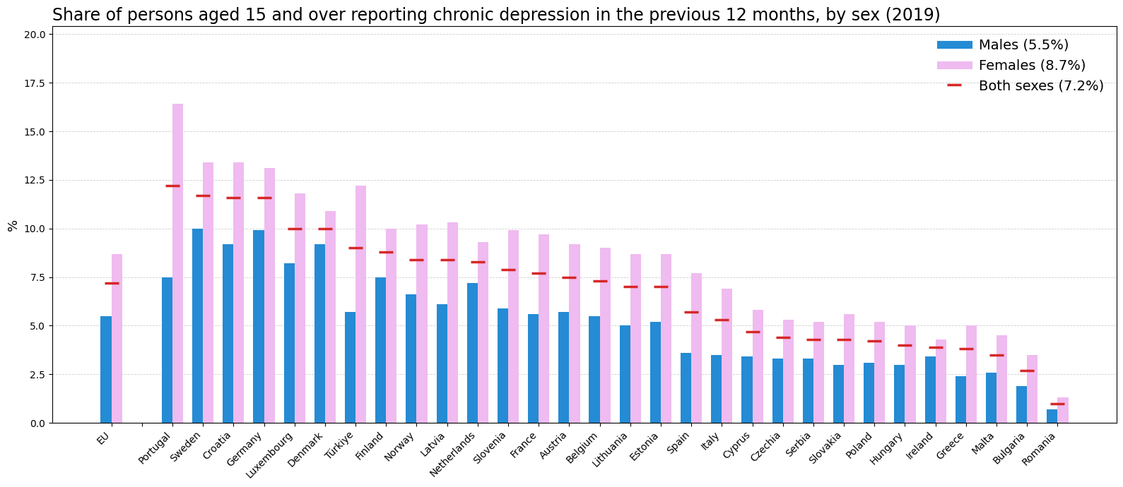
And what about Europe?

Slide 12
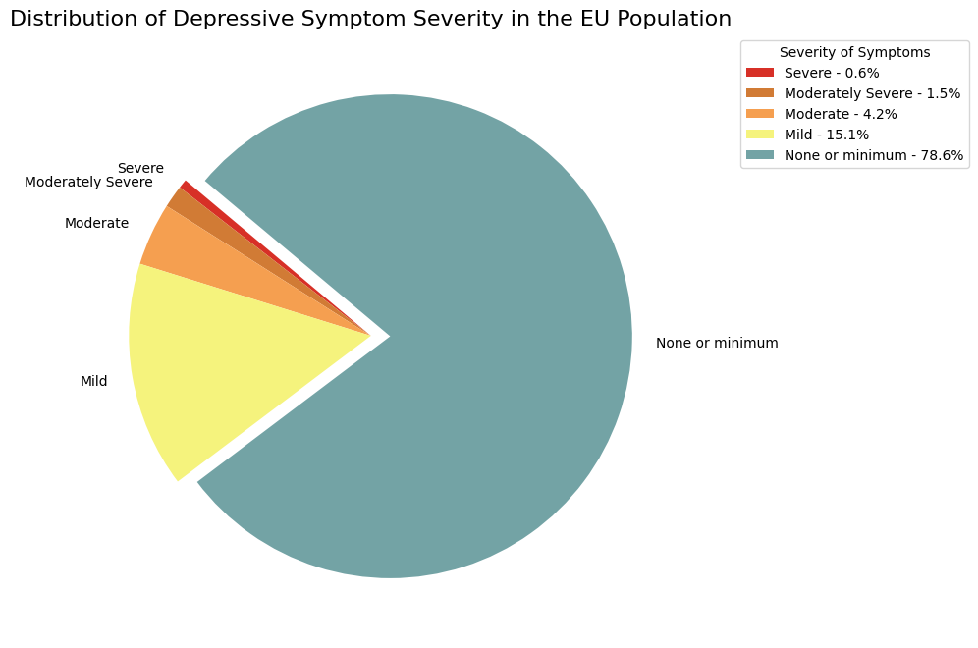

Slide 13
While depression is often characterized by persistent sadness and loss of interest, its most severe consequences can include self-harm and suicide.
 | Self harm | Suicide
Frequency | Incidents are very frequent | Attempts happen less frequently
Severity | Less severe | Much more severe, sometimes lethal
Purpose | Done to avoid suicidal impulses | Done with an intent to die

Slide 14
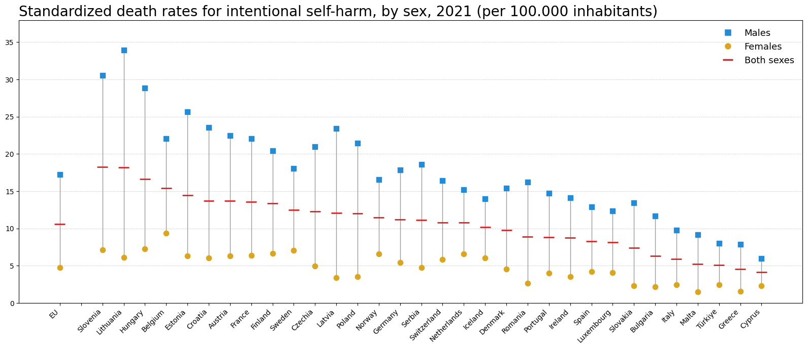

Slide 15
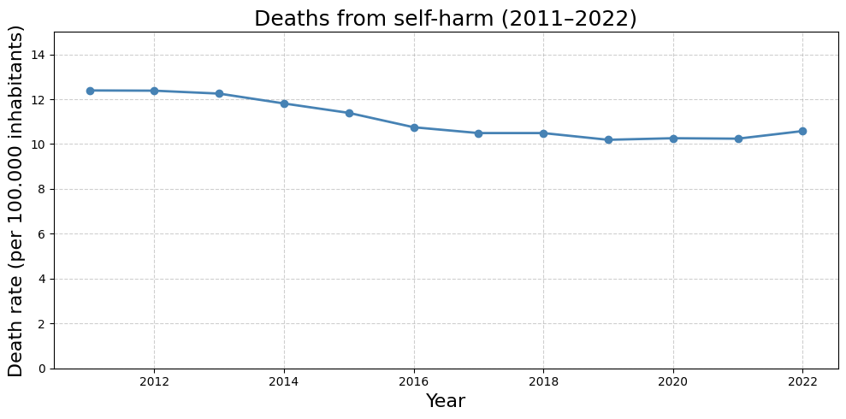
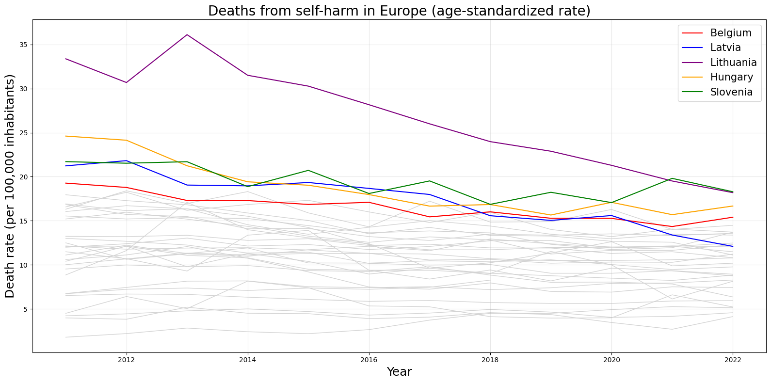
Overall there has been a 13,6% decrease in deaths from self harm
Countries with higher rates saw slightly larger decreases

Slide 16
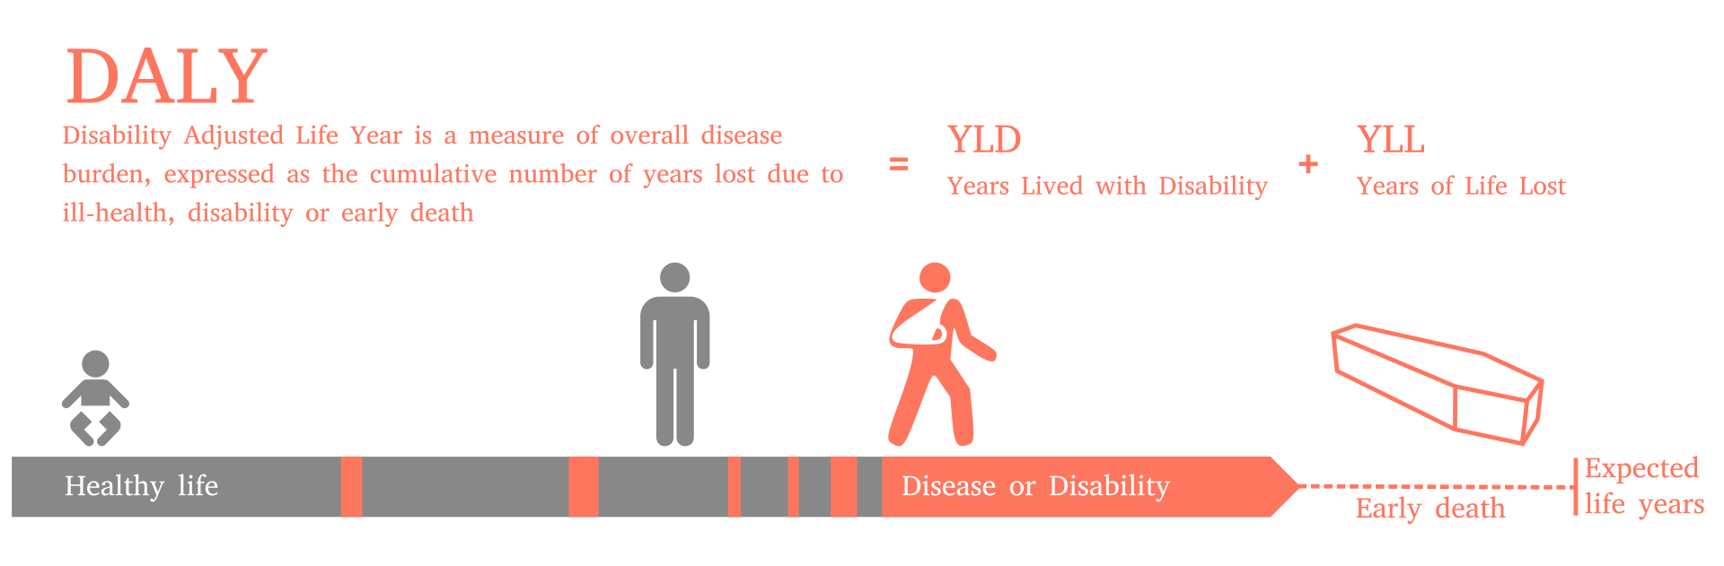
The Burden of depression

Slide 17
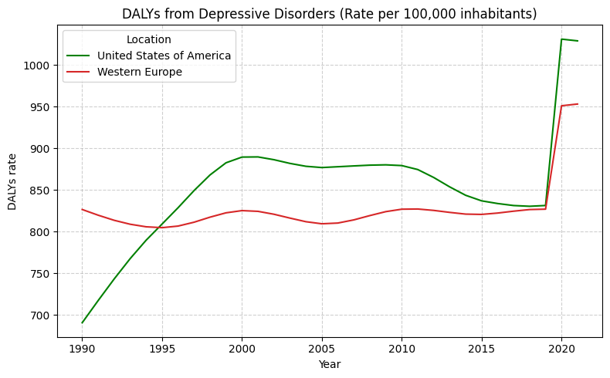

Slide 18
Sources
https://ourworldindata.org/
https://www.who.int/
https://ec.europa.eu/eurostat
https://www.kaggle.com/
https://www.healthdata.org/research-analysis/gbd
https://www.nimh.nih.gov/

