Slide 1
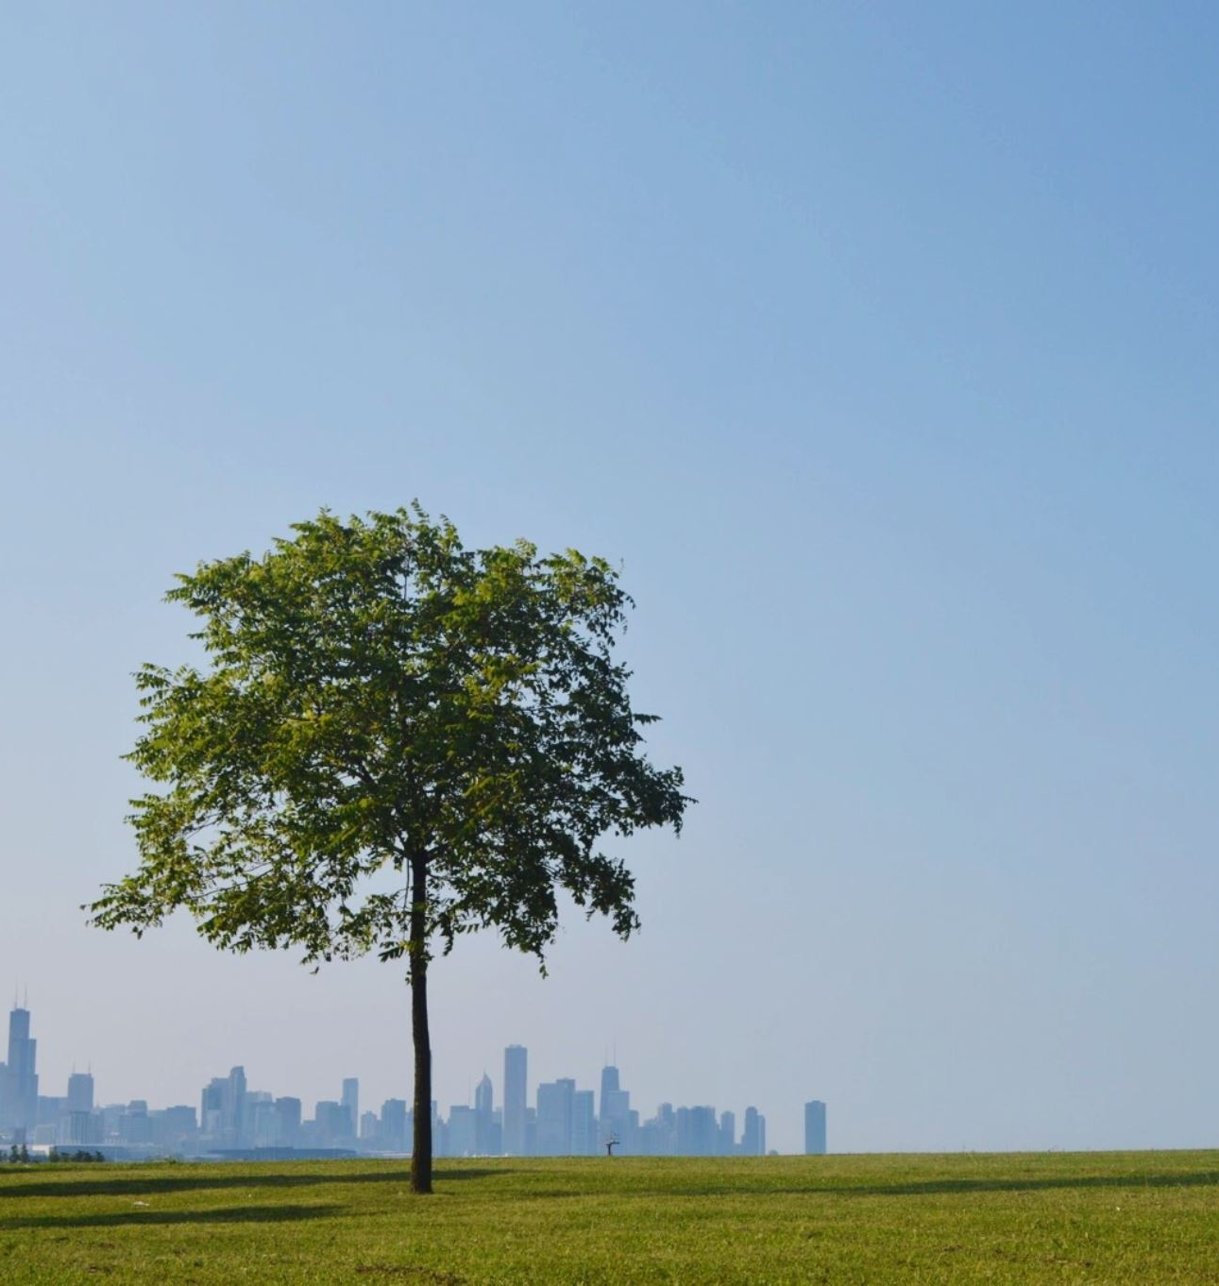
Urban Tree Management for Climate Resilience in Würzburg
Irem Halac
23041509

Slide 2
Introduction
Significant environmental problems are experienced in urban areas worldwide due to climate change.
Urban trees, as the "green lungs" of cities, play a critical role in improving urban living conditions.
This project aims to enhance climate resilience and improve living conditions in the city of Würzburg using urban tree data.
Key question: How can urban tree data be used to increase climate resilience and improve living conditions in Würzburg?

Slide 3
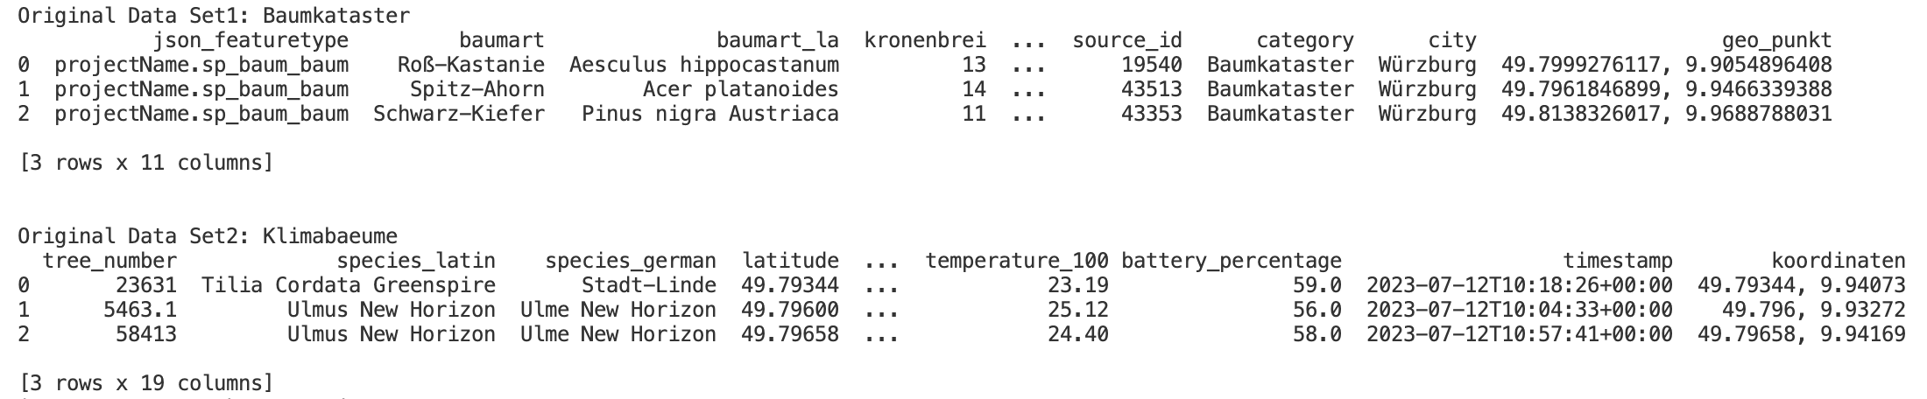
Data Sources
Data Set 1: Baumkataster der Stadt Würzburg
URL: https://www.govdata.de/web/guest/suchen/-/details/baumkataster-der-stadt-wurzburg
Description: This dataset contains comprehensive information on over 40,000 public trees in Würzburg. It includes attributes such as species (both common and Latin names), trunk circumference, height, crown width, and geographical coordinates.
Data Set 2: Würzburger Klimabäume – Bodenfeuchte
URL: https://www.govdata.de/web/guest/suchen/-/details/wurzburger-klimabaeume-bodenfeuchte
Description: This dataset includes sensor data from selected trees planted in various soil types across Würzburg. It tracks soil moisture levels, which is critical for understanding tree health and the effectiveness of watering schedules under different urban conditions.

Slide 4
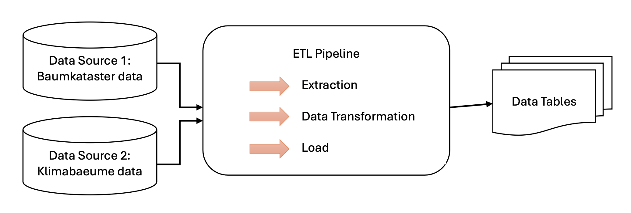
Data Pipeline
Data extraction and cleaning steps: Download, remove unnecessary spaces, fill in missing values, standardize data formats.
Transformation: Clarify column names, integrate different data sets.
Loading: Upload the cleaned data to a SQLite database.

Slide 5
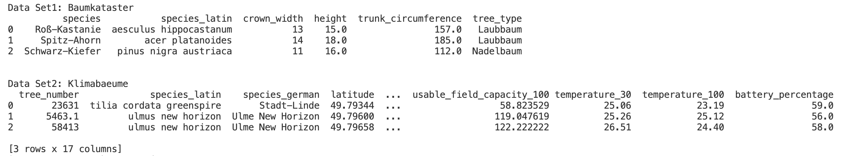
Methods
Libraries Used: Pandas, Numpy, Seaborn, Matplotlib, os, requests.
Data Pipeline: Data extraction, cleaning, transformation, and loading steps.
Cleaning Steps:
Downloading data
Removing extraneous whitespace
Filling missing values
Standardizing data formats
Validating data types
Loading cleaned data into SQL database

Slide 6
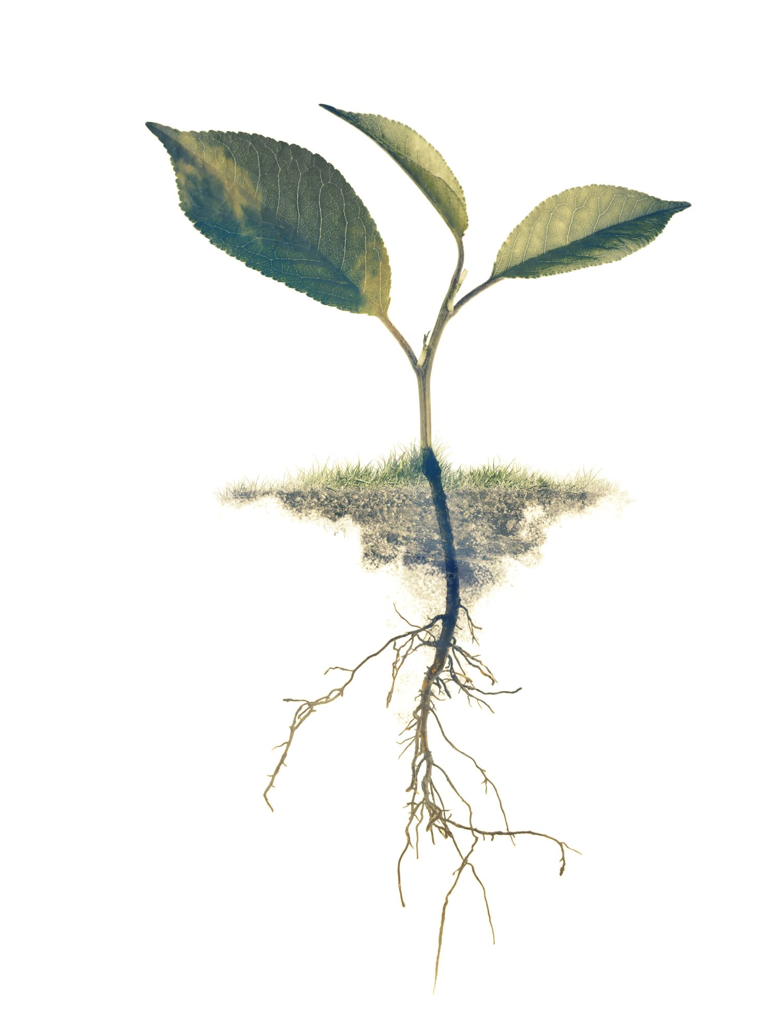
Analyses
Distribution of tree species.
Tree health and growth relationship.
Tree characteristics relationship.

Slide 7
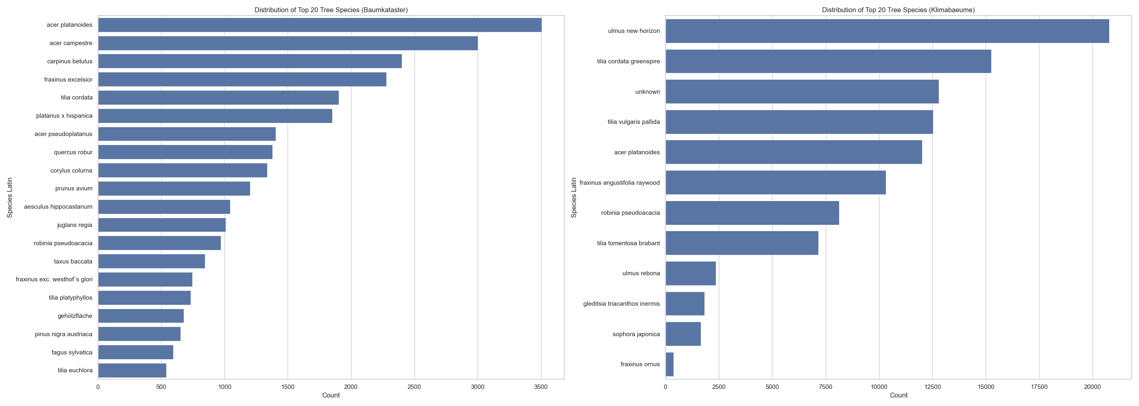
Analysis and Findings: Distribution of Tree Species
Analysis of the diversity and prevalence of different tree species in Würzburg.
Crucial for biodiversity, identifying common and rare species, ecological balance, and urban forestry management.

Slide 8
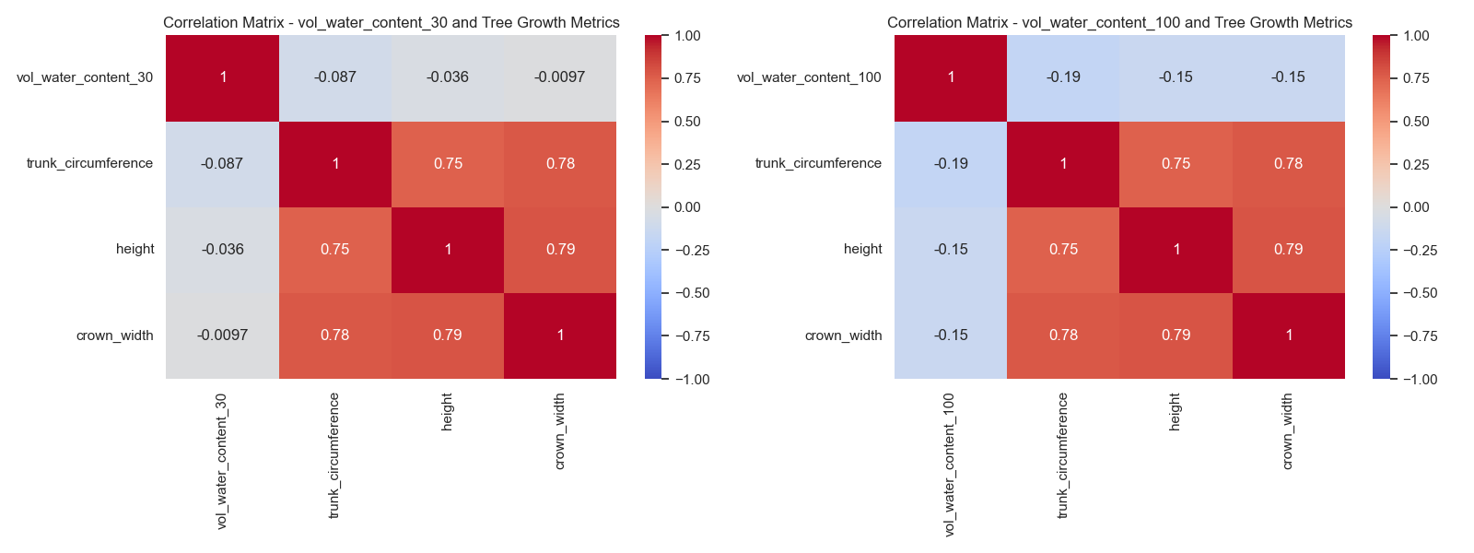
Analysis and Findings: Tree Health and Growth Relationship
Examining the relationship between tree health metrics and growth patterns.
Identifying key indicators affecting tree health, understanding their impact on growth, and improving maintenance and management practices.

Slide 9
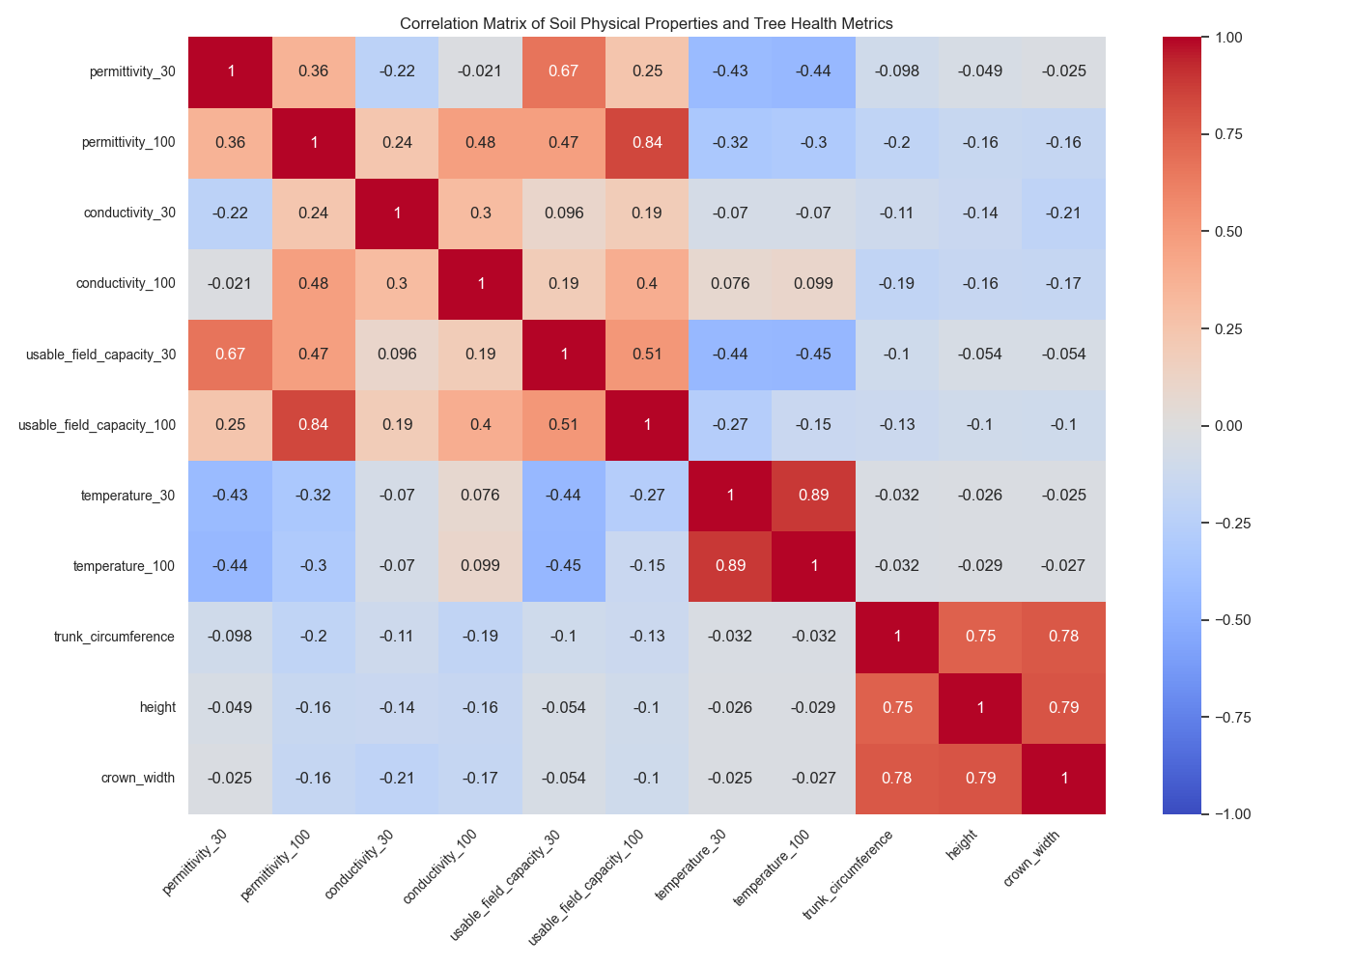
Analysis and Findings: Tree Characteristics Relationship
Investigating the relationships between various tree characteristics and overall health status.
Determining the most influential characteristics on health, understanding dependencies between characteristics, and providing insights for improving tree care interventions.

Slide 10
Discussions
Tree Species Distribution
Importance of tree species diversity in Würzburg for ecological balance and resilience against diseases.
Relationship between Tree Health and Growth
Examining the relationship between tree health metrics and growth, crucial for optimizing maintenance and management practices.
Relationship between Tree Characteristics
Investigating the relationships between tree characteristics and health metrics, critical impact of soil temperature on tree health and growth.

Slide 11
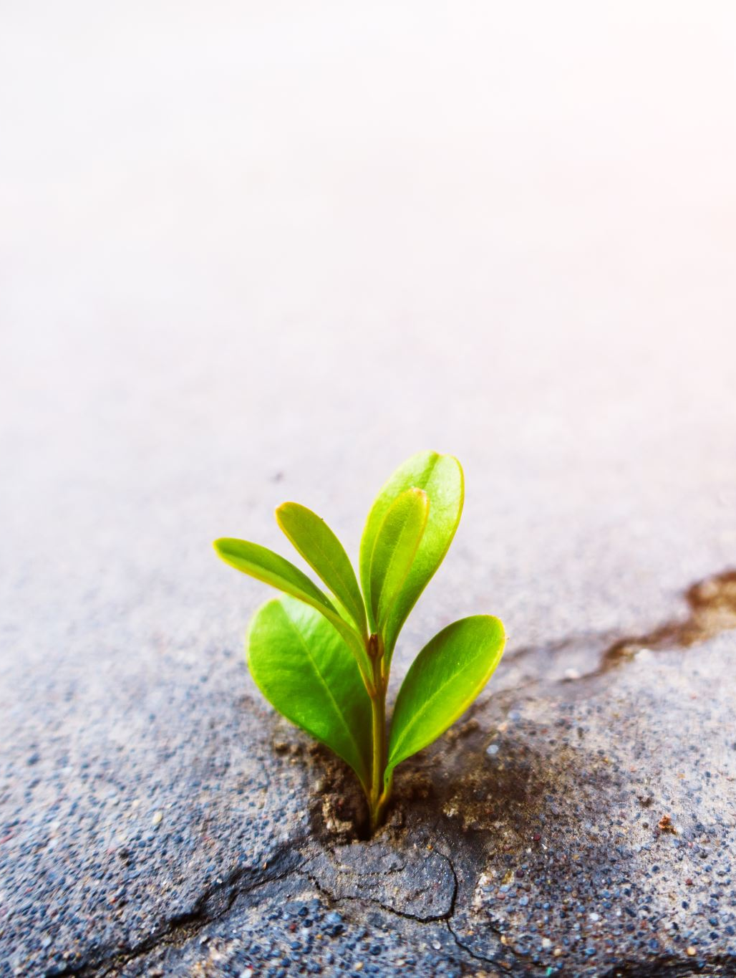
Conclusion
This study underscores the pivotal role of urban trees in bolstering climate resilience and enhancing urban living standards in Würzburg. Through thorough analysis of extensive tree and soil datasets, we have unearthed critical insights essential for refining urban tree management practices.
Diverse species are integral to maintaining ecological stability and facilitating climate adaptation strategies. Looking ahead, the integration of these findings into urban planning frameworks will promote sustainable development and cultivate resilient cities.

Slide 12
Thank you for listening to me.

