Slide 1

Final Project
Virtual Internship
14-May-2021
Name: İrem Tanrıverdi
Email: Tanriverdiirem.95@gmail.com
Location: Turkey
Collage: Middle East Technical University
Spealization: Data Science

Slide 2
Outline
Problem Description
Data Description
Explanatory Data analysis
Recommended models for this data set

Slide 3
Problem Description
ABC Bank wants to sell it's term deposit product to customers and before launching the product they want to develop a model which help them in understanding whether a particular customer will buy their product or not (based on customer's past interaction with bank or other Financial Institution)

Slide 4
Data Description
Bank dataset includes 45211 observations and 17 variable.
There are 7 numeric variables which are age, balance, day, duration, campaign, pdays, and previous.
There are 10 categoric variables which are job, martial, education, default, housing, loan, contact, month, poutcome and y.

Slide 5
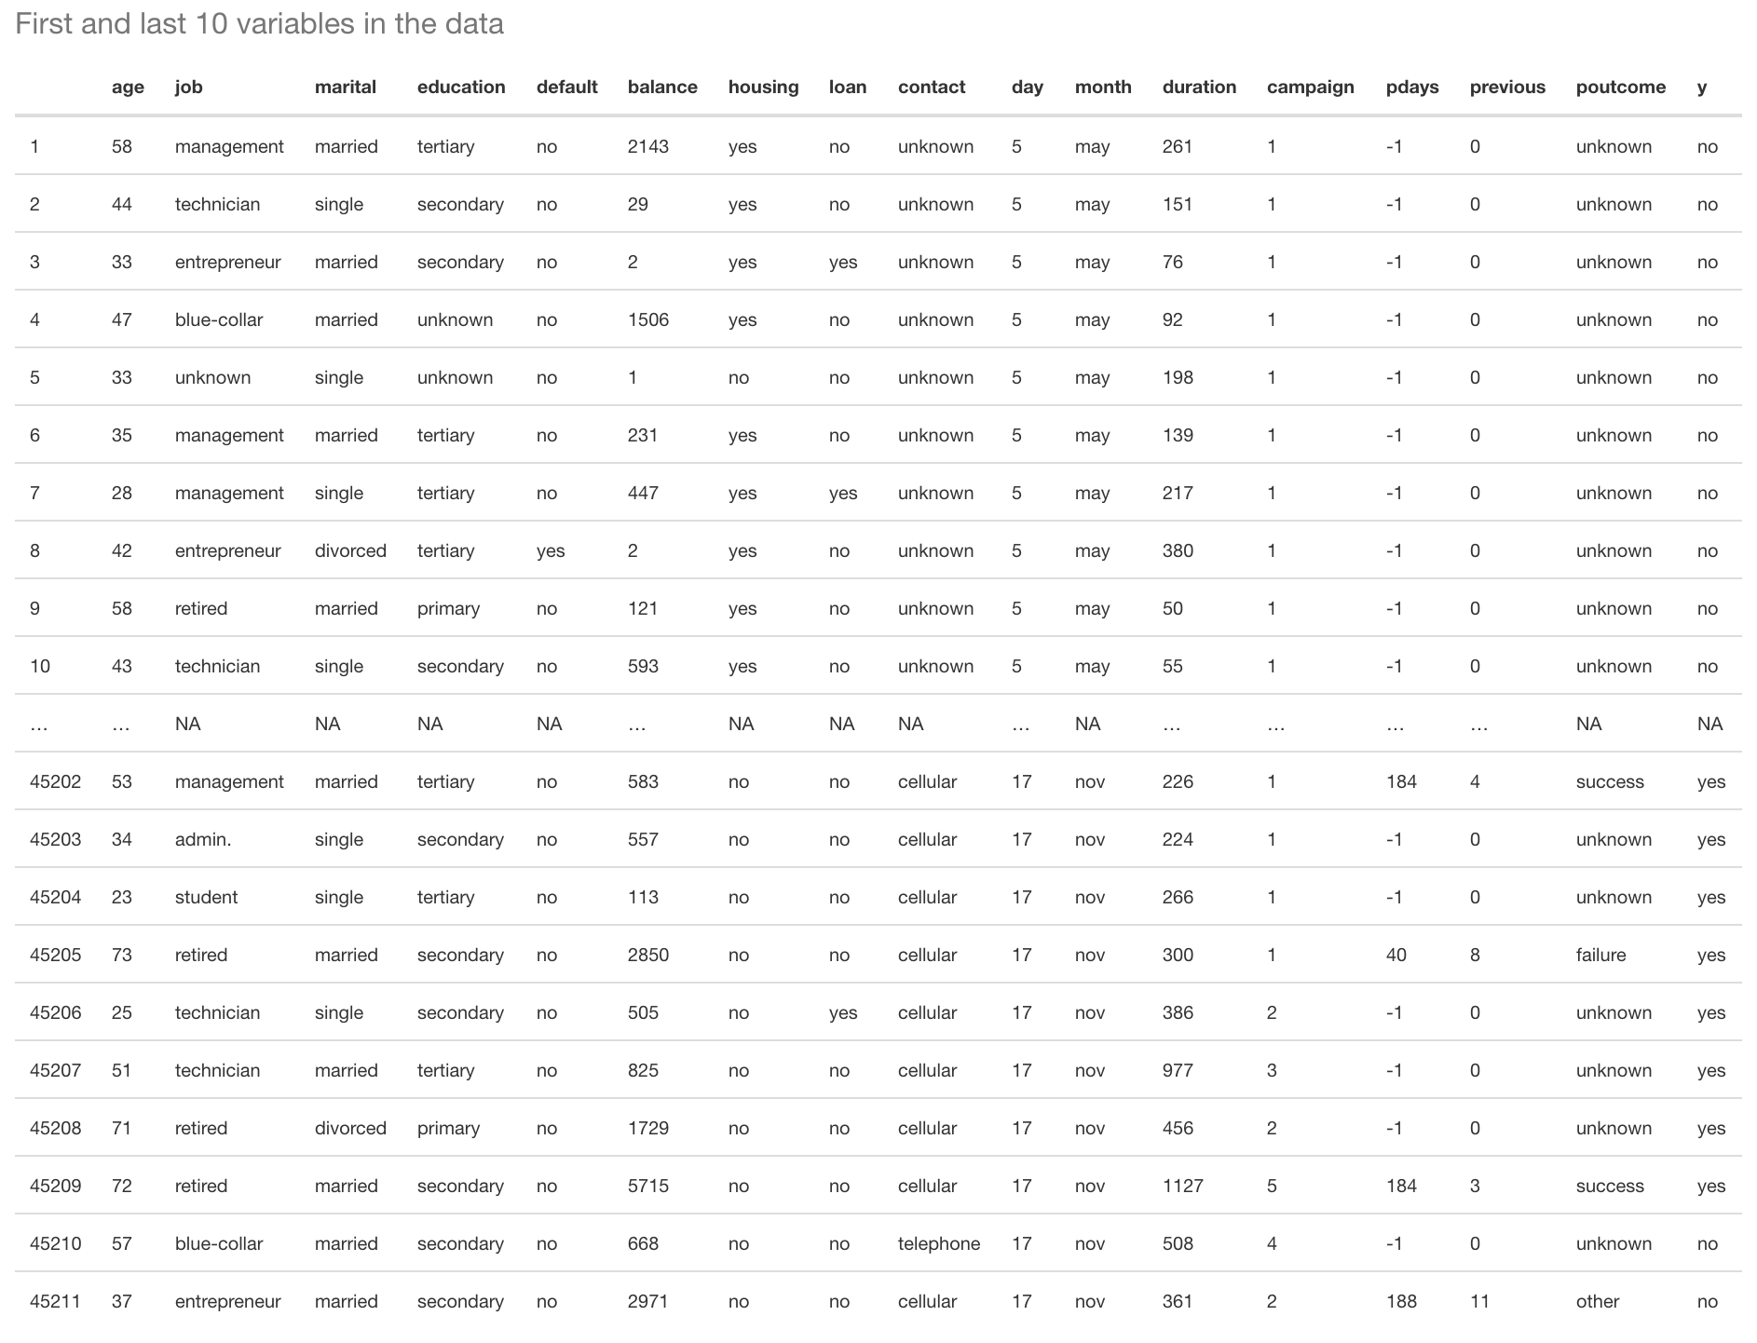

Slide 6
Data Description
1 - age (numeric) 2 - job : type of job (categorical: 'admin.','blue-collar','entrepreneur','housemaid','management','retired','self-employed','services','student','technician','unemployed','unknown') 3 - marital : marital status (categorical: 'divorced','married','single','unknown'; note: 'divorced' means divorced or widowed) 4 - education (categorical: 'basic.4y','basic.6y','basic.9y','high.school','illiterate','professional.course','university.degree','unknown') 5 - default: has credit in default? (categorical: 'no','yes','unknown') 6 - housing: has housing loan? (categorical: 'no','yes','unknown') 7 - loan: has personal loan? (categorical: 'no','yes','unknown') # related with the last contact of the current campaign: 8 - contact: contact communication type (categorical: 'cellular','telephone') 9 - month: last contact month of year (categorical: 'jan', 'feb', 'mar', ..., 'nov', 'dec') 10 - day_of_week: last contact day of the week (categorical: 'mon','tue','wed','thu','fri') 11 - duration: last contact duration, in seconds (numeric)
12 - campaign: number of contacts performed during this campaign and for this client (numeric, includes last contact) 13 - pdays: number of days that passed by after the client was last contacted from a previous campaign (numeric; 999 means client was not previously contacted) 14 - previous: number of contacts performed before this campaign and for this client (numeric) 15 - poutcome: outcome of the previous marketing campaign (categorical: 'failure','nonexistent','success’) Output variable (desired target): 17 - y - has the client subscribed a term deposit? (binary: 'yes','no')

Slide 7

Explanatory Data Analysis

Slide 8
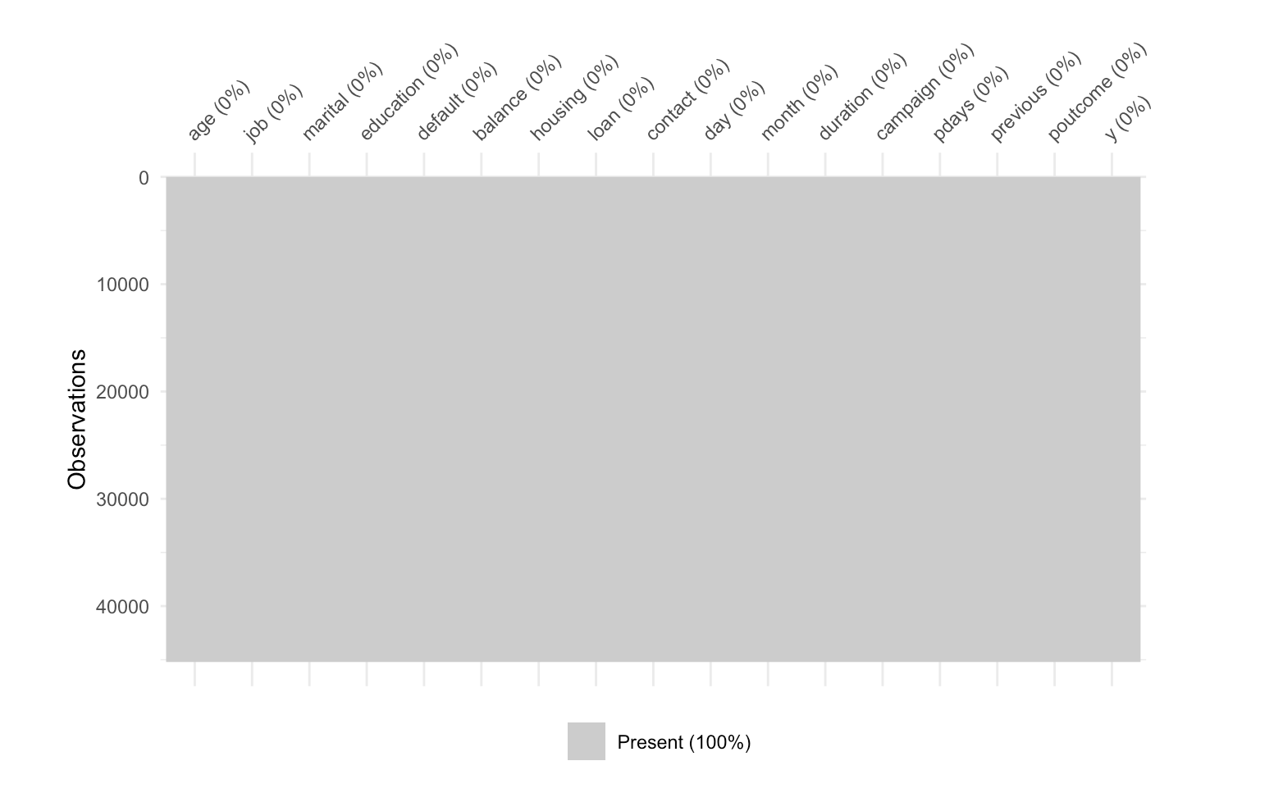
Is there any missing value in the data?
As seen, there is no missing value in the bank dataset.

Slide 9
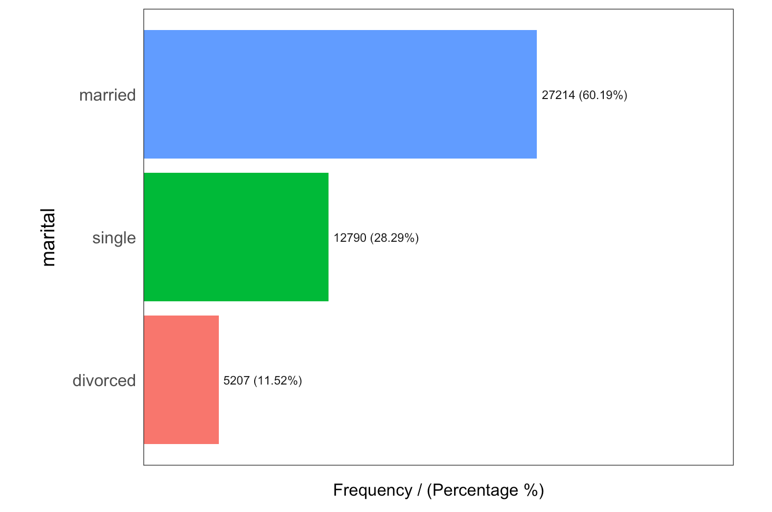
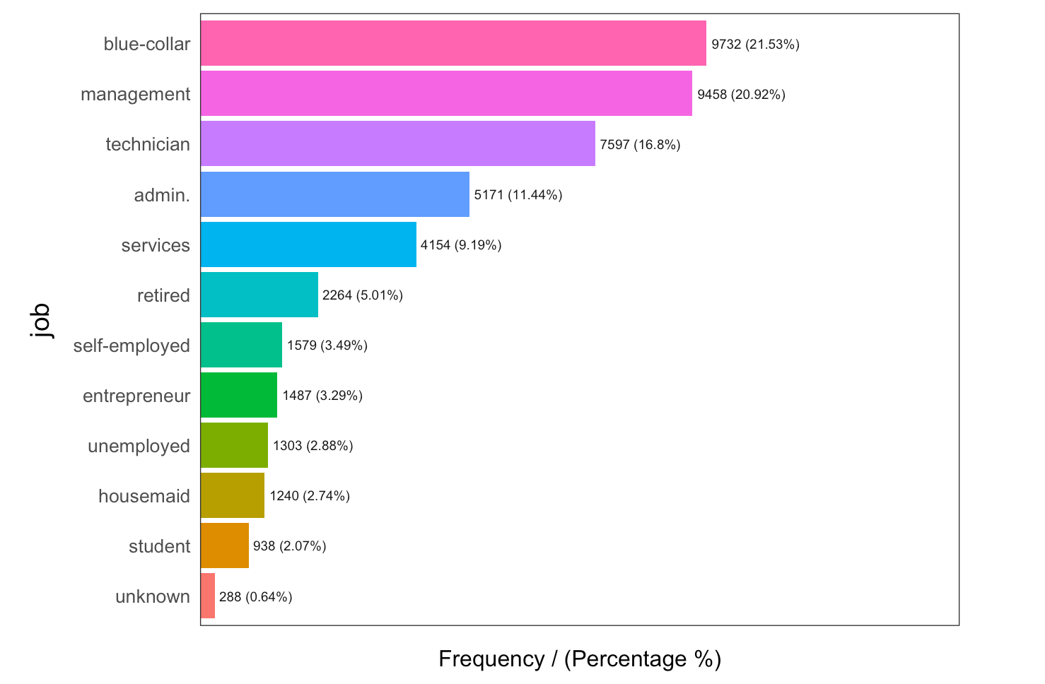
Frequency of the martial status and type of the job

Slide 10
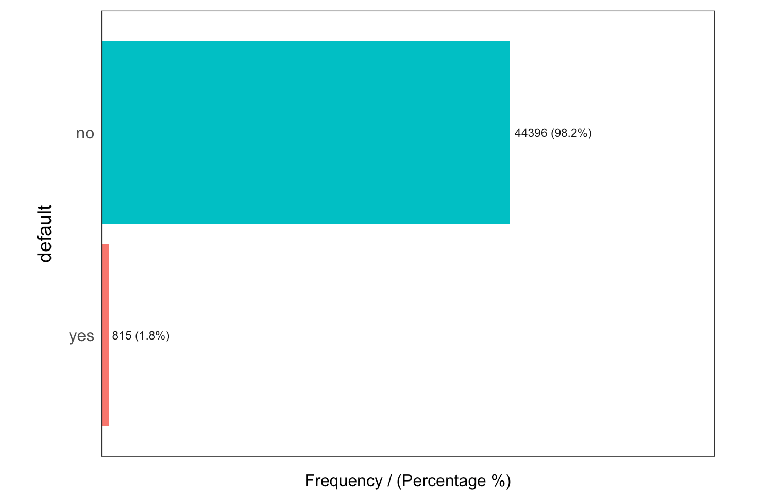
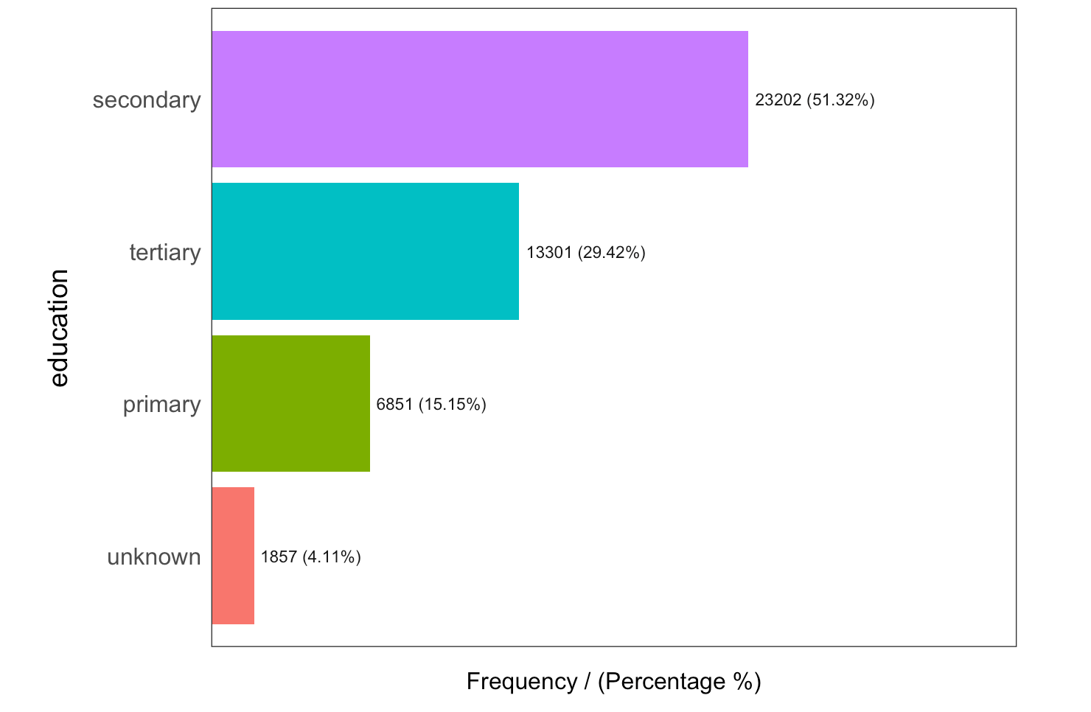
Frequency of the default and education

Slide 11
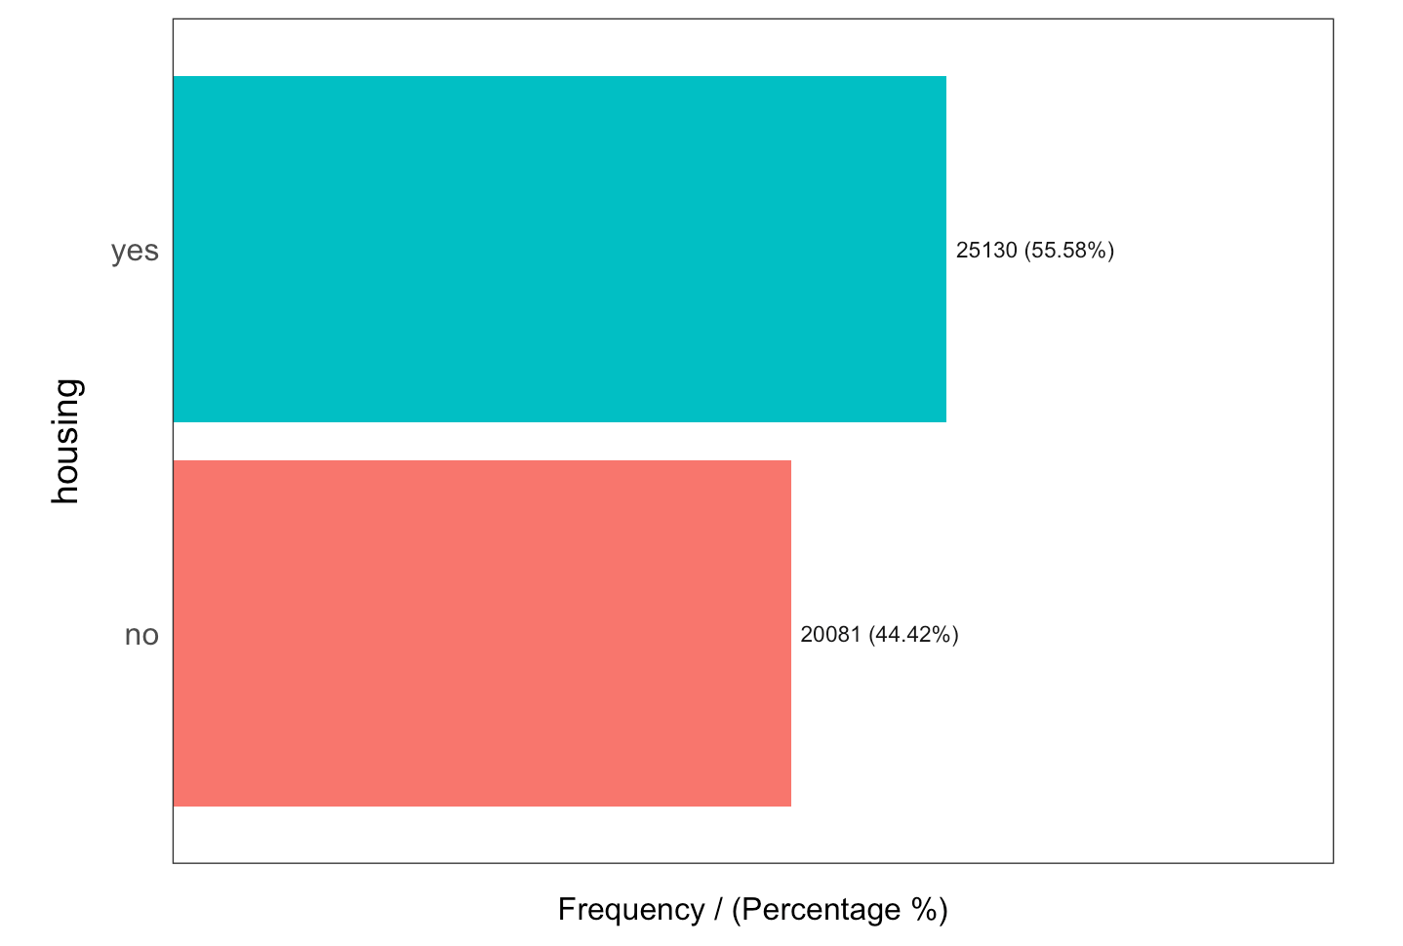
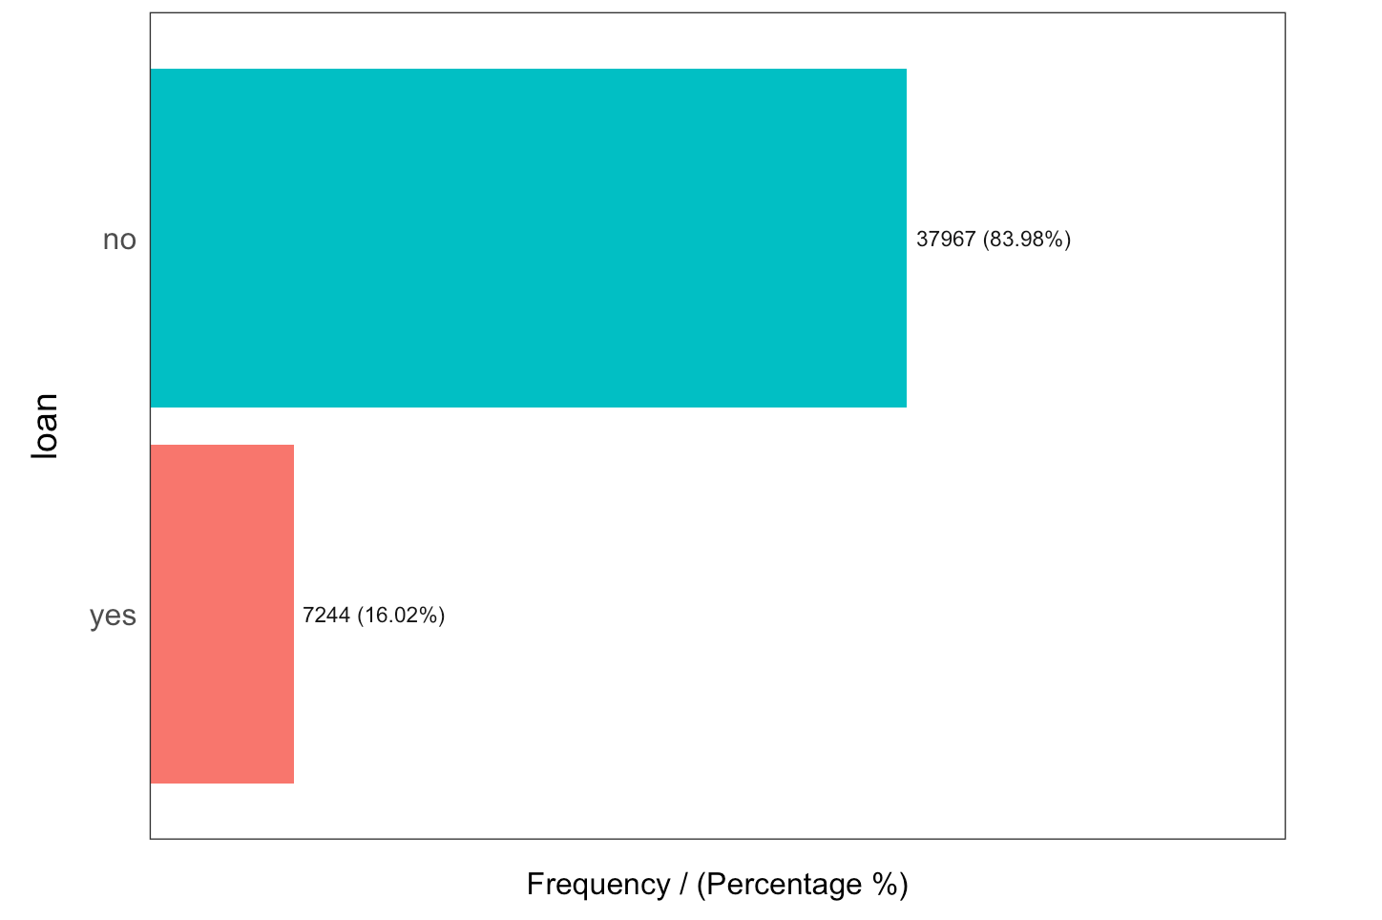
Frequency of the housing and loan

Slide 12
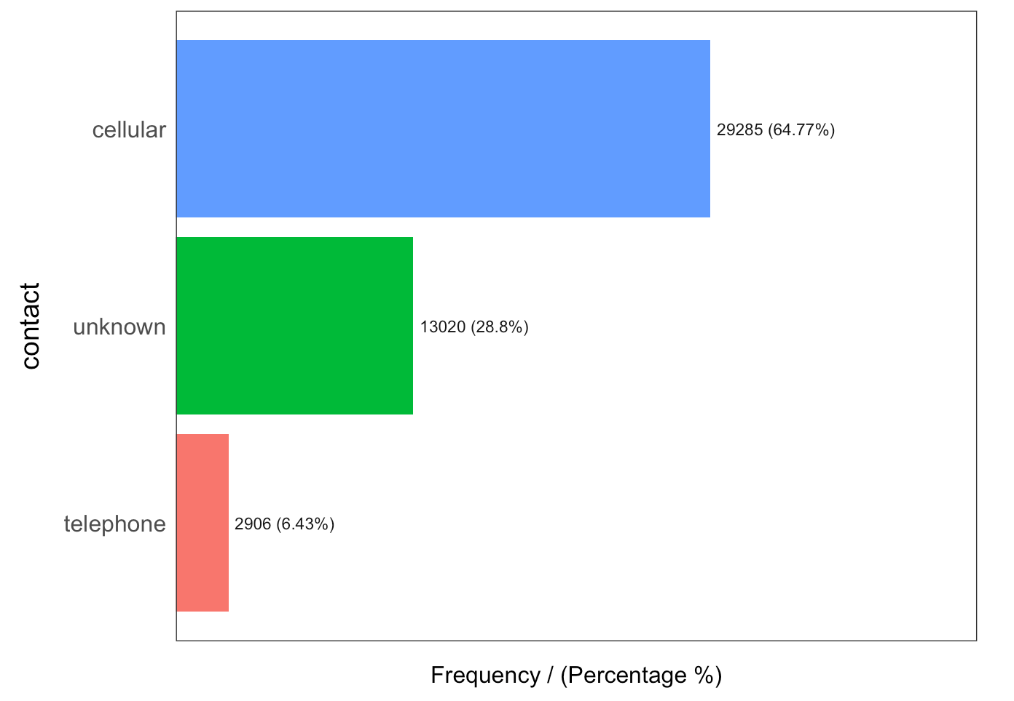
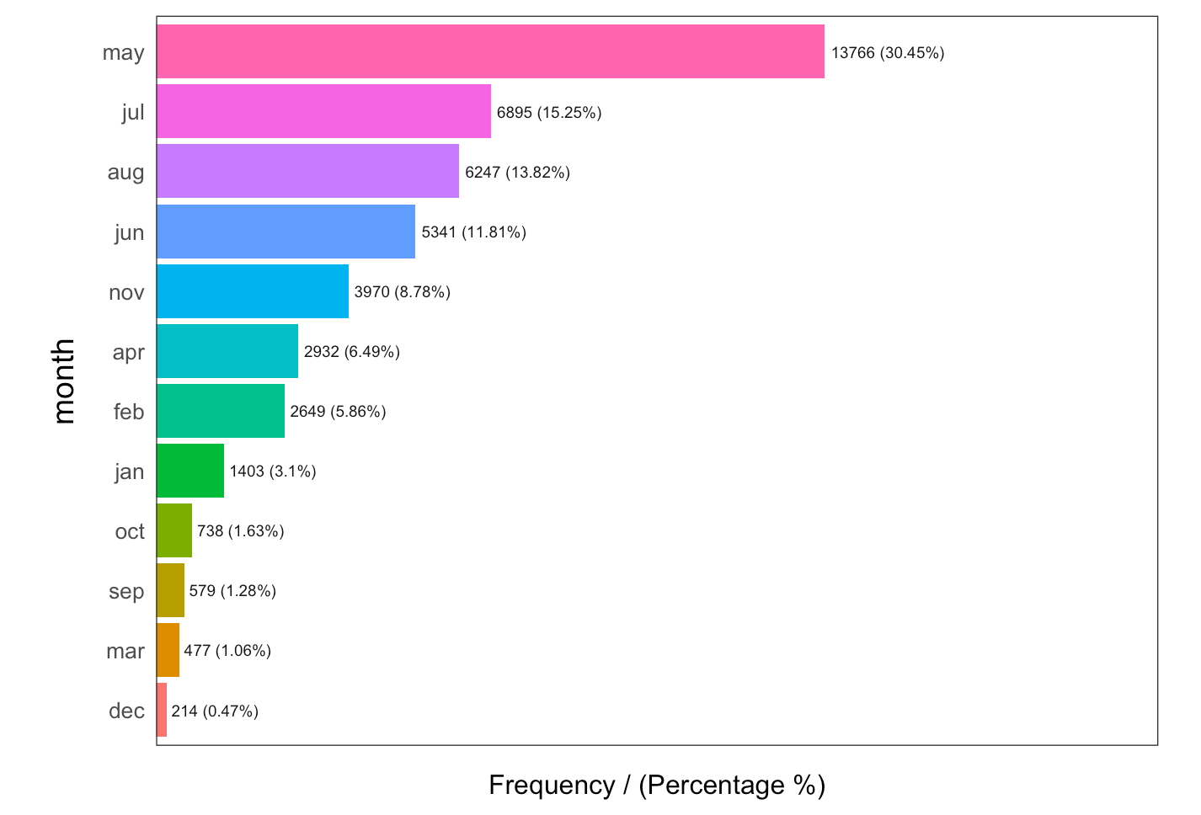
Frequency of the contract and last contact month of year

Slide 13
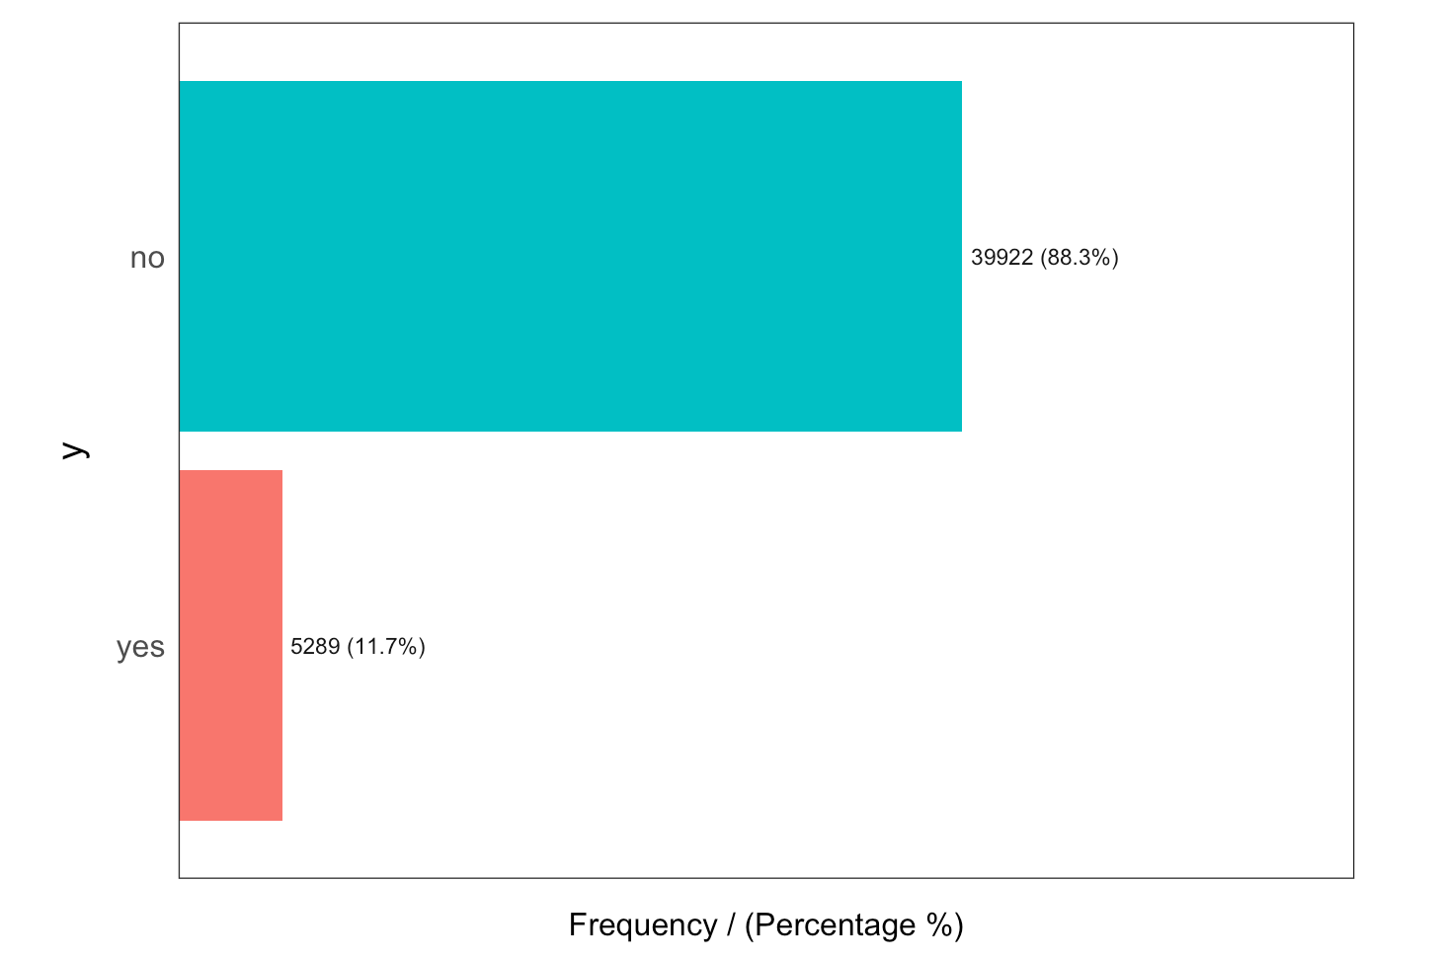
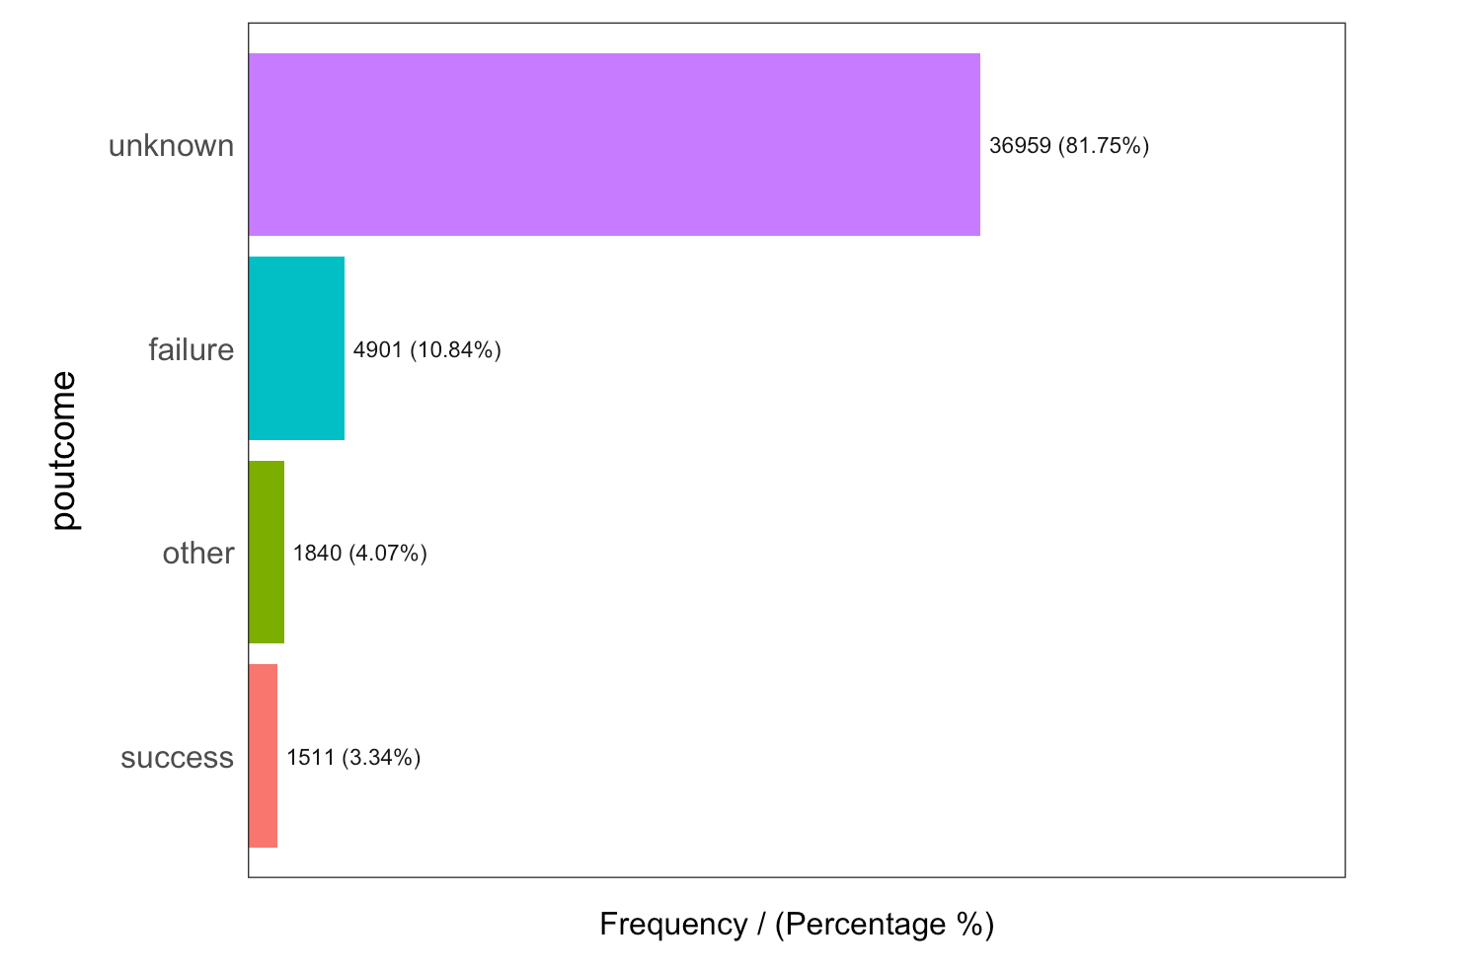
Frequency of the outcome of the previous marketing campaign and y

Slide 14
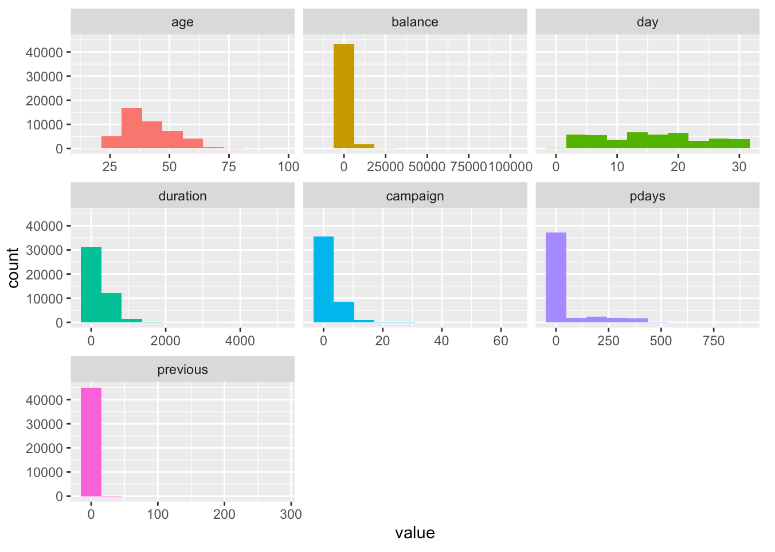
Shapes of the numeric variables

Slide 15
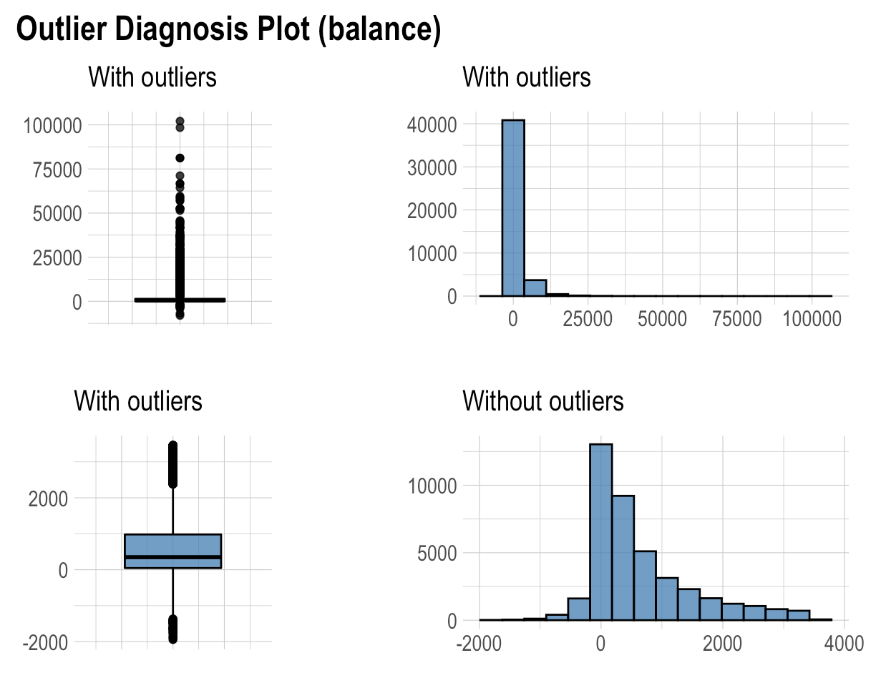
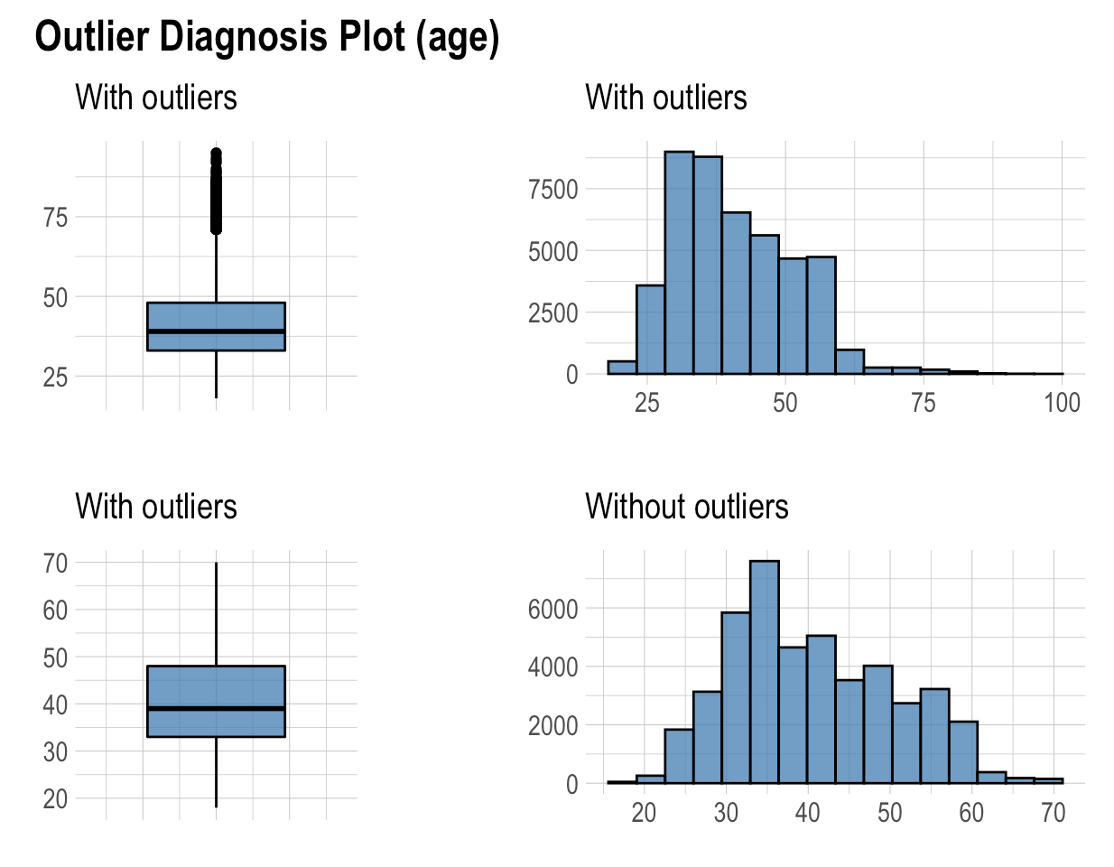
Does numeric variables have any outlier and what will be shape of the variables exclude the outliers?

Slide 16
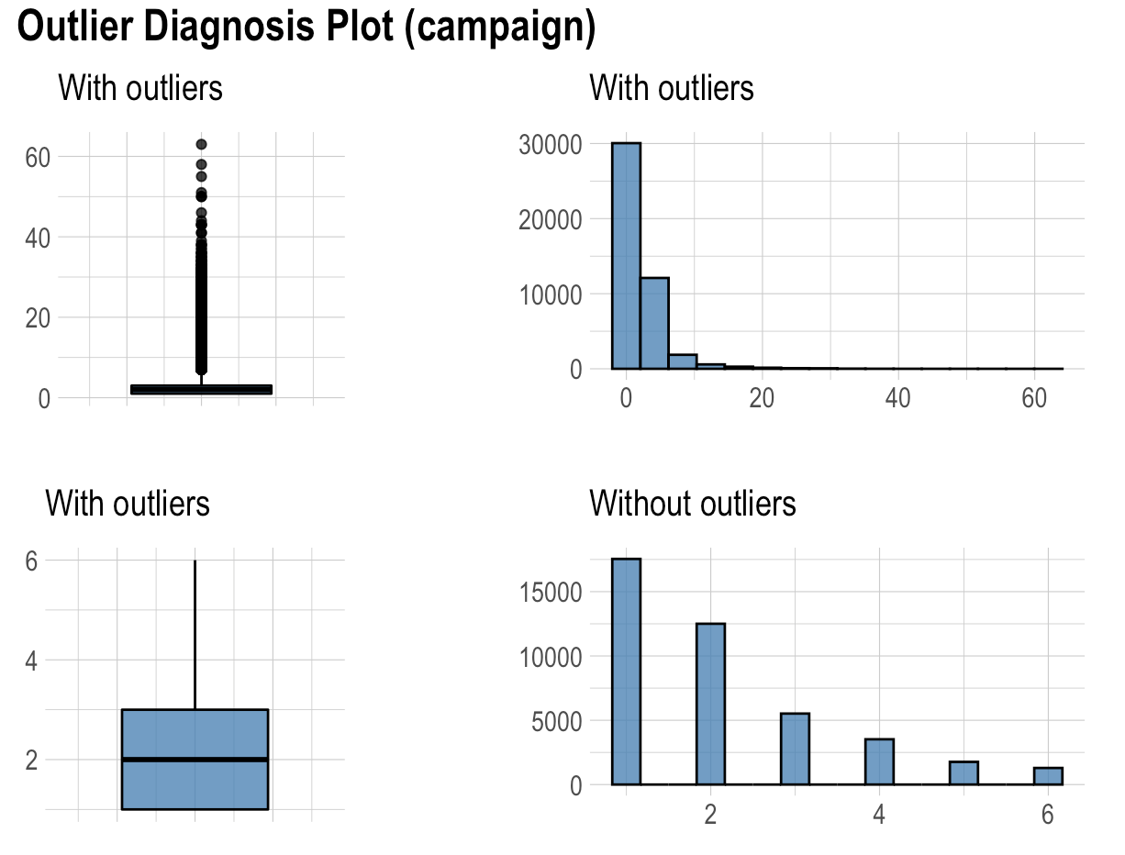
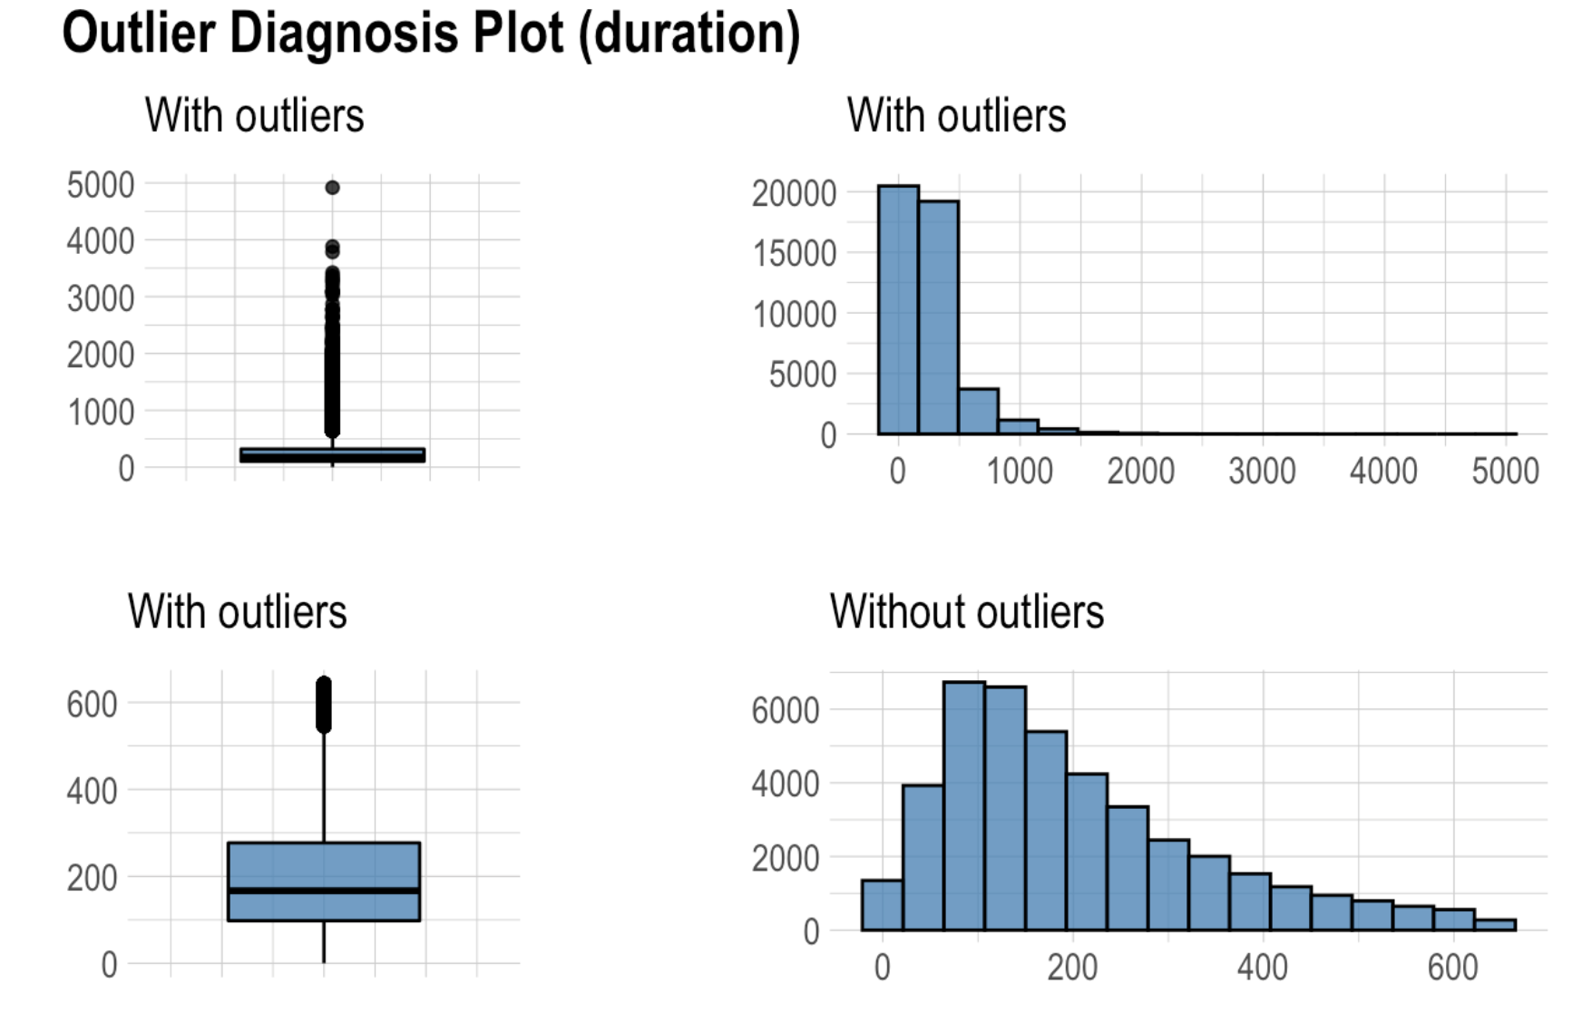
Does numeric variables have any outlier and what will be shape of the variables exclude the outliers?

Slide 17
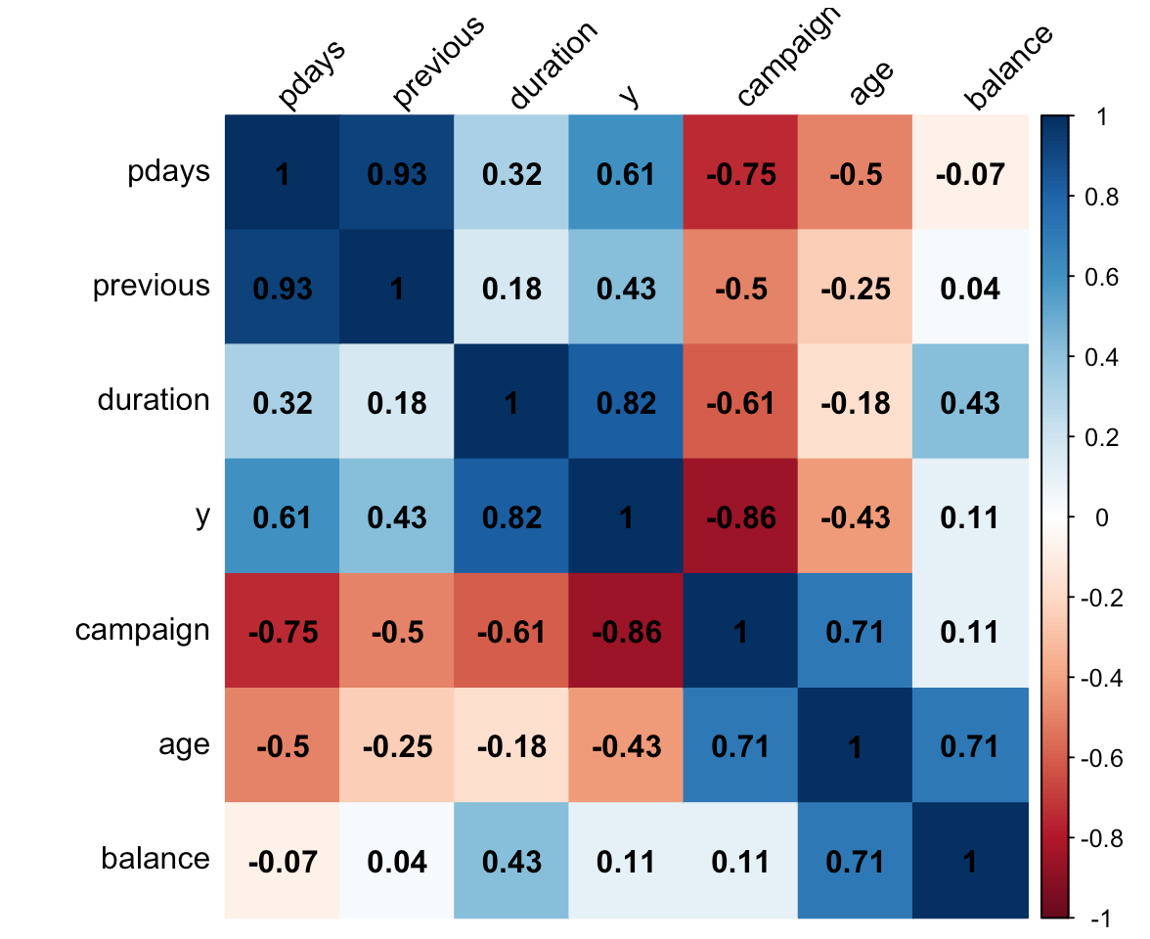
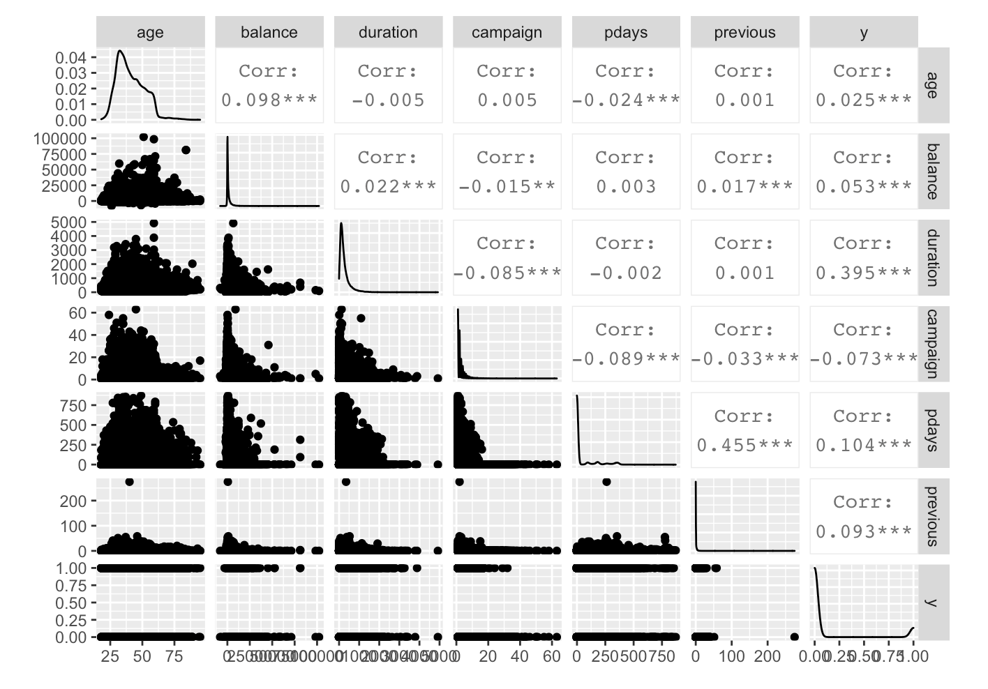
Is there any significant relationship between numeric variables and y, if y taken as numeric (1:no, 0:yes)?

Slide 18
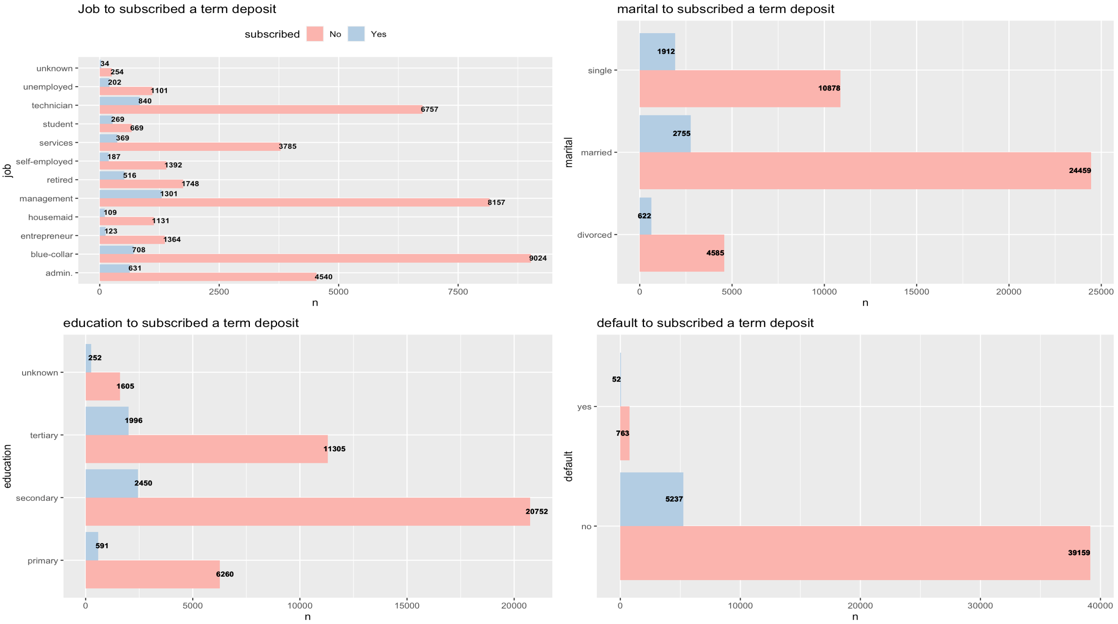
Is there any significant relationship between categorical variables and y?

Slide 19
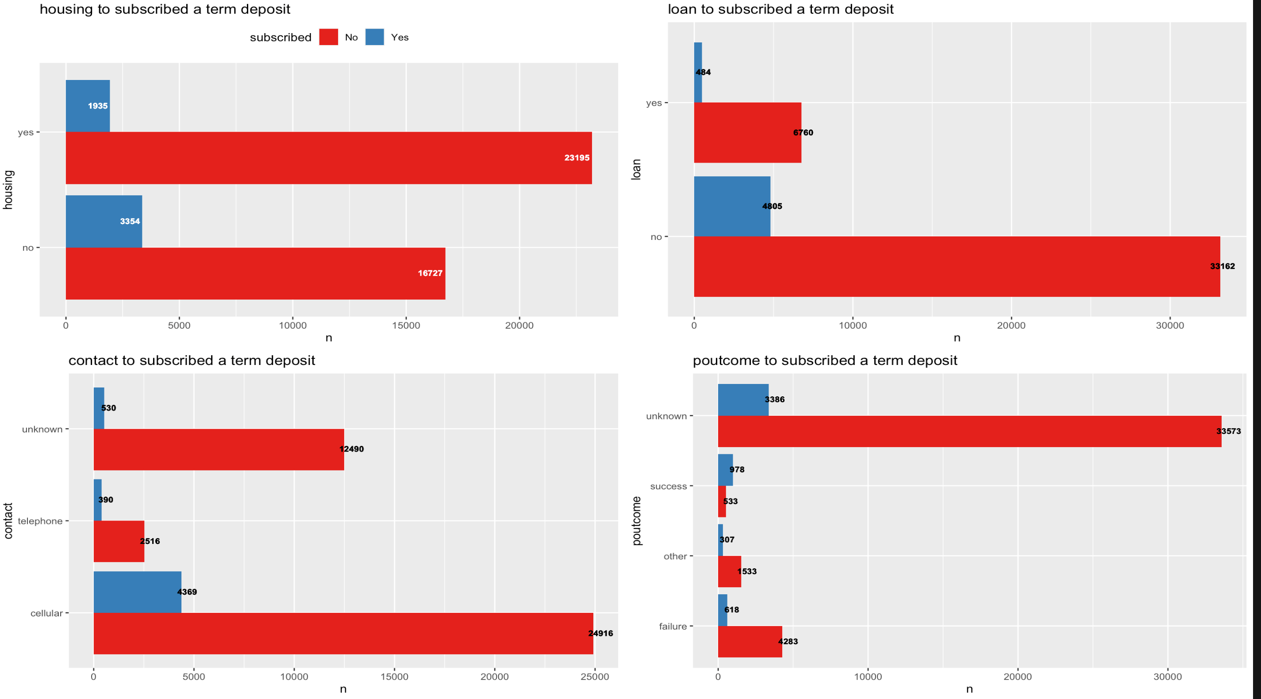
Is there any significant relationship between categorical variables and y?

Slide 20
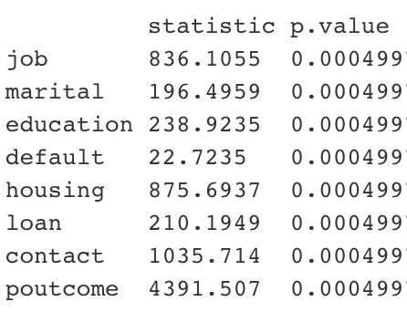
H_{o} : There is not significant relationship between variables (Variables are independent )
H₁: There is significant relationship between variables
As seen all p-values are smaller than the significance level of 0.05, so there is significant relationship between categorical variables and y.

Slide 21

Modeling

Slide 22
Recommended models for this data set
We see that in EDA part, in response variable, “no” class proportion is 88.3 while “yes” class proportion is 11.7. There is huge difference difference between two class. Thus, we have imbalance data and it causes reduction in accuracy of ML algorithms.
What are the methods to deal with imbalanced data sets ?
The methods are widely known as ‘Sampling Methods’. Generally, these methods aim to modify an imbalanced data into balanced distribution using some mechanism. The modification occurs by altering the size of original data set and provide the same proportion of balance.
Below are the methods used to treat imbalanced datasets:
Undersampling
Oversampling
Synthetic Data Generation
Cost Sensitive Learning

Slide 23
Recommended models for this data set
After applying one of the methods for imbalanced data; we conduct three ML models which are very popular for classification data.
1. Logistic regression
2. Decision Tree
3. XGBoots

