Slide 1

Final Project
Virtual Internship
14-May-2021
Name: İrem Tanrıverdi
Email: Tanriverdiirem.95@gmail.com
Location: Turkey
Collage: Middle East Technical University
Spealization: Data Science

Slide 2

Model Selection and Model Building

Slide 3
What are the methods to deal with imbalanced data sets ?
We see that in EDA part, in response variable, “no” class proportion is 88.3 while “yes” class proportion is 11.7. There is huge difference difference between two class. Thus, we have imbalance data and it causes reduction in accuracy of ML algorithms.
The methods are widely known as ‘Sampling Methods’. Generally, these methods aim to modify an imbalanced data into balanced distribution using some mechanism. The modification occurs by altering the size of original data set and provide the same proportion of balance.
Below are the methods used to treat imbalanced datasets:
Undersampling
Oversampling
Synthetic Data Generation
Cost Sensitive Learning

Slide 4
What are the methods to deal with imbalanced data sets ?
I applied the both undersampling and oversampling since you we’ve lost significant information from the sample when doing undersampling.
In this case, the minority class is oversampled with replacement and majority class is undersampled without replacement.
After under and oversampling number of response class be:
No | Yes
22628 (0.5004%) | 22583 (0.499%)

Slide 5
After over and undersampling data divided into two part; training and test set.
80% of the data used as training set and 20% of the data used as test set.
In train data, proportion of class of the response variable is:
Nrow train set | Nrow test set
36169 | 9042
No | Yes
0.50062% | 0.4993%
In all of models, y taken as response variable (by taking 0:No, 1:Yes), all of the other variables taking as covariate.

Slide 6
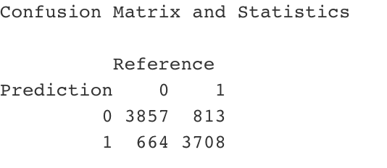
First Model: Logistic regression

Slide 7
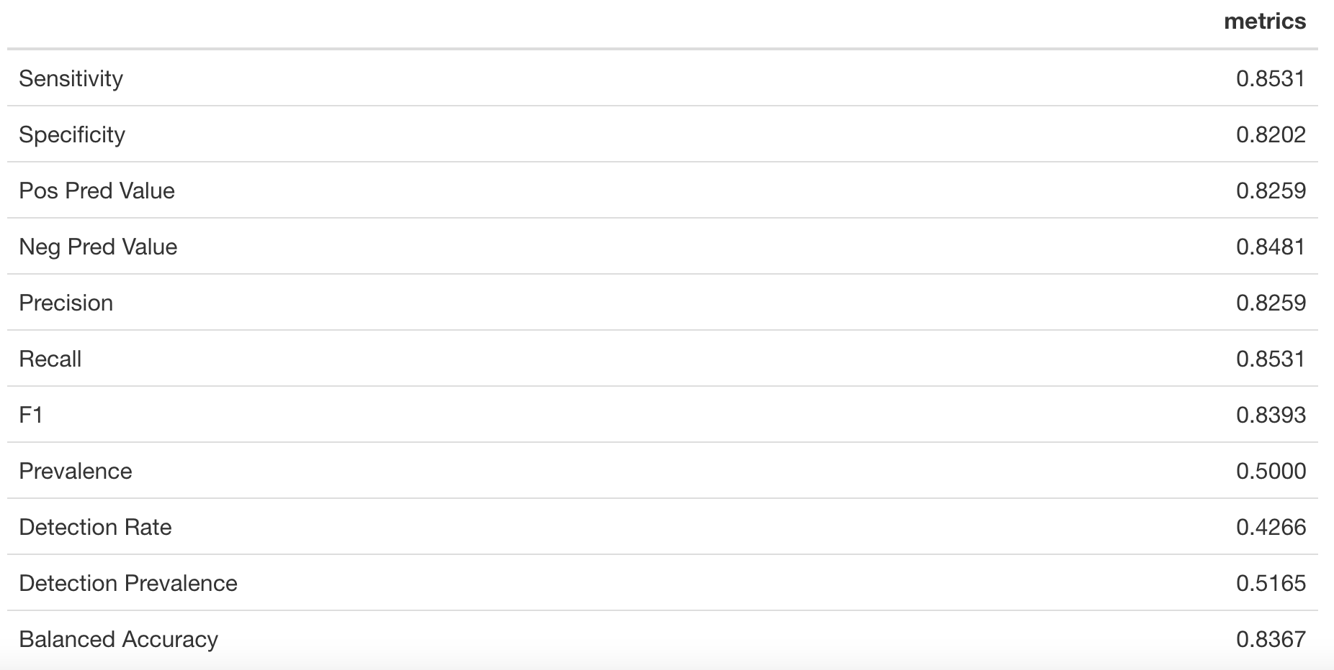
Logistic regression

Slide 8
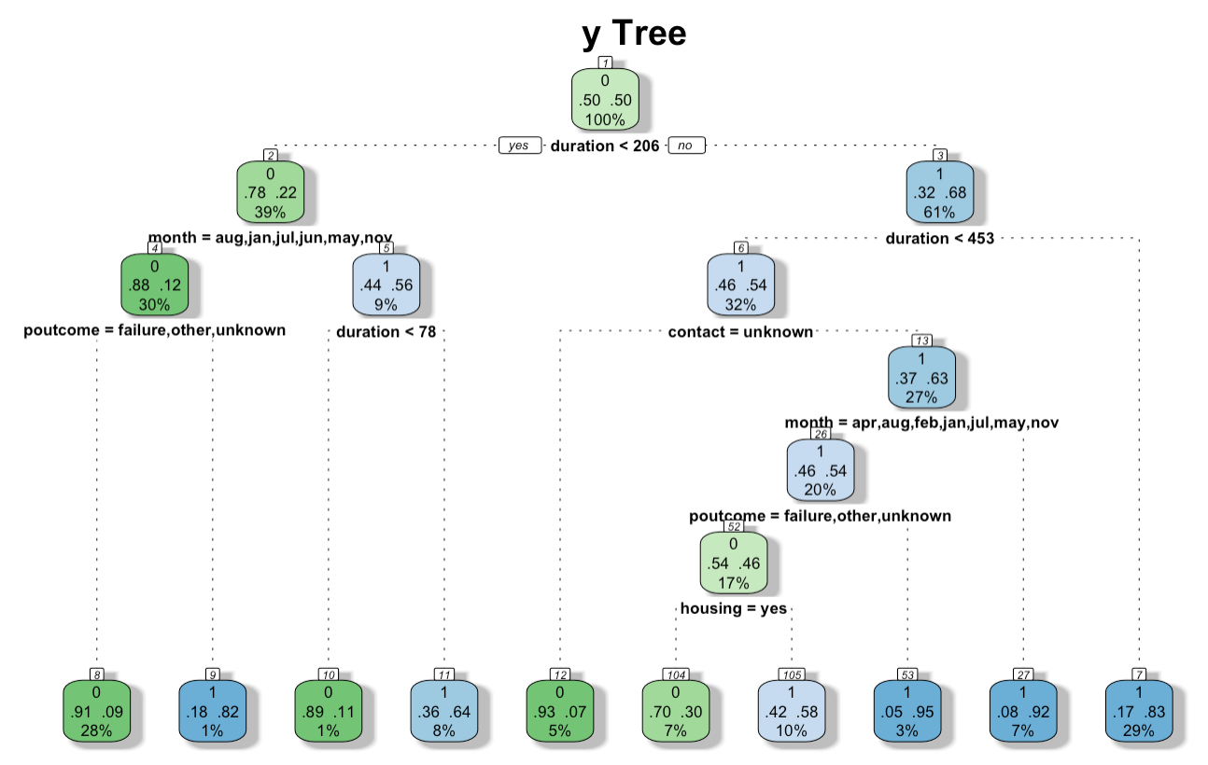
Second Model: Decision Tree

Slide 9
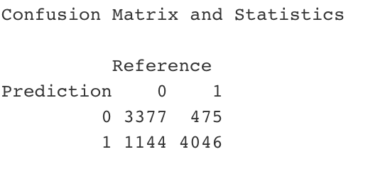
Decision Tree

Slide 10
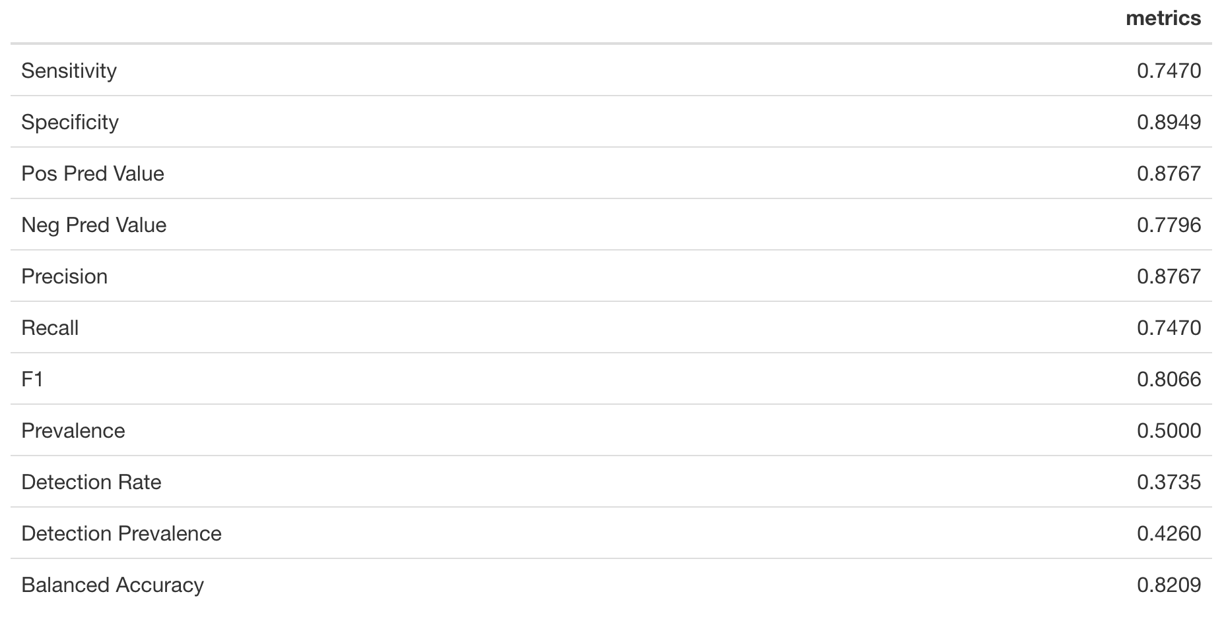
Decision Tree

Slide 11
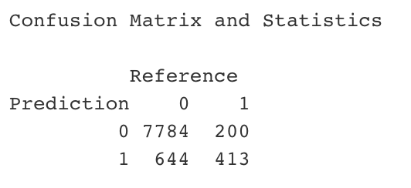
Third Model: XGBOOST

Slide 12
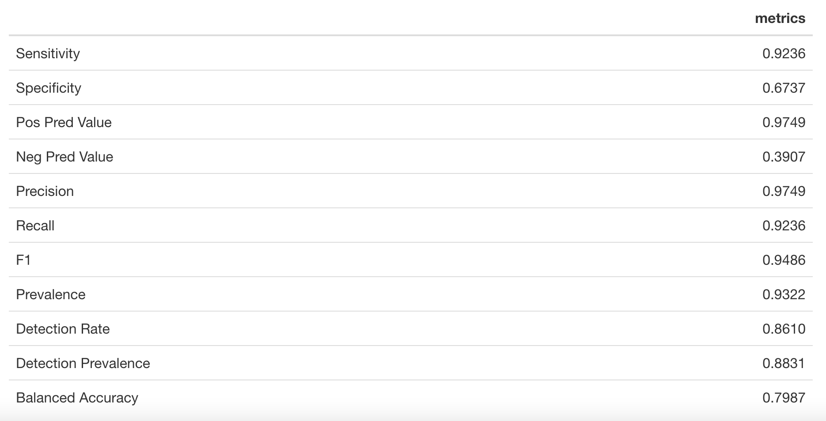
XGBOOST

Slide 13
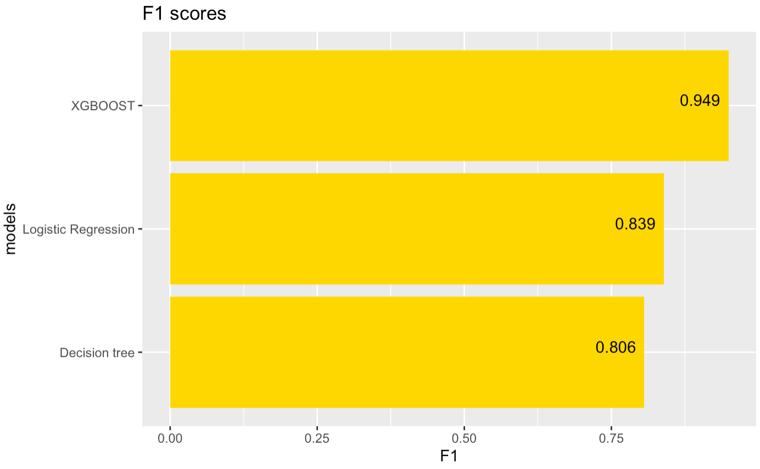
Model Selection

Slide 14
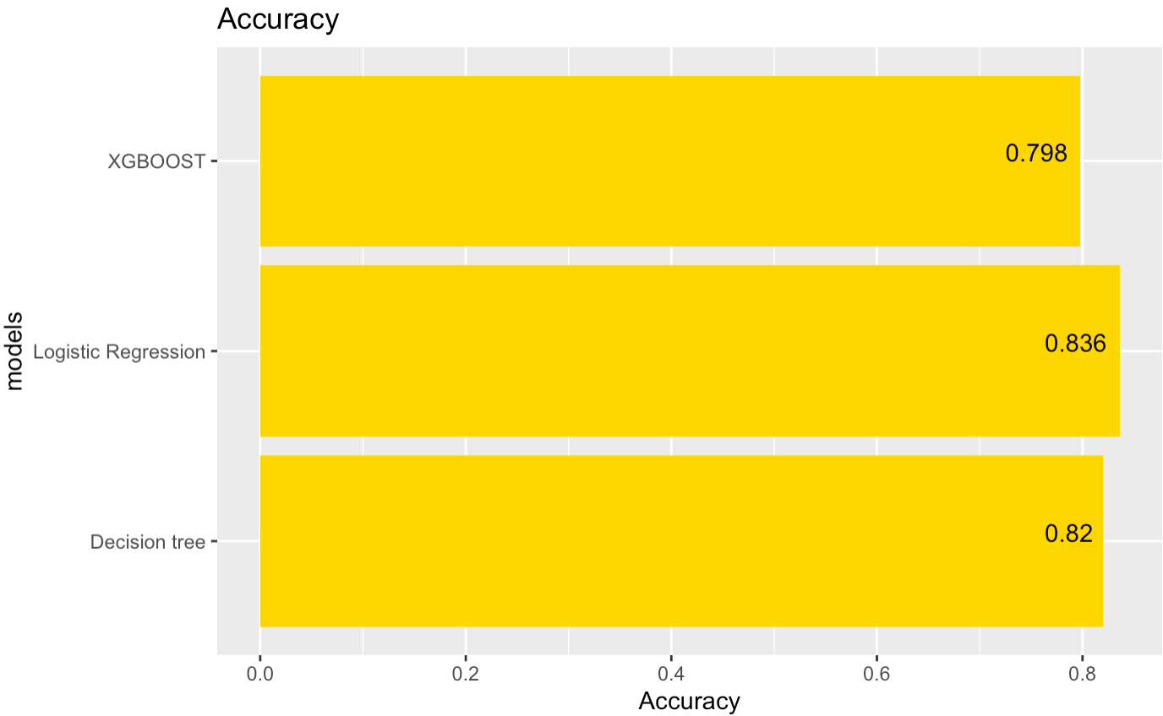
Model Selection

Slide 15
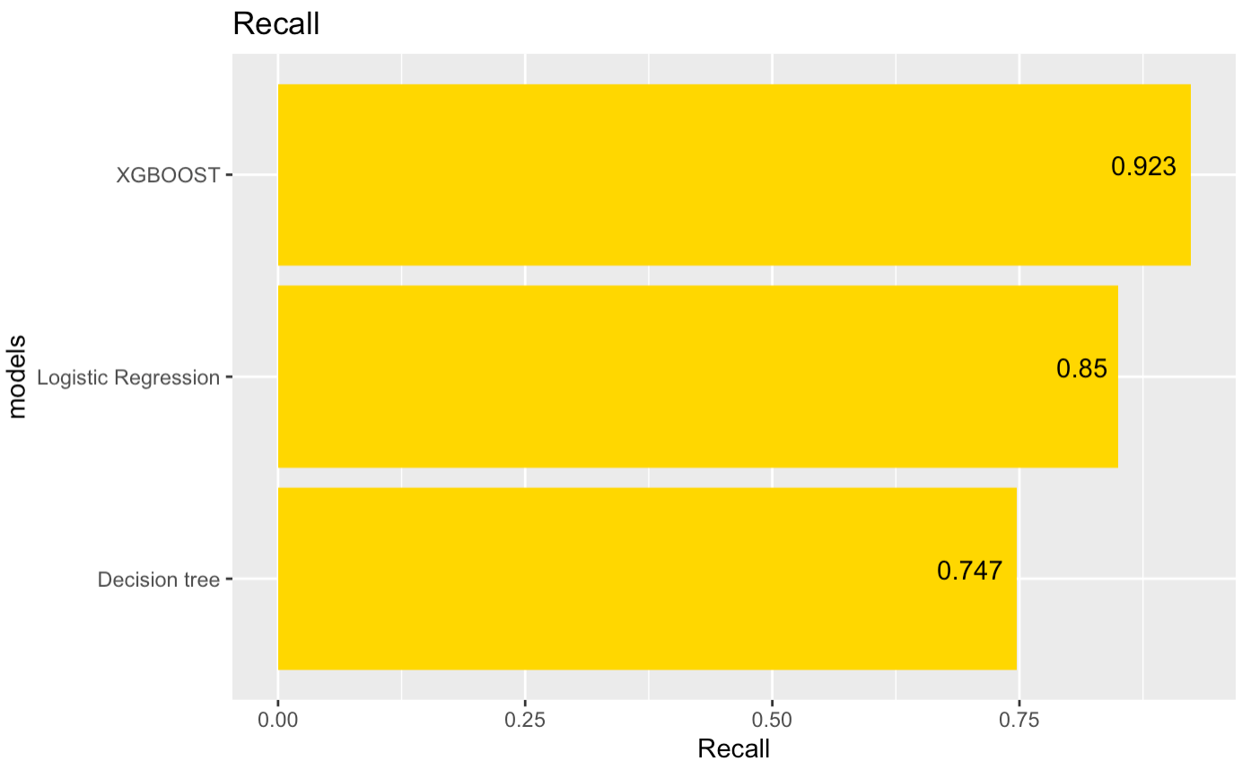
Model Selection

Slide 16
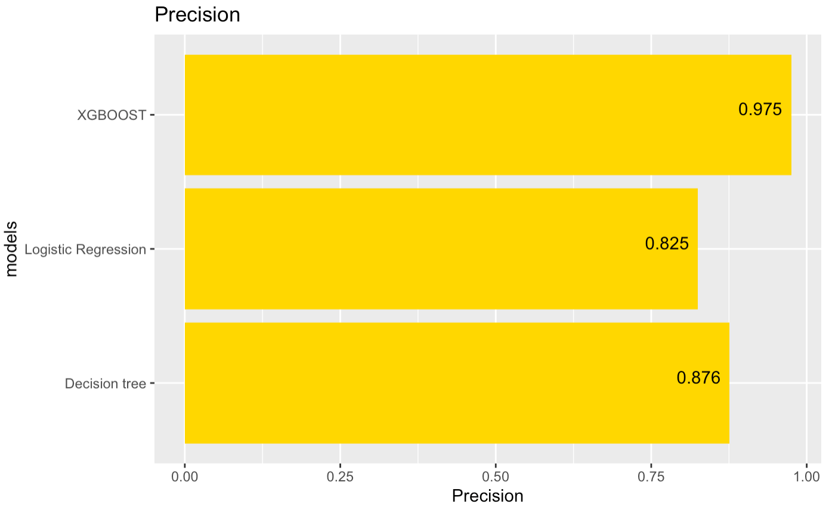
Model Selection

Slide 17
Model Selection
As seen from the plots, F1 score, recall and precision of the model conducted with XGBOOST is the highest.
Thus, F1 score, recall and precision suggest that XGBOOST model is better model among 3 models.

