Slide 1
How DaIly HabIts Shape Body ComposItIon wIth a Focus on Body Fat and WeIght Change
FATMA IREM ULUSAL 32036
DSA-210 FINAL PRESENTATION

Slide 2
What’s In ThIs PresentatIon
Project Motivation & Objectives
Dataset & Methodology
Exploratory Data Analysis (EDA)
Hypothesis Testing
Machine Learning Models
Key Insights & Conclusions

Slide 3
Project MotIvatIon & ObjectIves
Motivation
Improve body composition by reducing body fat and overall weight.
Understand how my body responds to different daily habits.
Combine personal health tracking with data science for real-world impact.
Objectives
Identify which daily habits (e.g., calories, macros, sleep, exercise) have the strongest impact on fat and weight.
Use Python to clean, analyze, and model the data.
Generate actionable strategies to improve health and maintain progress.

Slide 4
Dataset Overview
Caloric Intake (kcal)
Macronutrients (g):
Protein
Carbohydrates
Fats
Body Composition Metrics:
Body Fat Percentage (%)
Body Weight (kg)
Lifestyle Indicators:
Sleep Duration (hours)
Sleep Quality (1–5)
Exercise Time (minutes)
Derived Metrics:
Calorie Deficit
Fat % Change
Weight Change
Data was collected daily over a 4-month period, logged manually in Excel, and analyzed using Python.
Temperature (°C): Daily ambient temperature, sourced from historical weather data and merged with manually recorded daily logs in Excel.

Slide 5
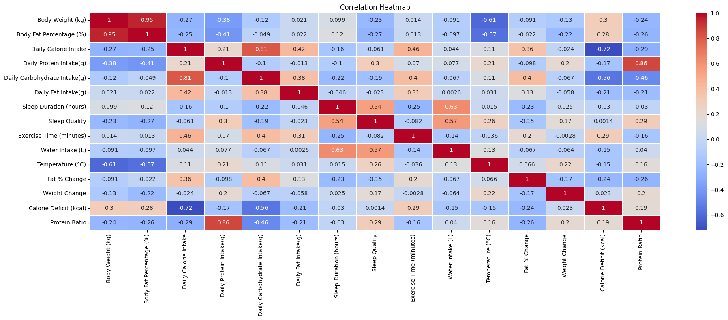
Exploratory Data AnalysIs (EDA)
1) Correlation Matrix
Body Weight and Body Fat % were highly correlated (r = 0.95), indicating that reductions in weight strongly aligned with reductions in fat mass.
Calorie intake and calorie deficit show a strong negative correlation (-0.72), highlighting the direct impact of calorie intake on energy balance.

Slide 6
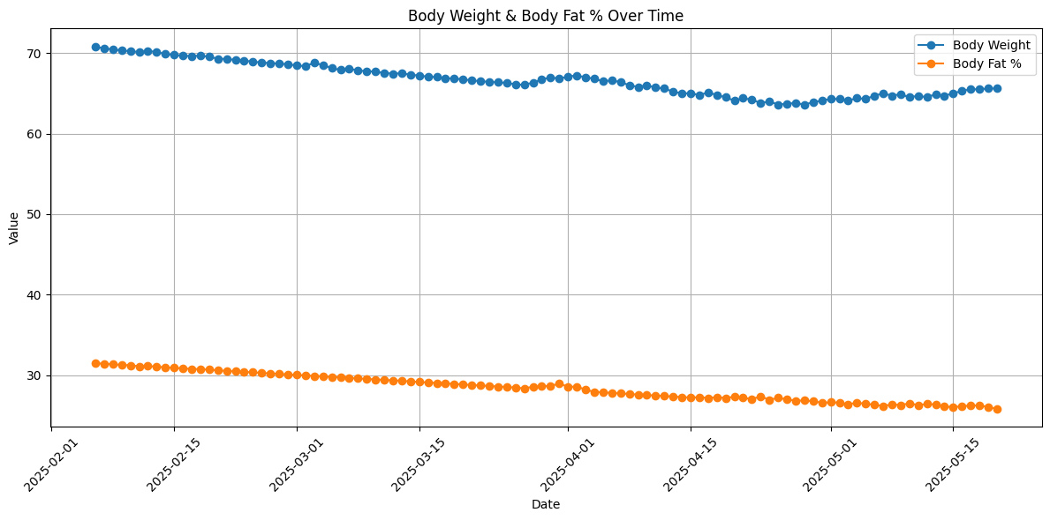
2) Time‑series Plot: Body Weight & Body Fat
Both body weight and body fat percentage showed a steady decline over the 4-month period, suggesting consistent progress in fat reduction and weight loss.

Slide 7
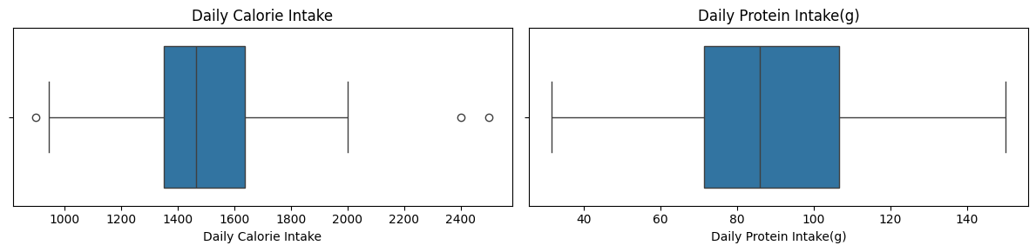
3) Boxplots
Daily Calorie Intake is mostly centered around 1400–1700 kcal, with a few higher outliers above 2300 kcal, likely due to occasional surplus days.
Daily Protein Intake shows a relatively balanced distribution between 60–130g, with no major outliers, indicating stable protein habits.

Slide 8
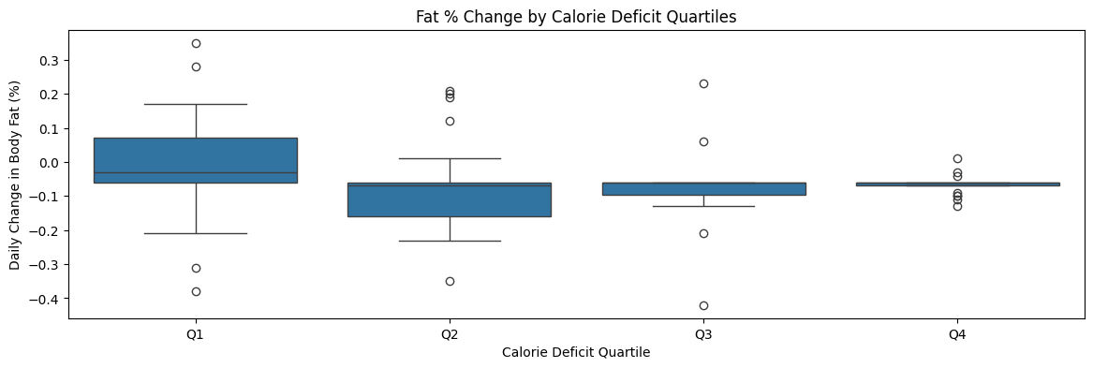
The plot shows that individuals in the highest calorie deficit quartile (Q4) experienced the most consistent fat percentage reductions, with minimal variability.
In contrast, Q1 (lowest deficit) showed the widest range of changes, including both increases and decreases in body fat.
This suggests that higher and sustained deficits may not only reduce fat more reliably but also stabilize day-to-day fluctuations.

Slide 9
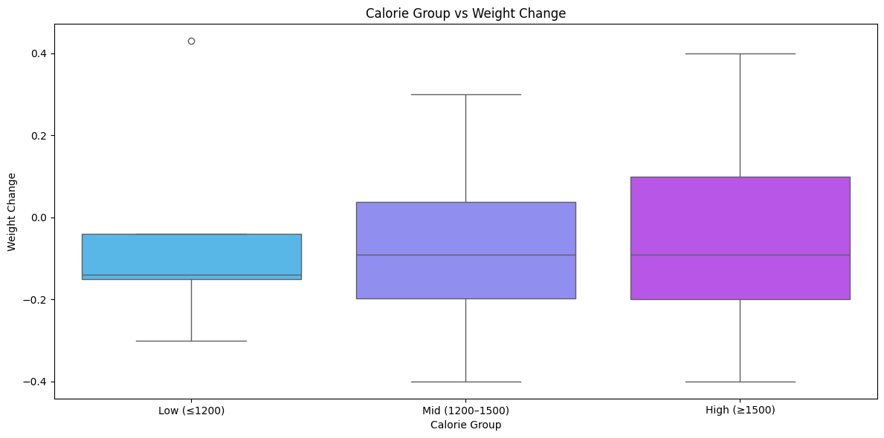
Low Calorie Group (≤1200 kcal)
This group did not consistently result in weight loss. Some days even showed weight gain, indicating that short-term restriction does not guarantee immediate fat loss.
Mid Calorie Group (1200–1500 kcal)
Showed the widest range of weight fluctuations, including both loss and gain. This suggests that other variables (like exercise/sleep) may play a greater role than calorie level alone in this range.
High Calorie Group (≥1500 kcal)
Surprisingly, this group also included instances of weight loss, possibly due to increased physical activity, higher metabolism, or delayed caloric impact.

Slide 10
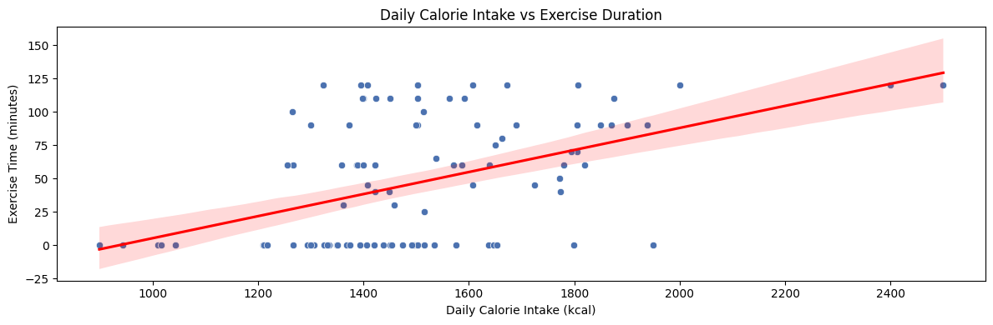
This plot shows that higher daily calorie intake is generally associated with longer exercise durations.
This observation helps explain why weight loss can still occur on high-calorie days—because they often coincide with more exercise, offsetting the increased intake.

Slide 11
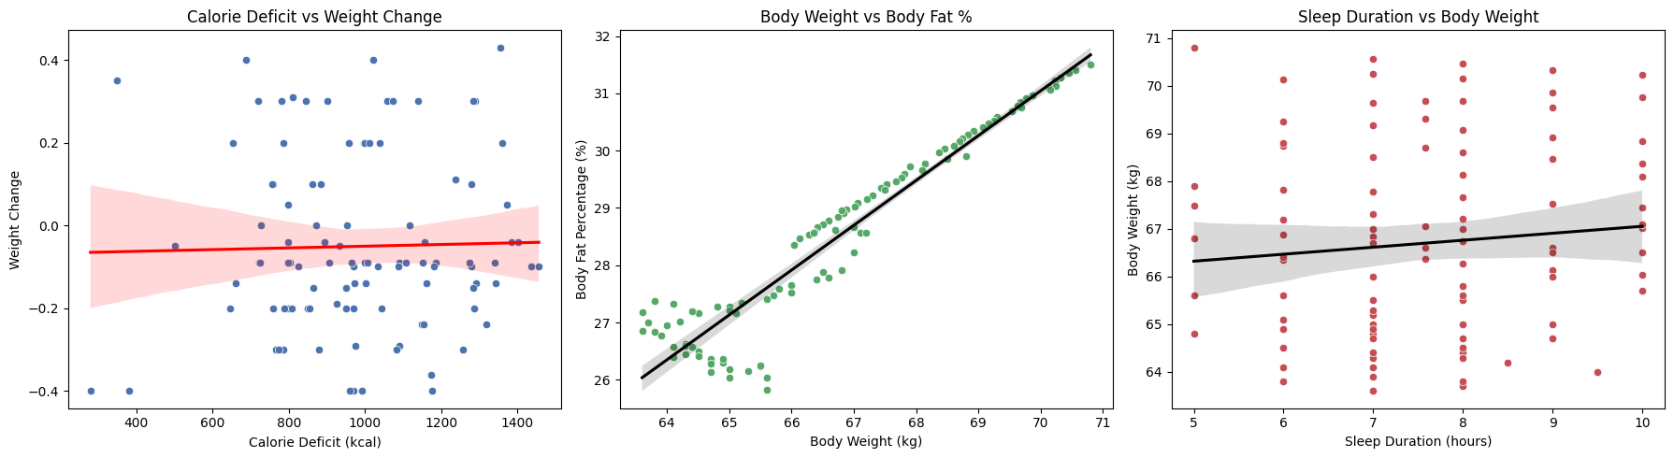
4) Scatterplots with Regression Lines
Calorie Deficit vs Weight Change
A weak positive trend is visible, but the wide confidence interval suggests low predictive power. This indicates that same-day calorie deficit does not reliably predict immediate weight change.
Body Weight vs Body Fat %
A very strong linear correlation is evident (r ≈ 0.98), showing that reductions in weight closely mirror reductions in body fat percentage.
Sleep Duration vs Body Weight
There is no significant trend, indicating sleep duration alone is not strongly associated with variations in body weight in this dataset.

Slide 12
HypothesIs TestIng
Hypothesis 1: Calories vs. Body Weight
H₀: Daily calorie intake has no significant relationship with body weight.
H₁: Higher calorie intake is significantly associated with increased body weight.
Method
Two-sample t-test, 0.05 significance level.
Results
t-test (Calories >1700 vs <1700, next-day weight)
t = -1.32, p = 0.19
p ≥ 0.05 → Fail to reject null hypothesis
No significant difference found between groups.

Slide 13
Hypothesis 2: Calorie Deficit vs. Fat % Change
Method
Results
Pearson r = -0.240, p = 0.0143
p < 0.05 → Reject null hypothesis
Consistent calorie deficits significantly influence fat % change.
H₀: Daily calorie deficit does not significantly influence fat % change.
H₁: Consistent calorie deficits are significantly associated with reductions in fat %.
Pearson correlation, 0.05 significance level.

Slide 14
Hypothesis 3: Protein Ratio vs. Body Fat %
Method
Results
t = -2.71, p = 0.0112
H₀: The proportion of protein intake has no significant effect on body fat % reduction.
Two-sample t-test, 0.05 significance level.
H₁: A higher proportion of protein intake is significantly associated with greater reductions in body fat %.
p < 0.05 → Reject null hypothesis
Conclusion: Protein ratio significantly affects body fat %.

Slide 15
Hypothesis 4: Sleep Quality & Sleep Duration vs. Fat-Loss Success
H₀: Sleep duration and sleep quality have no significant influence on body fat percentage.
H₁: Longer sleep duration and better sleep quality are significantly associated with greater reductions in body fat percentage.
Method
Pearson correlation for sleep duration, Chi-square test for sleep quality. 0.05 significance level.
Results (Sleep Duration vs Fat % Change)
r = -0.226, p = 0.0220
p < 0.05 → Reject null hypothesis
Conclusion (Sleep Duration)
Sleep duration significantly influences fat % change.
Results (Sleep Quality vs Fat-Loss Success)
Chi-square = 1.57, p = 0.4557
p ≥ 0.05 → Fail to reject null hypothesis
Conclusion (Sleep Quality)
No significant association found between sleep quality and fat-loss success.

Slide 16
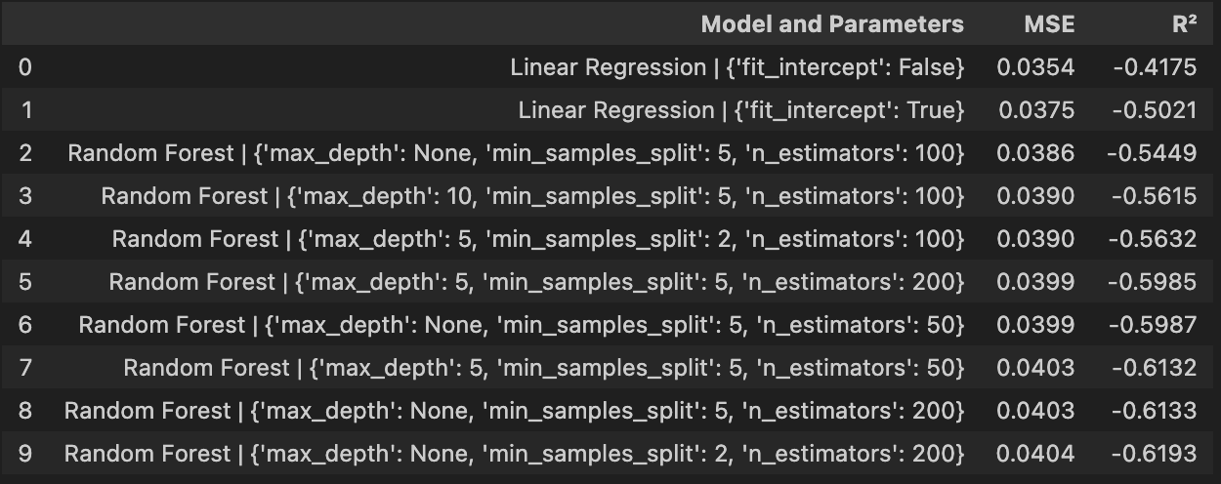
MACHINE LEARNING
Methodology
Model comparison was conducted by evaluating three regression models: Linear Regression, Decision Tree Regressor, and Random Forest Regressor. A grid search approach was employed to explore different hyperparameter combinations for each model. The dataset was split into training (80%) and testing (20%) subsets.
Each model was trained on the training set and evaluated on the test set using R² and Mean Squared Error (MSE) metrics. The goal was to identify the model and hyperparameter configuration that best predicts weight change.
Model Comparison Results (sorted by R²)

Slide 17
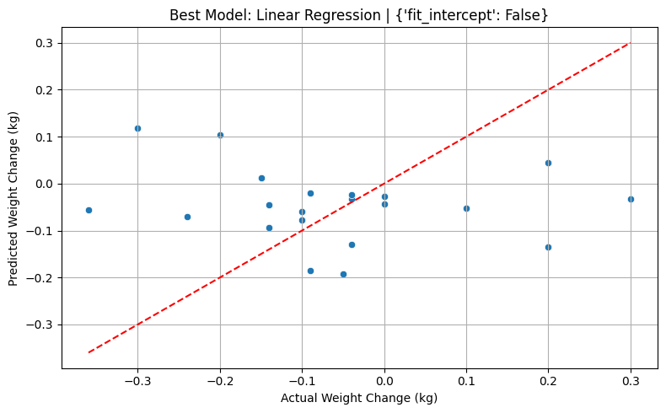
Best Model and Performance EvaluatIon
The best model identified through the grid search was Linear Regression with the parameter setting fit intercept to false.
The model's performance was poor, with an R² score of -0.4175.
This result was expected, as weight fluctuations are not always immediately observable on a single day. Therefore, a single-day prediction model may not effectively capture the underlying patterns.
Based on these findings, the analysis proceeds with modeling weight change over a 7-day period, where trends may be more prominent and the impact of daily habits more measurable.

Slide 18
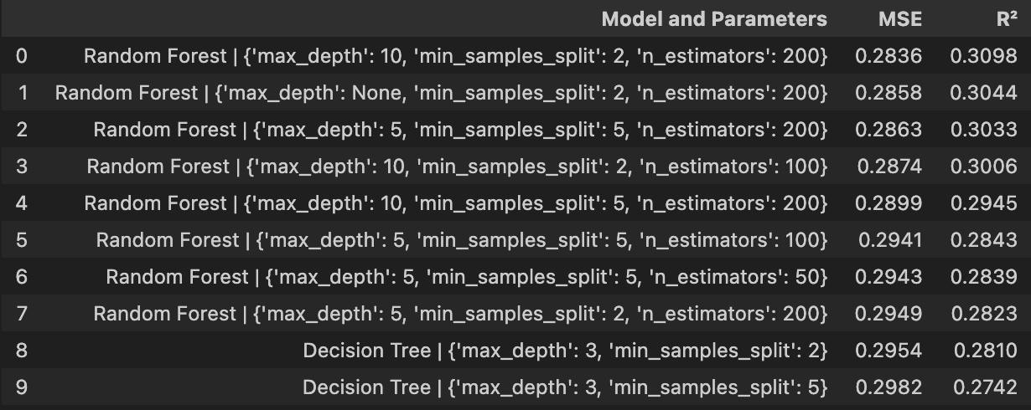
Model ComparIson for 7-Day WeIght Change PredIctIon
The model comparison table was created by performing a grid search over different hyperparameter combinations for Linear Regression, Decision Tree, and Random Forest models.
Each model was trained on the 7-day weight change data, and its performance was evaluated using R² and Mean Squared Error (MSE) on a separate test set (20% of the data).
The top 10 models were ranked by R², with Random Forest achieving the best score.
📈 R² Summary:
Average R²: 0.1526
Best R²: 0.3098
Worst R²: -0.3820

Slide 19
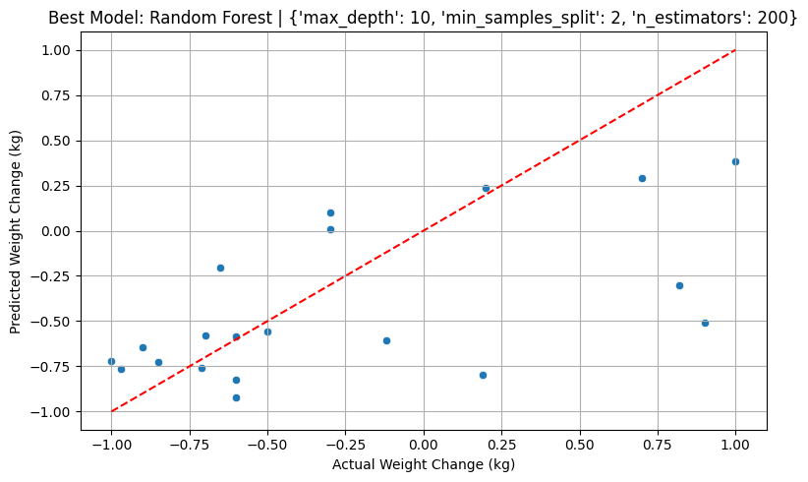
Best Model and Performance Evaluation for 7-Day
The best model, Random Forest with 'max_depth': 10, 'min_samples_split': 2, 'n_estimators': 200, achieved an R² score of 0.3152.
The model shows a positive trend between predicted and actual weight change.
CONCLUSION
This model performs better than the daily weight change model, suggesting that weight fluctuations are more predictable over longer time periods.
Although the model's predictive power is not very high, it provides a useful baseline for further improvements and offers meaningful insights.

Slide 20
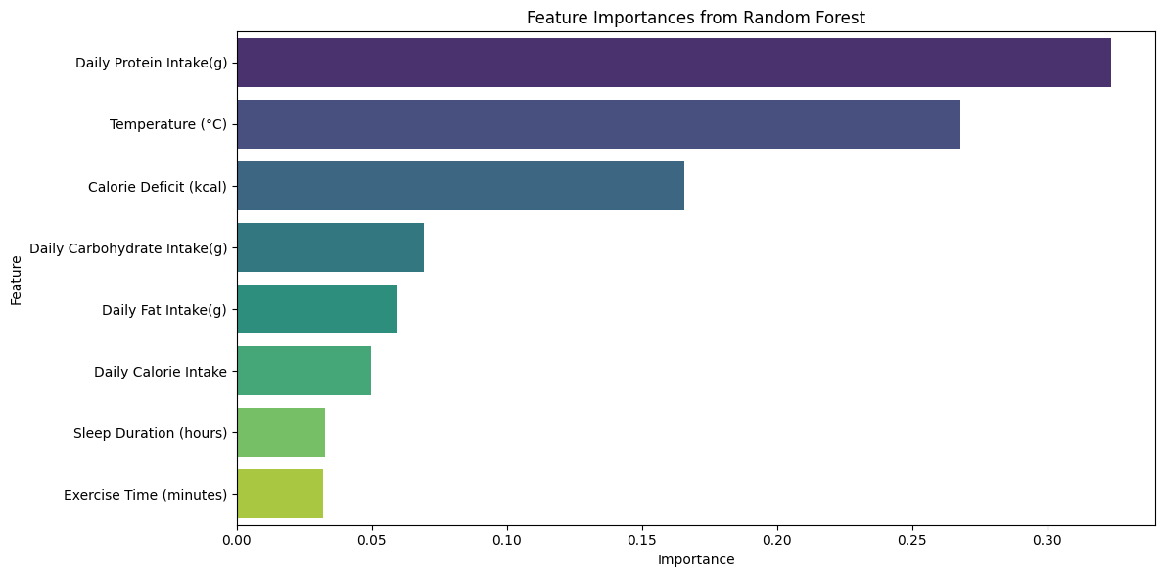
Feature Importance Results: What DrIves WeIght Change?
This chart displays the feature importance values extracted from the best-performing Random Forest model. It highlights the relative contribution of each factor in predicting 7-day weight change:
Daily Protein Intake emerged as the most important factor, suggesting its key role in body composition changes.
Surprisingly, Temperature (°C) had a strong influence—indicating that external factors like weather could impact weight fluctuations.
Calorie Deficit (kcal) was also a strong predictor, partly influenced by exercise duration (since deficit calculations accounted for calories burned during workouts). This reinforces the idea that exercise indirectly contributes to weight change by increasing caloric expenditure.

Slide 21
Key InsIghts & ConclusIons
This project has been a fascinating deep dive into how my daily habits impact my body composition and it’s taught me a lot about how my body responds to different factors.
One of the biggest takeaways is that maintaining a consistent calorie deficit really works—this strategy helped me reduce body fat percentage and lose weight over time.
Surprisingly, daily calorie intake on its own wasn’t as impactful as I initially thought. The scatter plots showed that on high-calorie days, I often exercised more, which helped balance out the extra intake. This really highlighted the importance of looking at habits in context, not in isolation.
One of the most unexpected results was the strong connection between temperature and weight changes—a factor I didn’t even consider at the start. It shows how much external variables can influence outcomes, and it’s something I’d want to explore further.
The feature importance results from the Random Forest model confirmed that daily protein intake, temperature, and calorie deficit were the strongest predictors of weight change, with exercise indirectly contributing by increasing caloric expenditure.
The hypothesis tests supported these findings, showing that both protein intake and calorie deficits are key drivers for reducing body fat percentage, while factors like daily calorie intake and sleep duration had less obvious or inconsistent effects.

