Slide 1





NUTRIZIONE’ 26
Technical Evaluation of Fiber-Based Packaging and Bio-Polymer Barriers
for Liquid Food Applications
TEAM MEMBERS:
Pratheeksha Shalbin - URK25FP2003
Deekshanya Shri L - URK25FP2010
Shanney Maria Simon - URK25FP2006
Feb 10,2026

Slide 2

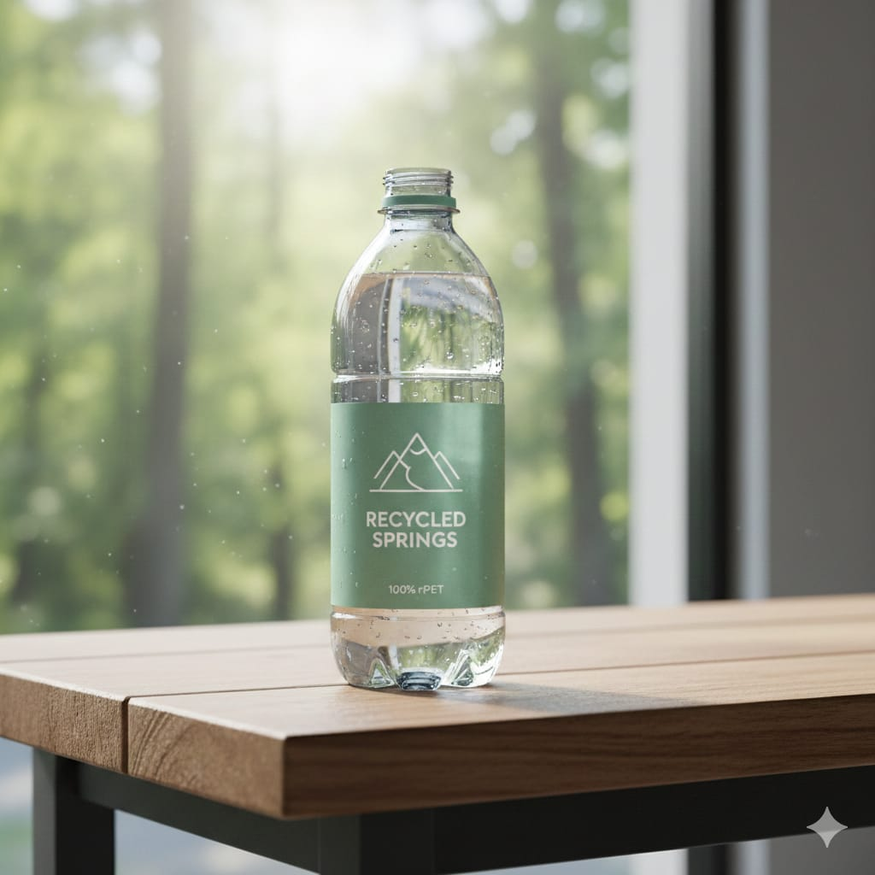
Problem Statement
Current liquid food packaging (like aseptic cartons) relies on multi-layer laminates of polyethylene (plastic) and aluminum. While these provide an excellent barrier against moisture and oxygen, they are extremely difficult to recycle and are derived from non-renewable resources.
​The technical challenge is that fiber-based materials (paper) are inherently porous and hydrophilic (water-attracting), making them unsuitable for liquids unless paired with a barrier that matches the performance of plastic but maintains the recyclability of paper.

Slide 3
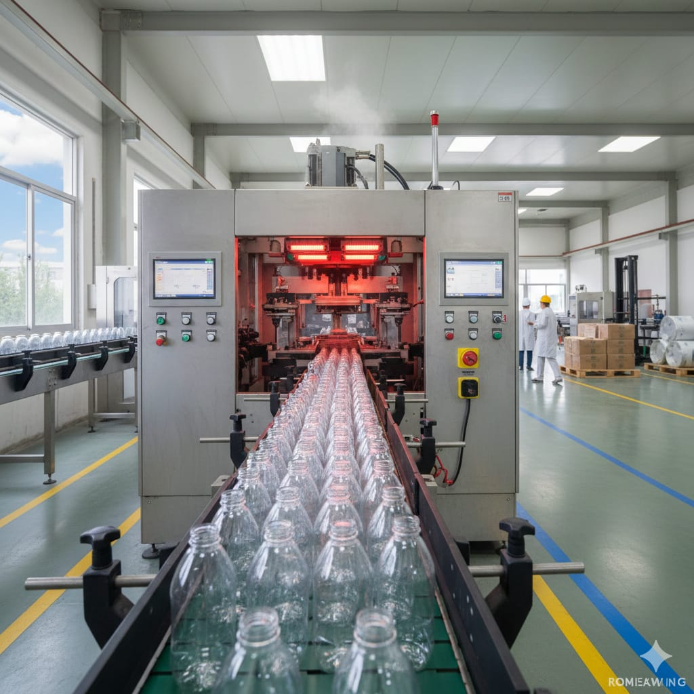
INTRODUCTION
The global food industry is under increasing pressure to transition from traditional PET and glass packaging to sustainable alternatives like "Paper Bottles". Developed through molded fiber technology, these designs aim to establish a circular packaging model.
​For professionals, the primary technical challenge lies in maintaining necessary Water Vapor (WVTR) and Oxygen Transmission Rates (OTR) to preserve beverage shelf-life and organoleptic properties. Research highlights plant-based liners, such as Polyethylene Furanoate (PEF) , as ultra-thin internal coatings that prevent moisture absorption and structural degradation of the wood-pulp shell.
While difficulties persist in carbonated pressure management and high-speed aseptic filling, these fiber-based systems can reduce plastic use by 60–80%. Ultimately, integrating bio-barrier engineering provides a viable, recyclable pathway for sustainable liquid food distribution.

Slide 4
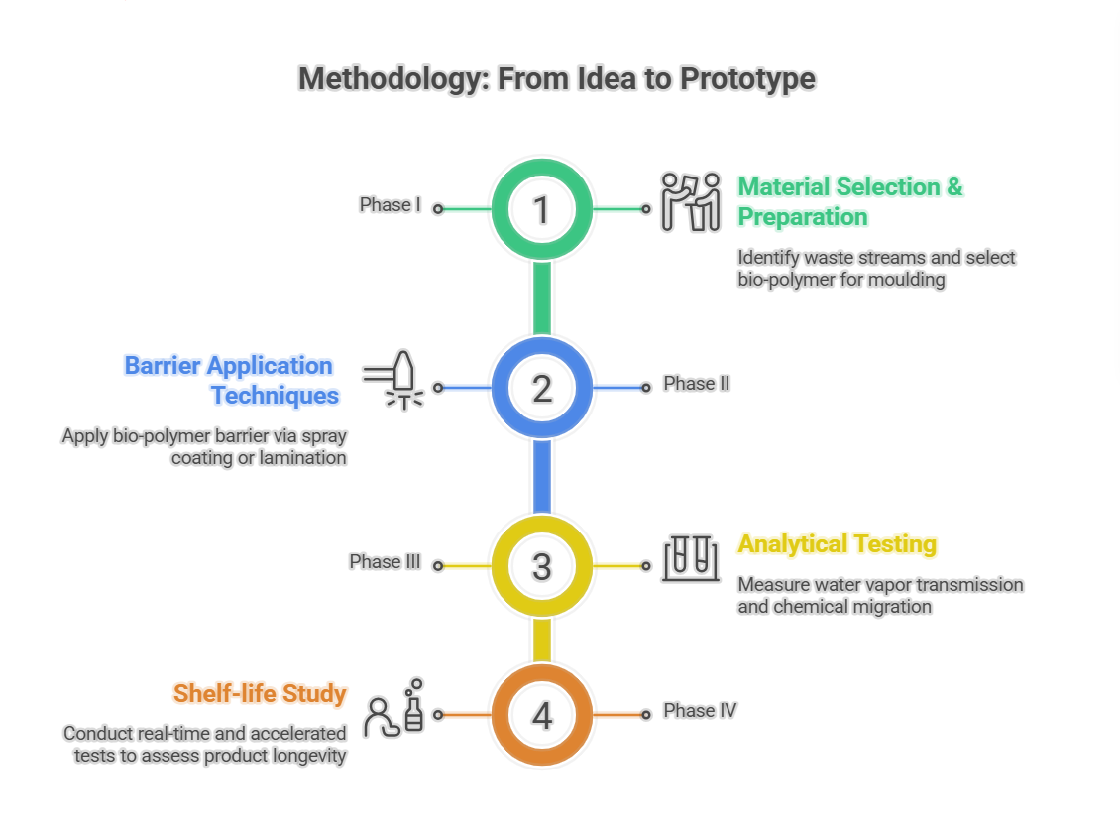
METHODOLOGY

Slide 5
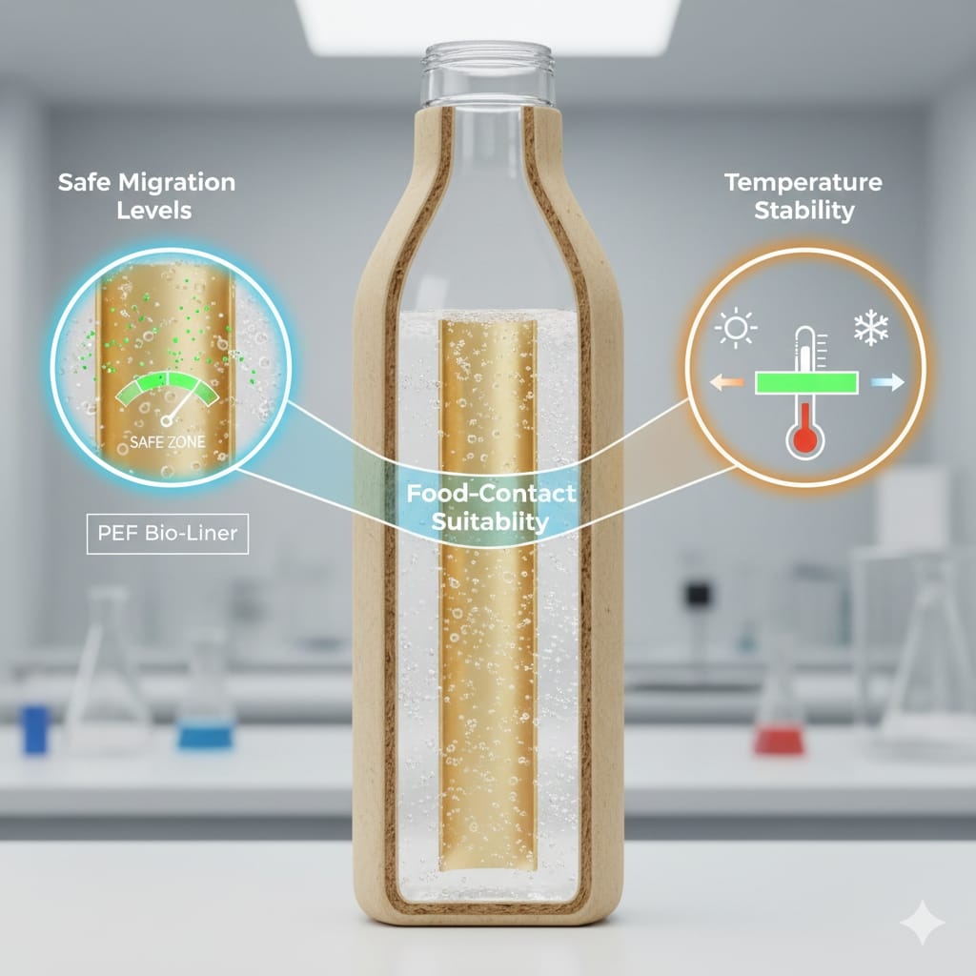
FOOD SAFETY EVALUATION
Food safety evaluation addresses the critical health and safety concerns related to switching from traditional plastics to plant-based materials.
​Safe Migration Levels: The research confirms that the amount of bio-polymer material transferring into the food or drink stays within safe, acceptable limits.
​Food-Contact Suitability: The bio-polymers used (like PEF) are technically approved for direct contact with liquids, acting as a safe interface between the wood-pulp and the beverage.
​Temperature Stability: The packaging maintains its structural integrity and safety even when stored at various temperatures, ensuring the bottle doesn't degrade on the shelf.

Slide 6
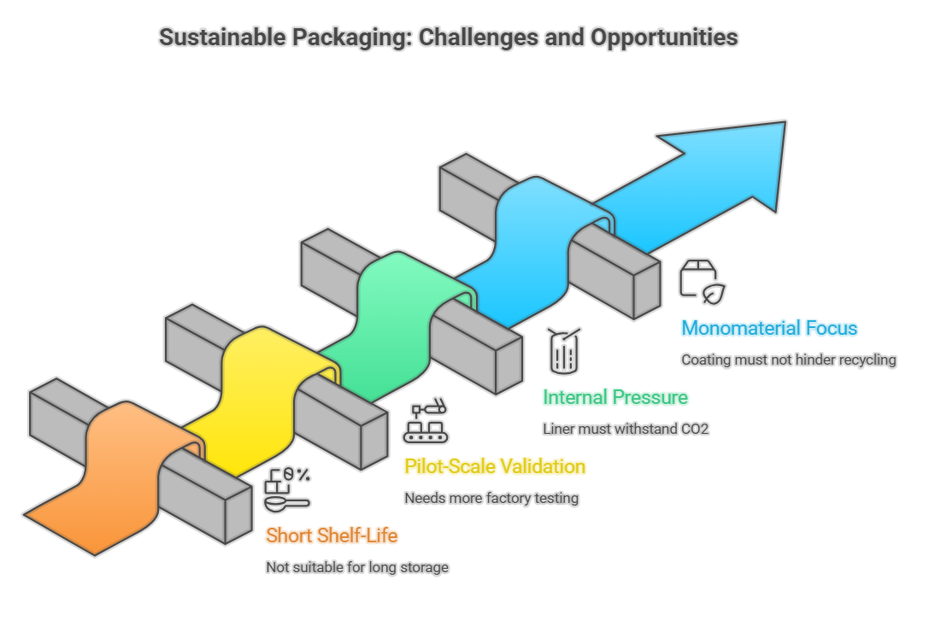
OUTCOMES
This technology can be used in the real world and what the current limitations are.
​Short-Shelf-Life Applications: Currently, this packaging is most suitable for liquid foods that don't need to sit on a shelf for years.
​Massive Plastic Reduction: Implementing this technology can reduce the industry's plastic use by 60–80%.
​Pilot-Scale Validation: While the theory works, the slide notes that more testing is needed to see how these bottles perform in high-speed factory filling lines.
Experimental Validation: We need more real-world tests on how these bottles hold up in fast-moving factory environments.
​Internal Pressure Management: For carbonated drinks, the liner must be strong enough to handle the internal pressure of CO2 without the fiber shell losing its shape.
​Monomaterial Focus: The ultimate goal is a "monomaterial fiber system" where the coating is so thin it doesn't interfere with standard paper recycling.

Slide 7
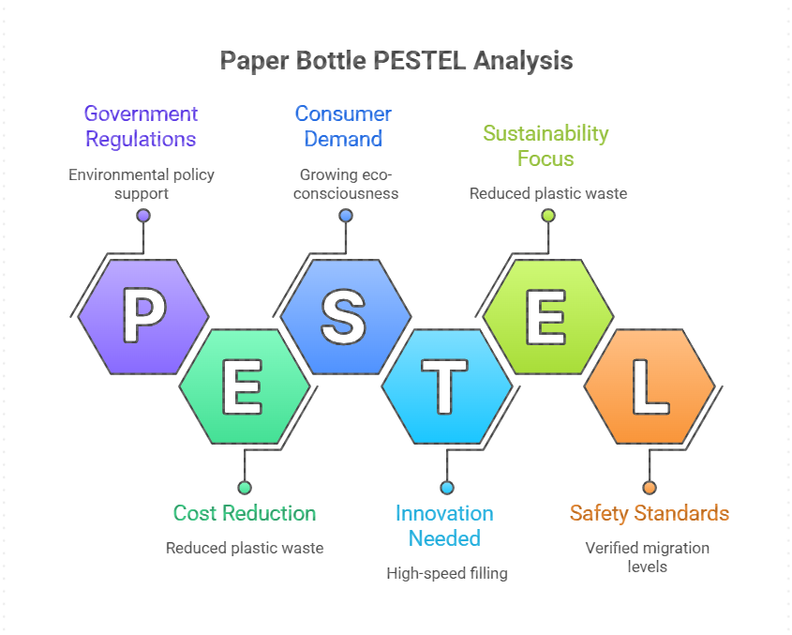
CONCLUSION
Eco-Friendly Packaging: The industry is replacing PET and glass with "Paper Bottles" made via Moulded Fiber Technology.
Bio-Barriers: Plant-based liners like PEF prevent liquid absorption and maintain the bottle's structure.
Protection: These coatings manage WVTR and OTR to preserve drink taste and shelf-life.
Verified Safety: Testing confirms safe migration levels and stability across various temperatures.
Impact: This design reduces plastic usage by 60–80% while staying recyclable.
Next Steps: Challenges remain in high-speed aseptic filling, requiring more industrial-scale testing.

Slide 8

KEY REFERNCES
Avantium. (2024).
PEF and FDCA: Pioneering sustainable chemistry solutions.
Paboco. (2022).
Paboco reveals a prototype of the next generation paper bottle.
Burgess, S. K., et al. (2014).
"Oxygen sorption and transport in amorphous poly(ethylene furanoate).Macromolecules, 47(4).

Slide 9
THANK YOU

