Slide 1
Analysis HXN, March 2018
CdTe system

Slide 2
Rocking curve
Scanid: [45193:1:45233]
Excel lab book, line 135
Angles:
th_start = 81.25;
th_end = 83.75;
XRF channel = 7 (Cu fluorescence channel); used for the alignment of the fluorescence map

Slide 3
Assimetry in rocking curve and shift in the map’s columns comes from drift of grain during rock scan

Slide 4
Shift applied in each map of the rocking curve
shift starts to be problematic

Slide 5
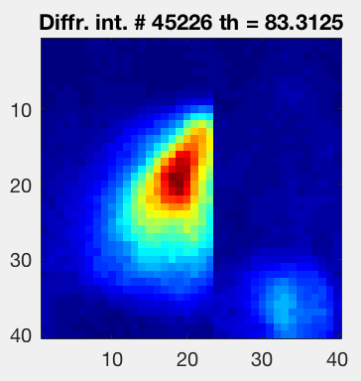
Identification of the ROI in the real space where the rocking curve is complete
Rocking curve in pixel (19,20)
pixel(19,20)
pixel(19,30)
row 19
Rocking curve in pixel (19,30)

